Slide 1
Department Meeting Service Recovery Training
11/28/2023
Notes:
Important Points:
“This service recovery training is part of TPMG’s new CareXM (Care experience management system). CareXM is a way for us to have a more real-time pulse on what our patients experience. This new survey is more timely and the questions are more intentional – to allow us to identify what we really do well (so we can keep doing that) and where we can improve. What we’ve found is we overwhelming amount of comments – 80-90% are very positive. They love the care they receive at KP. The remaining 10-20% of comments explain the opportunities we have to improve on the patient experience. Even with those opportunities, we to catch them/identify when we drop the ball so that we can try to make things right and provide exceptional care. All managers/chiefs will receive access to Qualtrics survey data & patient comments via the CareXM dashboard in September/October. Which allows you to identify trends, consistent opportunities. As we start receiving real-time patient feedback and think through how to respond/act on it, it’s critical for all teams and individuals to be armed with the skills and behaviors to respond. Service recovery, providing exceptional care experience is a team effort, it doesn’t fall to one individual or a group of individuals.

Slide 2
Agenda
Caring Moment (2 min)
Training Objectives (2 min)
Why the continued focus on care experience? (7 min)
What is Service Recovery? (10 min)
CARE Model Discussion (20 min)
Review (15 min)
Scenario Activity (20 min)
“I Will…” Activity (5 min)
Wrap Up (5 min)
Notes:
Reasons:
Provide audience with a roadmap of what they can expect in the training and the timing for each

Slide 3
We create caring moments with personalized and exceptional experiences for patients, their families, and each other – because every moment matters.

Slide 4
1. Refresh your Service Recovery skills, behaviors, and share best practices with each other 2. Brainstorm how to keep service recovery top of mind for our department
Training Objective
Compassionomics 2019. Stephen Trzeciak.
Notes:
Important Points:
•Service Recovery happens at all levels of the organization
•Everyone should feel comfortable and empowered to perform service recovery – it’s not just the manager’s job

Slide 5
Why does Care Experience matter to you?
Compassionomics 2019. Stephen Trzeciak.
Notes:
Important points:
"In a few words, can I have a couple people share - Why does care experience matter to you? Think about your own experiences – what stood out, what made an exceptional experience for you? What sets it apart?"
Reasons:
Connect back to TPMG’s vision/common purpose around the care experience that we strive to provide for all our members

Slide 6
What is the impact of Exceptional Care Experience?
Prevention
Clinical Outcomes
Staff Retention
JAMM
Compassionomics 2019. Stephen Trzeciak.
Notes:
Important points:
Key points:
Patients expect high quality care – that's the standard. But patients choose where they get healthcare based on their personal/overall care experience, and others’ experience (friends and family).
Having an exceptional care experience also positively impacts patient health outcomes. So a combination of high-quality care and exceptional care experience is what we’re trying to provide. KP is wonderful at delivering high quality care – where we have opportunity is our care experience. When we don’t focus on exceptional care experience, we’re leaving outcomes on the table (not helping patients be as healthy as they could be). Health statistics below:
Prevention
80% Better blood sugar control
34% Better medication adherence
Clinical Outcomes
Patients who rated experiences exceptional (nursing care, physician care, cleanness) had better clinical outcomes:
↓ Hospital acquired infections
↓ Lengths of stay
↓ Readmissions
Retention - Staff Well-being
Health care workers are four to six times more likely to stay with the organization when they see their organization has a meaningful purpose and delivers great patient care. Best Place to Work, Best Place to receive Care
Reasons:
Quality care is table stakes – care experience is what sets us apart.

Slide 7
Service Recovery Introduction (10 minutes)

Slide 8
What is Service Recovery?

Slide 9
Think about someone you love.
Notes:
Important Point:
In an ideal world, you’d never have to do service recovery, but the reality is we drop the ball sometimes. If your loved one went through a negative experience and someone had to provide service recovery, how would you want that experience to go? How would you want your loved one to feel?
Reason:
To connect service recovery to something personal. Our patients are people, someone’s mom, dad, grandma, grandpa, son, daughter, niece, nephew, etc.

Slide 10
Why is service recovery so important?
96%
75%
82-95%
of unhappy customers don’t tell us they are unhappy
of unhappy customers will tell at least 9 other people
of customers who complain, return if they are impressed with the company’s response
Notes:
Important Points/Key Steps:
“Most unhappy people don’t speak up – they don’t signal to us that we could’ve done better so we don’t know what our opportunities are. The 4% that do speak up, that takes a lot of courage, we need to take action on it.”
Reason:
Set the context/”why” we’re talking about service recovery training. It’s not just a tool, there are real people giving their real opinions and feedback behind this. We want to make things right by our members.

Slide 11
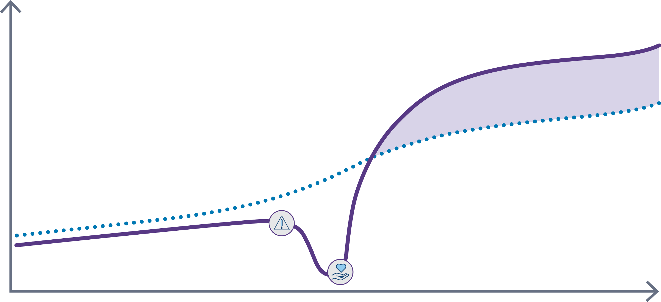
Service recovery paradox
Customers with service failure and successful recovery
Customer Loyalty
Customers without service failure
Service failure
Service recovery
Time
A very positive service recovery can result in even stronger customer loyalty than if service failure hadn’t occurred.
Notes:
Important Points:
“So what is the Service Recovery Paradox? Amazingly, this means that a very positive service recovery can result in stronger customer loyalty than if a service failure hadn’t occurred. Think about that.”
“Less-than-optimal experiences will occur, we’re not perfect, we will absolutely drop the ball sometimes. But it’s not about being perfect, it’s about how we recover from dropping the ball. Again, most people don’t even tell us about their bad experiences. So when we do hear about them, they are gifts/opportunities. By the simple act of listening, participating, acknowledging we have the opportunity to take them from someone who dislikes KP to someone who promotes KP.”
Reason:
Set the context/”why” we’re talking about service recovery training. It’s not just a tool, there are real people giving their real opinions and feedback behind this. We want to make things right by our members.

Slide 12
What are the benefits of service recovery?
Resolves the concern in the moment so the member does not leave unhappy
Helps prevent member from lodging a complaint with member services – why does this matter?
Notes:
Important Points:
“So what are the benefits of service recovery?”
“Why are we trying to prevent members from lodging complaints?”
“That’s right, the complaint process is long and resource intensive, and very delayed from the point of service”
Complaints come right back to the departments they were filed within, after several weeks of processing. Member is left without a resolution at the time AND will get even more upset as they are required to wait for the complaint process.
Each complaint takes resources to process – regional team, local manager & chief”
“At the end of the day, want to do the right thing for our members – fix issues in a timely and efficient manner”
Reason:
Set the context/”why” we’re talking about service recovery training. It’s not just a tool, there are real people giving their real opinions and feedback behind this. At the end of the day, want to do the right thing for our members – fix issues in a timely and efficient manner.

Slide 13
CARE Model Group Discussion (20 minutes)

Slide 14
Connect with compassion and intentional listening
How do we connect with compassion? What are some things we can do or say?
What does intentional listening look like and sound like?
How do we know patients feel like they have been heard?
Notes:
Important Points
The first component of CARE is to connect with compassion and intentional listening.

Slide 15
If we fall short of creating a caring moment, then we recover with …
It’s about
Connect
Apologize
Respond
Express
Repairing Trust
Notes:
Important points:
What is our model at KP when things go wrong and people complain or express dissatisfaction? How can we show our patients that we understand and care? How can we make things right and regain their trust? The way we recover when we miss the mark is with CARE. Here’s what that looks like.
“Has anyone heard of CARE or other models? The steps are similar, saying the same things, rebranding to CARE, but the main points are the same – we are trying to repair trust with our patients because we let them down.”
Reason:
Introduction of the model we will using for service recovery.

Slide 16
APOLOGIZE for disappointment
Why do we apologize? What are we trying to do?
What makes a good apology?
Notes:
Important Points
The second component of CARE is to apologize for a disappointment.

Slide 17
RESPOND with integrity and take action efficiently
What are specific things we can do to respond with integrity?
What does efficient action mean?
How do we ensure the response is the appropriate one?
Notes:
Important Points
The 3rd step is to respond with integrity and take action efficiently connect with.

Slide 18
EXPRESS gratitude and our commitment to safety & excellence
Why is it important to express gratitude at the end of a service recovery?
What are some phrases you’ve used that work well?
How do we want the member to feel at the end of the interaction?
Notes:
Important Points
The final step is to express gratitude and our commitment to safety and excellence.

Slide 19
Connect with compassion and intentional listening
A Closer Look
Actively listen without judgement or interruption, take notes if needed
Recognize & manage your own emotional response
Acknowledge and state the emotion
Express empathy for the patient’s distress
Notes:
Timing: 30 seconds
Important Points
Say: Here are the key points under CONNECT – many of these were shared during the discussion.

Slide 20
Ways to connect compassionately
Oh no! Such a shame that happened.
I am so sad and sorry you’re experiencing that.
I understand exactly what you’re going through. It’s so frustrating.
I know what that’s like. I want to help you in any way I can.
engagement
Pity
Sympathy
Empathy
Compassion
I acknowledge your suffering
I care about your suffering
I feel your suffering
I want to relieve your suffering
Notes:
Important Points
Here we see ways to engage patients considerately with pity, sympathy, empathy, and compassion. At the heart of each of these responses is understanding. We’re not challenging the patient’s experience in any way. We’re striving towards the right side - empathetic and compassionate responses. Most of all be genuine – for example, don’t say you understand, if you don’t.

Slide 21
What does empathy sound like?
Notes:
Important Points
Here’s a fun video on the difference between empathy and sympathy.

Slide 22
Ways to connect compassionately
Listen attentively and without interruption
Take notes, if necessary, and explain that you want to capture all that they’re sharing
Recognize and manage your personal response to stress or confrontation
Fight or Flight? Do you withdraw? Become defensive? Passive aggressive?
Clarify their concerns, when appropriate
Remember communication is almost entirely body language and tone of voice
Make eye-contact using friendly body language and facial expressions (lean in, tilt and/or nod your head)
Speak softly and patiently
Put yourself in their shoes, and validate their feelings, verbalizing the emotion they are experiencing
Communicate that your goal is to want to make it right and help in any way possible
Notes:
Important Points
Here are the key actions we should take when engaging patients with complaints.

Slide 23
APOLOGIZE for disappointment
A Closer Look
Never underestimate the power of a sincere apology since the service mishap may have caused frustration, disappointment and anger
The trust of our patients must be earned through respectful acknowledgements
Notes:
Important Points
“Here are the key points under APOLOGIZE”

Slide 24
The power of apology
Key Actions
Acknowledge what happened
Apologize for patient’s experience
Restate key points patient shared
Avoid blaming
Be sincere
Don’t start to problem solve yet
Notes:
Important Points
“Here we see a list of steps we can take to take responsibility for our mistake. By owning what went wrong and not being defensive, we put the patient at ease and clear the way for a resolution.”
“A lot of people may ask – why do I have to apologize? I didn’t do anything wrong. But apologizing does not mean you’re admitting blame or saying it was your fault, you’re apologizing and taking ownership on behalf KP.”

Slide 25
Examples of an apology
I’m sorry for the delay.
I’m sorry this was disappointing.”
Insincere apologies are condescending and ineffective
“I’m sorry you didn’t know where the pharmacy was.” = You can’t find your way around
“I’m sorry they didn’t understand what you needed.” = They/you don’t have good communication
“I’m sorry I don’t have the time to find that for you.” = You aren’t important enough
It’s all about the patient’s experience
Address the incident: “I’m sorry for the delay.”
Address the patient’s feeling: “I’m sorry this was disappointing.”
Notes:
Important Points
“We talked about being genuine and sincere in our apologies - When you’re working to make things right, it’s not about you — it’s about the patient. Here are some examples.
“What does an insincere apology sound like? I think we’re all guilt of doing that sometimes – saying sorry without actually saying sorry. We want to try to avoid these ways of apologizing.”

Slide 26
RESPOND with integrity and take action efficiently
A Closer Look
It is critical to quickly demonstrate empathy by validating the feelings and values of the patient/family
A timely response is key to recovery and is best achieved by fully equipping & empowering employees
Ask the patient/family what would make it right for them
Listen for what’s important to the patient and incorporate this into the solution
Notes:
Important Points:
Say- "The third component of CARE is to respond with integrity and take action efficiently."

Slide 27
How to respond
Ways to resolve a patient’s concern.
Key Actions
Restate their requested solution if possible
Provide additional options, so they’re aware of all possible solutions
If you’re unable to resolve the concern to the person’s satisfaction, reference your department’s escalation process for next steps
Notes:
Important Points:
"As you can see on this slide, there are three suggested actions you can take to resolve a patient’s concern.
Let’s take the first one: By restating the solution offered by a patient, we show that we understand their issue.
On the second action, we demonstrate a willingness to find a solution. Note that all of these exhibit a willingness to help and don’t challenge the patient’s version of events. It may be helpful to ask the patient they would like for us to do to understand if they are looking for a solution or simply an apology and understanding of what they experienced.
On the final action, we want everyone to know who to escalate to if you have tried all of the above and the patient still does not feel heard. Here is our escalation process.."

Slide 28
Examples of appropriate responses
My goal is to resolve this for you.
I hear you saying that … is most important to you.
I want to make this right.
As you requested …
Notes:
Important Points:
Say- "This slide gives you some appropriate wording to remember and use. When you go back to work, experiment with your own ways to respond to patient issues and see which ones work best. "

Slide 29
What if you cannot honor their exact request?
Do you …
Say no and state the exact corporate policy?
Say no and explain the reason why?
Apologize and blame your boss in a quiet voice?
Apologize and present other options?
a
b
c
d
People don’t like hearing the word “no”, corporate policies, long explanations, or passing the buck. Just apologize and offer an appropriate solution.
Notes:
Important Points:
“Here’s what I CAN do…” rather than saying “I can’t”
What if you can’t honor a patient’s request?
We all can get frustrated when situations become difficult. The best way to handle these times is to remain calm, apologize earnestly, and offer another possible solution to the issue.
Reason:
A lot of people struggle with finding a nice way to no without saying "no" or setting boundaries, so this may be helpful for them. How do you navigate these sorts of encounters?

Slide 30
EXPRESS gratitude and our commitment to safety & excellence
A Closer Look
Thank the patient / family for taking the time to express their disappointment
Express commitment to their safety and satisfaction as a top priority and share that you hope to exceed their expectations next time
Notes:
Important Points:
Say - "The last component of CARE is to express gratitude and a commitment to safety and excellence.
Imagine being frustrated and you actually speak up. How wonderful would it be to be thanked for taking the time to share your experience."

Slide 31
Express gratitude & commitment
A complaint is a gift! We have an opportunity to re-establish greater trust, and we learn where we can make improvements to our systems and processes.
Key Actions
Express our commitment to our common purpose and service values as top priority
Assure them that you are always interested in hearing their feedback – encourage them to come to you if they ever have additional feedback
Notes:
Important Point:
"96% of people don’t say anything. Only 4% speak up, which means it takes a lot of courage to speak up."
If we don’t know there’s a problem, we can’t change it – so complaints are a gift and opportunity to do better.
By not allowing our ego or emotions to get in the way, we can see the opportunity a complaint gives us. Remember what we learned earlier — a positive service recovery can result in stronger customer loyalty than if a service failure hadn’t occurred. "

Slide 32
Ways to express gratitude
Thank you for allowing us to making things right for you.
Thank you for bringing this matter to our attention.

Slide 33
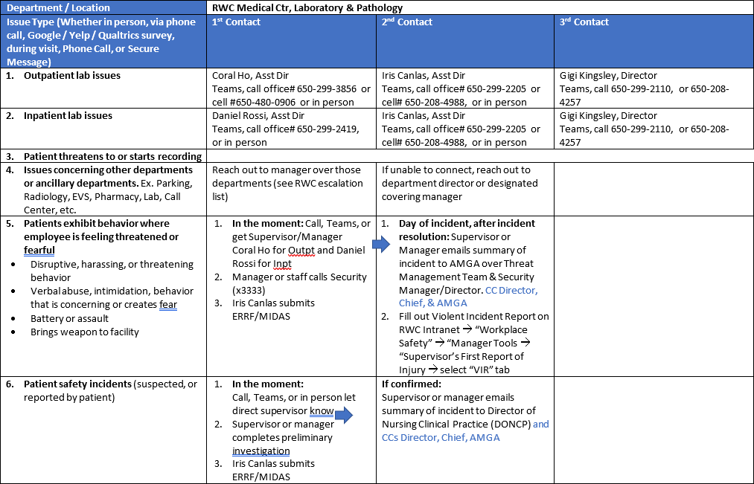
Escalation Plan
Notes:
Important Points:
Although there are some things that may be out of your control, do your absolute best to provide service recovery – use the CARE model to take the time to show the member you care, that you want to help them and make them feel better about the situation

Slide 34
Notes:
Thank you all for participating in the Service Recovery Program. Take the tools you’ve learned today and incorporate them into KP’s common purpose: to create caring moments with personalized and exceptional experiences for patients, their families, and each other — because every moment matters. And remember, when service issues arise with patients, we have two choices: we can use the CARE model or we can become dismissive and defensive which only makes matters worse. Lean into your challenges, put yourself in the patient’s shoes, and offer compassion. You’ll feel better for it and so will the patient.

