Slide 1
Dignity Health Standards of Conduct and HIPAA Compliance
Kurt Strubeck
Phlebotomy Supervisor Marian Regional Medical Center

Slide 2

Standards of Conduct
  Employee Responsibility
  Dignity Health’s commitment to the Standards of Conduct is dependent upon the commitment of each Dignity Health employee.
  Dignity Health does not exist separately from its employees and can only function through its employees
  Take responsibility for his/her own actions
  Know and comply with applicable laws and rules, including applicable Federal health care program requirements, the Dignity Health Standards of Conduct and Dignity Health policies and procedures as they apply to his/her particular job responsibilities
  Refrain from involvement in illegal, unethical or other improper acts
  Promptly report any potential or suspected violation of the Dignity Health Standards of Conduct, Dignity Health policy or applicable laws or regulations

Slide 3

Professionalism and Respect
Honesty/Integrity-consistent regard for the highest standards of behavior. Honesty and integrity imply being fair, being truthful, keeping one’s word, meeting commitments, and being forthright in interactions with patients and staff
Reliability/Responsibility-Being accountable to other, this must happen on a number of levels. Inherent in responsibility is reliability in completing duties and fulfilling commitments. Acceptance of errors.
Respect for Others-The essence of humanism, expanding to all aspects of contact, patient, family member, co-worker. Treat all persons with respect and regard for their individual worth and dignity. One must be fair and nondiscriminatory toward others.
Compassion/Empathy-Crucial to the act of helping others. One must listen attentively and respond humanely to the concerns of others. Appropriate empathy for and assisting with relief of stress and anxiety should be part of the daily practice in helping others
Self-Improvement-commitment to providing the highest quality of care through continued learning. Seek to learn from errors and aspire to excellence through self-evaluation and acceptance of the critiques of others.
Self-Awareness/Knowledge of Limits- Recognition of the need for guidance and supervision when face with new or complex responsibilities. One must also be insightful about the impact their actions have on others and be cognizant of appropriate professional boundaries.
Communication/Collaboration- Critical in providing the best care to patients. One must work cooperatively and communicate effectively with all co-workers and patients and their families.
Altruism/Advocacy- Refers to unselfish regard for and devotion to the welfare of others and is a key element of professionalism. Self-interest or the interests of other parties should never interfere with work.

Slide 4
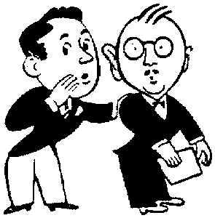
Gossip in the Workplace
Creates drama that negatively impacts productivity and fosters a detrimental effect on accuracy and quality.
Drama will dissect a team’s unity and become the focus of their work activities and priorities.
Drama results in employees “taking their eye off the ball” and this induces costly mistakes.
Drama and gossip reduce everything good you are trying to build.

Slide 5
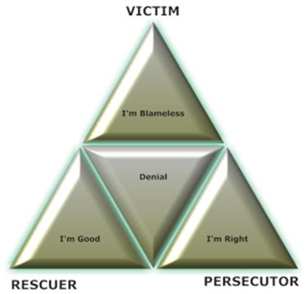
Drama Pyramid Game
Players
● The Victim – The person who is treated or accepts the role of being vulnerable
Victim’s Moto – “I’m Blameless” Victim’s Need – Love
● The Persecutor – The person who pressures, coerces, or persecutes the Victim
Persecutor’s Moto – “I’m Right” Persecutor’s Need – Power
● The Rescuer – The person who intervenes; ostensibly wishing to help the situation or underdog
Rescuer’s Moto – “I’m Good” Rescuer’s Need – Acceptance
Scenerio
Players will engage in a game of con and hook hoping for
the final payoff. Moves will continue as the drama
Progresses
Goal
To get unspoken psychological wishes and needs met in a manner they
feel justified, without having to acknowledge the broader harm done during the process.

Slide 6
H.I.P.A.A
Health Insurance Portability and Accountability Act
Privacy and Security

Slide 7


Patient Privacy Protection/HIPAA Compliance
  It is the responsibility of every employee to protect the privacy and security of sensitive information in all forms
  The common forms are Printed, Spoken, and Electronic
  Patient Privacy Breech - Use (maintained inside) vs. Disclosure (shared)
  Examples of Sensitive Information
  Social Security Numbers Computer Passwords
  Credit Card Numbers Individually Identifiable Health Information
  Driver’s License Numbers Research Data
  Personnel Information Photographs
  Breaches of information privacy may result in criminal and civil penalties.
  Audits Happen…In fact, audits by organizations are mandated.

Slide 8
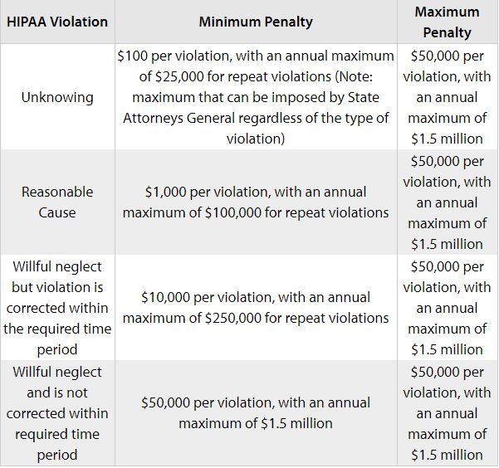


HIPAA Violation Results

Slide 9
Protected Health Information (PHI)
Individually identifiable health information collected or created in a covered entity is considered “protected health information” or PHI.
A “covered entity” is any person or organization that furnishes, bills, or is paid for health care services in the normal course of business. (Electronic transaction required.)
PHI is generally defined as: Any information that can be used to identify a patient (living or deceased) that relates to the patient’s past, present, or future physical condition and/or mental health, including health care services provided and the payment for those services.

Slide 10
Access to PHI
Employees may access PHI only when necessary to perform their job related duties.
If an employee accesses or discloses PHI without a patient’s written authorization or without a job-related reason for doing so, the employee violates Dignity Health policy and HIPAA.
Inappropriate Use and/or Disclosure of Protected PHI will lead to termination and investigation by State and/or Federal prosecutors.
Inappropriate Use is defined as an internal breech and occurs simply by accessing PHI without need to know - “just out of curiosity”.
Inappropriate Disclosure of PHI occurs when protected information is: Lost, stolen, or improperly disposed, hacked, communicated, faxed or sent to others who have no official need to receive it.
Audits Happen.

Slide 11



Reporting HIPAA
If you witness a HIPAA violation, you must report it!

Slide 12






Social Media
PHI must never be shared on social media
71% of all internet users visit social media sites, the potential for exposure to PHI is very great.
Private groups are not excluded from HIPAA.
Common social media violations include
  Posting of images and videos of patients without written consent
  Posting gossip about patients
  Posting any information that could allow an individual to be identified
  Sharing photographs or images taken inside a healthcare facility in which patients or PHI are visible.
  Sharing photos, videos, or text on social media platforms within a private group

Slide 13

Humankindness
In a world that can leave people isolated, Dignity Health is helping to unleash the healing power of humanity. An act of humanity can be an act of heroism, big or small. In contrast, kindness is more personal, but equally powerful. It’s an act in which one person creates a connection with another, which strengthens them both. And these human connections can work wonders for the human spirit
Respectful care boosts your immune system.
Human connection decreases blood pressure.
Stress is a disease healed by human connection.
Caring for people is at the heart of what we do, how can we be great at it if we can’t treat each other with humankindness?
We cannot begin to understand humankindness if we do not display it to each other, we must view every encounter with someone, no matter who they are, as an opportunity for humankindness.
Unleash the humankindness in you!

Slide 14
Thank You

