Slide 1
Dignity Health Standards of Conduct and HIPAA Compliance
Kurt Strubeck
Phlebotomy Supervisor Marian Regional Medical Center

Slide 2
Standards of Conduct
Employee Responsibility
Dignity Health’s commitment to the Standards of Conduct is dependent upon the commitment of each Dignity Health employee.
Dignity Health does not exist separately from its employees and can only function through its employees
Take responsibility for his/her own actions
Know and comply with applicable laws and rules, including applicable Federal health care program requirements, the Dignity Health Standards of Conduct and Dignity Health policies and procedures as they apply to his/her particular job responsibilities
Refrain from involvement in illegal, unethical or other improper acts
Promptly report any potential or suspected violation of the Dignity Health Standards of Conduct, Dignity Health policy or applicable laws or regulations

Slide 3
Professionalism and Respect
Honesty/Integrity-consistent regard for the highest standards of behavior. Honesty and integrity imply being fair, being truthful, keeping one’s word, meeting commitments, and being forthright in interactions with patients and staff
Reliability/Responsibility-Being accountable to other, this must happen on a number of levels. Inherent in responsibility is reliability in completing duties and fulfilling commitments. Acceptance of errors.
Respect for Others-The essence of humanism, expanding to all aspects of contact, patient, family member, co-worker. Treat all persons with respect and regard for their individual worth and dignity. One must be fair and nondiscriminatory toward others.
Compassion/Empathy-Crucial to the act of helping others. One must listen attentively and respond humanely to the concerns of others. Appropriate empathy for and assisting with relief of stress and anxiety should be part of the daily practice in helping others
Self-Improvement-commitment to providing the highest quality of care through continued learning. Seek to learn from errors and aspire to excellence through self evaluation and acceptance of the critiques of others.
Self-Awareness/Knowledge of Limits- Recognition of the need for guidance and supervision when face with new or complex responsibilities. One must also be insightful about the impact their actions have on others and be cognizant of appropriate professional boundaries.
Communication/Collaboration- Critical in providing the best care to patient’s. One must work cooperatively and communicate effectively with all co-workers and patient’s
Altruism/Advocacy- Refers to unselfish regard for and devotion to the welfare of others and is a key element of professionalism. Self-interest or the interests of other parties should never interfere with work

Slide 4
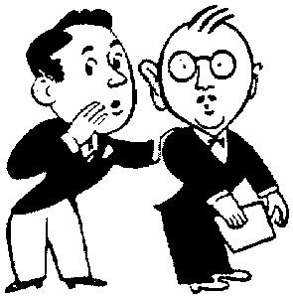
Gossip in the Workplace
Workplace drama with scathe productivity and foster a detrimental effect on accuracy and quality.
Drama will dissect a teams unity and become the focus of their work activities and priorities.
Drama results in employees “taking their eye off the ball” and this induces costly mistakes.
Drama and gossip reduce everything good you are trying to build

Slide 5
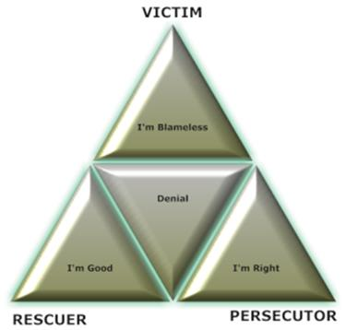
Drama Pyramid Game
Players
● The Victim – The person who is treated or accepts the role of being vulnerable
Victim’s Moto – “I’m Blameless” Victim’s Need – Love
● The Persecutor – The person who pressures, coerces, or persecutes the Victim
Persecutor’s Moto – “I’m Right” Persecutor’s Need – Power
● The Rescuer – The person who intervenes; ostensibly wishing to help the situation or underdog
Rescuer’s Moto – “I’m Good” Rescuer’s Need – Acceptance
Scenerio
Players will engage in a game of con and hook hoping for
the final payoff. Moves will continue as the drama
Progresses
Goal
To get unspoken psychological wishes and needs met in a manner they
feel justified, without having to acknowledge the broader harm done during the process.

Slide 6
HIPAA Compliance
“Need to know” vs. “Want to know”
If information is needed to do your job, then it is acceptable
If someone else does not need to know information you have, then it should not be shared.
Results going to an outside fax that is not within Dignity network and does not have a secure fax is a HIPAA violation.
Different categories of HIPAA violation-
Unknowing- A simple mistake does not mean you did not commit a HIPAA violation

Slide 7
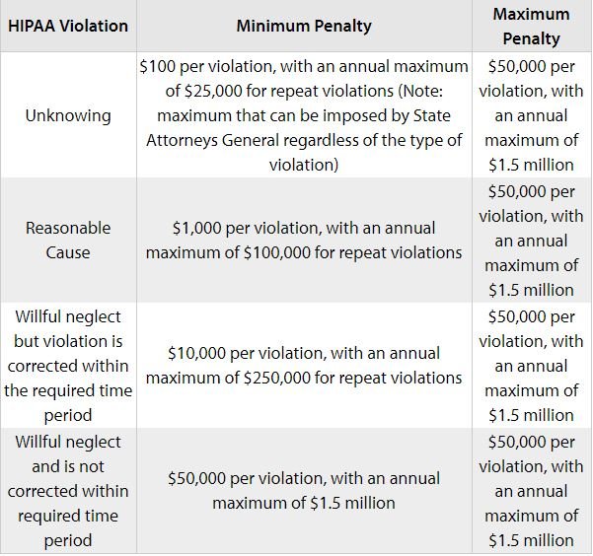
HIPAA Violation Results

Slide 8
Social Media
Social Media is not a safe place to put work related topics.
Sharing photographs or videos where any patient is visible is a HIPAA violation
Even if the posts are in a private group they are considered violations
If someone can connect your post with related news articles or stories, this can be considered a HIPAA violation. (The post would not have to include names or directly identifiable information for someone to make the connection.)
71% of all internet users visit social media sites. The potential for exposure to PHI is extremely great.

Slide 9
Humankindness
In a world that can leave people isolated, Dignity Health is helping to unleash the healing power of humanity. An act of humanity can be an act of heroism, big or small. In contrast, kindness is more personal, but equally powerful. It’s an act in which one person creates a connection with another, which strengthens them both. And these human connections can work wonders for the human spirit
Respectful care boosts your immune system
Human connection decreases blood pressure
Stress is a disease healed by human connection
Caring for people is at the heart of what we do, how can we be great at it if we can’t treat each other with humankindness?
We cannot begin to understand humankindness if we do not display it to each other, we must view every encounter with someone, no matter who they are, as an opportunity for humankindness.

Slide 10
Thank You

