Slide 1
Standard Use of the TEAM System
Kurt Strubeck
Phlebotomy Supervisor

Slide 2
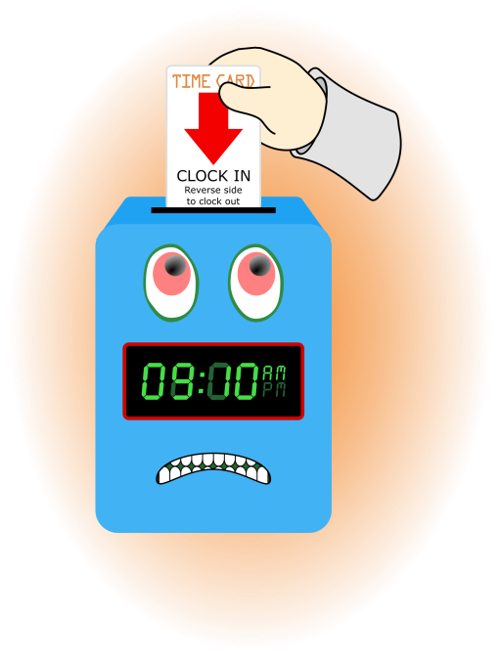
TEAM documentation is good for you and the department
Policy states that employees will accurately record hours worked utilizing the TEAM automated system.
Swiping your identification badge in and out of the time clock closest to your primary work area/ Recording your in and out times using Quick Badge are the only two acceptable ways of capturing clocking’s.
Non-exempt employees are to record start and stop times at their scheduled shift times.

Slide 3

Rounding Punches
Employees should record their start time no earlier than seven (7) minutes before the scheduled shift start and record their stop time no later than seven (7) minutes after the scheduled shift stop, unless overtime is preauthorized by their manager.
These seven minutes is for quarter hour rounding for payroll calculation purposes only. These seven minutes in no way indicate if an employee is early or tardy for their work shift. Local Human Resource departments determine early/tardy policy.

Slide 4
Rounding for Time Keeping and Payroll Only

Slide 5

End of Pay Period Review and Sign off
Non-exempt employees must review and electronically sign their time records at the end of the last worked shift of the pay period.
All requests for Sick, PTO, or other modifications must be requested by the employee and approved by the supervisor or the employee risks not getting paid appropriately
Time records can be reviewed and electronically signed at the time clock or on the TEAM System web portal from any computer with an internet connection.

Slide 6
TEAM Terms to Remember
Add Calendar- Request a calendar to add a whole day. Examples would be Sick pay, PTO, Jury duty. It will add a day as an entire block of time.
Add Clocking-Request a clocking to add one specific clocking to a day. Examples would be an in punch from lunch, or an out when leaving at the end of the day.
Edit an existing punches-to edit an existing punch, use the red down arrow on the right of the clocking.

Slide 7
Special Codes
Special Codes may need to be applied to your clocking. These codes will indicate a certain event and let the TEAM approvers know what exactly you were asking for.
LCP-Low Census Paid-If flexing off and you would like to be paid for the time you miss.
LCU-Low Census Unpaid-If flexing off and you would not like to be paid for the time you miss
RHC-Relief Higher Classification-When training an employee, this is an incentive for training an employee

Slide 8

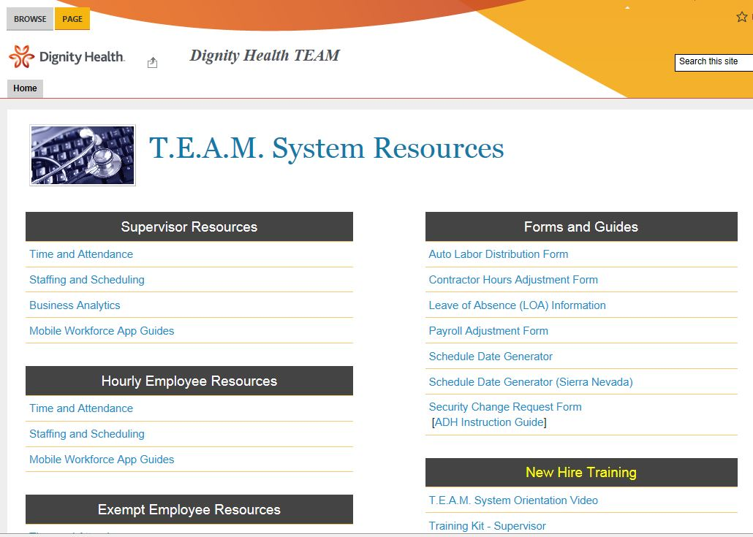
Resources for How to Guides
Access the TEAM system on your desktop
In the TEAM system, click the New TEAM system Help Resource
This will bring you to helpful TEAM resources. Here there are guides and tutorials

Slide 9
Thank You for taking the time to learn TEAM!

