Slide 2
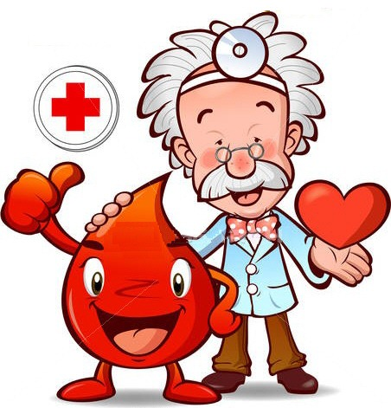
The Role of the Phlebotomist

Slide 3
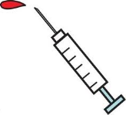
Phlebotomists Role in Healthcare
Phlebotomists are an important member of the health care team.
60 to 70 percent of all decisions regarding a patient’s diagnosis and treatment are based on laboratory results.
Health care providers rely on us to help them care for their patients.

Slide 4
Pre-course Quiz Questions
Make sure that your iclicker is turned on

Slide 5
What is the root meaning of the word Phlebotomist?
MultipleChoice
A.
Laboratory employee
B.
Vein Specialist
C.
Lab Specimen Specialist
D.
Blood Processing Employee
E.
Person who transports blood
Answer :
Please press “send” after making your selection.

Slide 6
Which of the following words describes a specialist?
MultipleChoice
A.
A person who has received proper training in a particular field
B.
A person highly skilled in a specific and restricted field
C.
A person who has enjoys his/her occupation
D.
A person who performs a job duty correctly
E.
None of the above
Answer :
Please press “send” after making your selection.

Slide 7
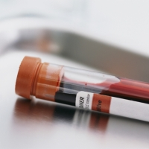
What do patients expect of their Phlebotomist (specialist)

Slide 8
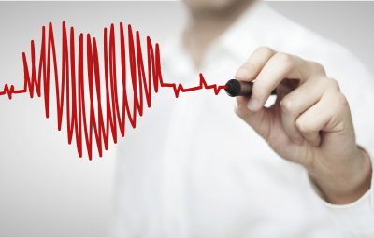
Courteousness
Gentleness
Empathy
Good communication skills
Professionalism
Good hygiene

Slide 9
Perceptions are realities

Slide 10
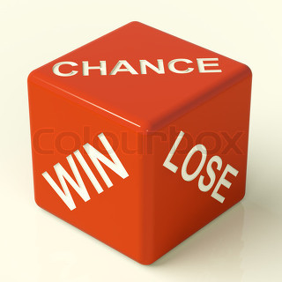
experts say that you only get one chance to make a good impression.

Slide 11
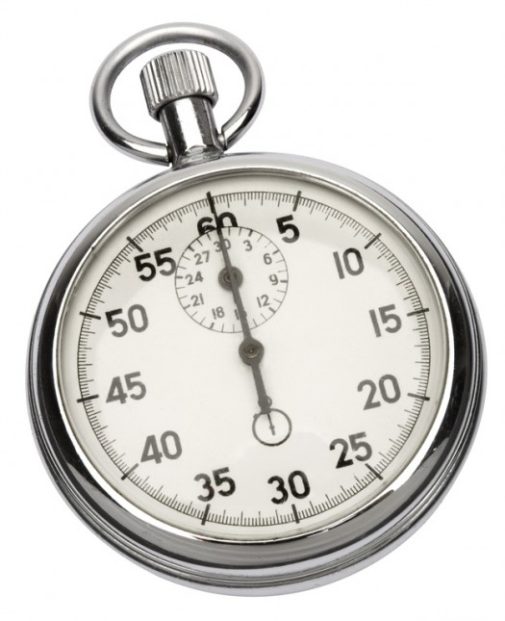
Experts believe that a customer can form a lasting impression within 7 seconds

Slide 12
Why did you choose to become a phlebotomist?

Slide 13
Types of Motivation
Intrinsic vs. extrinsic

Slide 14
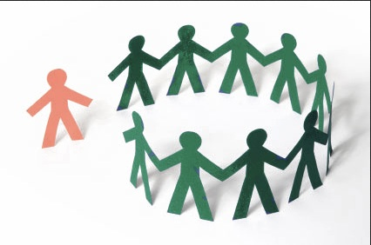
Extrinsic motivation fueled by outside goals
Often is short-lived and can lead to early job burn-out

Slide 15
Intrinsic motivation
Motivation that originates from within and focuses on lifetime goals

Slide 16
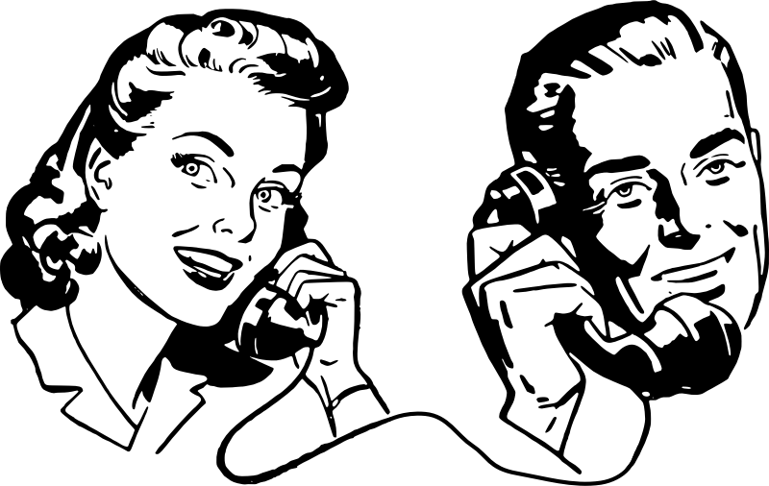
Professional/Therapeutic communication

Slide 17
Focuses on the patient

Slide 18
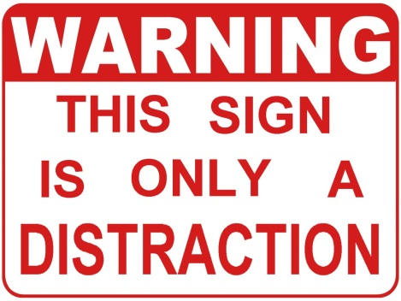
Don’t allow distractions
Listen actively
Speak professionally (clear and concise)
Match verbal with non-verbal communication

Slide 19
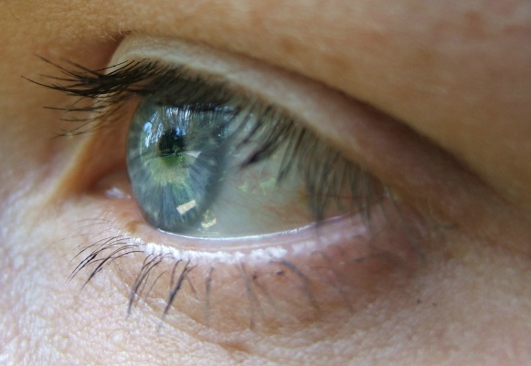
Make eye contact with the patient while in the room

Slide 20
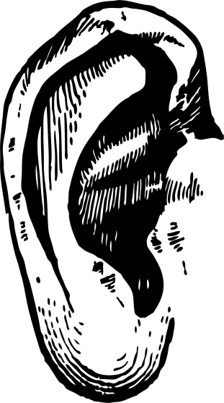
Active listening
Reflect
Restate
clarify

Slide 21
Use terms that are age sensitive
Speak to express not impress

Slide 22
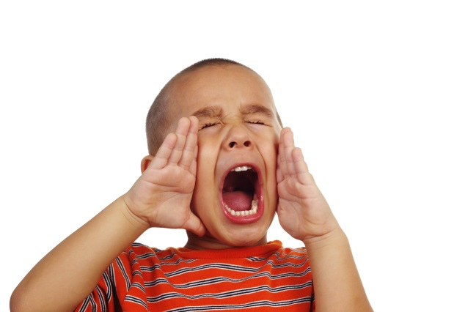
Verbal vs nonverbal.

Slide 23
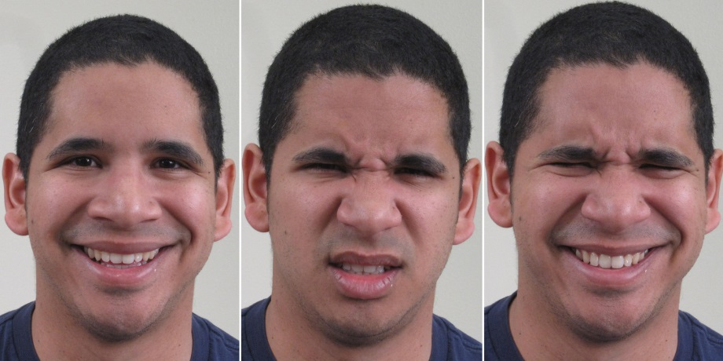
Verbal is spoken words and tone of voice
Non-verbal communication include gestures and facial expressions

Slide 24
A UCLA professor stated that 70% of communication is
non-verbal.

Slide 25
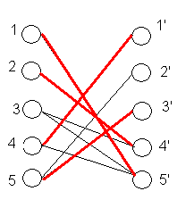
Always make sure to match non-verbal with verbal communication

Slide 26
Patient safety

Slide 27
Risk Factors with Phlebotomy
Bleeding and
Bruising
Nerve and Muscle Damage
Allergic Reactions and Fainting

Slide 28
The use of needles larger than 21 gauge for venipunctures, places the patient at an increased risk to which of the following
MultipleChoice
A.
Excessive Bleeding
B.
Tissue Damage
C.
Bruising
D.
Delayed bleeding
E.
All of the above
Answer :
Please press “send” after making your selection.

Slide 29
Blind Probing is best defined as which of the following?
MultipleChoice
A.
Closing your eyes while inserting the needle
B.
Not taking time to accurately locate the vessel before insertion
C.
Inserting the needle at the wrong angle
D.
Inserting the needle past the vessel lumen
E.
Hitting the bone
Answer :
Please press “send” after making your selection.

Slide 30
Excessive Probing is acceptable when?
MultipleChoice
A.
Patient moved arm back after inserting the needle
B.
You suspect that you did not go into the skin deep enough
C.
Your needle placement is too far to the left or right of the vein
D.
Vessel is difficult to find
E.
Never
Answer :
Please press “send” after making your selection.

Slide 31
What is the best action to follow when a patient tells you they are about to faint?
MultipleChoice
A.
Divert their attention by talking to them
B.
Pull the tourniquet
C.
Pull the needle out
D.
Have them place their head between their knees
E.
All of the above
Answer :
Please press “send” after making your selection.

Slide 32
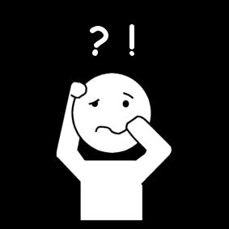
Difficult draws

Slide 33
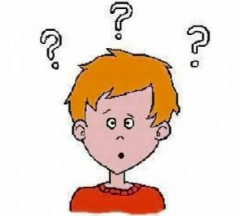
Patient doesn’t understand your instructions

Slide 34
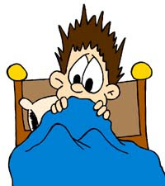
Patient is needle phobic

Slide 35
Geriatric patients with fragile skin

Slide 36
Patient’s with “hard to find” veins

Slide 37
Always ask the patient for location of the best veins

Slide 38
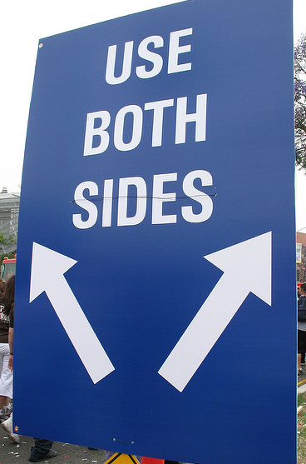
Carefully look on both arms

Slide 39
Place warm blankeT on arm for 5 min before looking for a vein

Slide 40
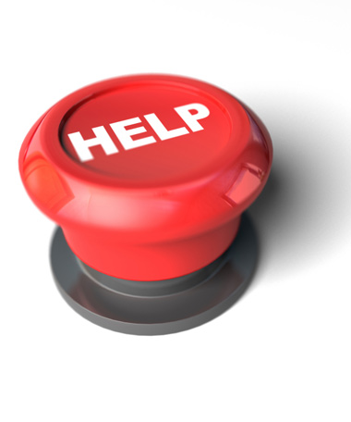
Get help

Slide 41
Never place tourniquet on too tight or too long

Slide 42
Only stick twice if you know you can get it

Slide 43
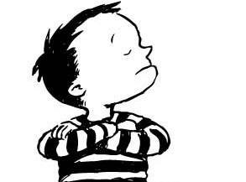
Patient refuses

Slide 44
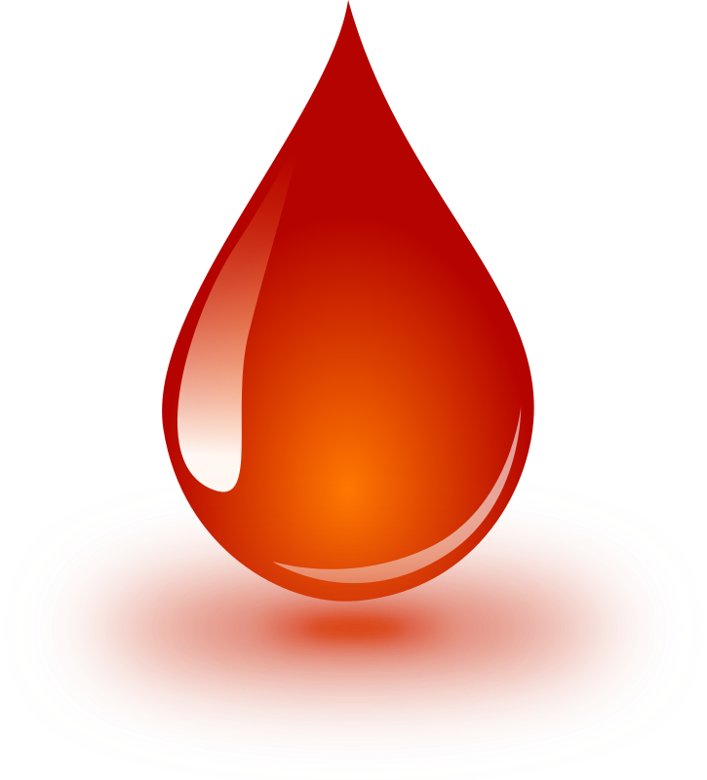
Patients with bleeding disorders

Slide 45
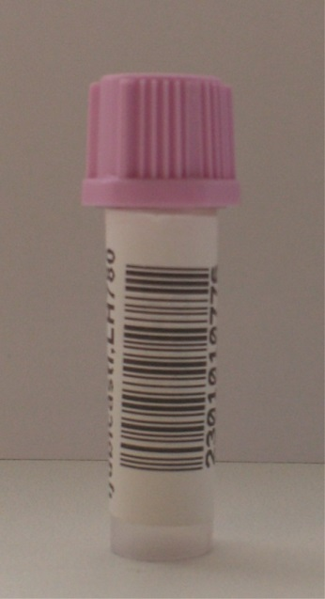
Preanalytical errors

Slide 46
Errors that occur before testing or analysis

Slide 47
Include: contaminated specimens short samples hemolyzed specimens specimen incorrectly labeled wrong patient drawn specimen drawn in incorrect tube specimen transported incorrectly specimen processed incorrectly hemo-concentrated specimen

Slide 48
Clia regulations

Slide 49
All preanalytical errors must be documented. corrective actions must follow

Slide 50
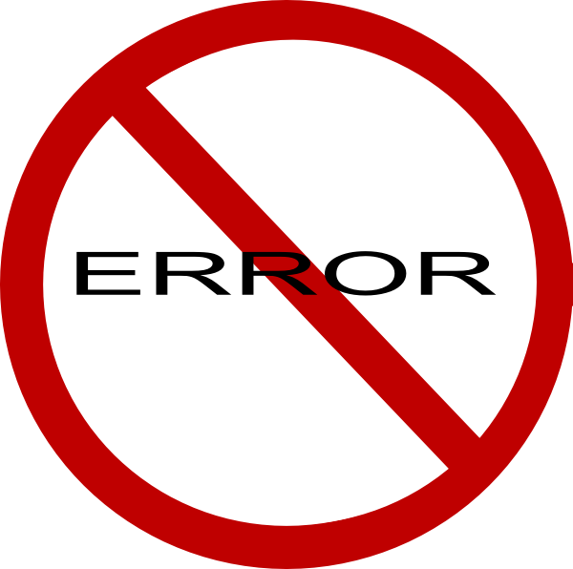
Errors can go undetected

Slide 51
Remember, 70% of diagnosis are arrived from lab test results

Slide 52
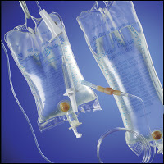
Contaminated specimens

Slide 53
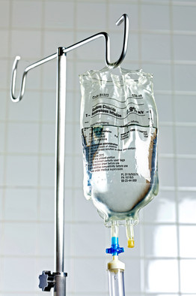
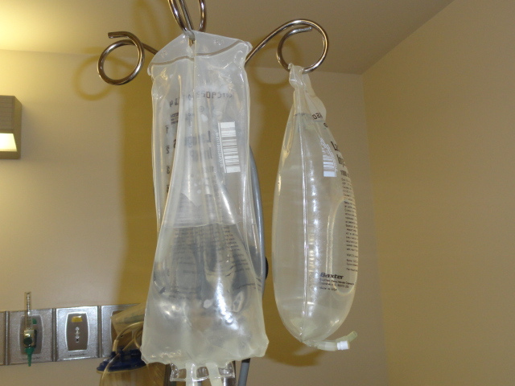
Drawing above an Iv site

Slide 54
Not recommended due to high possibility of contamination

Slide 55
Much better for the patient to stick below and avoid contamination

Slide 56
When a stick is performed above an iv site, you must document.

Slide 57
Accuracy starts with you!

Slide 58
Thank you

