Slide 1
Newborn Screening Program

Slide 2
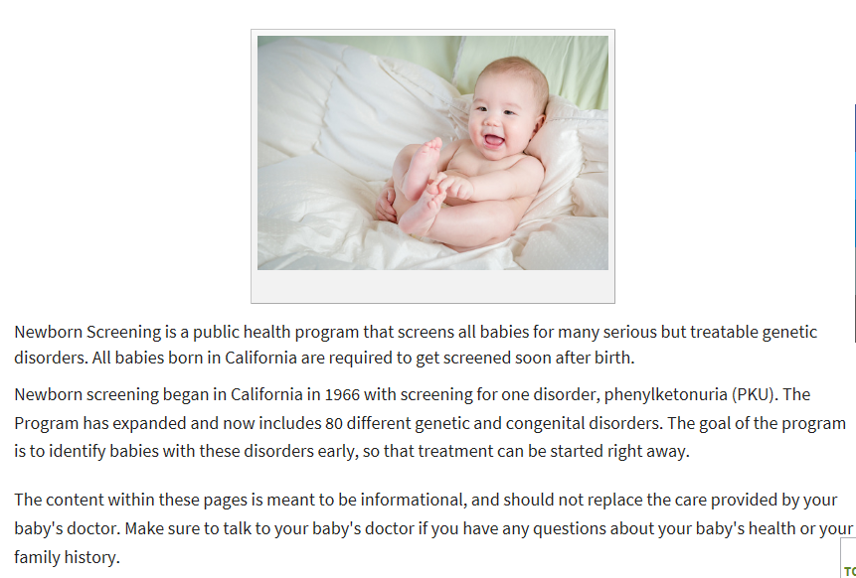
Newborn Screening at Public Health

Slide 3
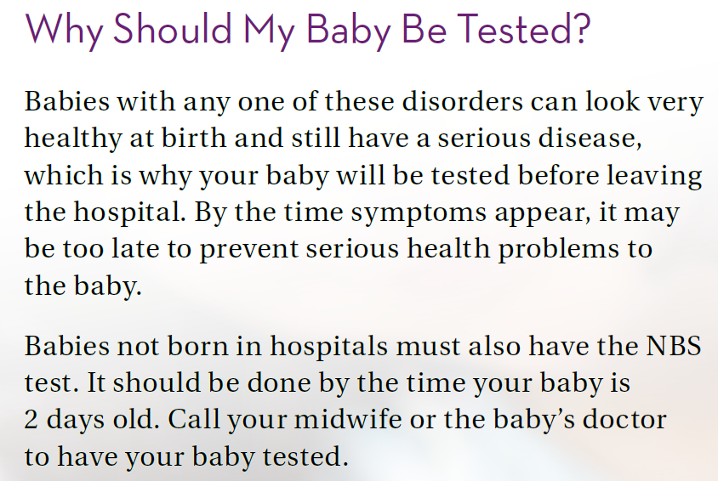
Why Test?

Slide 4
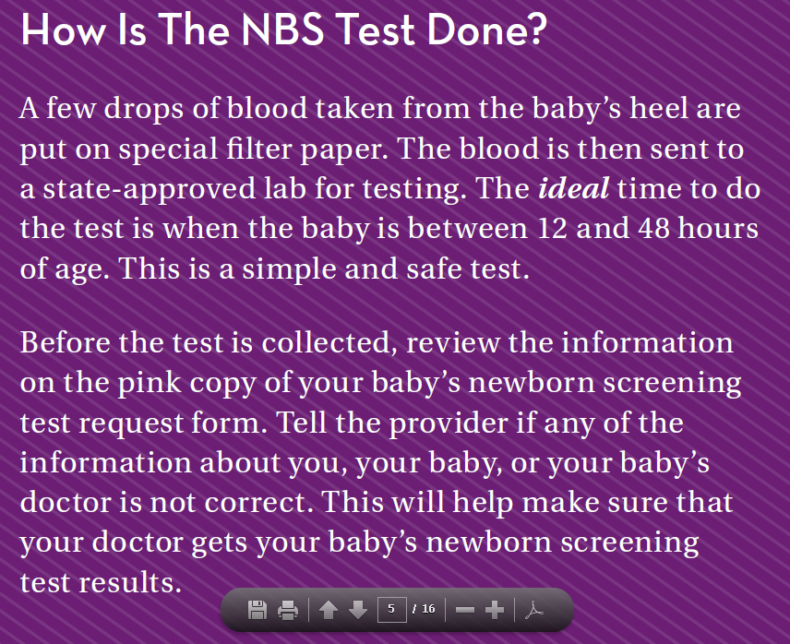
How is Testing Done

Slide 5
California Newborn Screening Brochures for Parents

Slide 6
Is More Testing Needed?

Slide 7
Why More Testing?

Slide 8
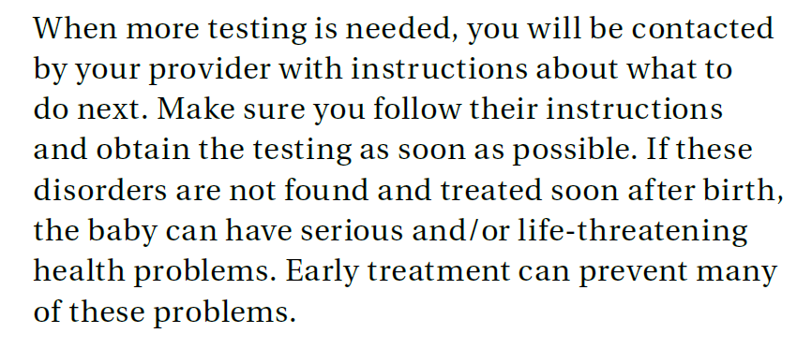
More Testing Needed

Slide 9
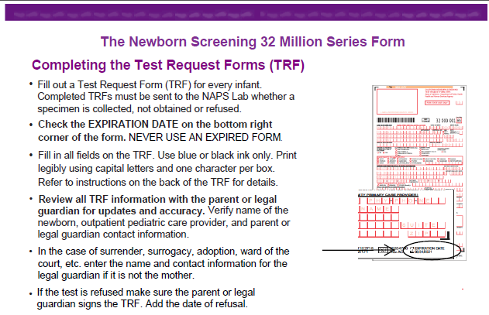
Newborn Screening Forms

Slide 10
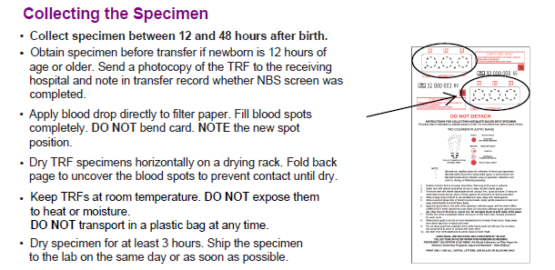
Newborn Screening Forms

Slide 11
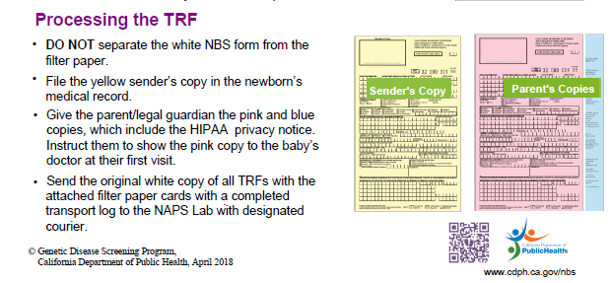
Newborn Screening Forms

Slide 12
Newborn Screen Recollect
If a Newborn Screen needs to be recollected, the state will send
a recollect form. This is to be considered an order.
All recollect forms sent to the lab will be scanned to the G drive
Please make every effort to get the patient taken care of thoroughly
Follow through with the collections and make sure it gets to processing in good time.
If the patient is unhappy, please contact a supervisor or manager on duty to talk to the patient.
If special circumstance for the patient, presents challenge for recollect, please notify a supervisor for further arrangements

Slide 13
Disorders Screened
What does a NBS tell us?

Slide 14
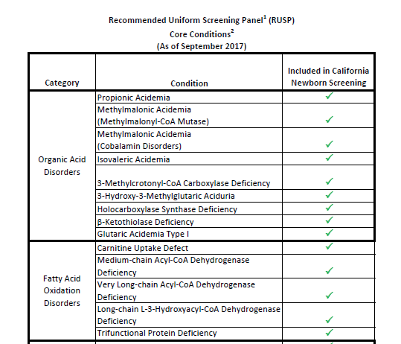
Disorders Screened

Slide 15
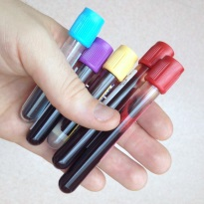
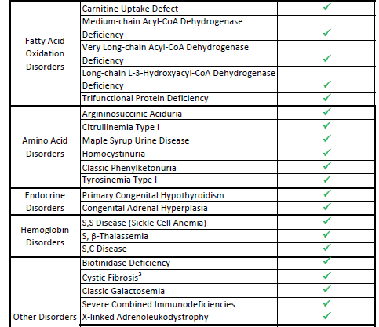
Disorders Screened

Slide 16
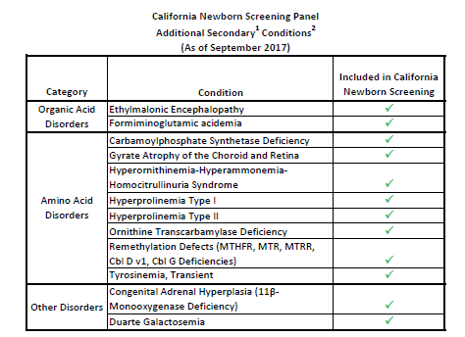
Secondary Disorders Screened

Slide 17
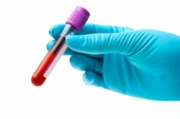
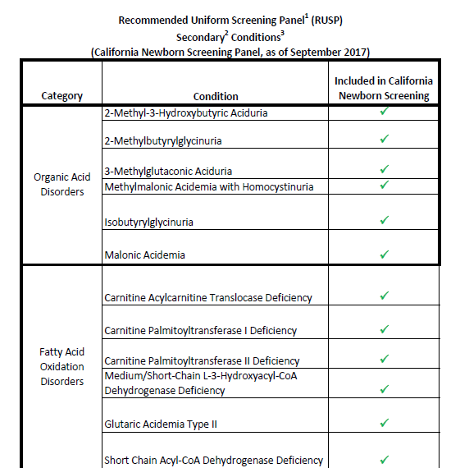
Secondary Disorders Screened

Slide 18
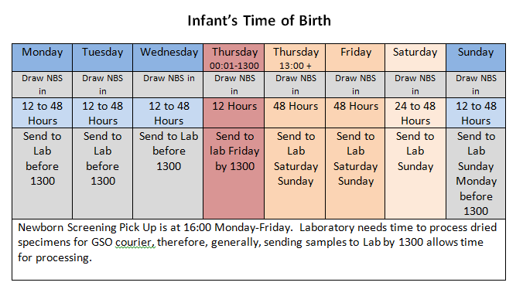
Process Timing Importance

Slide 19
Inadequate Screening

Slide 20
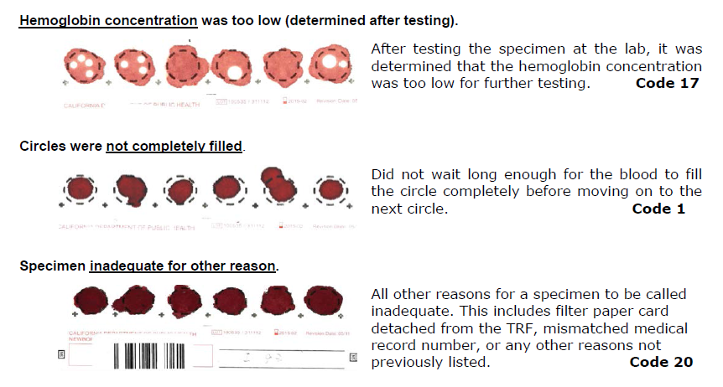
Inadequate Screening

Slide 21
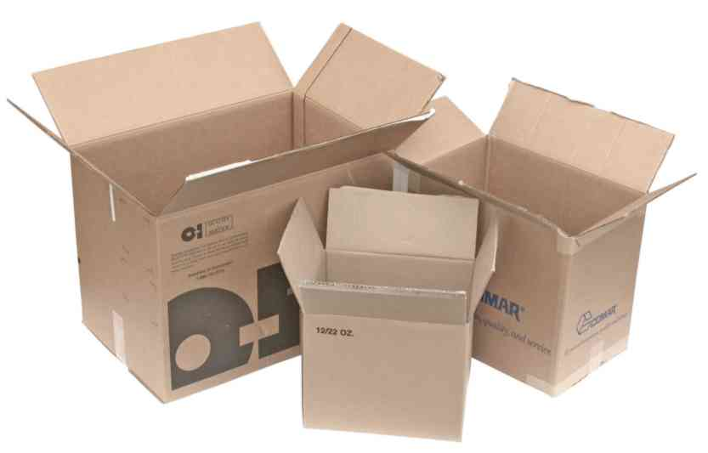
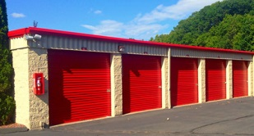
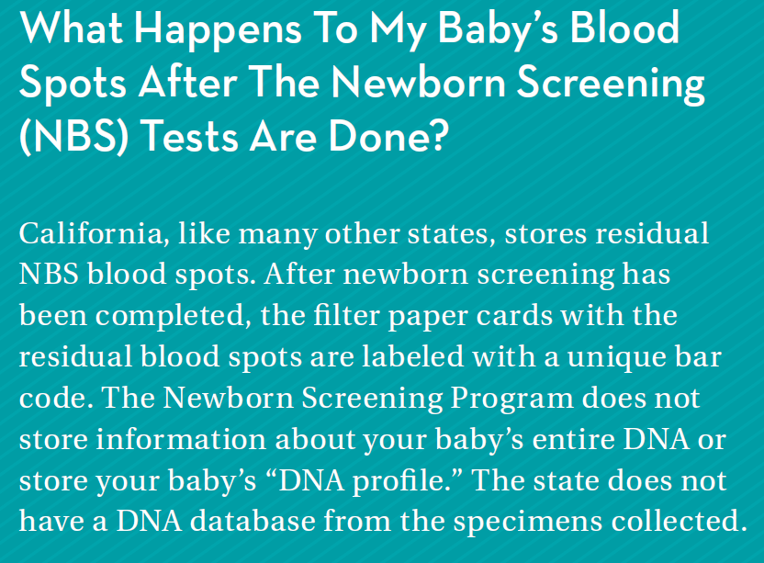
Storage of Samples

Slide 22
Storage Questions?

Slide 23
Save Babies
http://www.savebabies.org/video.html

Slide 24
Policy Manager-Useful Review of Policy
Age Dependent Approach for Phlebotomy
Capillary Puncture
Newborn Screening (PKU) Specimen Collection
Lancet Devices for Capillary Blood Collection

Slide 25
Thank You

