Slide 1
COMMUNICATION LOG

Slide 2
Comm Log: Smoother Critical Result Communication
Share critical lab results with providers sooner by speeding up log entry. Users can open the Communication Log activity as a sidebar without leaving their current activity, and when they document an outcome, a relevant dot phrase (comment) can be added.

Slide 3
A. Comm Log Activity
Communication Log activity opens as a sidebar to the right of the lab user's current activity when lab users click the Comm Log button in the toolbars for Result Entry, the Follow-up Work List, and the Outstanding List.
Lab users can also open the activity from the Actions button in Requisition Entry, Receiving, Case Results and Specimen Inquiry by Patient
The recommended workflow is that a lab user entering test results attempts to contact a Provider after a critical result have been entered. During or after this attempt, they open the Comm Log from the toolbar and completes the necessary fields.

Slide 4
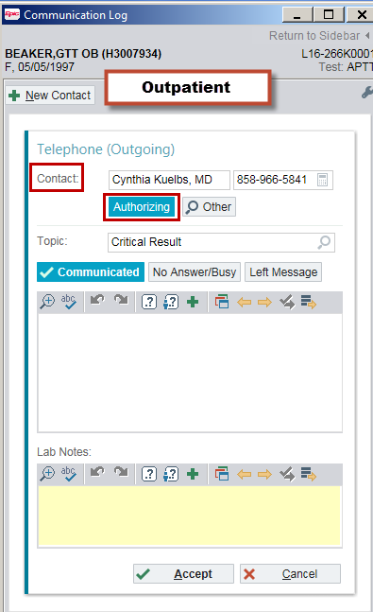
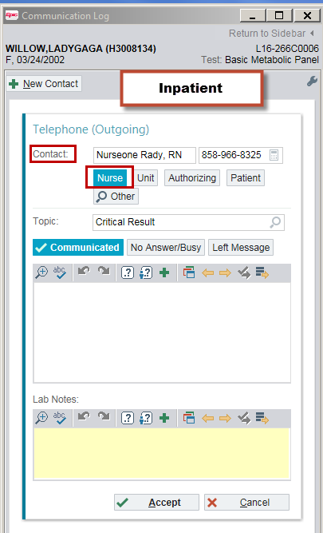
1. Contact
When the activity opens, the “Authorizing” button with the name and phone number appear automatically if the communication log is for an outpatient encounter.
For inpatient encounters, the “Unit” button and unit phone number appear automatically. If the nurse assigned to the patient is Signed In, then the “Nurse” button and the phone number appear automatically.

Slide 5
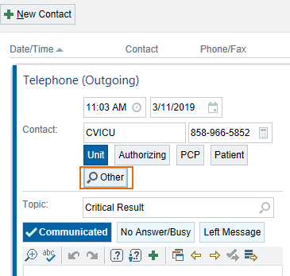
When lab users need to document a Comm Log for a contact not listed in the speed buttons, they can use the “Other” button to search the system for the right person.
When the Recipient Lookup window opens up, type in the Contact’s last name and select the correct one.
There may be same first and last name listed, make sure to select the correct one with the license/credential after their name

Slide 6
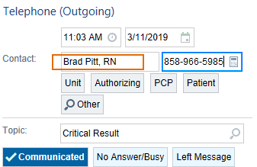
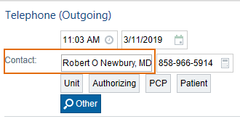
If the correct person is not listed in the Lookup, users can still enter the contact name as free text by typing over the Contact box. Enter the first and last name and the license/credential (RN, MD)
Type over the phone number to enter the correct Contact number if available

Slide 7
2. Topic The default topic is “Critical Result”, but there are other options for this. Click the magnifying glass to open your selection (Lab Call Results, Missing Items and other).

Slide 8
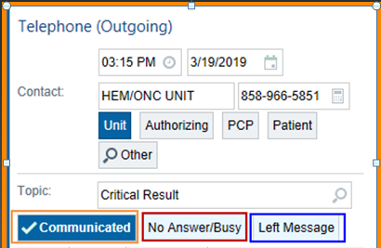
3. Contact Outcome (Speed Buttons)
Communicated – default button, select this when a lab user successfully reached the Provider
No Answer/Busy – suggested for Outpatient results during or after office hours. Not recommended for Inpatient results that need to be communicated immediately. Follow up is required. Unit location should be selected as contact for this outcome if there was no one notified. Comments can be added for additional documentation.
Left Message – suggested for Outpatient results during or after office hours or when a page is sent out. Comments are suggested for additional documentation. Not recommended for Inpatient results that need to be communicated immediately. Follow up is required.

Slide 9
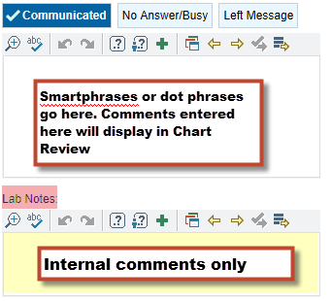
4. Comments
Comments entered in the white box are seen by staff outside of the lab and is included in the report. Enter the smartphrase here.
.ccall - Critical result(s) available 12/20/2018 3:14 PM. Called to and read back by contact at 12/20/2018 3:14 PM. Verbal value confirmed.
.mcall - Result(s) called to and repeated by contact 12/20/2018 at 3:16 PM.
Lab Notes – enter internal lab comments here. Comments entered here are not seen outside of the lab.

Slide 10
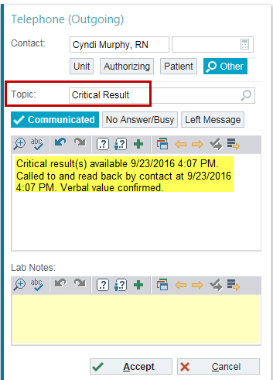
C. Smartphrases
Smartphrases (dot phrases) can be used in the comment box depending on the Topic selected.
If Critical Result topic is selected, .ccall can be used.

Slide 11
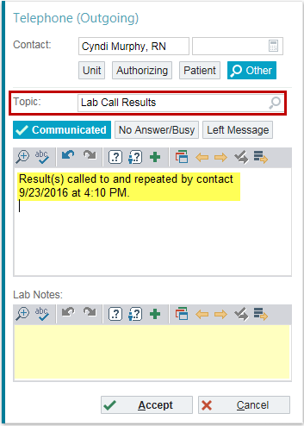
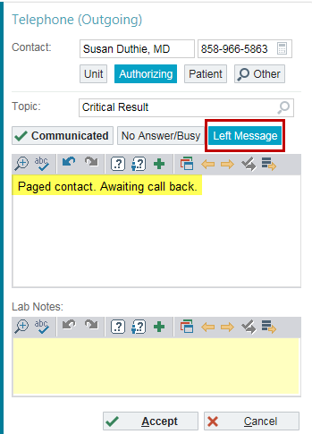
For courtesy calls or results that are not critical but need to be communicated to Providers, select the “Lab Call Results” topic. Smartphrase .called can be added as a comment.
Comm log can also be used to document messages sent to Providers by selecting the “Left Message” outcome button. Smartphrase .paged can be used to add a comment to the log.

Slide 12
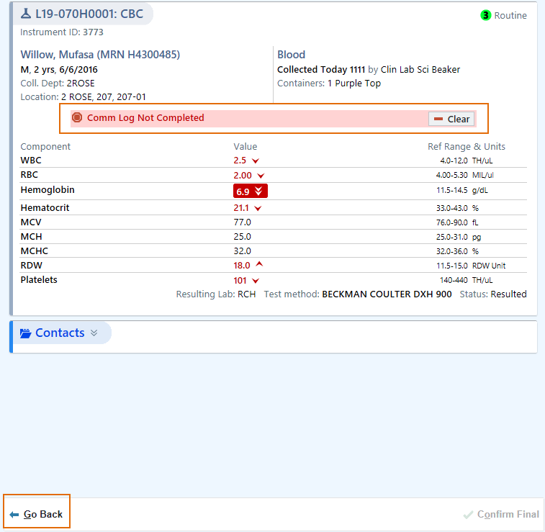
B. Hard Hold
To ensure that staff follow the Comm Log workflow, a Hard Hold will fire to prevent “Critical” result from being Final verified if there's no communication log opened or the communication log is still not completed. A Hard Hold will only fire if there is a “Critical Result” flagged. Click Go Back to create and complete the Comm Log.

Slide 13
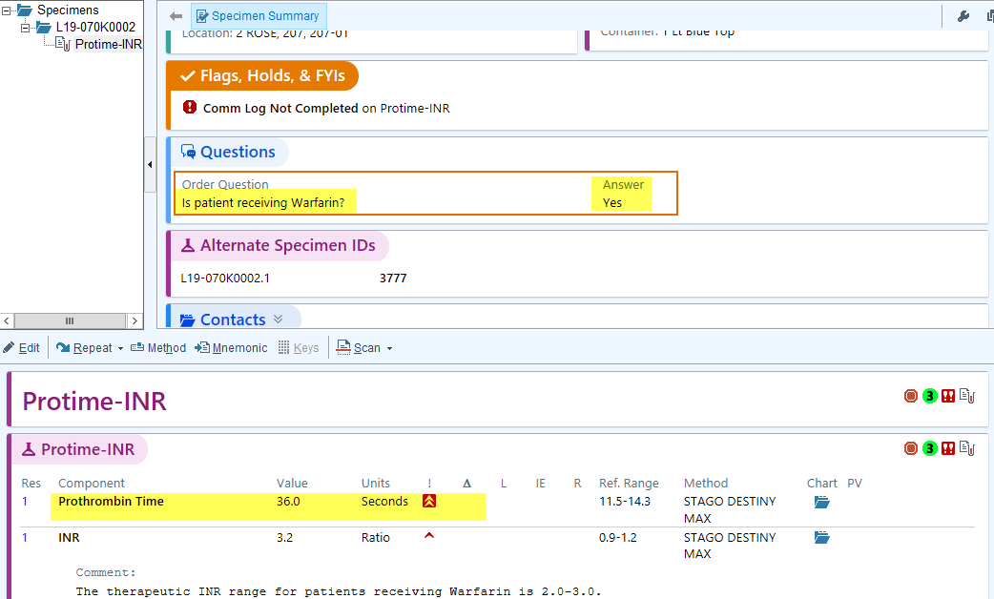
Hard Holds for test results that do not need a Comm Log can be cleared per policy.
Answer: Yes to Anti-Coagulant Therapy question
Creatinine and Sodium results - Consistent with Previous Results

Slide 14
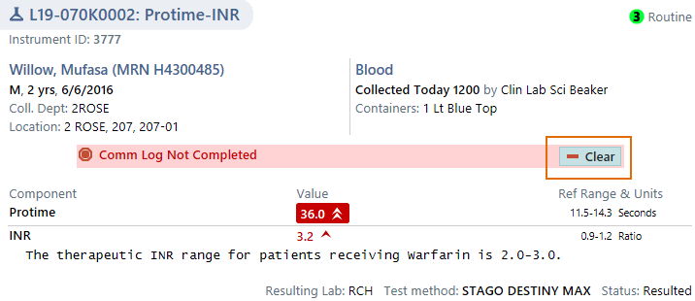
Hard Holds can be cleared by selecting the appropriate reason. Click “Clear” to proceed.

Slide 15
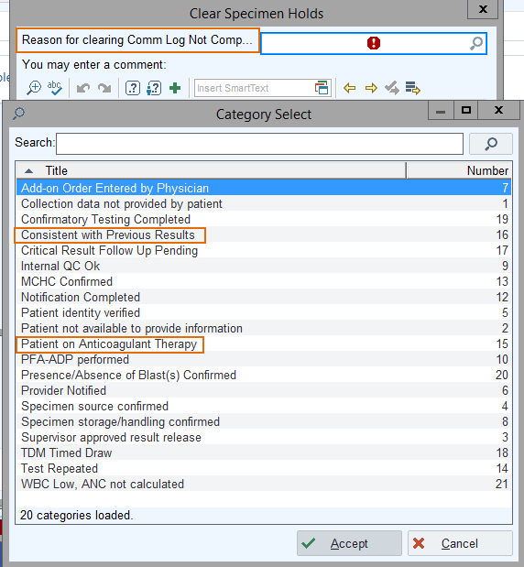
Clear Specimen Holds box with display. Click the magnifying glass to view all selections and select the appropriate reason.
Consistent with Previous Results ( Creatinine, Sodium etc. )
Patient on Anti-Coagulant Therapy

Slide 16
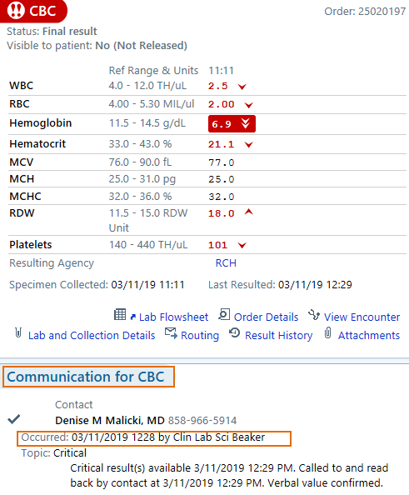
D. Reports
Communication details are available in several reports in Epic.
Green check mark icon - Completed Comm Log with a Critical topic, Contact info, Smartphase used with correct date/time and the occurrence information including user name.

Slide 17
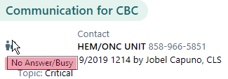
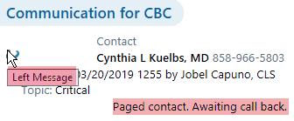
No Answer/Busy – hover over the icon to view the contact outcome. Follow up is required to complete the Comm Log documentation.
Left Message - hover over the icon to view the contact outcome. Contact info of the person the message was left to displays. Comments entered will also display.

Slide 18
Nursing Reports
Nursing department are also required to follow up on all Lab Critical Results
All information entered by LAB in Comm log are visible on the reports that Nursing generates for their review:
Contact Person
Date and Time the call was made
Lab personnel who completed the Comm Log
Topic (Critical, Lab Call, Paged)
Contact Outcome (Communicated, No Answer/Busy, Left Message)
External Comments
If the Hold was cleared, they can also see - Reason for Clearing Hold – and who cleared the Hold

