Slide 1
COMMUNICATION LOG

Slide 2
Comm Log: Smoother Critical Result Communication
Share critical lab results with providers sooner by speeding up log entry. Users can open the Communication Log activity as a sidebar without leaving their current activity, and when they document an outcome, a relevant dot phrase (comment) can be added.

Slide 3
A. Comm Log Activity
Lab users do not have to leave their current activity to create log entries for critical result calls, saving time and allowing lab users to refer to information in another activity when creating entries
Communication Log activity opens as a sidebar to the right of the lab user's current activity when lab users click the Comm Log button in the toolbars for Result Entry, the Follow-up Work List, and the Outstanding List.
Lab users can also open the activity from the Actions button in Requisition Entry, Receiving, and Case Results.

Slide 4
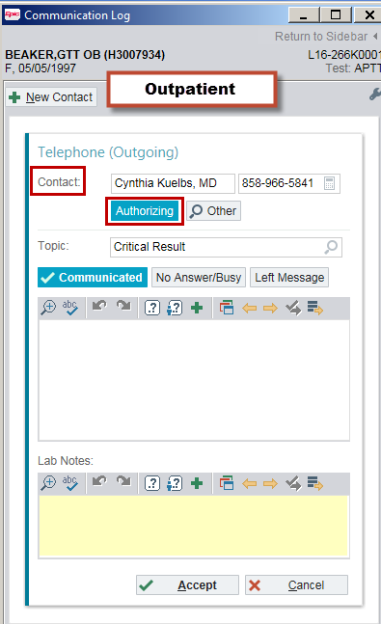
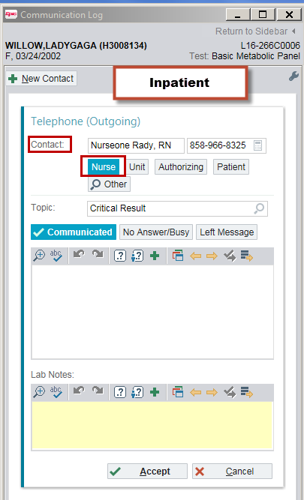
When the activity opens, the “Authorizing” button with the name and phone number appear automatically if the communication log is for an outpatient encounter.
For inpatient encounters, the “Unit” button and unit phone number appear automatically. If the nurse assigned to the patient is Signed In, then the “Nurse” button and the phone number appear automatically.

Slide 5
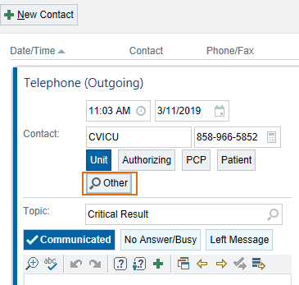
When lab users need to document a Comm Log for a contact not listed in the speed buttons, they can use the “Other” button to search the system for the right person.
When the Recipient Lookup window opens up, type in the Contact’s last name and select the correct one

Slide 6
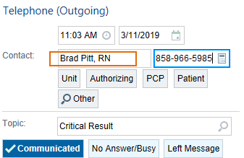
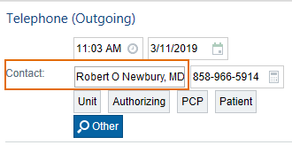
If the correct person is not listed in the Lookup, users can still enter contact names as free text by typing over the Contact box. Enter the first and last name and the license/credential (RN, Dr.)
Type over the phone number to enter the correct Contact number if available

Slide 7
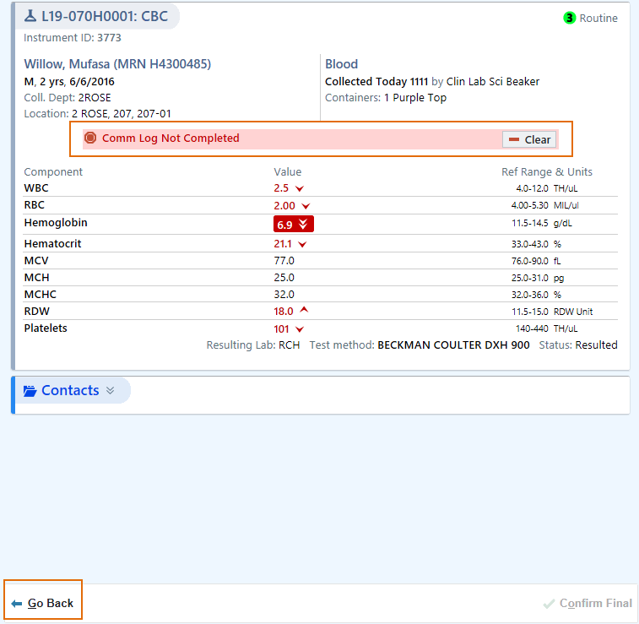
B. Hard Hold
To ensure that staff follow the Comm Log workflow, a Hard Hold will fire to prevent critical results from being verified if there's no communication log or the communication log is still open. Click Go Back to create a Comm Log.

Slide 8
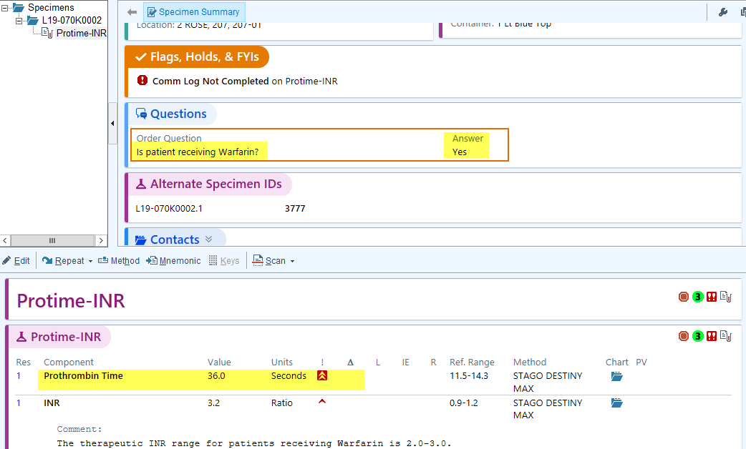
Hard Holds for test results that do not need a Comm Log can be cleared:
Answer: Yes to Anti-Coagulant Therapy question
Creatinine result is Consistent with Previous Results from a Renal patient

Slide 9
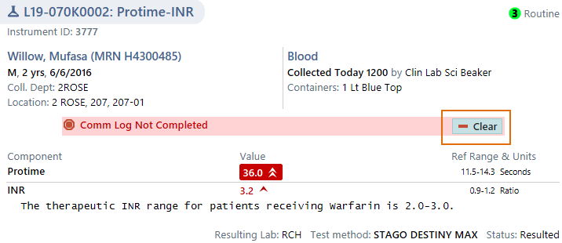
Hard Holds can be cleared by selecting the appropriate reason. Click “Clear” to proceed.

Slide 10
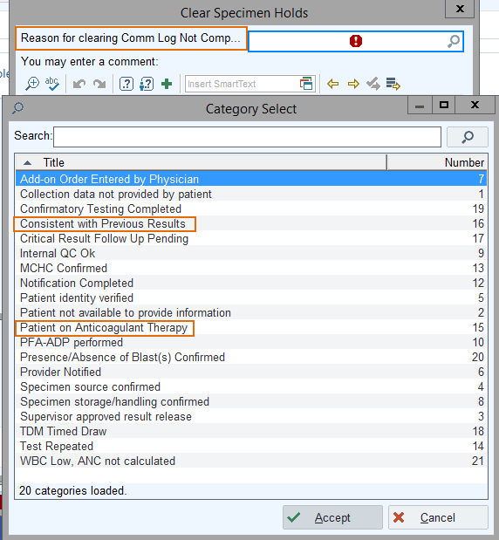
Clear Specimen Holds box with display. Click the magnifying glass to view all selections and select the appropriate reason.
Consistent with Previous Results ( Creatinine, Sodium etc. )
Patient on Anti-Coagulant Therapy

Slide 11
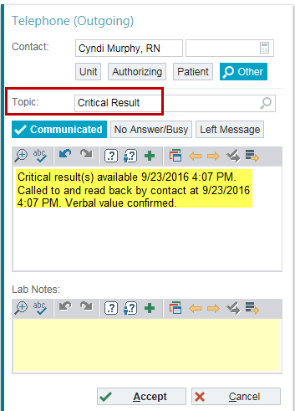
C. Smartphrases
Smartphrases (dot phrases) can be used in the comment box depending on the Topic selected.
If Critical Result topic is selected, .ccall can be used.

Slide 12
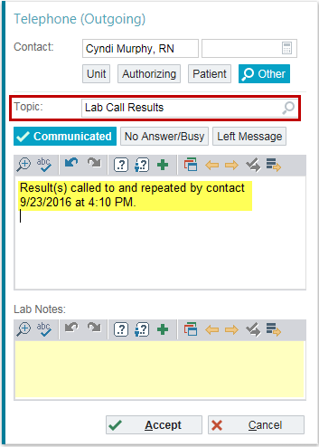
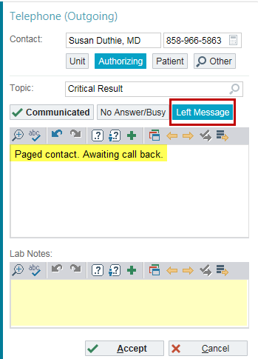
For courtesy calls or results that are not panic or critical but need to be communicated to Providers, select the “Lab Call Results” button. Smartphrase .called can be added as a comment.
Comm log can also be used to document messages sent to Providers by selecting the “Left Message” button. Smartphrase .paged can be used to add a comment to the log.

Slide 13
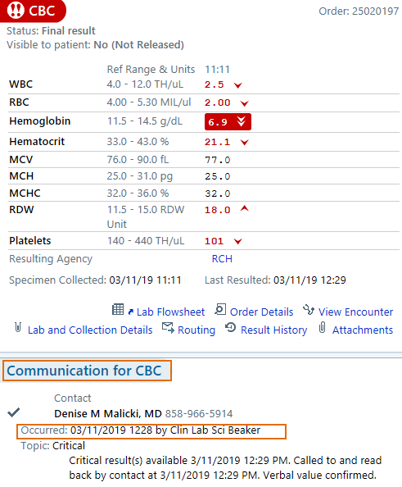
D. Reports
Communication details are available in several reports and can be seen in Chart Review, Result Report and Follow-Up Work list activity.

Slide 14
Nursing Reports
Nursing department are also required to follow up on all Lab Critical Results
All information Lab entered in the Comm log are visible in the reports that Nursing generates for their to review:
Contact Peson
Date and Time the call was made
Lab personnel who completed the Comm Log
Topic (Critical, Lab Call, Paged)
Comments
If the Hold was cleared, they can also see - Reason for Clearing Hold – and who cleared the Hold

