Slide 1
Rady Children’s Hospital-San Diego Laboratory Services
DEPARTMENT MEETING
May 2019

Slide 2
Rady Children’s Hospital-San Diego Mission and Vision Statement
Mission:
“The mission of Rady Children’s Hospital San Diego is to
restore, sustain, and enhance the health and developmental
potential of children through excellence in care, education,
research, and advocacy.”
Vision:
“We will be a leader, recognized nationally and internationally, for Excellence in patient care, education, research and advocacy.”

Slide 3
Reminders:
Reminders
Complete AMEs, MTS Training, Competency Assessments, Self-Evaluation
Work with Lab Leadership and Leads to schedule time and coverage
Code Meeting/Training

Slide 4
Department Updates

Slide 5
Productivity Report
We continue to staff to volume for the rest of this Fiscal Year…

Slide 6
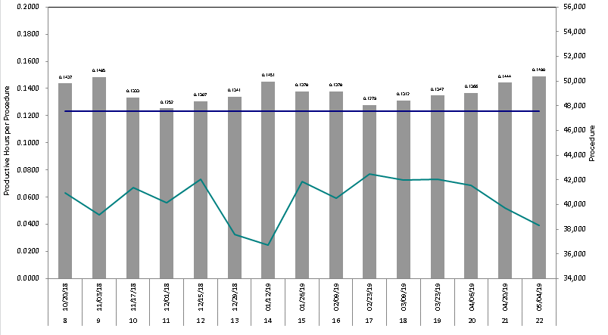
Productivity Report (cont.)

Slide 7
2019 Lab Week Celebration Recap
Team Rady Bulletin

Slide 8
2019 Lab Week Celebration Recap
Team Rady Bulletin

Slide 9
2019 Lab Week Celebration Recap (cont.)
Daily Themes:
Monday, April 22nd - Wear Green or Brown for Earth Day
Tuesday, April 23rd - Crazy Hair/Hat Day
Wednesday, April 24th - Disney Dress Up Day
Thursday, April 25th - Favorite Sports Team
Friday, April 26th - Aloha Friday
Meals for All Shifts
Daily Lunch and Learn
Daily Fun Activities
SPECIAL THANK YOU TO THE LAB WEEK COMMITTEE
(Lead by Liz Delos Reyes)

Slide 10
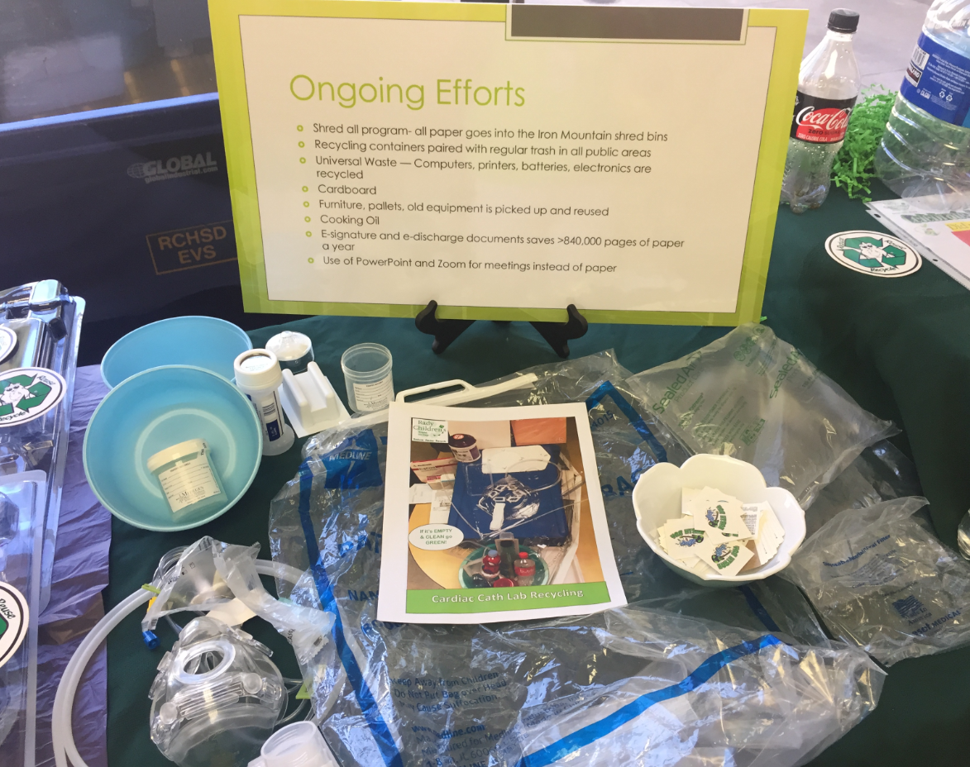
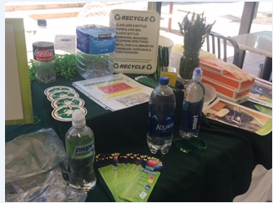
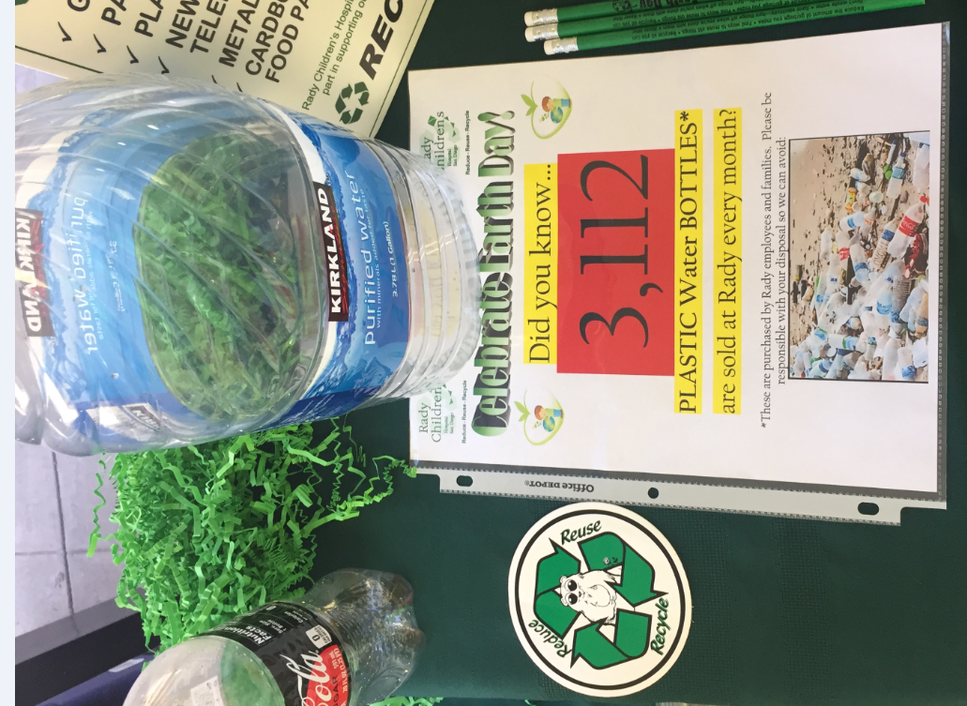
Earth Day – April 22nd
Green Day – (1st Day of Lab Week)
Collected many electronic waste items that needed to be disposed
Many departments participated across RCHSD.

Slide 11
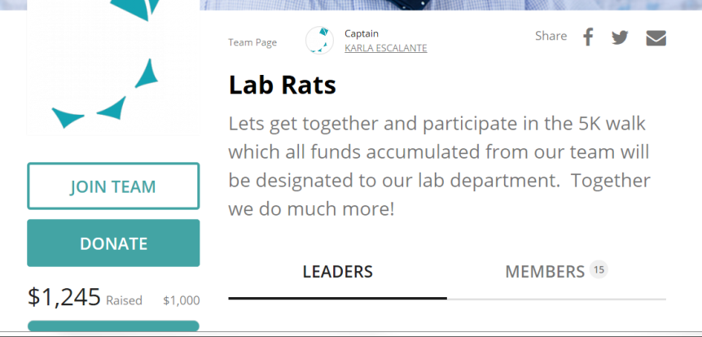
5K Walk and Silent Auction
THANK YOU to everyone who contributed to the 5K Walk
Lab Rats Team generated a total of $1,245
All funds were designated to our Lab Department

Slide 12
5K Walk and Silent Auction (cont.)
The 5K Walk generated a total of $701.00
Silent Action generated $544.00
All items were donated by Lab Staff, and we thank you so much for helping our Department.
We thank you for your generosity. Together we are better.

Slide 13
Hematology/Coagulation/Urinalysis
1. Finishing TEG system setup, currently waiting for interface built.
2. Urinalysis instrument: currently training staff and will complete in the second week of June.
3. Hematology competency review is due by May 31st.

Slide 14
LIS
Epic Upgrade
Sunday, June, 2, 2019 (2am-4am)
Onsite Support during downtime:
Steve Watanabe
Ann Lindgren
Post-Upgrade: Please wait for call notification from Beaker Team before using Epic

Slide 15
LIS (Cont.)
Upgrade Downtime Procedures:
Epic will be available in Shadow Read only (SRO) mode to view patient information only. It will not permit data entry.
SRO can be accessed by clicking on the standard Epic Production icon on all computers. This mode will permit users to view current orders as well as documentation entered into Epic up to the start of the downtime
You will be able to use all other systems during the downtime; however, interfaced data will not pass between systems.
Instruments will continue to run but orders and results will not cross over between the analyzers and Epic
At he end of the downtime, the interfaces will catch up and you will be able to see all patient data in all systems.
New patients admitted during this time will not show up in downstream systems.

Slide 16
Director of Lab Services
Current Status: Working remotely full time during recovery
Goal: Back to working onsite in 2 weeks (starting June 10th)
Connect with LaVonnye:
1. Daily Lab Huddles
2. Email
3. Private FaceTime Zoom session during office hours – Email LaVonnye to schedule, or make arrangements with Karla Escalante
*You may use LaVonnye’s office

Slide 17
Hospital Updates

Slide 18
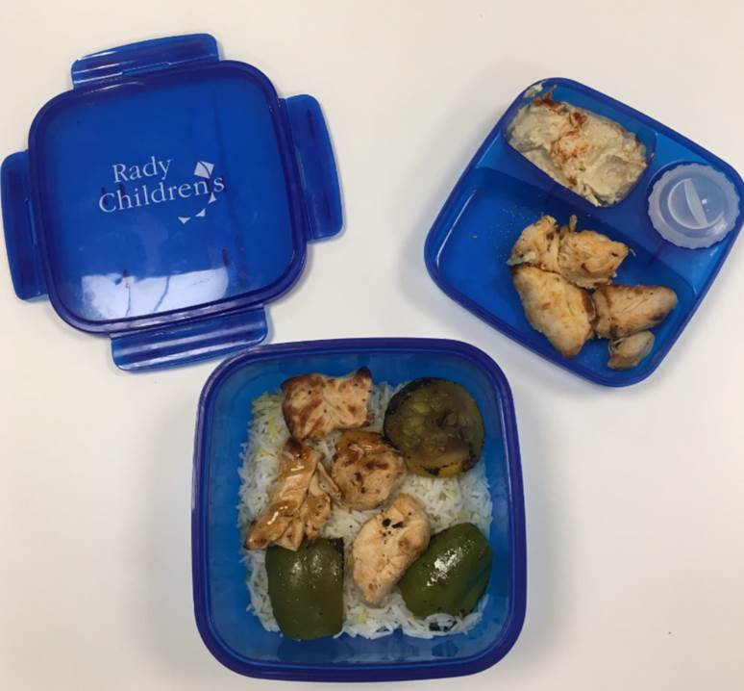
Green Team Initiative
Your health, wellness, and overall well-being are incredibly important to us. As part of our Green Team initiatives to be environmentally-friendly, we are moving towards eco-friendly food containers and utensils. To help reduce waste, if you bring this BPA free, microwave and dishwasher safe food container to the cafeteria, you will receive a discount on your food purchase! Thank you for helping us make a difference,
Your Executive Team
Early June: Gift from RCHSD to ALL STAFF
$0.25 discount when you use the RCHSD Container
Use RCHSD Container:
For grill, deli, Hot Line, Action Station and salad bar items.
To replace “To Go” containers

Slide 19
Engagement Survey Report
Lab: 73 Responses
More details at June Lab Staff Meeting

Slide 20
Patient Story

Slide 21
Patient’s Compliment
Date: March 20, 2019 Location: Outpatient Lab
I had a kiddo that I drew blood on yesterday and she told me, "This place reminds me of Disneyland because everyone here is so happy and fun to talk to." I feel like being compared to Disneyland is a huge compliment to everyone here. Great job team!
Shared by: Dana Haizlip

Slide 22
Ideas, feedback, concerns
Bring it up at Daily Lab Huddles
Discuss with your area Lead
Email/schedule appointment with LaVonnye

