Slide 1
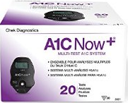
POCT Hemoglobin A1C
A1CNOW+ Test Kit

Slide 2
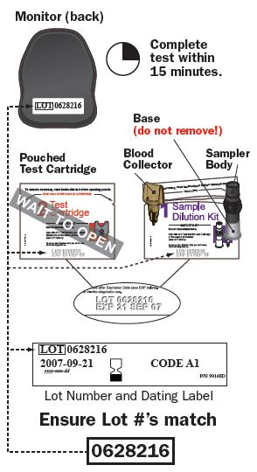
The HGB A1CNOW+ Kit
The A1CNow+ test provides quantitative measurement of the percent of glycated hemoglobin (%A1C) levels in capillary (finger stick) or venous whole blood samples.
The test is for professional use to monitor glycemic control in people with diabetes.

Slide 3
Storage and Stability
Kits should be stored refrigerated (2-8°C)
  Expiration date on refrigerated kits: Date on the package
Before use, kits must be allowed to come to room temperature (18-28°C)
  Kits must sit at room temperature for a minimum of 60 minutes when removed from the fridge
  Expiration date on room temperature kits: 4 months from the date placed at room temp
  Note: 4 month expiration date must be written on package

Slide 4
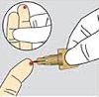
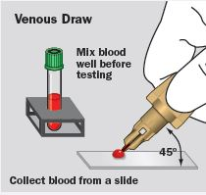
Sample Collection
Finger stick (most common)
Venous blood draw

Slide 5
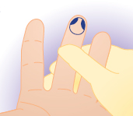
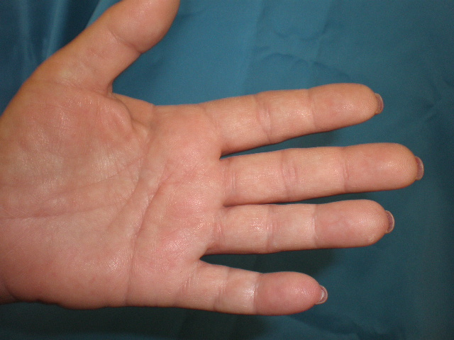
Finger Stick samples
Best locations for a finger stick is the 3rd and 4th fingers of the non-dominant hand
Perform the stick off to side of the center of the finger.
NEVER use the tip or center of the finger.

Slide 6
Specimen Collection
Wipe away at least 1-2 drops of blood prior to collecting the sample.
If necessary, apply light pressure to the surrounding tissue until another drop of blood appears.
Avoid "milking“ the finger.

Slide 7
Venous blood samples
Perform phlebotomy procedure and collect sample in a green top vacutainer tube
  Tubes may be lithium heparin or sodium heparin
Sample should be well mixed prior to testing and should tested at room temperature within 8 hours of collection
  Refrigerated heparin tubes are stable up to 14 days from collection for testing

Slide 8
Applying sample to the Blood collector
Finger Stick
Gently touch the tip of the blood collector to the finger stick site and fill the blood collector.

Slide 9
Applying sample to the Blood collector
Venous Draw
Mix sample well prior to sampling.
Place a drop of blood on a slide.
Holding the blood collector at 45° from the slide, fill the blood collector with sample.

Slide 10
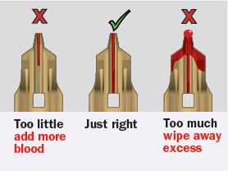
Inspecting the blood collector
Inspect the blood collector prior to inserting it into the sampler body.
Ensure that you wipe away any excess blood on the outside of the blood collector and/or continue filling the blood collector if adequate sample is not present.

Slide 11
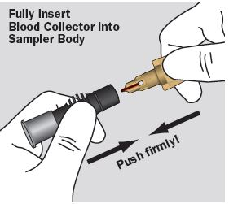
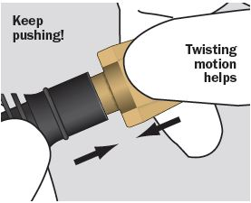
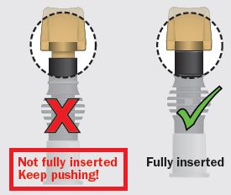
Inserting the blood collector into the sampler body

Slide 12
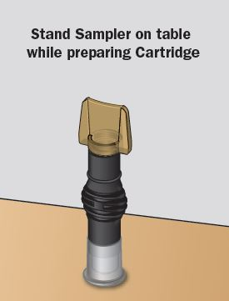
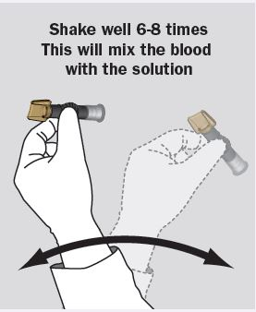
Mixing the Sample

Slide 13

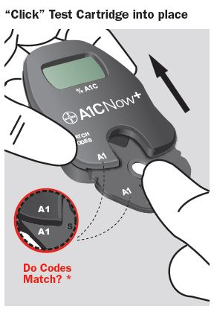
Preparing to run the test
Open the test cartridge and immediately insert the cartridge into the meter.
Ensure that the code on the cartridge matches the code on the meter.
You only have 2 minutes to apply sample to the cartridge once inserted into the meter.

Slide 14
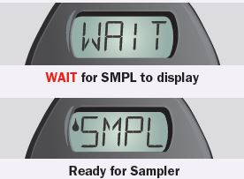
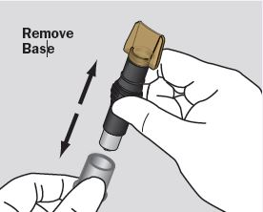
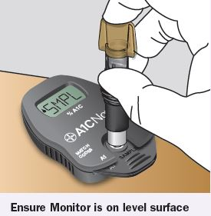
Sampling Cartridge
When the cartridge is inserted into the meter, the screen powers on and instructs you to “WAIT”.
Do not apply sample until the display prompt you to sample by displaying “SMPL”.
When Prompted to sample, remove the cap from the sampler body and align it on the cartridge and push down on the sampler body.

Slide 15
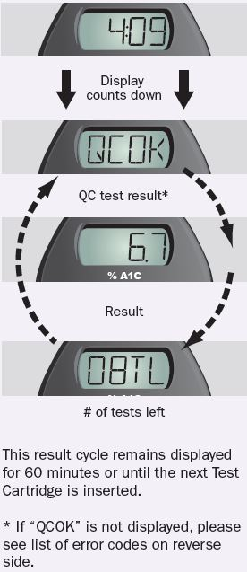
Meter performing the test
When the meter display says “Run”, remove the sampler body.
Do not handle the meter while sample is running.
A 5 minute count down displays on the screen while sample is running.

Slide 16
Results
Upon completion of sample testing, the meter should display “QC OK”.
The meter will then cycle through three screens displaying the following promts:“QC OK”, “Result”, “# of test left on meter”
Meter measures %A1C from 4-13
If error messages display, see package insert for list of error codes and corrective action.

Slide 17
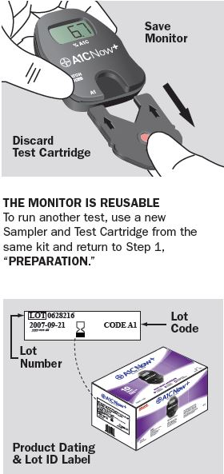
Discarding Cartridge
Upon completion of testing, remove the cartridge and discard in the appropriate container.
Return the meter to the test kit box (the meter is used for only the 20 tests that come in the box and discarded upon completion of these tests).
Meter should be disinfected with hospital approved disinfectant between each patient test.

Slide 18
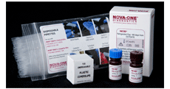
Quality Controls
Quality controls should be run with each new shipment of test kits, with each separate lot # within a shipment, and monthly (whichever comes first).
Quality controls are tested in the same manner as venous blood draw samples.
Controls are stable until the refrigerated expiration date printed on the box

Slide 19
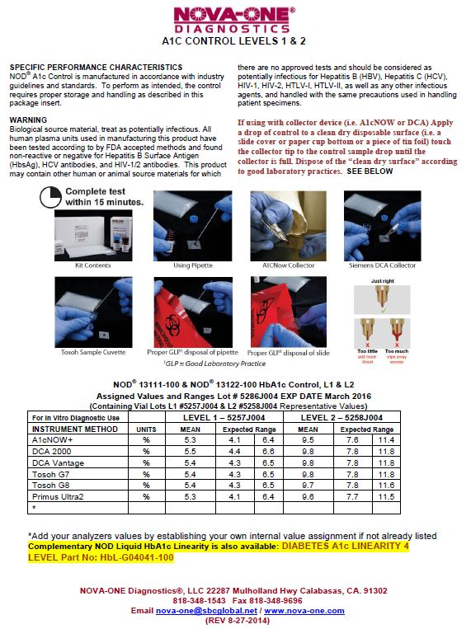
Quality Controls
The package insert that comes with the quality controls (ordered seperately from the kit) has instructions for running controls as well as the expected values for the controls.
This sheet should be saved with your quality control documents and filed when a new set of controls are put into use.

Slide 20
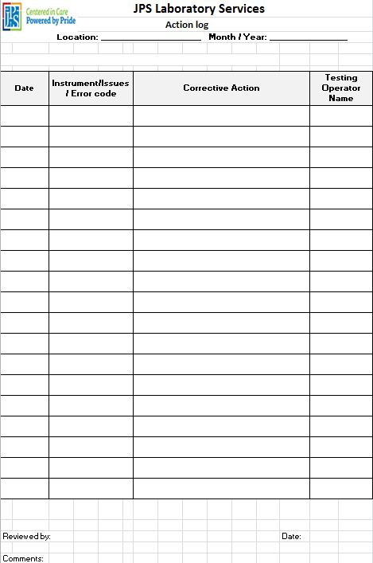
Documentation
When patient testing is completed, you must document your patient test results, successful internal controls and the lot # and expiration date of the kit used.
When quality controls are performed, you should document these results on the appropriate log sheet.
Do not perform any patient testing if quality controls do not fall within the expected ranges and immediately repeat the test. Document all corrective action for failed quality controls on the JPS action log.

