Slide 1
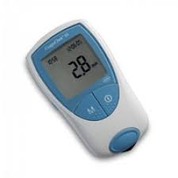
CoaguChek XS
PT/INR Testing

Slide 2
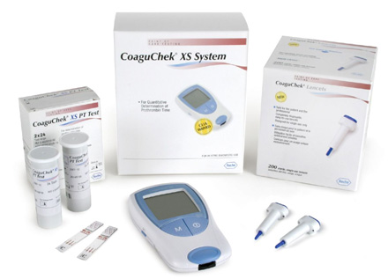
The CoaguChek XS Test System
                For measurement of PT/INR with patients on Coumadin therapy

Slide 3
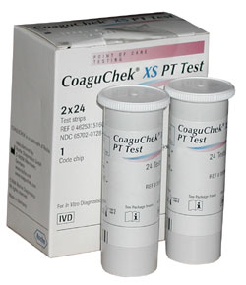
CoaguChek XS Strips
Strips are good until the expiration date printed on the vial
  Test strips exp. date does not change when opened
Must perform test within 10 minutes from the time the strip is removed from the strip vial

Slide 4
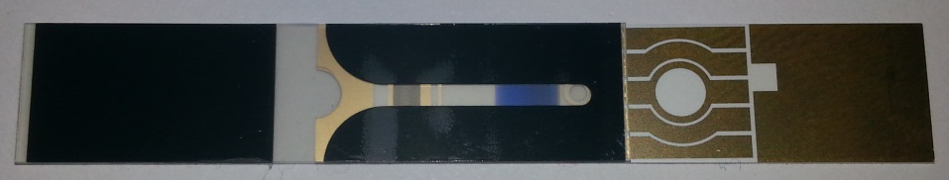
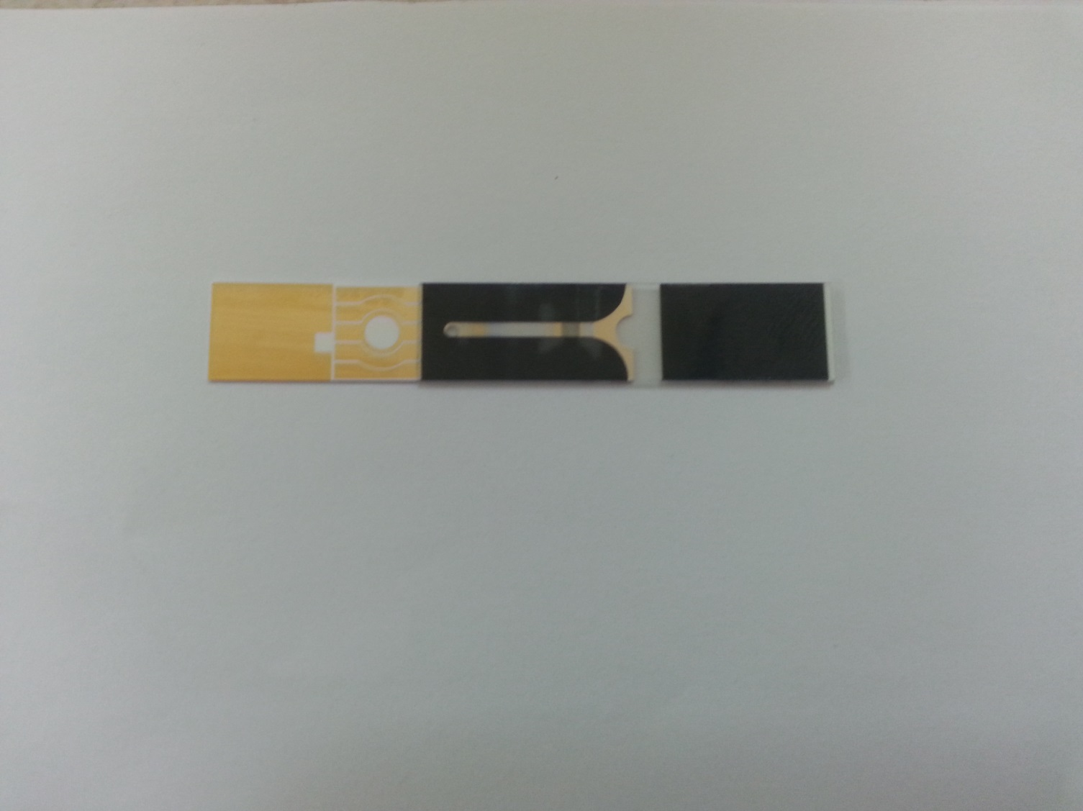
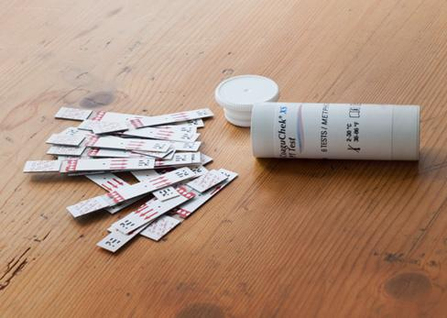
Good Strip, ok to use
Bad Strip, do not use
The lid must stay tightly capped on the vials to prevent moisture from damaging strips
Before using strips, inspect the back to ensure that the blue indicator is present (the absence of it indicates strip damage)

Slide 5
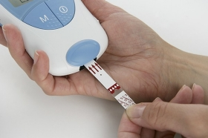
Preparing to run the test
Meter will power on when strip is inserted
After removing test strip from strip vial, insert it into the meter (arrows face up and point into the meter)

Slide 6
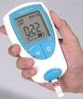

Preparing to run the test cont…
Meter will display a 3-digit code on the screen
Compare the code displayed on the screen to the vial and ensure that they match. (open strip boxes)
If the codes do not match or you are opening a new box of test strips, remove the current code chip from the meter and insert the new chip from the box of test strips. (strip is inserted into lower left corner of meter)

Slide 7

Preparing to run the test cont…
When you have matching codes, press the “M” button on the meter
An hour glass will display on the screen
  The meter is checking the strip exp. date and ensuring the code is correct
  During this time, you should prepare to collect your sample
The meter will beep and a 180-seconds countdown begins upon completion of these checks

Slide 8
Acceptable Patient Samples
Finger Stick
Venous Blood draw (optional method)
  Always use proper PPE when collecting any patient samples
  No sample should be collected prior to the countdown starting and sample should be applied to the test strip prior to the countdown ending

Slide 9
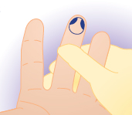
Finger Stick
  Clean the finger stick site with alcohol and allow to air dry
    Patients may also wash their hands with soap and water
  The best location to perform a finger stick is on the 3rd and 4th fingers of the non-dominant hand
  Perform the stick off to side of the center of the finger
  Never use the tip or center of the finger!

Slide 10
Finger Stick cont…
Need a “lady bug” size drop of blood to perform test (at least 8µL)
Do not “milk” the finger to stimulate flow!
  Use the first drop of blood to perform test.
  Do not wipe away the first drop!

Slide 11
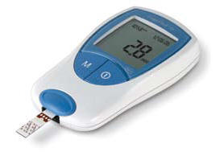
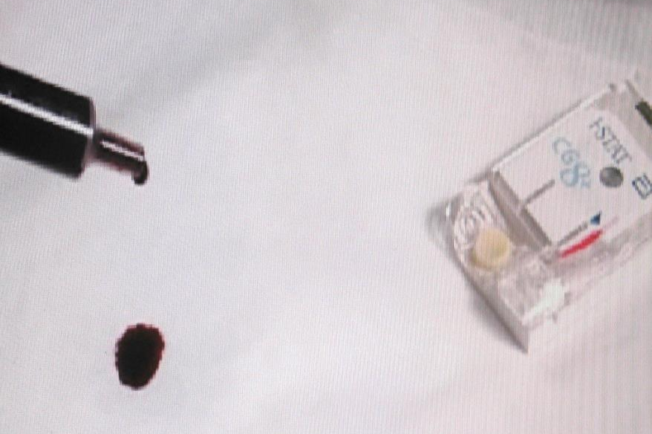
Venous Blood Draw
Perform venipuncture using only plastic, non-heparinized syringes.
Must waste 3-4 drop of blood and test immediately.
Do not fill any tubes with blood before testing or use blood from any tubes to complete testing.

Slide 12
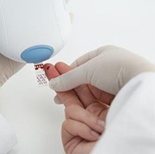
Sampling the Test Strips
Finger Stick
  Using the first drop of sample collected, apply sample to the strip within 15-seconds of lancing the finger
  Hold meter in either hand and touch the clear region of the strip to the patient’s finger below the finger stick site
  Slide the strip up to the finger stick site and stop in the middle of the finger stick site
  Hold the finger to the test strip until the meter beeps

Slide 13
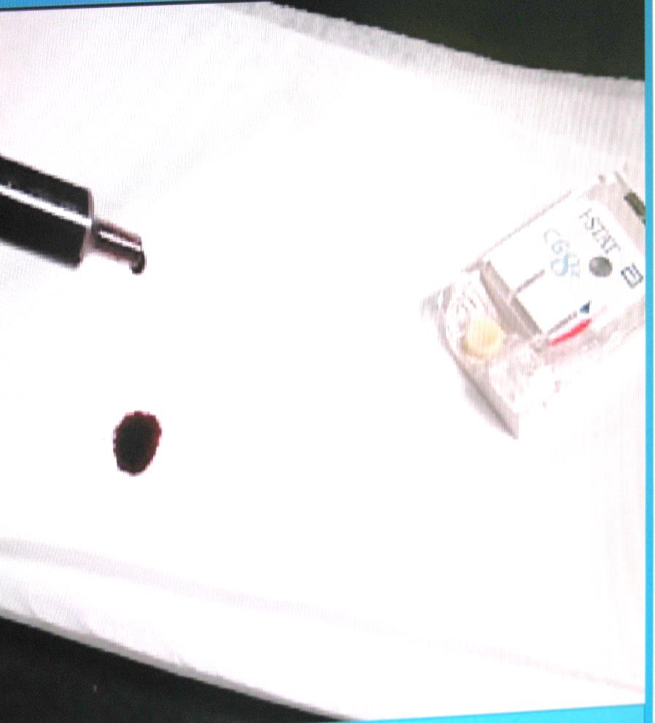
Sampling the Test Strips cont…
Venous Blood Draw
  Sample must be applied to the test strip within 15-seconds after collection
  After wasting 3-4 drops of blood (inspect for clotting while wasting) apply sample immediately to the center of the test strip
  Hold the syringe to the strip while steadily applying sample until the meter beeps

Slide 14
CoaguChek XS Analysis of Sample
During analysis of all samples, an internal quality check is performed
Upon successful quality check performance, “QC√” will appear on the strip shown on the screen
  If the internal quality check fails, the meter will display an error message, never a result
The INR for the sample being ran will display upon completion of analysis

Slide 15
Patient Results
When results are displayed on the screen, pressing the “set” button on the left slide of the meter will change the displayed result from the INR to the PT result (measured in seconds)
When the meter is off, pressing the “M” button will power on the meter and display the last result the meter analyzed
The meter’s memory contains the last 300 results with only the time and date of testing
  No patient identification is entered into the meter so you cannot rely on this information. You must record your result when it is initially displayed!!

Slide 16
Post Analysis Steps
Document all results in Epic and on appropriate log sheet (if in use)
  Any INR results >4.0 must have Core Lab PT/INR test ordered and blue top tube sent to the main lab for confirmation of result
To save meter batteries, power off the meter following completion of testing
  Meter uses 4-AAA batteries
The meter should be cleaned with appropriate JPS approved cleaner following each patient sample ran (Purple Sani-Cloth)

Slide 17
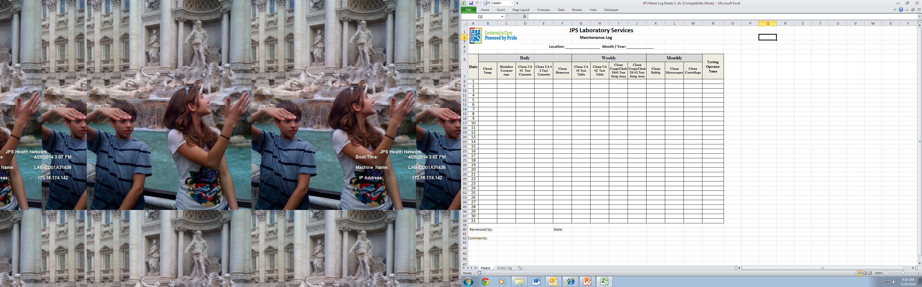
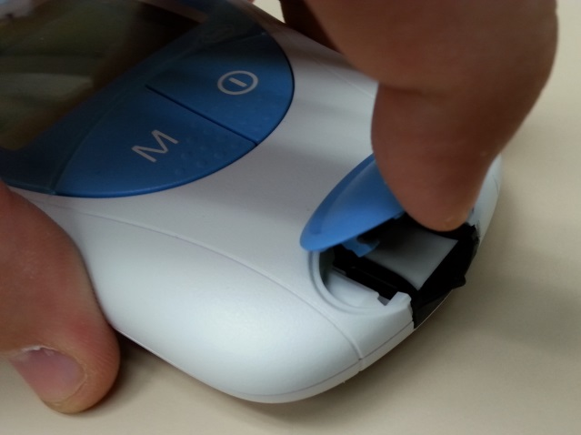
Maintenance
Weekly maintenance
  Remove the blue cap where test strips are inserted and clean the white pad test strips sit on with an alcohol wipe at least once each week that the meter is in use (powered off)
  Record this action on the JPS Laboratory Maintenance Log

Slide 18
Limitations of the CoaguChek XS
Measurement range is INR’s from 0.8-8.0
This meter should not be used for patients being treated with any Direct Thrombin Inhibitors, including Hirudin, Lepirudin, Bivalirudin and Argatroban.
No plasma or serum sample types should be used for testing.
Never add additional blood to the test strip once testing has begun.
If additional testing is required, a new strip and sample should be collected (from a different finger if performing a finger stick)

Slide 19
Limitations of the CoaguChek XS
Patients on IV infusion therapy should not have samples collected from the arm receiving the infusion line.
Patients with known or suspected APA’s (anti-phospholipid antibodies) such as Lupus Antibodies should not have INR checked using this meter. Main Core Lab testing should be utilized.
“Error 7” may display in rare instances when INR measurement is >8.0
“Error 6” may display in rare instances with patients under treatment with warfarin (vitamin K antagonists) in combination with antibiotics and/or chemotherapeutics leading to extremely prolonged clotting times >10 INR
No glass tubes or syringes should be used for sample collection

Slide 20
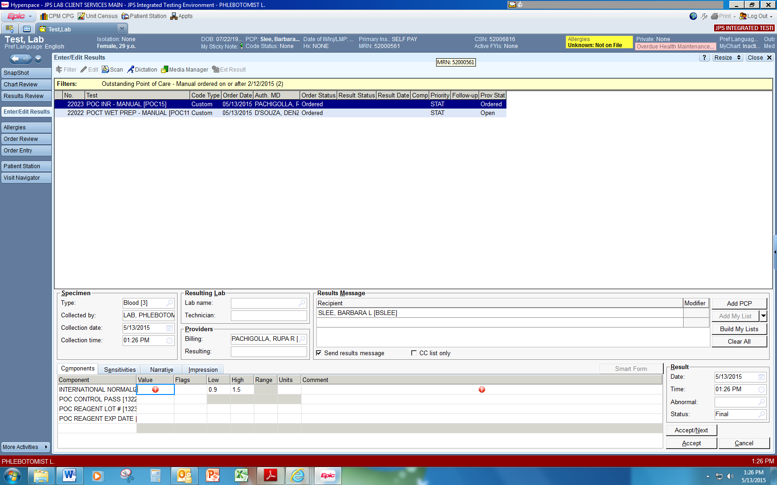
Result Reporting in Epic

Slide 21
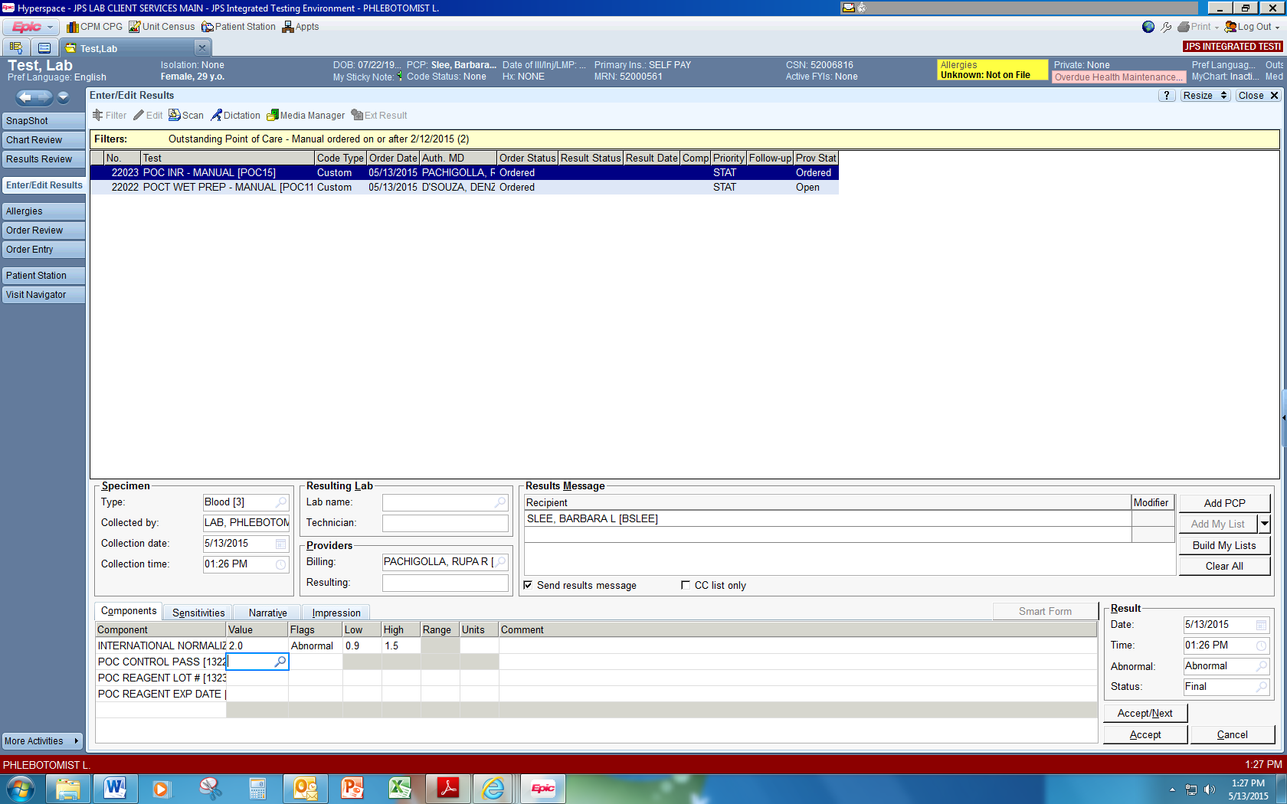

Slide 22
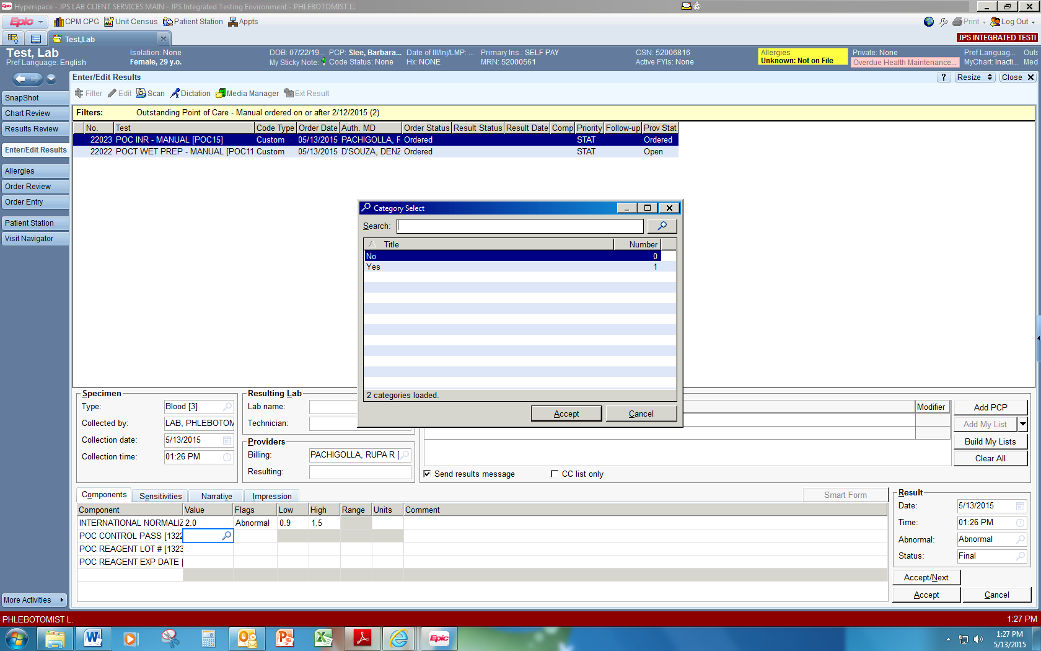
Select “Yes” for control pass

Slide 23


Slide 24


