Slide 1
i-STAT System Training
Point of Care Testing….
Nursing Laboratory
…is teamwork!

Slide 2
3-6 MONTH RE-CERTIFICATION
The 3-6 month re-certification is only required after the initial hiring period
Run QC and unknown sample using your ID and complete POCT i-STAT CBL
Skills check off and CBL or MTS Training module must both be completed to have your access renewed
ANNUAL RE-CERTIFICATION

Slide 3
Re-certification Check-offs
The 3-6 month and/or Annual recertification check-offs may be completed by:
Designated Technical Trainer
Laboratory Personnel

Slide 4
Warning! Warning!
Machine gives 30-day warning of pending expiration
Complete POCT i-STAT CBL
Schedule Re-Certification check-off

Slide 5
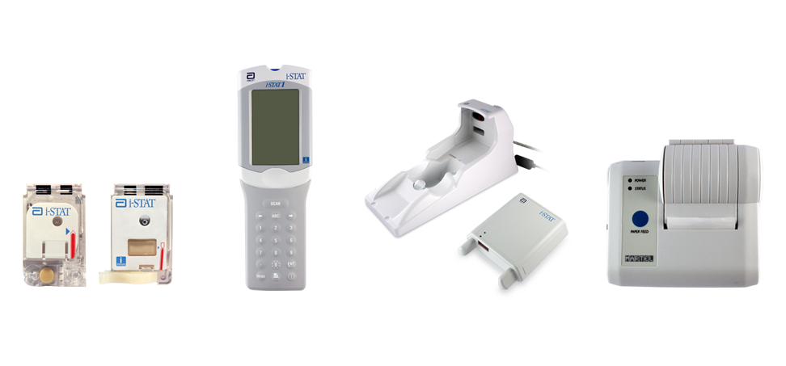
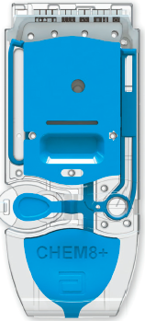
Components of the i-STAT System
Primary System Components
Cartridges
Handheld
Downloaders
Printer

Slide 6
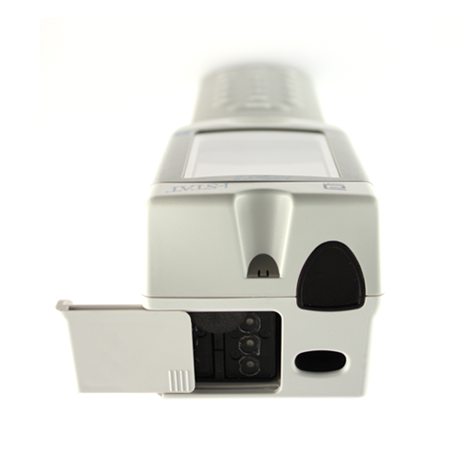
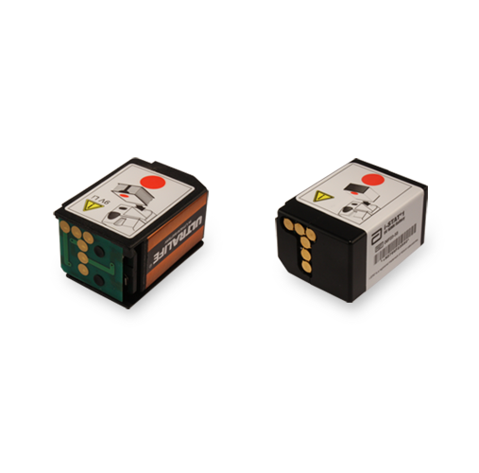
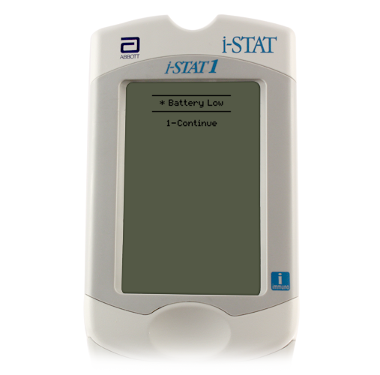
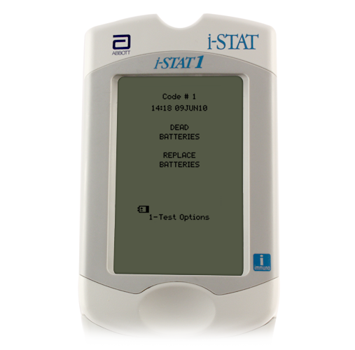
Batteries: 9 Volt
Battery compartment
9-volt lithium disposable batteries
Abbott rechargeable battery pack
Change the batteries when:
“Battery Low ” message is displayed
9-volt lithium disposable batteries
Abbott rechargeable battery pack
Battery
compartment

Slide 7
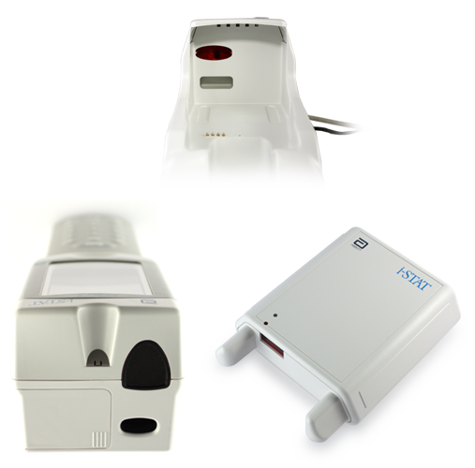
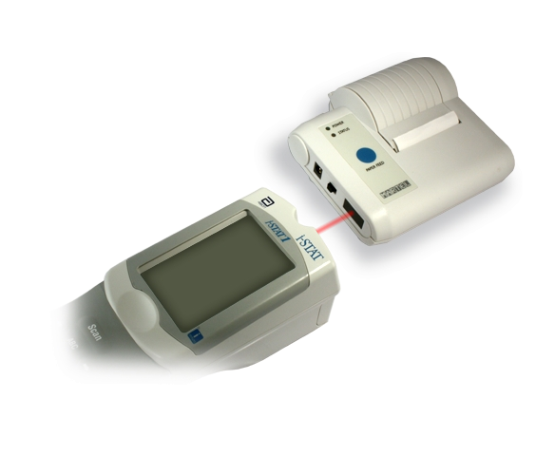
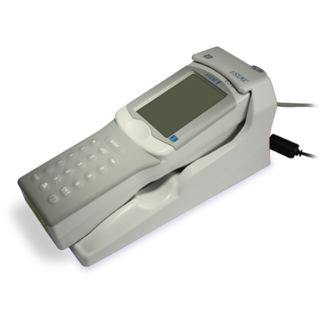
The Infrared Communication Window
Infrared communication window
Designed for communication
Downloaders
Printers
Accomplished by aligning infrared communication windows
Infrared communication window

Slide 8
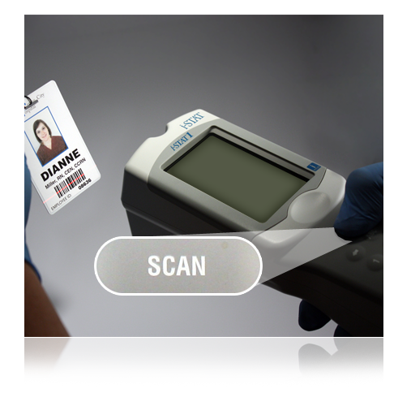
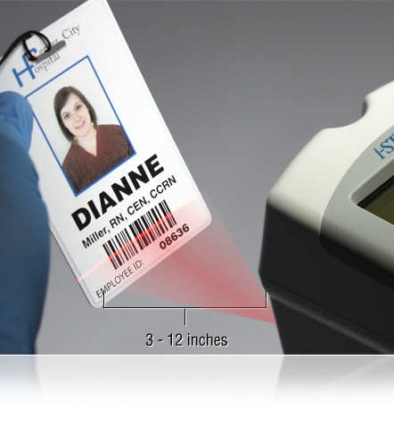
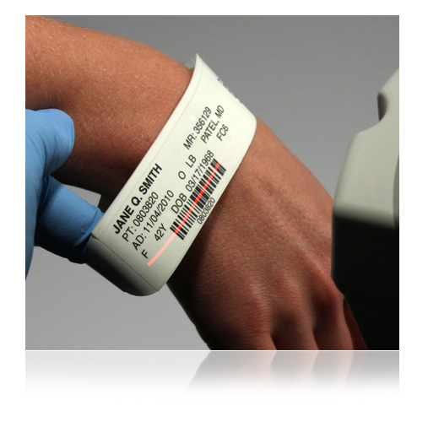
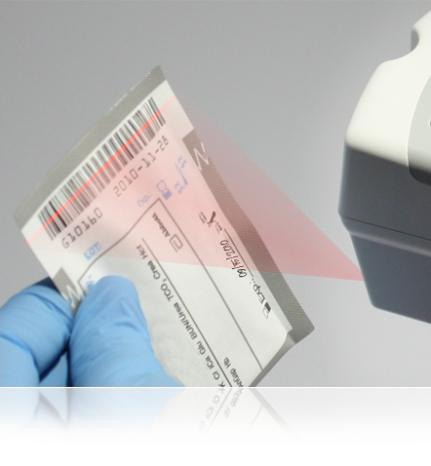
The Barcode Scanner
Used to scan
Operator IDs
Patient IDs
Cartridge lot number barcode
To scan
Hold the handheld 3 to 12 inches away from the barcode
Press and hold down the SCAN key
Laser beam must cover the entire length of the barcode
Wait for the beep or for laser beam to disappear
Release the SCAN key
Repeat if prompted
The barcode scanner is a class II laser device. Momentary exposure is not known to be harmful—however you should never point the scanner at anyone or look into the laser beam.
Barcode scanner

Slide 9
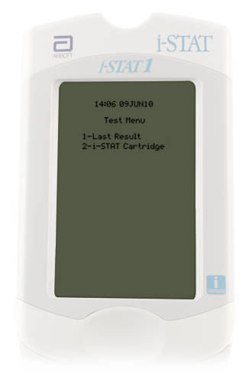
Handheld Test Menu
Test Menu
First menu to appear
Important Note:
This menu is used for patient tests only!
Cartridge Test Menu options
1 = Last Result
2 = i-STAT Cartridge

Slide 10
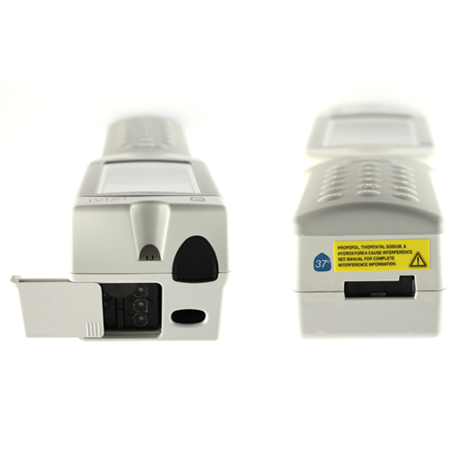
Cleaning the Handheld
Clean the handheld with
PDI® Super Sani-Cloth®
10% bleach solution
Allow to air dry
Handheld MUST be cleaned after use with each patient
Important note:
Do NOT let liquid enter the cartridge port or battery compartment.

Slide 11
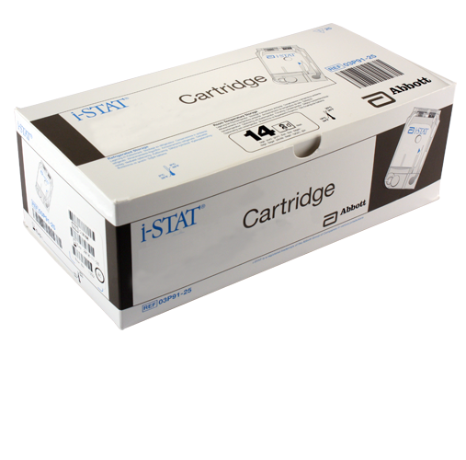
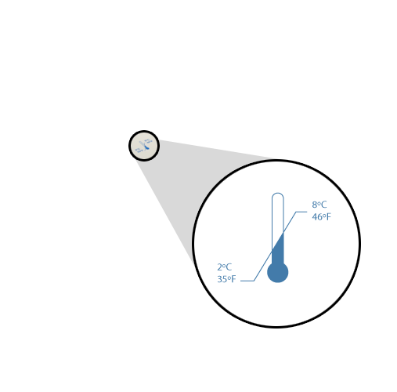
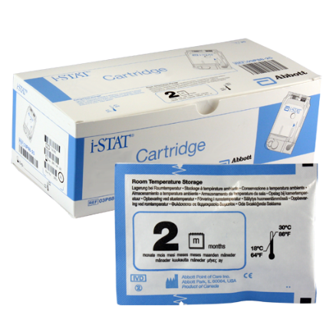
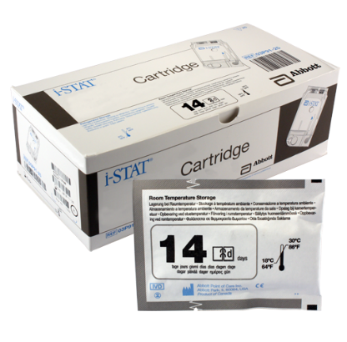
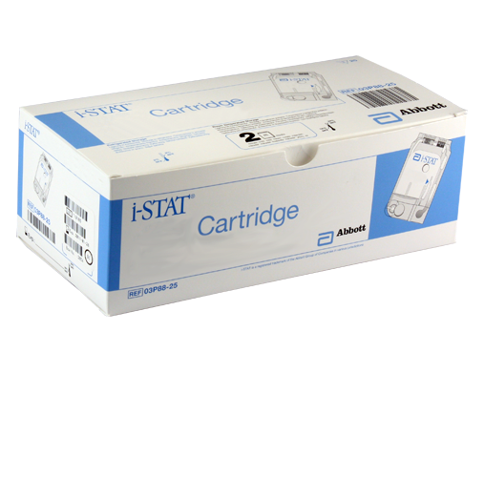
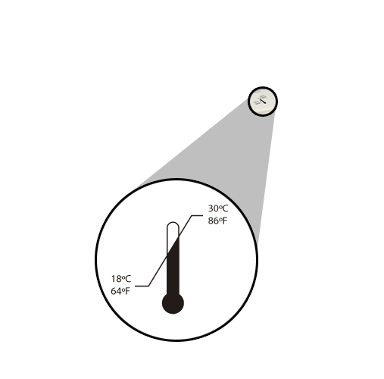
i-STAT Cartridge Overview
i-STAT Cartridges
Analysis, sample manipulation, and waste are confined within the cartridge
Refrigerated storage
May be used until the expiration date
Refrigerated storage range is 2°C - 8°C
Room temperature storage
14d = 14 days
2m = 2 months
Room temperature storage range is 18°C - 30°C

Slide 12
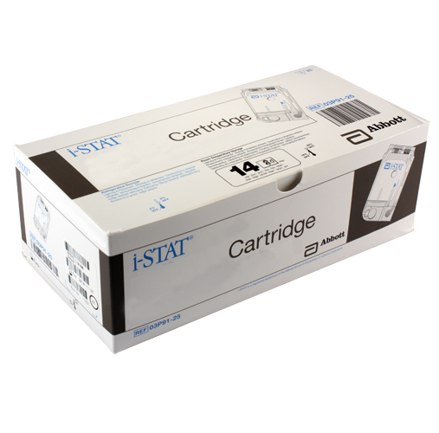
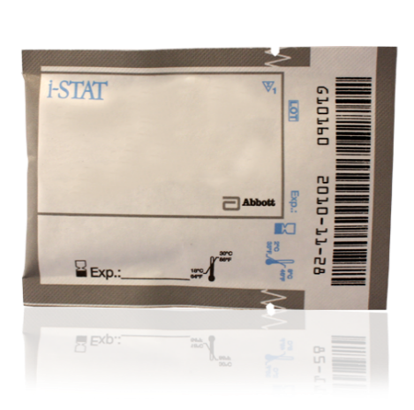
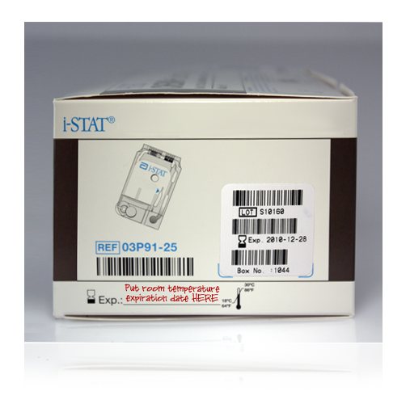
i-STAT Cartridge Overview (cont.)
Cartridges MUST be brought to room temperature before use
5 minutes for a single cartridge
1 hour for a box of cartridges
After removing cartridge(s) from refrigeration
They CANNOT be put back into the refrigerator
The room temperature expiration date must be written on the box or individual cartridge pouch
If the box is marked, cartridges must remain in the box until used
Do NOT manipulate the cartridge in any way to bring it to room temperature more quickly.
Put room temperature expiration date here

Slide 13
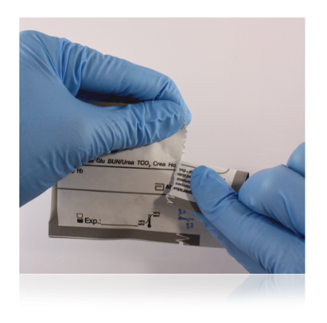
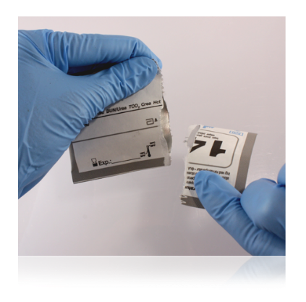
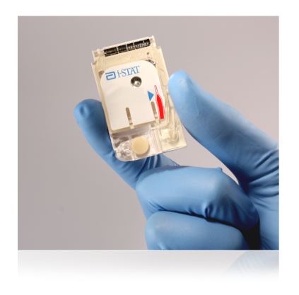
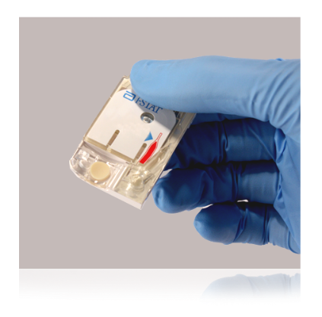
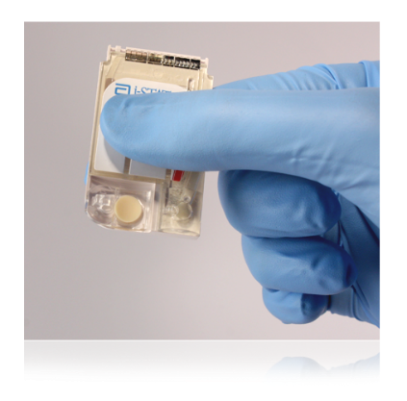
i-STAT Cartridge Overview (cont.)
Handling cartridges
Carefully tear open the cartridge pouch where indicated
Hold the cartridge by the sides or the bottom
Do not touch the sensors or apply pressure to the center of the cartridge
Prior to testing
The handheld will perform quality checks
Failure of a quality check will result in a Quality Check Code

Slide 14
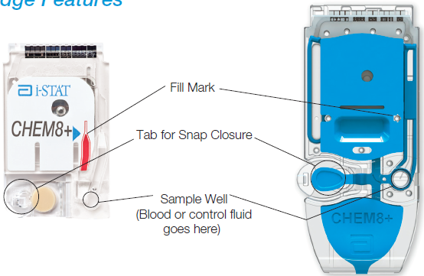
i-STAT Cartridge Components

Slide 15
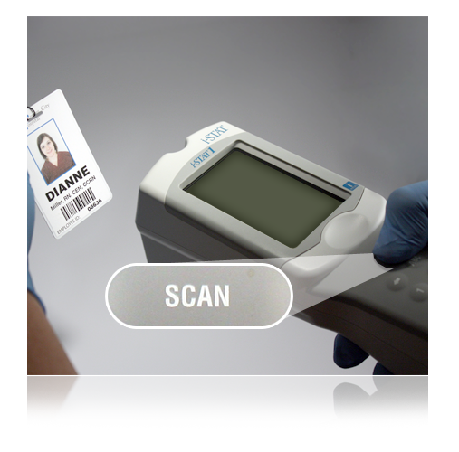
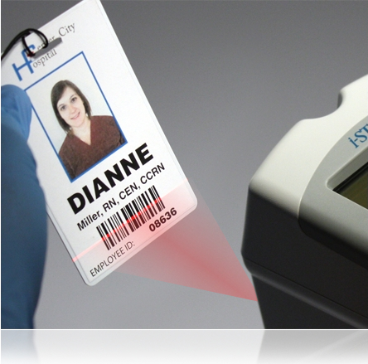
Preparing the Handheld for Testing
Turn on the handheld
Press the Power key
Test Menu will be displayed
Patient Test option
Option 2- i-STAT Cartridge
Press 2 on the keypad
Scan Operator ID (Employee number)
Hold the handheld 3 to 12 inches away from the barcode
Press and hold down the SCAN key
Laser beam must cover the entire length of the barcode
Wait for the beep or for laser beam to disappear
Release the SCAN key
Manual entry of Employee number is acceptable
3 – 12 inches
3 – 12 inches

Slide 16
Operator ID
Hospital Employee: 5 or 6 digit network employee#
Found on the back of your badge
Number should not be shared
You are responsible for any testing done with your ID

Slide 17
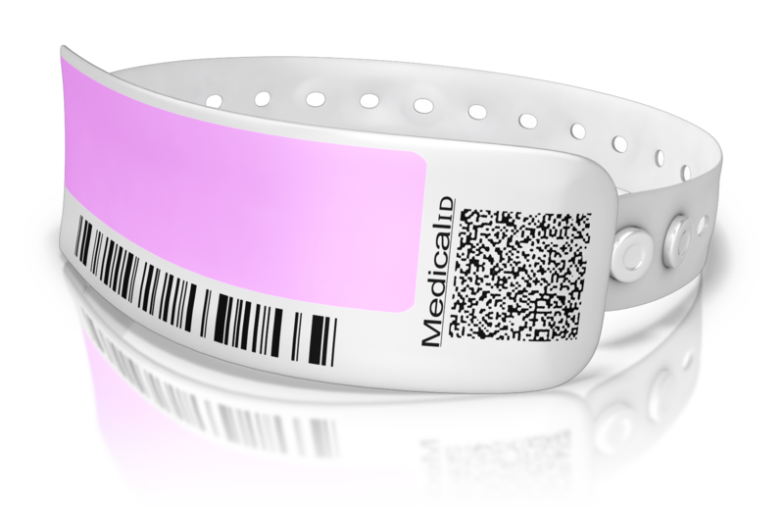
Patient Identification
Verify 2 patient identifiers at bedside only
Patient name and birth date (Use Patient armband only)

Slide 18
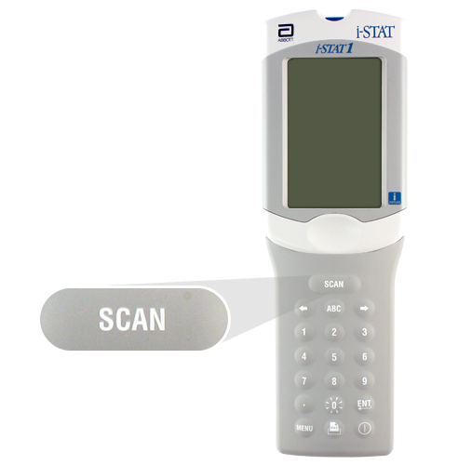
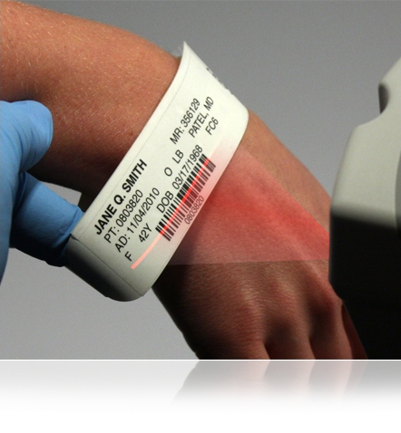
Entering Patient ID via Barcode Scan
Scan Patient ID
Hold the handheld 3 to 12 inches away from the barcode
Press and hold down the SCAN key
Laser beam must cover the entire length of the barcode
Wait for the beep or for laser beam to disappear
Release the SCAN key
Repeat if prompted
Manual Entry of Patient ID
Using the keyboard, type in the Patient’s current CSN number (8-digits)
3 – 12 inches

Slide 19
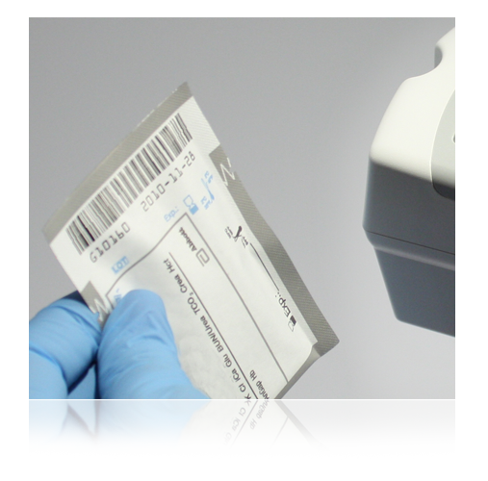
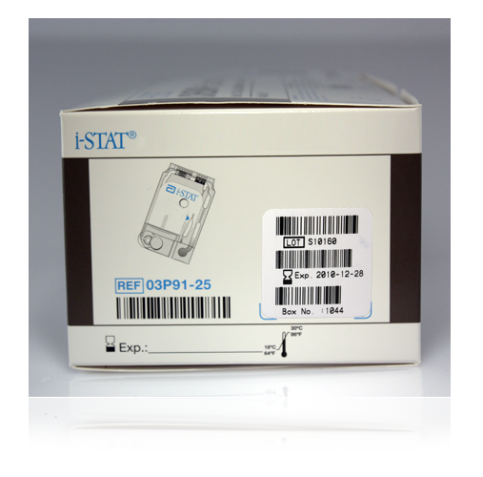
Scanning Cartridge Lot Number
Scan cartridge lot number
Hold the handheld 3 to 12 inches away from the barcode
Press and hold down the SCAN key
Laser beam must cover the entire length of the barcode
Wait for the beep or for laser beam to disappear
Release the SCAN key
3 – 12 inches
Very Important Reminder:
The correct barcode to scan is the barcode on the cartridge pouch, not the one on the cartridge box!

Slide 20
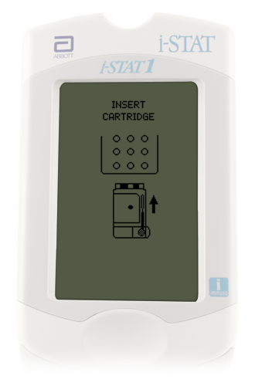
The Insert Cartridge Screen
From the Insert Cartridge prompt, you have 15 minutes to:
Open cartridge pouch
Obtain sample
Apply sample to cartridge and insert into instrument
Note: After 15 minutes the handheld will turn off and require re-entry of information to perform a test.
Important note:
Always mix properly and test promptly!

Slide 21
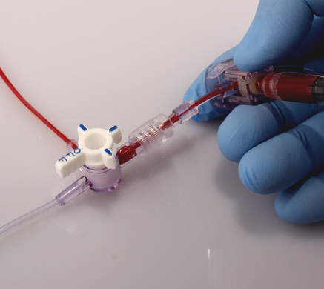
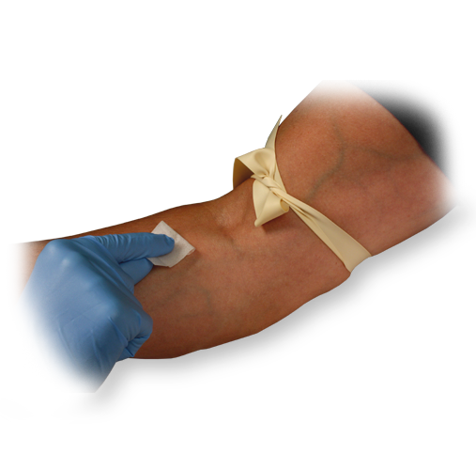
Sample Collection Techniques
i-STAT System may be used with:
Arterial samples
Venous samples
Capillary samples
Ensure a quality sample is obtained
IV line
Avoid drawing from an arm with an IV line
IV solutions dilute sample
Indwelling line
Draw sufficient waste
Tourniquet
If applied for more than 1 minute, release and reapply after 2 to 3 minutes to avoid hemolysis

Slide 22
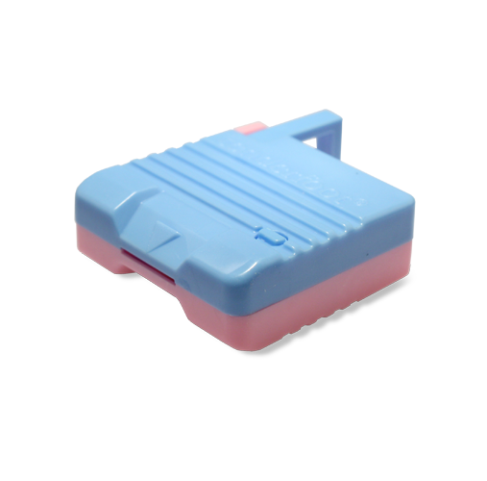
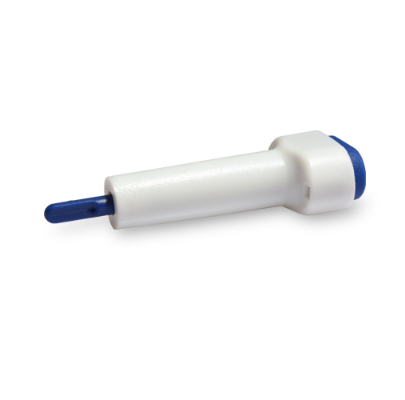
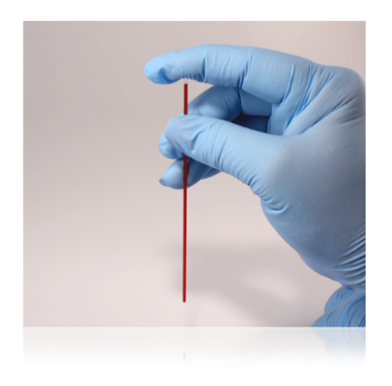
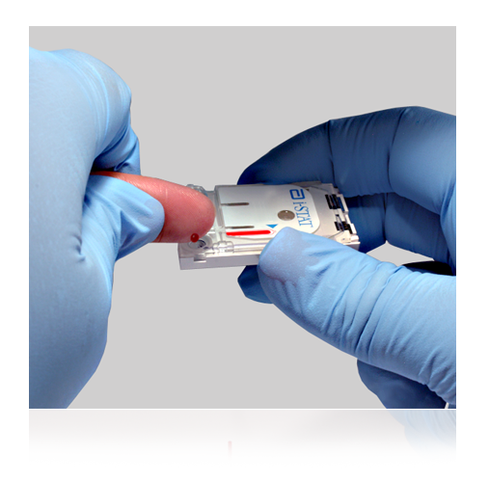
Additional Sample Collection Techniques
If using a capillary tube
Use a skin puncture device that provides free-flowing blood
Use a capillary tube to collect sample and apply sample to cartridge
When performing a finger stick
Use a skin puncture device that provides free-flowing blood
Gently squeeze the finger to produce a hanging drop of blood (avoid “milking” the finger)

Slide 23
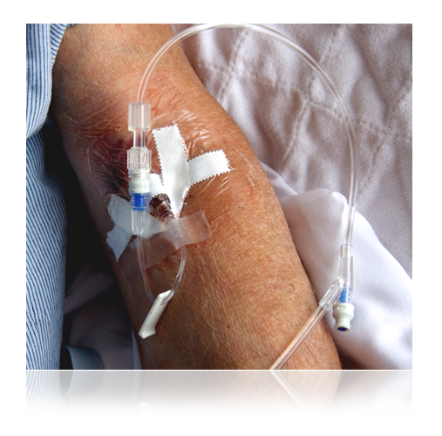
Factors That May Affect Results
Avoid affecting sodium results:
Draw adequate waste prior to drawing blood
Avoid drawing blood from an arm with an IV line
Avoid affecting potassium results:
Prevent hemolysis resulting from traumatic draws / vigorous sample handling
Don’t ice samples
Test promptly
Avoid extra muscular activity during blood draw

Slide 24
Factors That May Affect Results cont…
Avoid affecting glucose results:
Test promptly
Use another testing method if the patient has been administered hydroxyurea (Droxia®, Hydrea®)
Avoid affecting creatinine results:
Use another testing method if the patient has been administered hydroxyurea (Droxia®, Hydrea®)
Avoid affecting lactate results:
Test immediately
Do not use a tourniquet
Use another testing method if the patient has been administered hydroxyurea (Droxia®, Hydrea®)

Slide 25
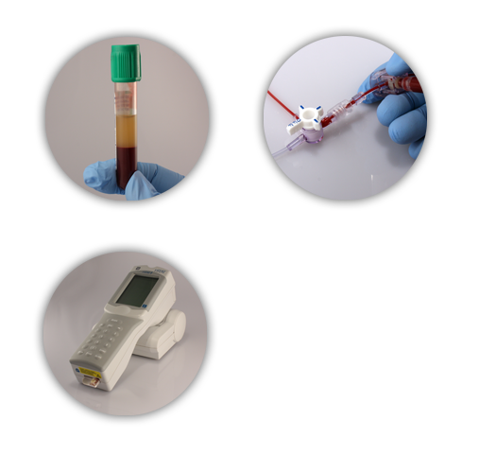
Factors That May Affect Results cont…
Avoid affecting hematocrit results:
Mix thoroughly
Draw adequate waste prior to drawing blood
Keep handheld level during testing

Slide 26
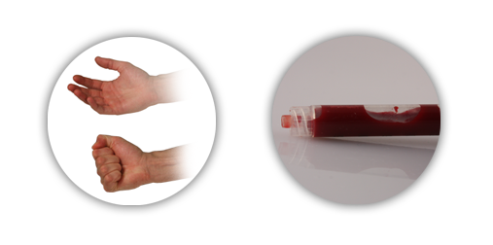
Factors That May Affect Results cont…
Avoid affecting ionized calcium results:
Fill blood collection devices completely
Limit extra muscular activity during sample collection
Avoid affecting pH results:
Avoid extra muscular activity during sample collection
Do not expose to air

Slide 27
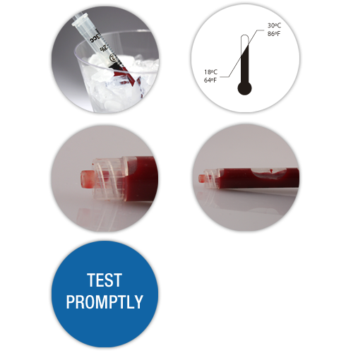
Factors That May Affect PCO₂, PO₂ & TCO₂ Results When Using Blood Gas Cartridges
Avoid affecting PCO₂ results:
Test promptly
Fill blood collection devices completely
Do not expose to air
Avoid affecting PO₂ results:
Do not ice the sample
Ensure the cartridge is at room temperature
Do not expose to air
Test promptly
Avoid affecting TCO₂ results:
Don’t expose to air
Fill blood collection device completely
Test promptly

Slide 28
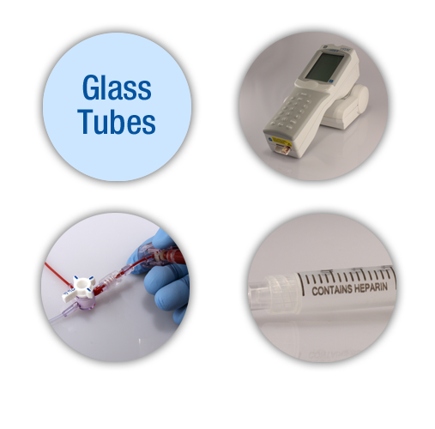
Factors That May Affect ACT Results
Avoid affecting ACT results:
Don’t use glass tubes
Level testing surface
Flush lines sufficiently
Ensure blood collection device does not contain anticoagulants

Slide 29
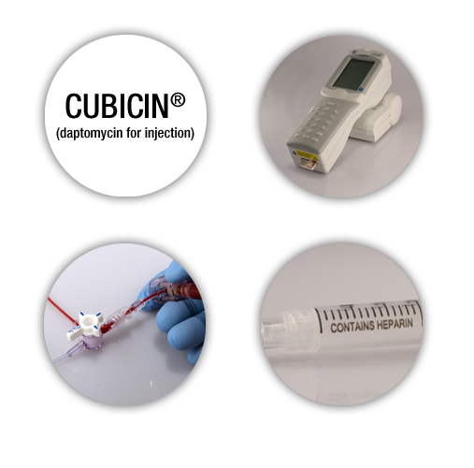
Factors That May Affect Prothrombin Time Results
Avoid affecting prothrombin time results:
Use another method if the patient is receiving CUBICIN® (daptomycin for injection)
Place the handheld on a level, nonvibrating surface
Flush lines sufficiently
Ensure blood collection device does not contain anticoagulants

Slide 30
Running a Patient Test
Avoid Quality Check Codes!
Mix the sample thoroughly and gently
Discard first few drops
Fill to the fill mark
Close the closure to seal
Fill mark
closure is closed

Slide 31
Chemistry Cartridges
Chemistry Cartridges
Whole blood sample
a. green-top tube (waived)
b. non-heparinized syringe (non-waived)
Time to test:
For green-top samples, test within 10 minutes
For non-heparinized Syringe samples, test Immediately (within 1 minute)

Slide 32
Arterial Blood Gas (ABG) Cartridges
ABG Cartridges
Whole blood sample
Use a syringe
Time to test
For heparinized samples, test within 10 minutes
For non-heparinized Syringe samples, test immediately (within 1 minute)

Slide 33
CG4+ Cartridges
CG4+ Cartridges
Whole blood sample
Use syringe
Time to test
Test immediately!

Slide 34
ACT Cartridges
ACT Cartridges
Whole blood sample
Use a plain, plastic syringe
Time to test
Test Immediately!

Slide 35
PT/INR Cartridge
PT Cartridges
Capillary sample
Fingerstick
Time to test
Test Immediately!
Filling a PT/INR Cartridge
Gently squeeze finger to obtain hanging drop of blood
Avoid milking the finger as this factor may impact results
Bring the cartridge sample well up to the bottom of drop of blood until they touch
Sample will be drawn into cartridge

Slide 36
Using an Evacuated Tube to Fill a Cartridge
Using an evacuated tube
Gently invert the tube end-to-end a minimum of 10 times
Draw sample into a syringe or pipette
When using a syringe, vigorously roll the syringe between the palms for at least 5 seconds, invert, and repeat
Apply sample to cartridge

Slide 37
Using a Syringe to Fill a Cartridge
Using a syringe
Vigorously roll the syringe between the palms for at least 5 seconds, invert, and repeat
Discard first few drops

Slide 38
Using a Syringe to Fill a Cartridge (cont.)
Place hub of syringe on top of sample well
Apply gentle downward pressure
Fill to fill mark
Close the cartridge:
Close the closure to seal
Fill mark
If the cartridge is not sealed, the handheld will return an Unable to Position Sample Quality Check Code.

Slide 39
Using a Capillary Tube to Fill a Cartridge
Using a capillary tube
Test Immediately!
Direct one end of capillary tube into sample well
Fill to fill mark
Close the cartridge:
Close the closure
Fill mark
If the cartridge is not sealed, the handheld will return an Unable to Position Sample Quality Check Code.
closure is closed

Slide 40
Using the Test Select Function
Test Select option
Used to view and report selected results
Refer to list of analytes displayed
Press corresponding numbers on keypad
Press again to deselect
Press right arrow key upon completion of test selection to move to the next page

Slide 41
Chart Page: Entering Sample Type
To enter sample type
Refer to the menu at the bottom of the screen
Enter the code for the sample type
If additional info needs to be entered, Press the ENT key
When all required info is entered, Press right arrow key upon completion to move to the next page

Slide 42
Chart Page: Entering CPB
CPB
Intended for use when samples are collected during cardiopulmonary bypass procedures
Adjusts hematocrit and hemoglobin results
To use CPB option
Refer to the menu at the bottom of the screen
Enter the code for the appropriate option
Press the ENT key

Slide 43
Immediately after Inserting the Cartridge
Running a patient test:
Place handheld on a level, non-vibrating surface or in the Downloader
The message “Cartridge Locked” will display
Do not attempt to remove the cartridge when the “Cartridge Locked” message is displayed
When the test is complete:
Results are displayed
“Cartridge Locked” message disappears
It is safe to remove the cartridge

Slide 44
The Results Screen
Results screen
Patient ID
Time and date of test
Type of cartridge
Test results
May display on 2 pages
Use right Arrow key to navigate

Slide 45
Critical Value Alerts
Critical value alert
Indicated by up or down arrows
Comment codes must be entered to document appropriate action taken

Slide 46
Comment Codes
Comment Codes
Numeric codes that represent responses to patient test
Examples:
1 = repeat test
9 = send blood to lab
11 = Nurse/Physician notified
Comments field appears at the top of the first page of the results screen
To enter a comment code:
Enter the code for the appropriate answer
Press ENT key

Slide 47
Out of Reportable Range Flags
Out of Reportable Range flag
Indicated with a < or > flag
Test results with these flags must have fresh samples collected and sent to the lab for analysis
Suppressed Result Flag
Indicated with a “<>” flag (if present, results will not cross into patient’s chart)
Result was dependent on the result that was flagged as < or >

Slide 48
Interpreting Test Results: Star Outs (***)
Star outs
*** appears in place of the test result (if present, results will not cross into patient’s chart)
Indicates that a sensor on the cartridge is compromised and unable to report a result
A fresh sample should be collected and all tests performed on the cartridge repeated

Slide 49
Transmitting Results
To transmit results:
Turn handheld off
Place handheld in the Downloader
Look for display screen to show arrows and the message “Communication in Progress”
When transmission is complete:
Screen goes blank
Handheld turns off
To prepare to print
The desired result is displayed on the handheld’s screen
The handheld is properly placed in the Downloader
The printer is turned on and displaying a green status light
To print:
Press the printer icon key on the handheld
Do not move the handheld until the results have printed
PRT Key

Slide 50
Internal Electronic Simulator
Internal Electronic Simulator
Performs internal checks to ensure proper and accurate functioning
Provides independent check on the handheld’s ability to take accurate and sensitive readings
Performs test at specified intervals – Every 8 hours
Performed automatically when needed before the sample is tested
Adds 20 seconds to testing cycle

Slide 51
External Electronic Simulator
External Electronic Simulator is performed:
When i-STAT software is updated (CLEW)
If the handheld is dropped or damaged
There is an Internal Electronic Simulator failure
Test takes approximately 60 seconds
Simulator test results
Testing time is approximately 60 seconds
Will receive a Pass or Electronic Simulator Fail message
If test fails, repeat the test
If test fails twice, contact the POCT department
External Electronic Simulator

Slide 52
Performing a Quality Control Test Using Liquid Controls
Prepare the handheld
Turn on the handheld
Press the MENU key
Press 3 to select Quality Tests
Press 1 to select Control
Scan or manually enter Operator ID
Press 1 to select APOC
Press 1-3 to select control level
Scan Control Lot Number
Scan Cartridge Lot Number

Slide 53
Quality Control Using Liquid Controls for Chemistry Cartridges
Quality Control Using Liquid Controls
Provided in 3 levels
Used to monitor cartridge performance at different points within the clinical range
Can be used until expiration date when stored at 2°C to 8°C
Must be left at room temperature for 30 minutes prior to use
Controls must be left at room temperature for a minimum of 4 hours prior to use when testing on the Blood Gas Cartridges
Once removed from refrigerator, unopened control solutions must be used within 5 days

Slide 54
Quality Control Using Liquid Controls for Coagulation Cartridges
Storage Conditions
Can be used until expiration date when stored at 2°C to 8°C
Must be left at room temperature for 45 minutes prior to use
Once at room temperature must be used within 4 hours

Slide 55
Performing a Quality Control Test Using Liquid Controls for Coagulation Cartridges (cont.)
Fill the cartridge
Remove cartridge from the pouch
Remove cap and stopper from vials
Pour entire contents of diluent into lyophilized plasma vial
Replace stopper
Allow vial to sit 1 minute
Gently swirl vial for 1 minute, then gently invert for 30 seconds
Use plastic pipette or plain plastic syringe to immediately transfer solution from vial into cartridge
Immediately close cartridge and insert into handheld

Slide 56
i-STAT System Troubleshooting Overview
i-STAT Quality System
Performs numerous quality checks during patient test cycle
Failed quality check
Cause message
Action message
Quality Check Code

Slide 57
Cartridge Error/Use Another Cartridge
What it indicates
Handheld could not complete test
Various causes:
Clots
Air bubbles
Failure to seal the cartridge using the snap closure
Most often caused by issues in sample handling
To resolve, collect fresh sample and repeat test with new cartridge.
If problems persist, contact POCC / POCT department for assistance troubleshooting

Slide 58
You have completed the module!
Please Proceed to the Test

