Slide 1
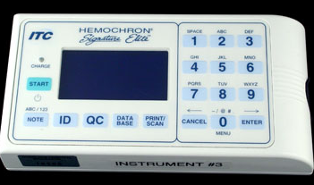
Hemochron Signature Elite

Slide 2
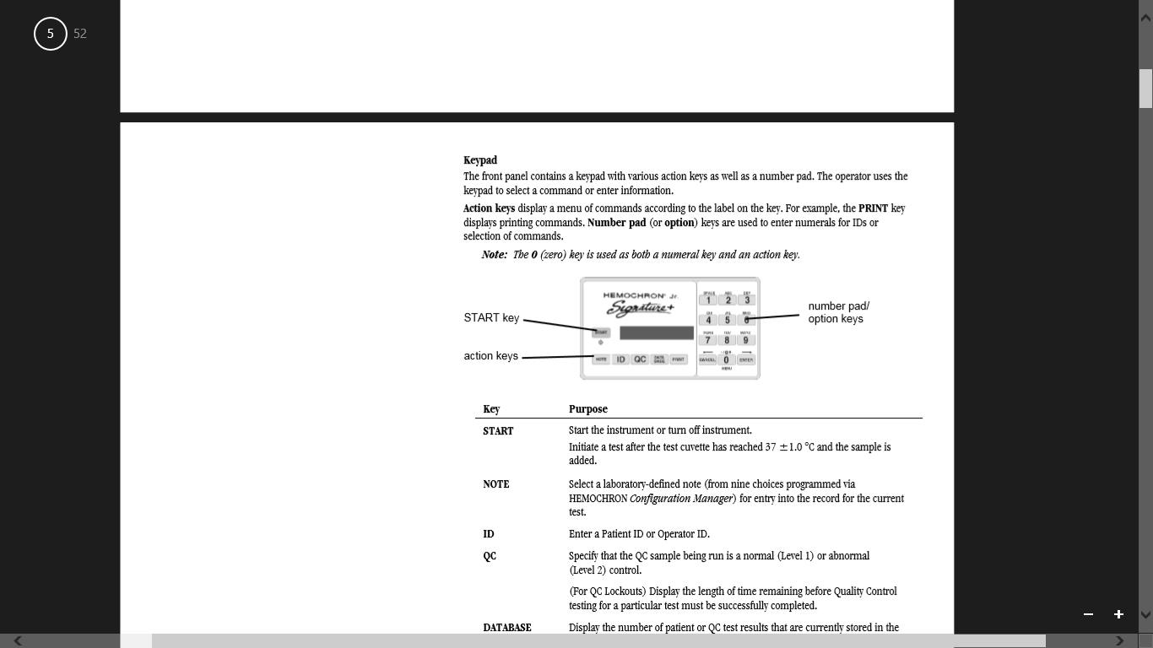

Slide 3
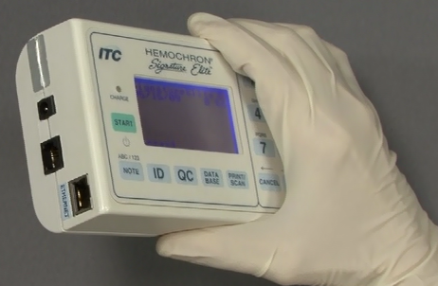
+2 hours battery operating times

Slide 4
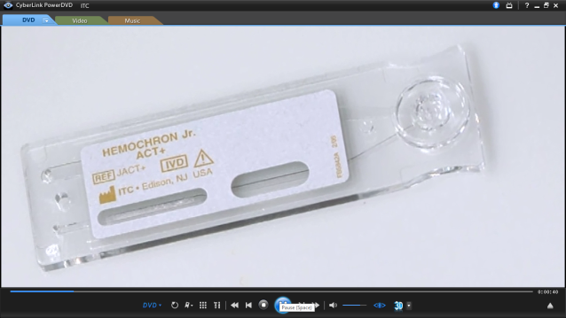
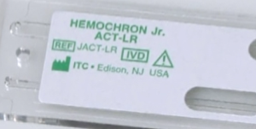
Cuvettes
ACT+ Cuvettes
It is intended for use in monitoring high heparin doses frequently associated with angioplasty and cardiopulmonary bypass surgery.
The ACT+ is not as sensitive to very low levels of heparin such as those encountered in critical care.
ACT LR Cuvettes
It is intended for use in monitoring low to moderate heparin doses
ECMO, Interventional Radiology Procedure, Cardiac Catheterization,

Slide 5
Sample type
Fresh whole blood sample collected prior to performing the test
Use plastic non-heparinized syringe without anticoagulants
Draw 0.5cc of fresh whole blood.
Blood samples must not be collected until the instrument display indicates “Add Sample” And “Press Start”.
If a syringe is used, 23 or larger gauge needle for blood collection.
      DO NOT use excessive force when expelling the sample

Slide 6
Inappropriate samples for use
Samples with any of the following characteristics should be discarded
      Sample contamination with tissue thromboplastin.
      Sample contamination with indwelling intravenous (I.V.) solutions.
      Sample contamination with alcohol cleansing solution.
      Samples with visible clotting or debris accumulation

Slide 7
Cleaning instructions
Clean instrument after use between patients
Use JPS Health Network approved cleaner
Do not use alcohol

Slide 8
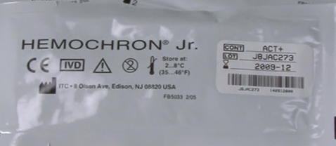
Reagents
Cuvette are stored refrigerated 2-8 C
Cuvettes are good for 12 weeks at room temperature.
For cuvettes stored at refrigerated temperature, allow to warm up for 60 minutes.
Each box contains 45 individually pouched cuvettes.
Cuvette pouches are stamped with a lot specific expiration date.
Once Cuvette is opened it should be used the same day to eliminate inaccurate test results.

Slide 9
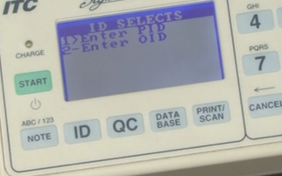
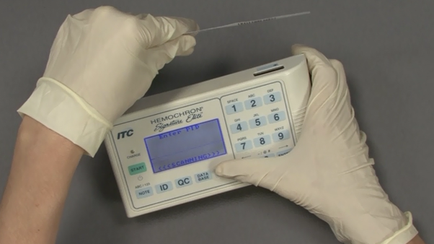
Testing Procedure
Turn analyzer on
Press Start
Analyzer will warm up to 37C
Ensure analyzer is ready
Insert Cuvette will display
Insert Cuvette
Instrument will count down to 5 minutes
Scan or enter Operator ID
Scan or enter patient ID
Press Print Scan bottom to scan patient id

Slide 10
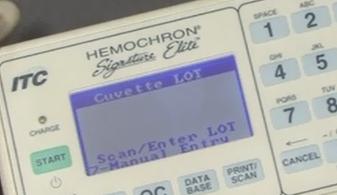
Patient Testing
Follow Universal protocols
Insure instrument is ready
Insert cuvettes
Enter operator id and patient CSN#

Slide 11
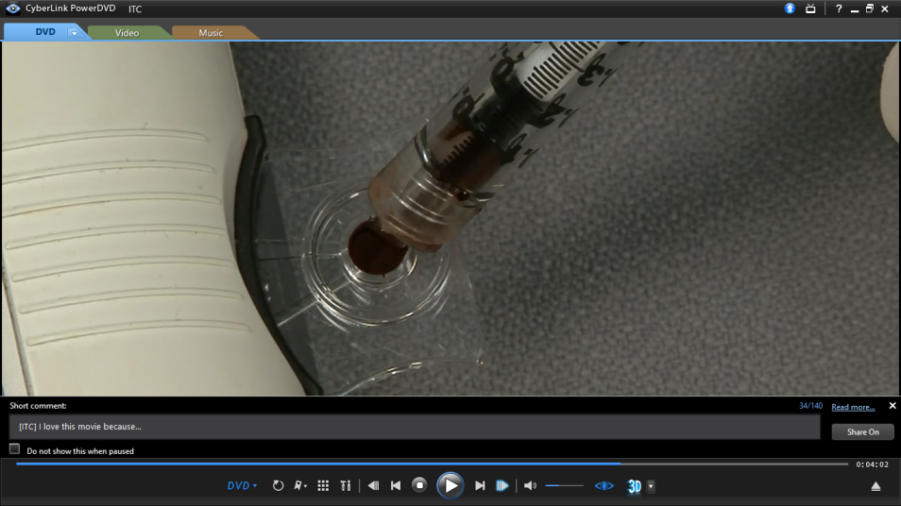
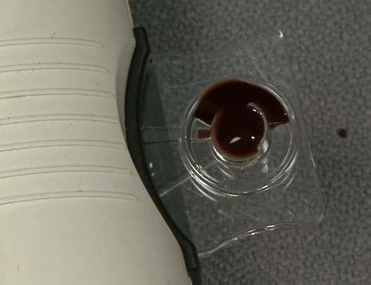
Once cuvette is warm and ready
5 minutes to collect and apply sample
the message “Add Sample Press START” will appear on screen.
Collect sample
Fill sample well from bottom up
Press start

Slide 12
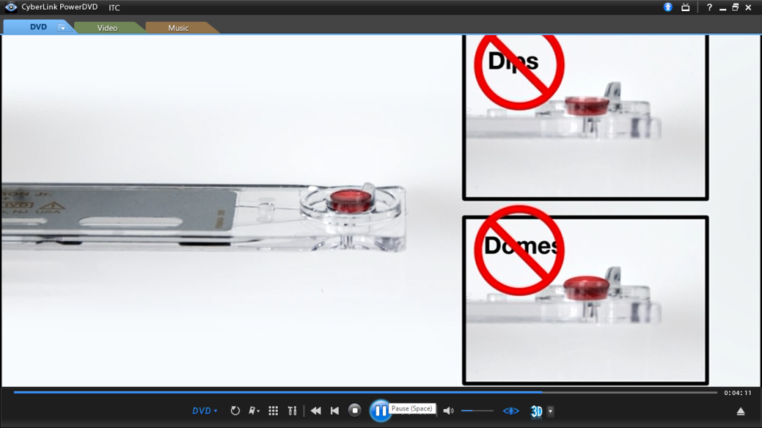
Sample application

Slide 13
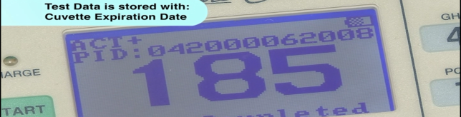
REPORTING RESULTS
Document patient results in log book
Results should be reported in seconds.
ACT-LR Results that exceed “400” should be reported as “greater than 400” (>400).
ACT+ Results that exceed “1005” should be reported as “greater than 1005” (>1005).

Slide 14
Normal Ranges
ACT-LR
Mean Range
Normal donors 131 113-149
Patients 129 89-169
ACT+
Normal donors 103 81-125
Patients 124 96-152

Slide 15
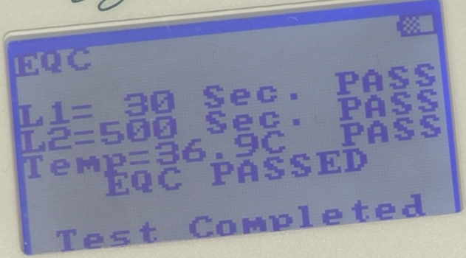
Electronic QC (EQC)
Temp check
Normal QC: 30 seconds
300-500 sec
Select QC to see time left for next QC
Must be done every 8 hours of use.
  If left plugged in and turned on, EQC will perform itself when this 8 hour time frame is up.

Slide 16
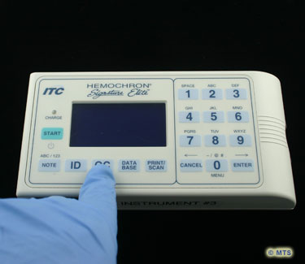
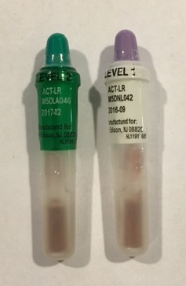
Liquid Quality Controls

Slide 17
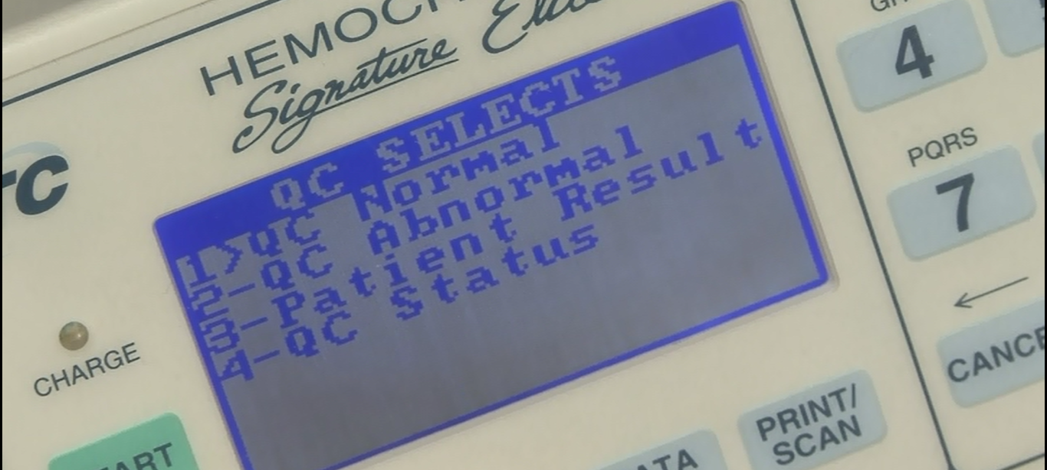
Insert cuvette
Select QC option

Slide 18
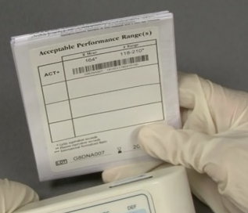
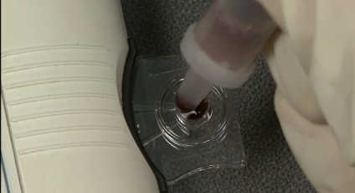
QC Testing
Select QC level
Insert Cuvette
Scan or enter your operator ID
Scan or enter cuvette lot#
Wait till instrument display add sample before
Use protective sleeve to break vial 3 times in 3 places
shake vial vigorously for 7 seconds while watching countdown time on screen.
Waste 1-2 drops in the lid.
Apply sample
Press start
Check ranges

Slide 19
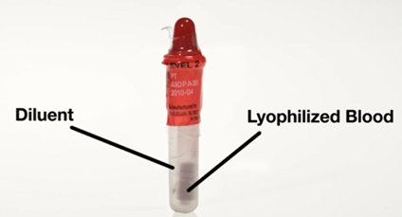
Quality Controls
Liquid QC can be stored refrigerated or room temperature
Expire within 4 weeks if stored at room
temp
QC material and vials must be at room temperature before use
Proper way to prepare and test DirectChek QC material

Slide 20
Quality Control
If results are outside of the acceptable range, check the following and repeat the test:
Control material and cuvette expiration dates
Instrument temperature
Proper technique
Cuvette sample volume
Presence of clots in the control material
If the repeat test still does not fall within the expected range, notify Lab and do not perform patient testing.

Slide 21
Interfering Substances
Test results are affected by poor technique during blood collection and delivery to the sample well.
The quality of the sample collection and the transfer of the blood to the test cuvette.
Tests may be affected by any of the following conditions:
Foaming of the sample (air bubbles)
Hemolysis
Clotted or partially clotted blood
Unsuspected anticoagulation with either heparin or warfarin
Presence of a lupus anticoagulant
The ACT assay is influenced to varying degrees by aprotinin depending on the ACT activator employed (Wang et al., 1992). The Celite® ACT is artificially prolonged while the kaolin ACT is not affected by antifibrinolytic therapy (e.g., aprotinin), except at very high (>500 KIU/cc) concentrations.
The HEMOCHRON Jr. Microcoagulation ACT-LR employs a Celite activator for its excellent heparin sensitivity. Celite based assays are not for use with patients receiving aprotinin

Slide 22
Interfering Substances
Samples with hematocrits less than 20% or greater than 55% , “Sample Not Seen” error message will be displayed.
Aspirin, tranexamic acid, DDAVP, anti-fibrinolytics, defibrinating agents (e.g. Ancrod), direct thrombin inhibitors (e.g. hirudin) and platelet preserving agents such as GPIIb/IIIa inhibitors (e.g., ReoPro®) on the ACT+ may be different than those on the reference ACT.
Any results exhibiting inconsistency with the patient’s clinical status should be repeated or supplemented with additional test data.

Slide 23
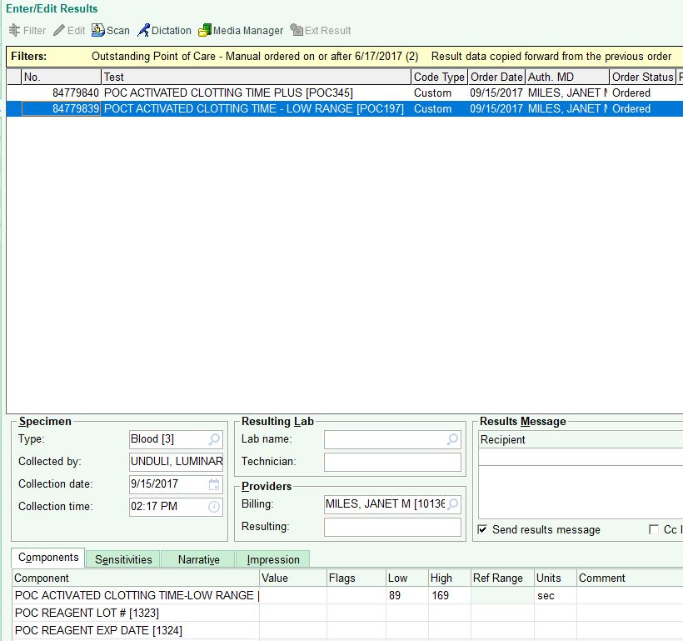
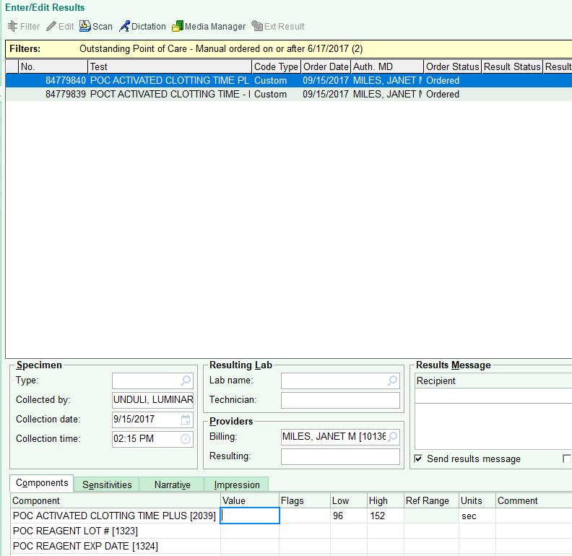
Reporting Results
  To report results:
      Open patient chart in EPIC.
      Select “Enter/Edit Results” tab.
      Select order for POC ACT.
      Enter result(s) from log.
      Repeat for each test performed.

