Slide 1

Emergency Formalin Spill Procedures in UWMC Pathology Labs

Slide 2
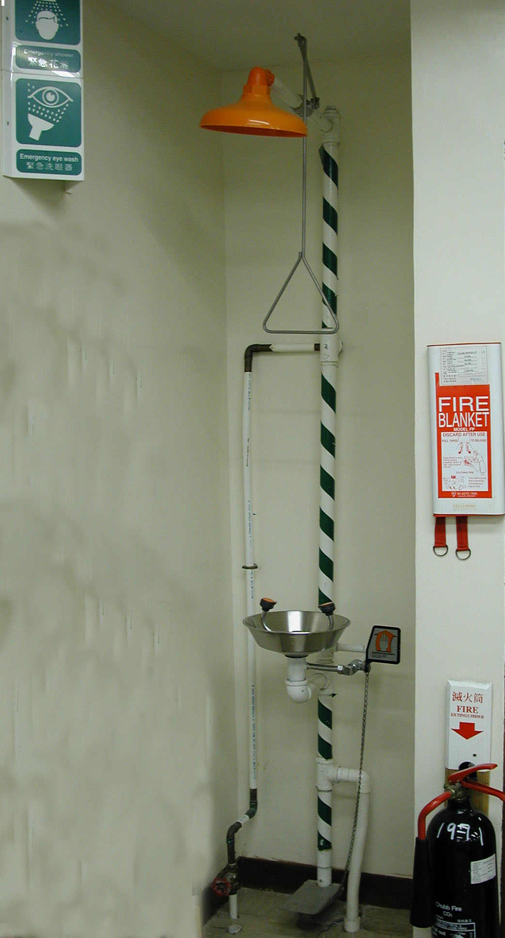
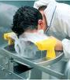
Contamination Emergencies
If you get formalin in your eyes or on your skin do the following…
- Skin/ eye contact
Eye Contact - Flush eyes immediately in an emergency eyewash for a minimum of 15 minutes
Skin Contact – Flush affected areas immediately in an emergency shower for a minimum of 15 minutes
Go to Employee Health Center (day hours) or Emergency Dept. (off hours) for medical evaluation/treatment
Know where the nearest eyewash/shower is in your area

Slide 3
EXPOSURE Emergencies
If you feel you have been exposed to high levels of vapors from formalin do the following…
- Skin/ eye contact
Leave the area
Notify supervisor
Go to Employee Health Center (day hours) or Emergency Dept. (off hours) for medical evaluation/treatment
Symptoms may include difficulty breathing, tightness in chest, burning eyes/nose/throat, skin rashes, nausea, allergic reactions

Slide 4

Emergencies – Spill Procedures
The following procedures address how you would respond to formalin spills that are small (250 ml or less) and those that are large (greater than 250 ml)
If there is a formalin spill and you feel you cannot SAFELY respond to it, call 222 from a campus phone (911 from offsite) and report a chemical spill
Do not expose yourself to excessive vapor levels!

Slide 5
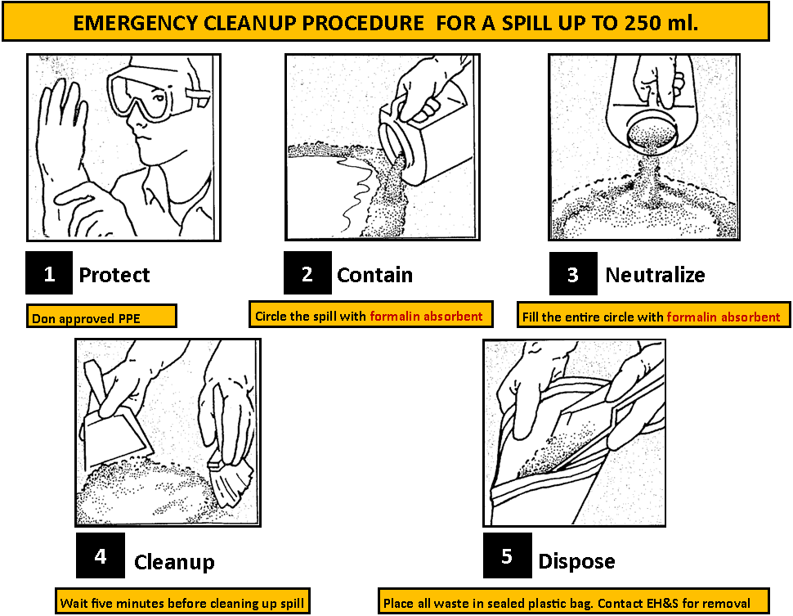

Slide 6
Emergencies – Spill Procedures
Small liquid formaldehyde/formalin spills
Spills of 250 ml (8 ounces or a fluid cup) or less spilled in an open or ventilated area can typically be cleaned up by people not sensitive to formaldehyde
Retrieve spill control supplies from the nearest spill kit
Wear nitrile gloves, goggles, lab coat or gown and foot covers if needed
Stop spread of spill with formalin neutralizing absorbent
Circle the spill with absorbent from perimeter inward
1
Protect
Don approved PPE
2
Contain
Circle the spill with
formalin absorbent

Slide 7
Emergencies – Spill Procedures
Cover the spill completely with absorbent
Notify coworkers in the immediate area.
Wait at least 5 minutes for the spill to be absorbed and neutralized
Clean up the absorbed material with scoop from spill kit
Wash the spill area with detergent and water
3
Neutralize
Fill the entire circle with formalin absorbent
4
Cleanup
Wait five minutes before cleaning up spill

Slide 8
Emergencies – Spill Procedures
Bag spill material, seal and label as formaldehyde/formalin -contaminated hazardous waste for waste pick up
Also bag used gloves, foot covers and other disposable PPE and supplies, seal and label as formaldehyde/formalin -contaminated hazardous waste
5
Dispose
Place all waste in sealed plastic bag. Contact EH&S for removal

Slide 9
Emergencies – Spill Procedures
Large liquid spills greater than 250 ml (8 oz. or 1 cup)
Wearing same PPE as with a small spill, cover spill if possible with formalin absorbent to keep vapors down and control spread of spill
Evacuate the area
Call 222 from campus phone (911 for offsite phones) in safe area to implement Code Orange
Cleaning large spills must be done by trained persons wearing appropriate PPE including respiratory protection.

Slide 10
Emergencies – Spill Procedures
After cleaning up any spill…
Thoroughly wash yourself -- hands, face and any potentially exposed areas
Wash reusable equipment (goggles, scoop, etc.) or dispose of as hazardous waste
Request Environmental Services to clean surfaces and floor where spill occurred
For waste pick up, complete and submit EH&S Chemical Collection Request form
Supervisor reports the incident by submitting a PSN report
Make sure supplies in the spill kit are replaced
Know where the nearest spill kit is in your area

