Slide 1
Advanced Potions 6th Year
Jayanna Slayten, MS, MT(ASCP)SBB^{CM}
Hufflepuff House

Slide 2
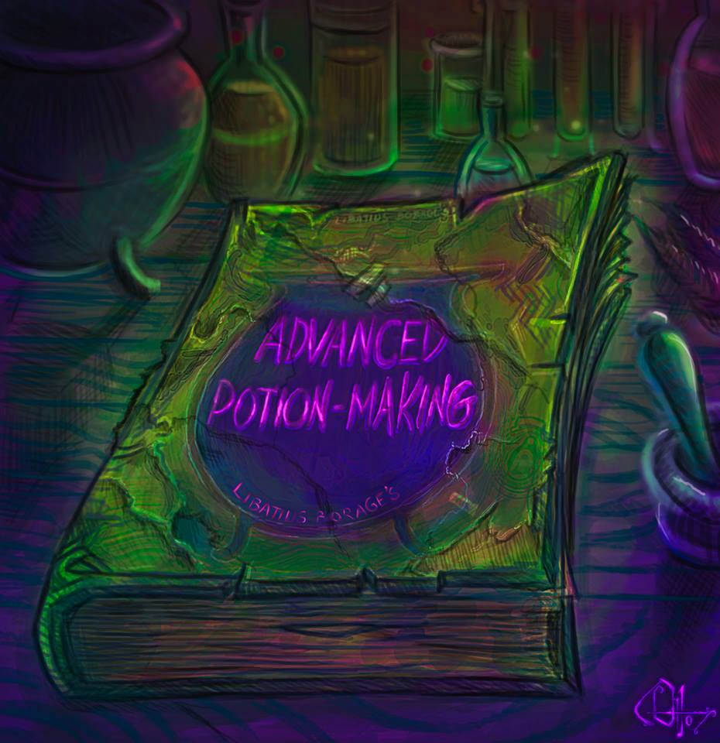
Advanced
Potions
Class
Advanced Potions Course
Advanced Potion-Making is a potions
textbook used at Hogwarts in the 1990s.
It is the N.E.W.T. level set text for Potions
Couse is open to 5-6th year Hogworts Students
Cost nine Galleons brand-new
The book was originally written around
the year 1946
Includes instructions for making the
Draught of Living Death
This image is copyrighted to Ottowl.
https://www.hp-lexicon.org/thing/advanced-potion-making/

Slide 3
Advanced Potions
Managing Pediatric Autoantibody
Background
Evans Syndrome – 30% of Hemolytic Anemia in Pediatrics
Defined with
Concomitant Warm Auto Immune Hemolytic Anemia (WAIHA)
Immune Thrombocytopenia
Less often Autoimmune Neutropenia
Evan’s Syndrome may be triggered by immunoregulatory disorders.
65% may be genetically determined
Our case today demonstrates two cases of Evans Syndrome
Audia S et al. J.Clin.Med 2020, 9.3851
Jhadjadj et al. Blood (2019) 134 (1): 9–21.
Voulgaridou and Kalfa. J. Clin. Med. 2021, 10, 216.
Notes:
A
range of immunoregulatory disorders have been related to Evans syndrome, triggering
its pathology [18]. In a large cohort study, 80 patients with Evans syndrome underwent
genetic testing searching for mutations in the most common genes involved in the pathogenesis
of immunodeficiencies; 52 of them (65%) received a genetic diagnosis determining
a pathogenic (n = 32, 40%) or probably pathogenic (n = 20, 25%) variant [19]. In ALPS,
apoptosis-resistant and autoreactive lymphocytes can cause severe autoimmune dysregulation
and lead to refractory Evans syndrome. With the increasing recognition of underlying
immunodeficiencies for w-AIHA, it is highly recommended that all children presenting
with Evans syndrome are screened for ALPS, CVID, as well as for HIV, especially in adolescents.
Close follow-up and regular re-examinations are also important, as multi-lineage
autoimmune cytopenias can be the single initial sign of SLE, with other SLE manifestations
presenting later in the course of the disease [20].
At least 65% of cases of pES may be genetically determined. l Genetic findings have prognostic significance and may guide the physician’s choice of a targeted treatment

Slide 4
Advanced Potions
Mara Mellow
11-year-old witch preparing for Hogwarts
11-year-old witch, Mara Mellow
She and her sister arrived at the pediatric wing of St Mungo's Hospital for Magical Maladies and Injuries
Mara’s Labs
Hgb 8.5g/dL Normal Range 12-16 g/dL
Platelet 4 K/uL Normal Range 140 to 400 K/uL
Mara’s symptoms
Shortness of breath
Pallor and petechiae on torso
Bleeding gums
Mara’s Diagnosis
Evans Syndrome

Slide 5
Advanced Potions
Mara Mellow
11-year-old witch preparing for Hogwarts
Mara’s Blood Bank Testing
Anti-A | Anti-B | Anti-D | A1 Cells | A2 Cells | Interpretation
4+ | 0 | 0 | 0 | 4+ | A Negative
Cell | Gel Antibody Detection Test
1 | 4+
2 | 4+
3 | 4+
DAT | Results | Interpretation
Polyspecifcic | 4+ | IgG only
Anti-IgG | 4+
Anti-C3b,d | 0√
Reflex Test | Results
Acid Eluate | Reactive with all cells

Slide 6
Advanced Potions
In your opinion, what would be the next step in the investigation?
Next steps for autoantibody investigation
Autoadsorption
37C-IAT only
LISS-IAT only
LISS-IAT and full phenotype testing with monoclonal antisera due to positive IgG DAT

Slide 7
Advanced Potions
House Views
Autoadsorption
Saline 37C-IAT only
LISS-IAT only
LISS-IAT and full phenotype with monoclonal antisera

Slide 8
Advanced Potions
Mara Mellow – Warm Autoantibody Resolution
Mara’s Blood Bank Testing:
Mara’s Provision of Blood
Request for 2 units of Platelets
 | D | C | E | c | e | K | k | Fyª | Fy^{b} | Jkª | Jk^{b} | P1 | Lea | Leb | M | N | S | s | Xga | IS | LISS 37C | LISS IAT | 37C-IAT
R₁R₁ | + | + | 0 | 0 | + | + | 0 | + | 0 | + | + | 0 | + | 0 | + | 0 | + | 0 | + | 0 | 0 | 0√ | 0√
R₂R₂ | + | 0 | + | + | 0 | 0 | + | 0 | + | 0 | + | + | 0 | + | 0 | + | 0 | + | 0 | 0 | 0 | 0√ | 0√
rr | 0 | 0 | 0 | + | + | 0 | + | + | + | + | 0 | + | 0 | + | + | + | + | + | + | 0 | 0 | 0√ | 0√
Autocontrol |  |  |  |  |  |  |  |  |  |  |  |  |  |  |  |  |  |  |  | 0 | 0 | 4+ | 4+

Slide 9
Advanced Potions
Provision of Platelets
What type Platelet to give Mara Mellow?
Mara’s Provision of Platelets Given the Current Inventory
A Pos PRT Platelet
O Neg PRT Platelet
AB Pos PRT Platelet
Call the donor center for A Neg PRT

Slide 10
Advanced Potions
House Views
What type Platelet to give Mara Mellow?
What type platelet to provide the pediatric patient
A Pos PRT
O Neg PRT
AB Pos PRT
Order A Neg PRT from Donor Center

Slide 11
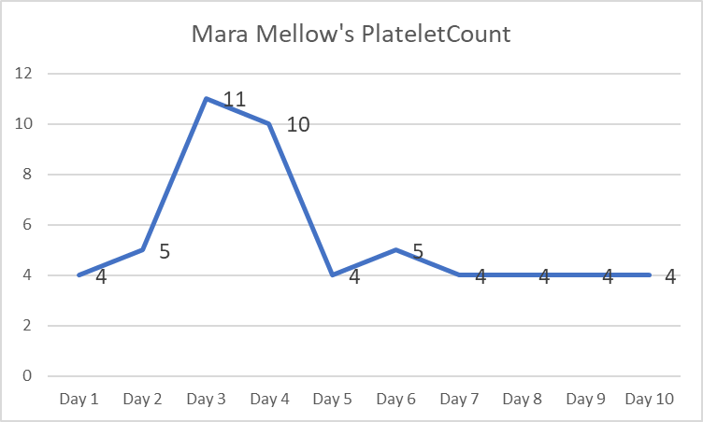
Advanced Potions
Mara Mallow Platelet Story
Platelet Count
Patient received platelets
and not red cells
Platelets given daily Day 1-10
ABO/Rh matched on Day 1-4
ABO out of type on Day 5-6
ABO matched on Day 7-10

Slide 12
Advanced Potions – Mara Mellow
Best Matched Platelets
After 10 days, the platelet count remained less than 20K/uL
A Negative platelets were not immediately available
Give RhIG and give A Pos Platelets
Give A Pos and Plasma reduced or wash platelets
Work with donor center for A Negative Platelet donors – LVDS vs. PRT
Consider platelet is refractory and test Platelet Antibody Screen, obtain HLA typing and determine HLA PRA

Slide 13
Advanced Potions
Mara Mallow House Views
Next steps for provision of platelets
Give RhIg and give group A Pos Platelets
Give A Pos with plasma reduction or washing the platelets
Donor center for A Negative Platelet donors – LVDS vs. PRT
Platelet Antibody Screen, HLA type and HLA PRA

Slide 14
Advanced Potions – Mara Mellow
Provision of “Better” Platelets
Patient’s samples tested for Platelet Antibody Screen and HLA PRA
Platelet Antibody Screen 85% Using Capture-P® Immucor
HLA PRA 0% Tested by PCR-SSO, PCR-SBT, PCR-SSP
HLA Type A01/A02; B35/B52; C4/C12
After physician and Blood Bank Review = Continue ABO identical platelets
Reason to no pursue crossmatching platelets at this time was there was an inadequate number of platelet units available for crossmatching
Notes:
HLA typing was performed by one or more of the following DNA techniques: PCR-SSO, PCR-SBT and PCR-SSP. These tests were developed in and performance characteristics determined by the above laboratory and have not been cleared or approved by the US FDA.
ASHI# 02-4-IN-03-1 CLIA# 15D0647197

Slide 15
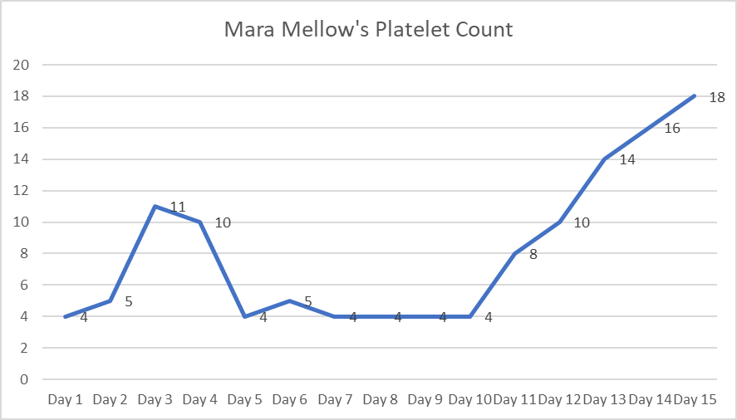
Closing of Class – Mara Mellow Case
Summary
Mara’s platelet count began to climb
Day 15 she was discharged
Challenges
Warm autoantibody patients
May not need RBC transfusion
Best matched Platelets
ABO identical
Before
Special HLA or XM’d Platelets

Slide 16
Advanced Potions
Managing Pediatric Autoantibody
Background
There was a known genetic risk with this marriage. The couple had genetic counselling before having children, and knew there was a risk of affected children
Two sisters diagnosed with early on-set Evans Syndrome associated with TPP2 (tripeptidyl-peptidase II deficiency)
TPP2 deficiency links premature immunosenescence of T and B cells with severe autoimmunity
6 siblings
2 sisters affected
Similar case reported in - Audia S et al. J.Clin.Med 2020, 9.3851
Notes:
Deficiency of TPP2 is
associated with Evans
syndrome and viral infection
susceptibility.
• TPP2 deficiency links premature
immunosenescence of
T and B cells with severe
autoimmunity.

Slide 17
Advanced Potions
Cara Mellow
5-year-old witch sister to Mara
5-year-old witch, Cara Mellow
Cara’s Labs
Hgb 4.5g/dL Normal Range 12-16 g/dL
Platelet 4 K/uL Normal Range 140 to 400 K/uL
Cara’s symptoms
Shortness of Breath, Pallor and Petechiae on Torso, Bleeding Gums
Respiratory infection believed to be viral in nature

Slide 18
Advanced Potions
Cara Mellow
5-year-old witch
Cara’s Blood Bank Testing
Anti-A | Anti-B | Anti-D | A1 Cells | A2 Cells | Interpretation
4+ | 0 | 4+ | 0 | 4+ | A Positive
Cell | Gel Antibody Detection Test | LISS-AHG | 37C-AHG
1 | 4+ | 4+ | 4+
2 | 4+ | 4+ | 4+
3 | 4+ | 4+ | 4+
Auto | 4+ | 4+ | 4+
DAT | Results | Interpretation
Polyspecifcic | 4+ | IgG and Complement coating cells
Anti-IgG | 4+
Anti-C3b,d | 2+
DAT control | 0
Reflex Test | Results
Acid Eluate | Reactive with all cells

Slide 19
Advanced Potions
In your opinion, what would be the next step in the investigation?
Next steps for autoantibody investigation
Autoadsorption
Alloadsorption since small volume of red cells
Give emergency release O Negative RBC and send sample to the Reference Lab
Completed phenotype testing and then decide the next step

Slide 20
Advanced Potions
House Views
What is the next step in the investigation?
Autoadsorption
Alloadsorption
Give blood and send to the IRL
Complete the phenotype and decide the next step

Slide 21
Advanced Potions
Cara Mellow
5-year-old witch
D+C+E-c-e+; K-; Fy(a-b+); Jk(a+b+); Le(a-b-); M+N+S+s+
Cara’s Blood Bank Testing Took 8-10 hours of testing
Cara’s Provision of Blood
Request for 2 units of Platelets Platelets given immediately
Request for 2 units of RBC Released C-E-K negative emergency release RBC
 | D | C | E | c | e | K | k | Fyª | Fy^{b} | Jkª | Jk^{b} | P1 | Leª | Le^{b} | M | N | S | s | Xgª | R1 x 4 | R2 x 4 | rr x 4 | Auto Ab x 3
R₁R₁ | + | + | 0 | 0 | + | + | 0 | + | 0 | + | + | 0 | + | 0 | + | 0 | + | 0 | + | 2+ | 2+ | 2+ | 2+
R₂R₂ | + | 0 | + | + | 0 | 0 | + | 0 | + | 0 | + | + | 0 | + | 0 | + | 0 | + | 0 | 1+ | 1+ | 1+ | 2+
rr | 0 | 0 | 0 | + | + | 0 | + | + | + | + | 0 | + | 0 | + | + | + | + | + | + | 1+ | 1+ | 1+ | 2+
Untreated R₁, R₂ and rr (triple) Alloadsorption and ZZAP treated Autoasorption

Slide 22
Advanced Potions
Cara Mellow
5-year-old witch
Cara’s Blood Bank Testing Took 4-6 hours of testing
Underneath the Warm Autoantibody
Anti-Leª identified with selected cells in alloadsorption study
QNS for further testing on the Autoadsorption study
Anti-Leª suspected to be naturally occurring
 | D | C | E | c | e | K | k | Fyª | Fy^{b} | Jkª | Jk^{b} | P1 | Leª | Le^{b} | M | N | S | s | Xgª | R1 x 5 | R2 x 5 | rr x 5 | Auto Ab x 4
R₁R₁ | + | + | 0 | 0 | + | + | 0 | + | 0 | + | + | 0 | + | 0 | + | 0 | + | 0 | + | 2+ | 2+ | 2+ | 1+
R₂R₂ | + | 0 | + | + | 0 | 0 | + | 0 | + | 0 | + | + | 0 | + | 0 | + | 0 | + | 0 | 0 | 0 | 0 | 0
rr | 0 | 0 | 0 | + | + | 0 | + | + | + | + | 0 | + | 0 | + | + | + | + | + | + | 0 | 0 | 0 | 0
ZZAP treated R1, R2 and rr (triple) Alloadsorption and ZZAP treated Autoasorption

Slide 23
Advanced Potions
In your opinion, what would the provision of blood after the adsorption studies?
Provision of blood
Match E-c-, K-, Fy(a-) but not Le(a-)
Match E-c-, K-, Fy(a-), Le(a-) screened with alloadsorbed serum as negative
Give A Pos crossmatch least incompatible
Match E-c,-K-,Fy(a-), Le(a-)

Slide 24
Advanced Potions
House Views
What type Blood to provide Cara Mellow?
Provision of blood
Full crossmatch, except Le(a-)
Full crossmatch with Le(a-) and crossmatch screen with alloadsorbed serum
Crossmatch Group A Pos
Full match including Le(a-) since reactive at IAT

Slide 25
Advanced Potions
Challenges of
Autoantibody Pediatric Patient Samples
Challenges
Clinical understanding of “least incompatible”
Providing Blood best matched blood products
Future Work-Ups for this patient
Getting enough samples to ensure adequate investigation
Adequate history available at time of the testing of the sample
Techniques and technologist available in the lab to investigate

Slide 26
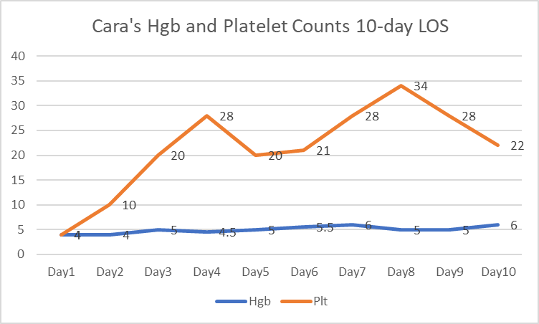
Closing of Class – Cara Mellow Case
Summary
Autoadsorption was slow with small volume of cells
Alloadsorption was ineffective untreated
Switch to ZZAP treated alloadsorption
Provision of blood was immediate
Give Rh and K matched uncrossmatched
After work-up provided matched
Challenges
Small volume
Decision to transfuse of wait for work up
Continued support phenotypic RBC match

Slide 27
Closing of Class – Advanced Potions
Take Away
Warm autoantibodies in pediatric setting are rare and may be related to genetic disposition
Each case is different
Manage the patient medically until work-up is complete

