Slide 1
BLOOD BANK TEAM MEETING
May 2022

Slide 2
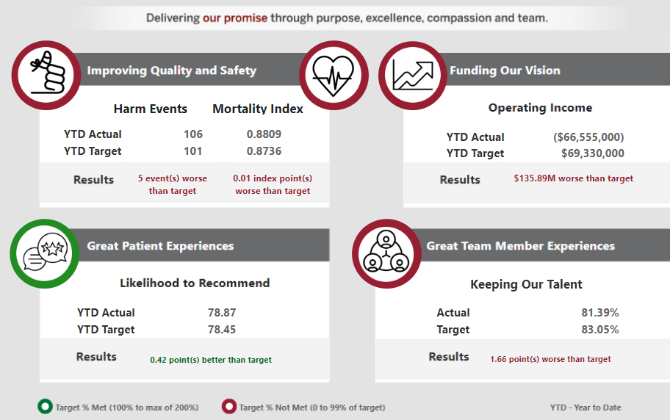
2022 IU Health System Promise Dashboard – March 2022
COVID volumes drove increased patient days risking greater infection and harm (ECR, RH, SCR, WCR reduced Harm). AAHC had largest mortality gap
NPS improved
FYTO improved 23% in Q4 with Region teams achieving Q4 goal.
COVID and non-COVID patient volumes and labor shortages challenged our financials.

Slide 3
Lab Promise Dashboard – Month Metrics (April 2022)
Goals Included in System Promise Dashboard
Improving Quality and Safety (Y/E Goal 25.30)
Blood Product Utilization (Red Blood Cell Units / 1,000 Patient Days)
Great Patient Experiences (Y/E Goal 78.59)
Likelihood to Recommend
Productivity Metrics (Y/E Goal $7.95 & 0.110)
Productivity Ratios
 | MTD Actual | YTD Actual | YTD Target
RBC / 1K Days | 23.55 | 23.19 | 25.30
 | MTD Actual | YTD Actual | YTD Target
NPS | 79.20 | 78.09 | 78.59
 | MTD Actual | YTD Actual | YTD Target
Tot. Cost / Test | 8.97 | 9.19 | 7.84
Hrs / Billed Test | .110 | .105 | .107
Great Team Member Experiences (Y/E Goal 79.41%)
Overall Team Member Retention
Funding Our Vision (Y/E Goal $18K)
Operating Income ($100K)
 | YTD Actual | R12 Actual | R12 Target
% Retained | 93.72 | 84.47 | 79.41
 | MTD Actual | YTD Actual | YTD Target
OI | (785) | (5815) | 443

Slide 4
Blood Bank Projects Update
Ortho Update:
Continuing Validation at all three sites.
Antigen Typing and IS XM validation to be postponed until “day 2”.
New process -- Not going LIVE with initial validation.
Requires additional SOP writing
Requires additional training
Information for refresh online Ortho Training and new team member training coming
Projected Go LIVE: last two weeks of June
Quick Registration for Outreach patients
Standard Work and Training coming
Will no longer need to send manual requisition to Main Lab for registration
Moving forward with Standardization of Bench Reagents for System; Smart Fridge purchase, removal of Cesium Irradiator at MH; implement use of Whole Blood for Trauma

Slide 5
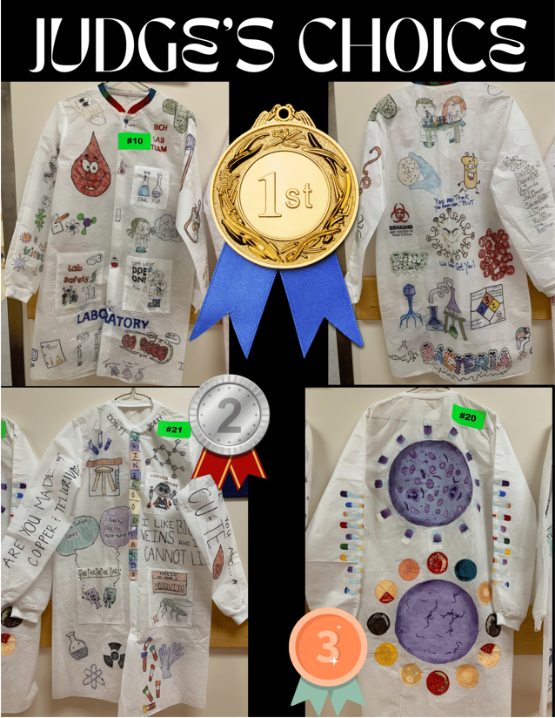
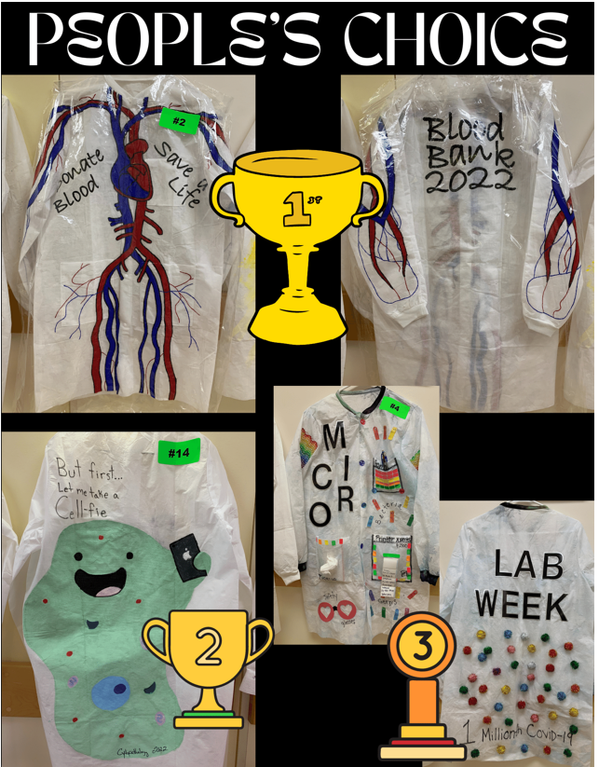
Lab Week- Blood Bank 1st Place Congratulations Abby

Slide 6
RECOGNITION
Birthdays
April
Jesse
Willie
May
Dawn
Abby
Aya
Danette
Jennifer

