Slide 1
APHERESIS TEAM MEETING
04.13.2022

Slide 2
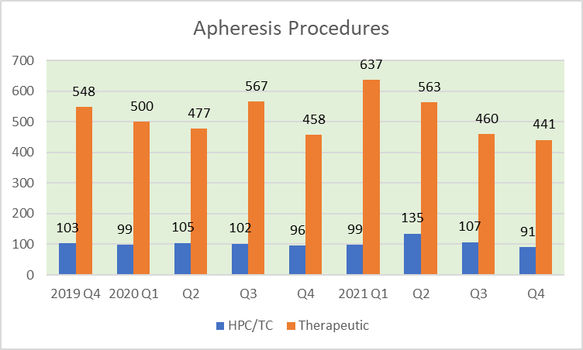
Apheresis Workload
Workload Trending

Slide 3
Apheresis Metrics - 2021

Slide 4
APHERESIS STAFFING
Future Needs- still collecting feedback
Later Shift Possibility 10:00 – 6:30 pm
Working on SBARs for the following:
Request additional FT (10-hour day) RN with on call
PCA/ Unit Secretary

Slide 5
Pooled Plasma for TPE
A new regulatory standard went into effect in the Blood Bank regarding the transfer of products from one container to another.
The standard states that if no storage time limit is specified in the package insert, the component shall have an expiration time of 4 hours after transfer from the original container.
Plasma for TPE is pooled into a large bag. These bags do not specify a storage time.
Expiration time will now be 4 hours.
Need to closely coordinate the pooling of these products to ensure the pooled plasma will be infused before the 4-hour expiration.
Blood Bank can send single units.
Looking for bags that have storage time limits.

Slide 6
Incident Update
Clinical IS working on the following build:
Cerner Apheresis Procedure Flowsheet to include:
“primed by”
“apheresis machine and lines primed”
“machine ready for patient connection”
Awaiting response for timeline
Apheresis SOPs to be revised and RN training after IS build
Currently working on electronic training/competency sheets

Slide 7
Reminders
Stem Cell Request for Processing Orders
Ensure that the patient’s name on this order is correct before starting procedure.
It must match stated name.
It must match armband and the Donor Registration Form.
Any discrepancies notify QA immediately for resolution.
FIT Testing
Methodist Hospital: Thursday, April 21 at 8 pm through Friday, April 22 at 3 am
University Hospital: Thursday, April 28 at 7 am through Friday, April 29 at 3 am
The Joint Commission
Inspection window is now open

Slide 8
Values Acknowledgments: Purpose, Excellence, Compassion, Team
EXCELLENCE:
Thank you to Jennifer for taking over Charge RN on day
TEAM:
Thank you to Charloom for covering an emergent on-call on a very short notice.

