Slide 1

Whole Blood Education

Slide 2
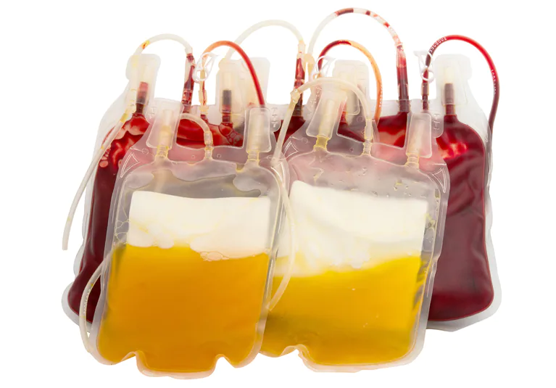
Current Practice
Component blood product resuscitation with emergency release Type O Blood
Goal is balanced resuscitation 1:1:1 (PRBC : Plasma : Platelets)

Slide 3
Challenges with Component Therapy
Keeping track of what is transfused can be challenging for balanced resuscitation
Platelets frequently are not transfused in a timely fashion (platelets have to come from blood bank)

Slide 4
Is There Another Way?

Slide 5
Low Titer Type O Whole Blood (LTOWB)
Whole Blood = Not separated into components
Low Titer = Low anti-A and anti-B antibodies
Low Titer minimizes hemolytic transfusion reactions when given to non Type-O patients

Slide 6
Whole Blood Advantages
Simplicity
  Reduce complexity compared to 1:1:1 transfusion
Patient Safety
  Reduce risk of hypocalcemia from multiple blood product Ca⁺⁺ binding agents
  Less infectious disease exposure from multiple donors

Slide 7
Differences Between Component Therapy and Whole Blood
Component 1:1:1 Therapy
Whole Blood
Hct 29%
Platelet 90,000/μL
Coagulation factors 62% of Whole Blood
Hct 35%
Platelet 150,000/μL
Coagulation factors 85% of pre-donation level

Slide 8
Whole Blood Program at Riley Hospital

Slide 9
Whole Blood in Riley Hospital
Whole blood will be available in Riley ED remote refrigerator ONLY
Intended for trauma patients
ED/Trauma physician must decide if whole blood or component therapy should be used

Slide 10
What Products will be Stored in the Refrigerator?
Whole blood and component packs
3 units of O NEG
3 packs of O NEG red cells with type A plasma

Slide 11
How to Distinguish Whole Blood from Component Red Cells
Whole Blood units look almost identical to component Red Cells, aside from volume
To help, Blood Bank will put a yellow “WHOLE BLOOD” sticker on the unit and the associated paperwork
Units will be in yellow baskets
Whole Blood and components will have their own drawers

Slide 12
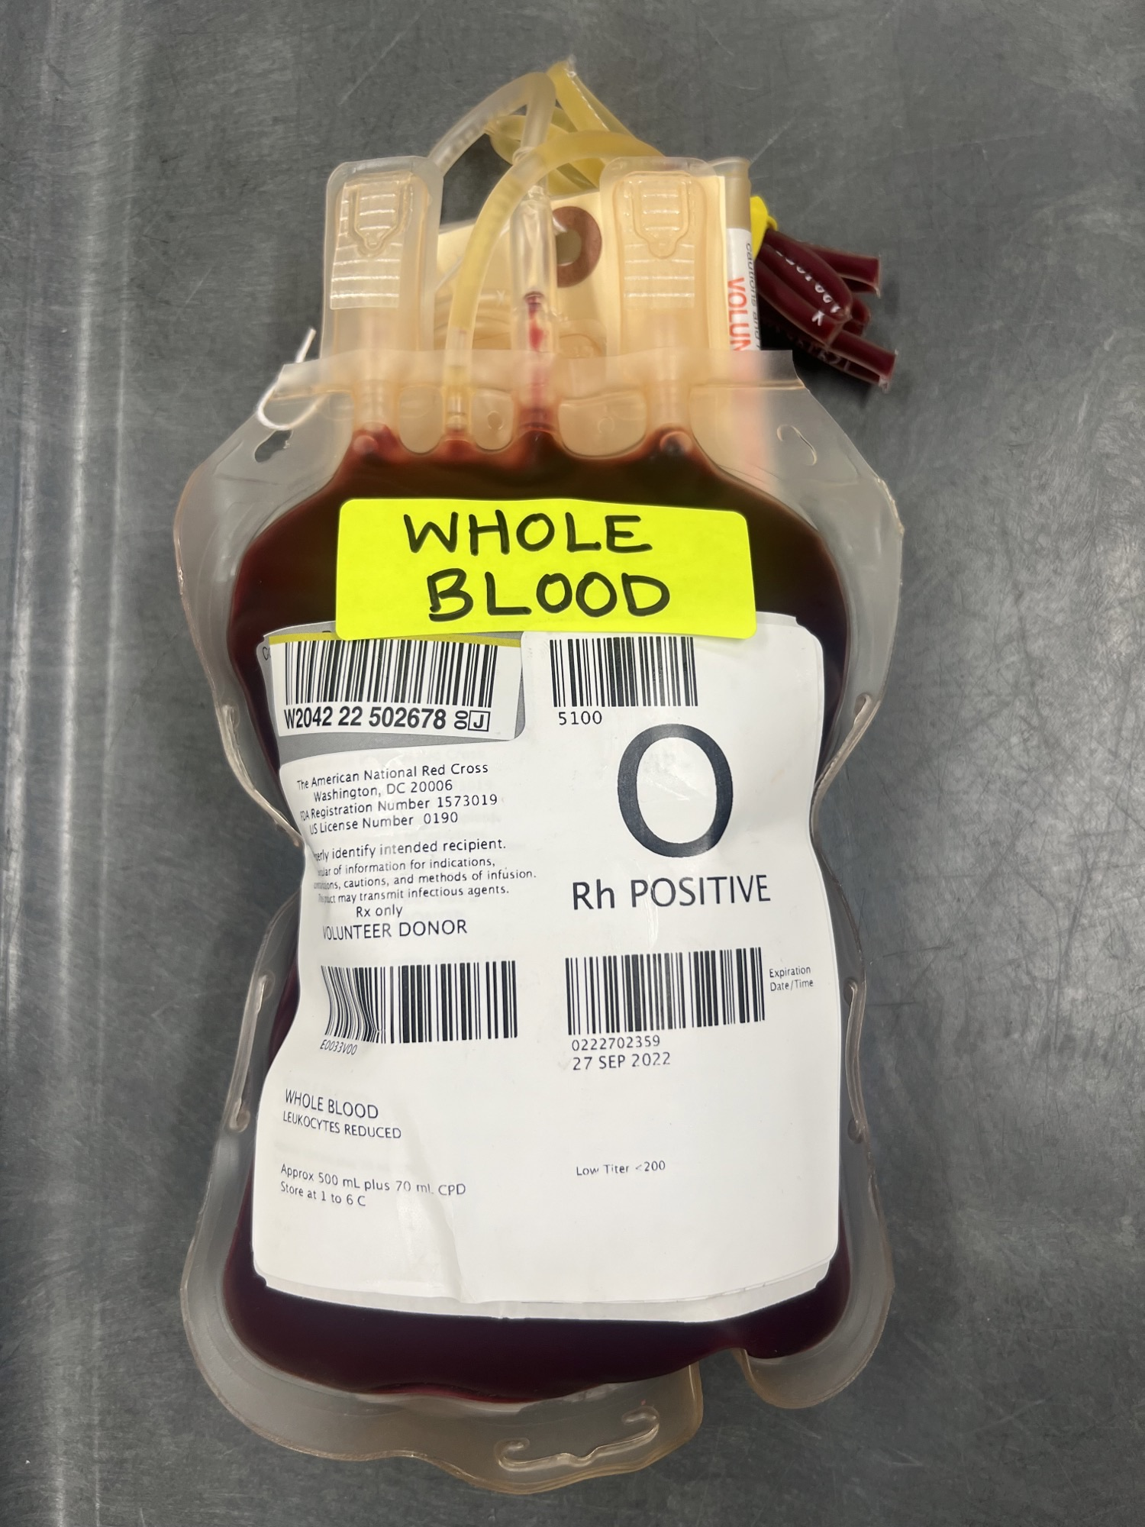
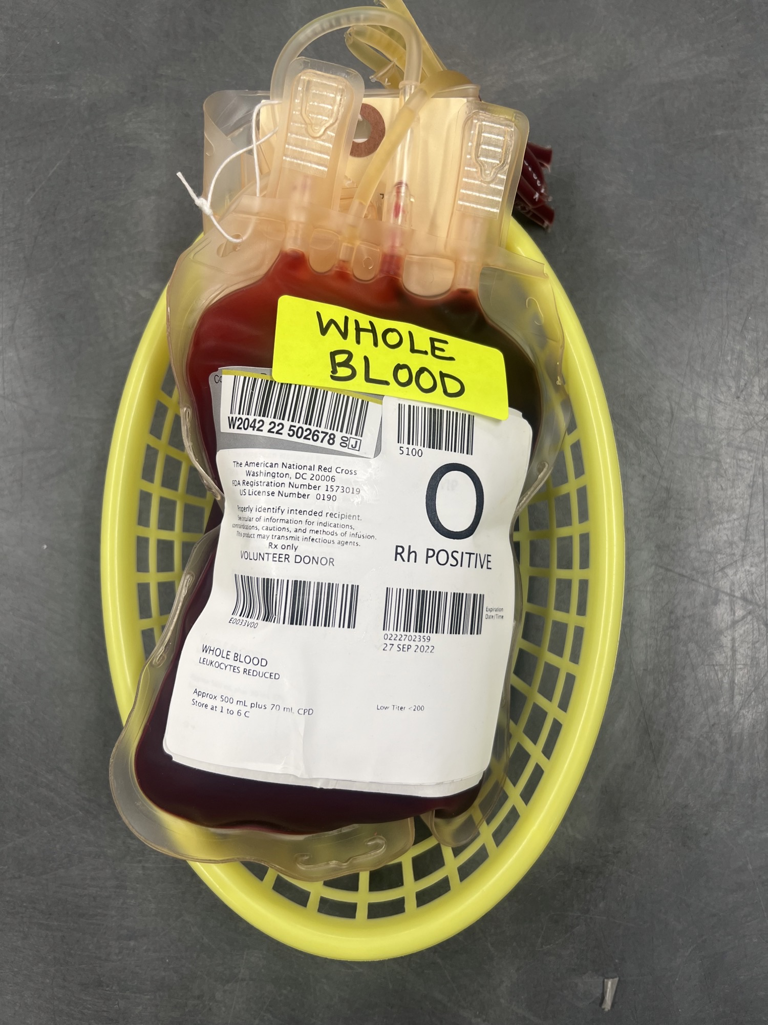

Slide 13
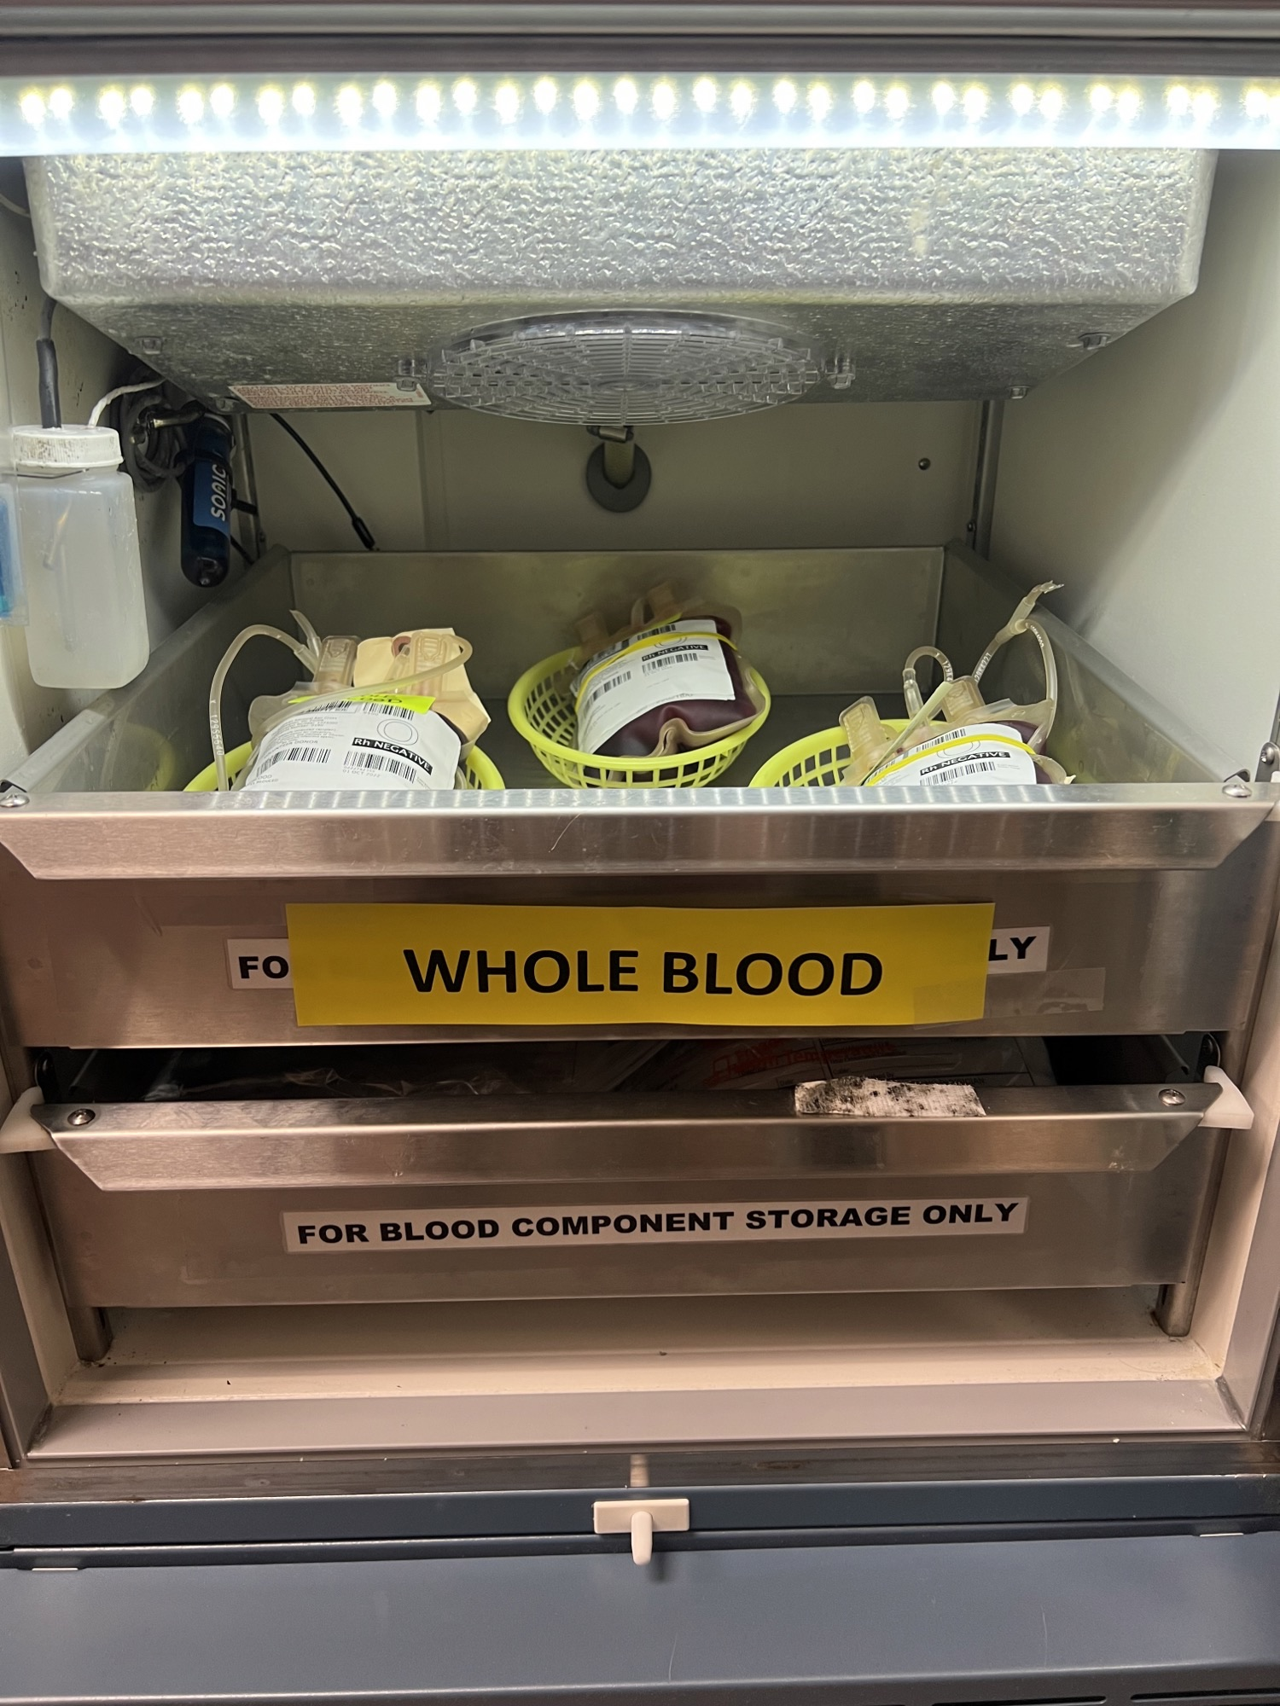

Slide 14
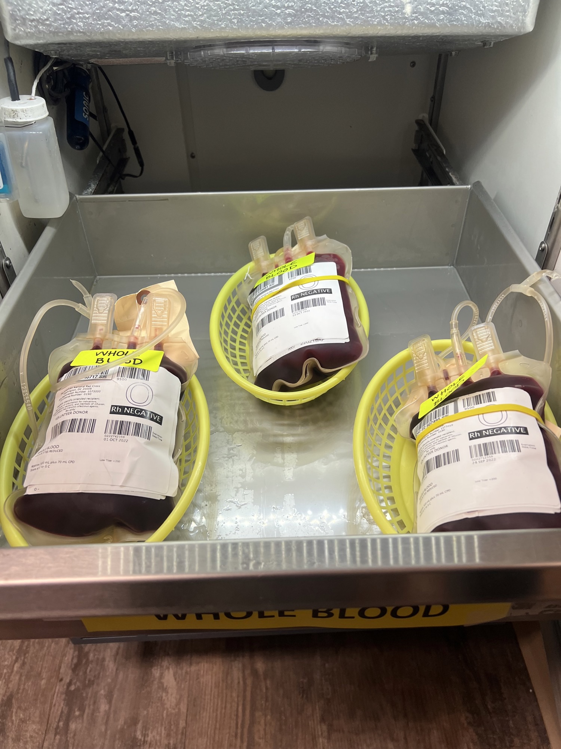

Slide 15
What if We Run Out of Whole Blood?
Blood Bank can only receive this product on a standing order, which means if all units are transfused, Blood Bank cannot order more from the donor center for that week
**Please note: If Blood Bank has no O NEG Whole Blood, the units will be replaced with component packs. This means there will be times when there is no Whole Blood in the refrigerator. We will replenish the inventory as soon as we can.**

Slide 16
Quick Facts
Can I use the Belmont Infuser with WB? YES
Can I use a pressure bag with WB? YES
Do I still need to send a Type and Screen? YES
What is the pediatric dose for WB? 10-15 ml/kg – patient should not receive more than 40ml/kg of whole blood
Is WB compatible with Lactated Ringers? NO

Slide 17
Other Considerations
Send Type and Screen early – will be difficult to get correct T&S after multiple units of WB administration
Transition to component therapy when possible
Support other aspects of damage control resuscitation – hypothermia protection and avoidance of hypocalcemia

Slide 18
Questions/Concerns?
Please contact Dr. Amy Gabbard (agabbard1@iuhealth.org) or Dr. Matt Landman (landman@iu.edu)

