Slide 1
Whole Blood Rollout EMTC
IU AHC Whole Blood Working Group
Sept 2022

Slide 2
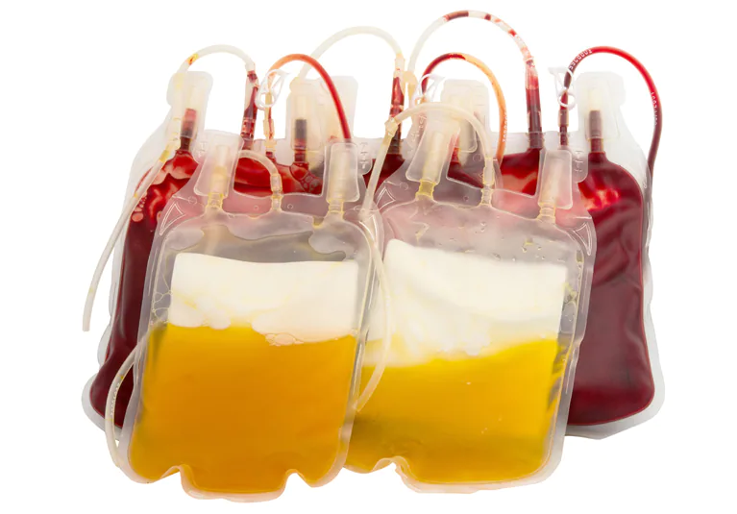
What we do currently
Component blood product resuscitation with emergency release Type O Blood
Goal is balanced resuscitation 1:1:1 (PRBC : Plasma : Platelets)

Slide 3
Challenges with Component Therapy
Keeping track of what is transfused can be challenging for balanced resuscitation
Platelets frequently are not transfused in a timely fashion (platelets have to come from blood bank)

Slide 4
Is there another way?

Slide 5
What is Old is New Again – Whole Blood

Slide 6
Low Titer Type O Whole Blood
Whole Blood = Not separated into components
Low Titer = Low anti-A and anti-B antibodies
Low Titer minimizes hemolytic transfusion reactions when given to non Type-O patients
All whole blood

Slide 7
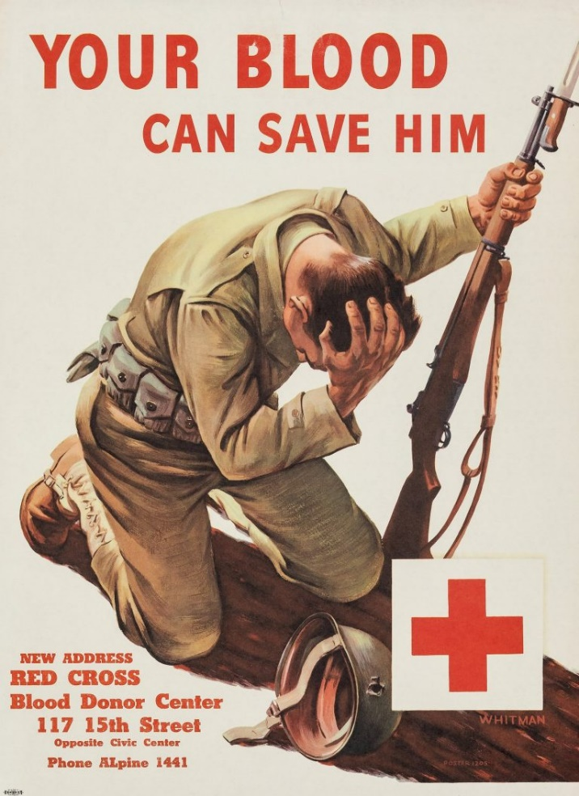
Low Titer Type O Whole Blood History
Whole Blood first used extensively in World War I and WWII
Became less common during the Vietnam War after component therapy and crystalloids used more frequently
Renewed use during Global War on Terror

Slide 8
Whole Blood supports:
Simplicity
Reduce complexity compared to 1:1:1 transfusion
Patient Safety
Reduce risk of hypocalcemia from multiple blood product Ca⁺⁺ binding agents
Less infectious disease exposure from multiple donors

Slide 9
The difference
Component 1:1:1 Therapy
Whole Blood
Hct 29%
Platelet 90,000/μL
Coagulation factors 62% of Whole Blood
Hct 35%
Platelet 150,000/μL
Coagulation factors 85% of pre-donation level

Slide 10
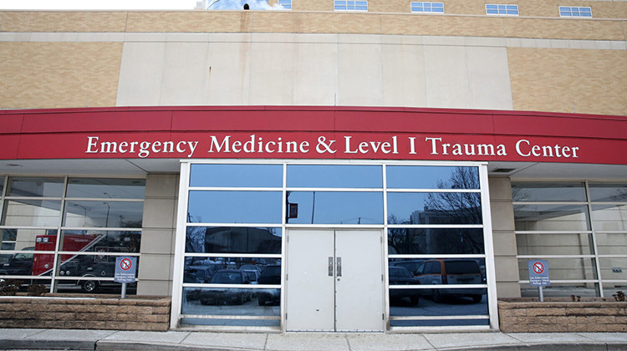
EMTC Whole Blood Program

Slide 11
Whole Blood in EMTC
Initial rollout - Only available in Emergency Department
Indication - Massive hemorrhage / exsanguination
Storage - Several units of Whole Blood will be in ED blood refrigerator, alongside component blood products
The process of retrieving uncrossmatched whole blood units from the refrigerator will be the same for the uncrossmatched components
The same transfusion document will be attached and must be completed and sent back to blood bank

Slide 12
EMTC WB Availability
To start, MH ED will have 8 uncrossmatched O POS Whole Blood units
O NEG uncrossmatched Whole Blood units may occasionally be in MH ED, if inventory allows
O NEG units should be reserved for females < 50 years of age or males < 13 years of age
Patients should be limited to no more than 4 units of Whole Blood before transitioning to uncrossmatched component 1:1:1 therapy given the limited supply of WB
The same refrigerator will also contain 8 units of uncrossmatched component Packed Red Blood Cells and Plasma

Slide 13
Rh-D Type for Whole Blood
O-Pos
For most male patients or females >50 years old
O-Neg
Preferred for female patients < 50 years old or males <13 years old
If O-Neg blood is unavailable for this group, it is acceptable to transfuse O-Pos blood to save their life

Slide 14
When Should We Use Whole Blood over Components?
The decision to transfuse any blood products (whole blood or components) from the MH ED refrigerator must come from a physician
Same physician must sign the box below on transfusion document
NP's and PA's cannot sign this document- this is mandated by the FDA

Slide 15
What if We Run Out of Whole Blood?
Blood Bank can only receive this product on a standing order, which means if all units are transfused, Blood Bank cannot order more from the donor center for that week
**Please note: If Blood Bank has no Whole Blood, the units will be replaced with component packs. This means there may be times when there is no Whole Blood in the refrigerator. We will replenish the inventory as soon as we can.**

Slide 16
How to Distinguish Whole Blood from Component Red Cells
Whole Blood units look almost identical to component Red Cells, aside from volume
To help, Blood Bank will put a yellow “WHOLE BLOOD” sticker on the unit and the associated paperwork
Units will be in yellow baskets
Whole Blood and components will have their own drawers

Slide 17
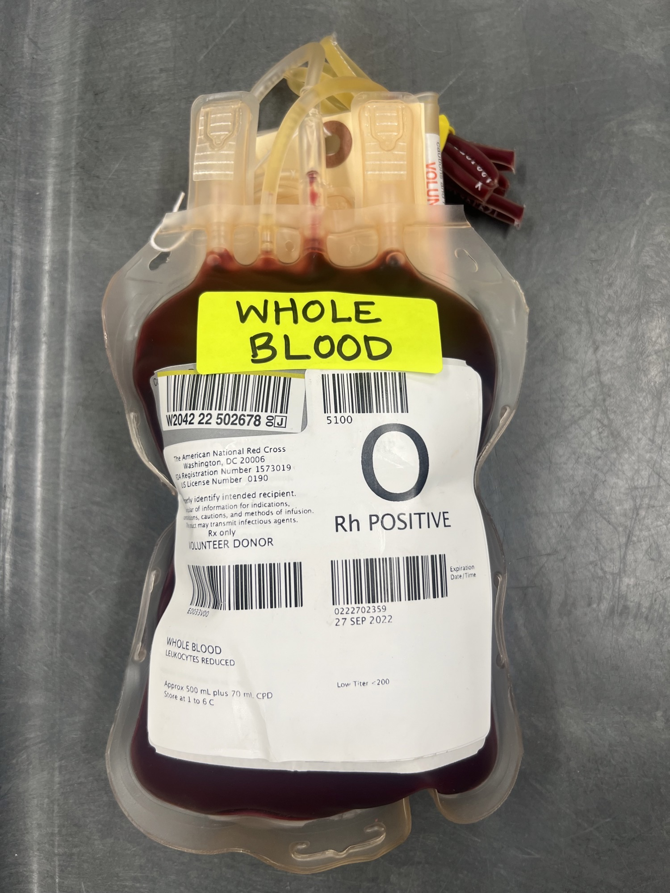
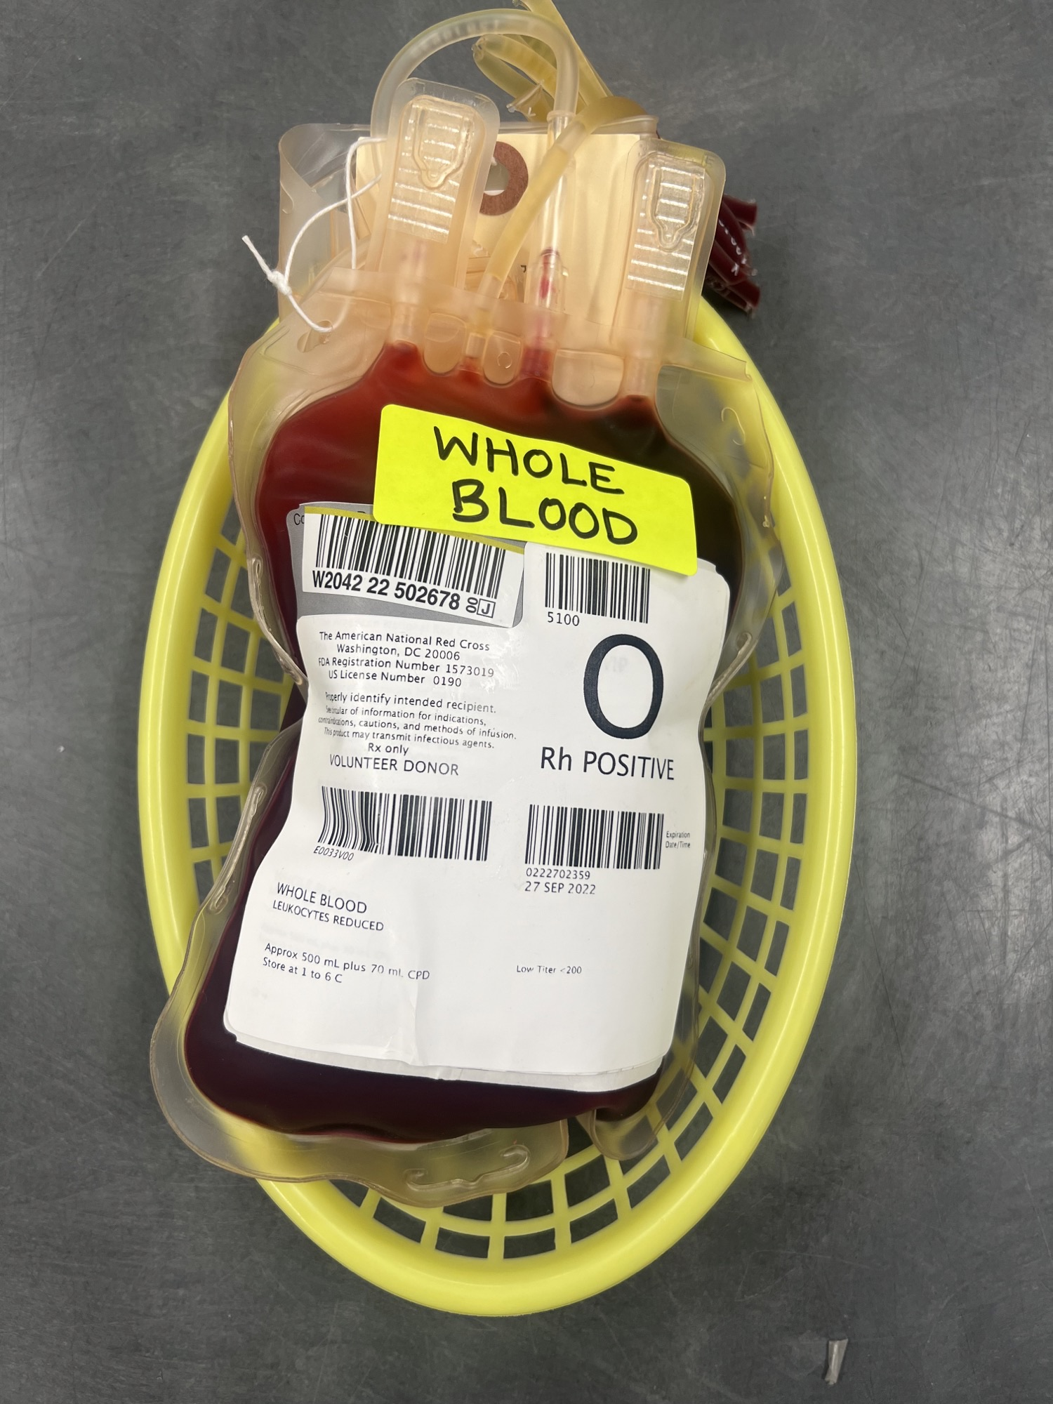

Slide 18
Location of WB
Whole Blood will be stored in the ED remote blood refrigerator

Slide 19
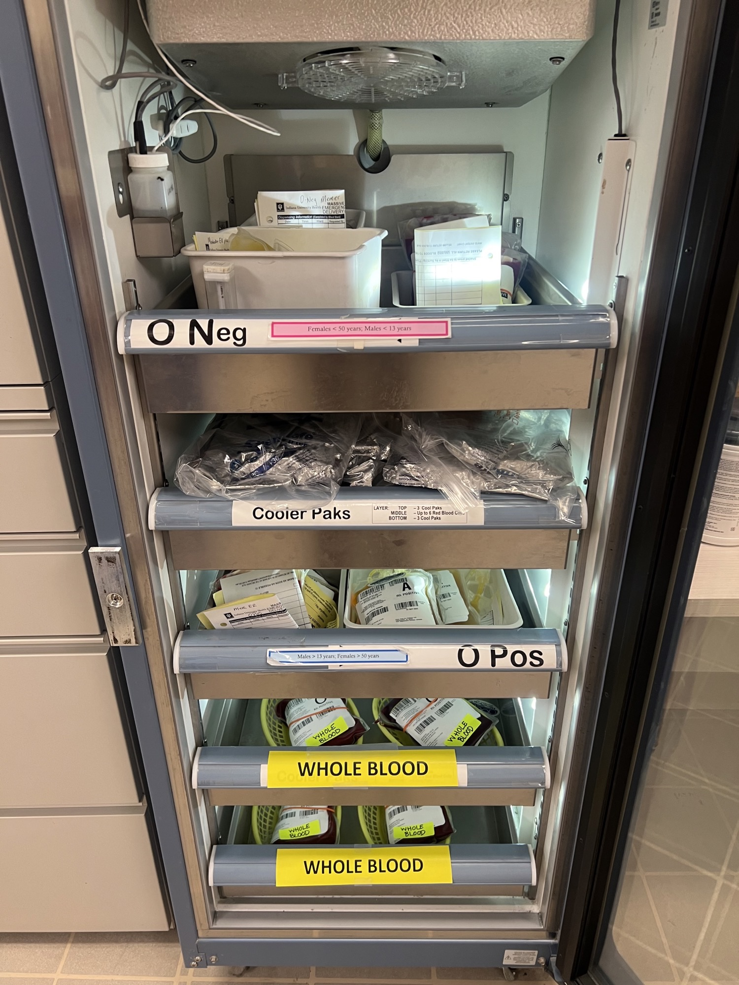
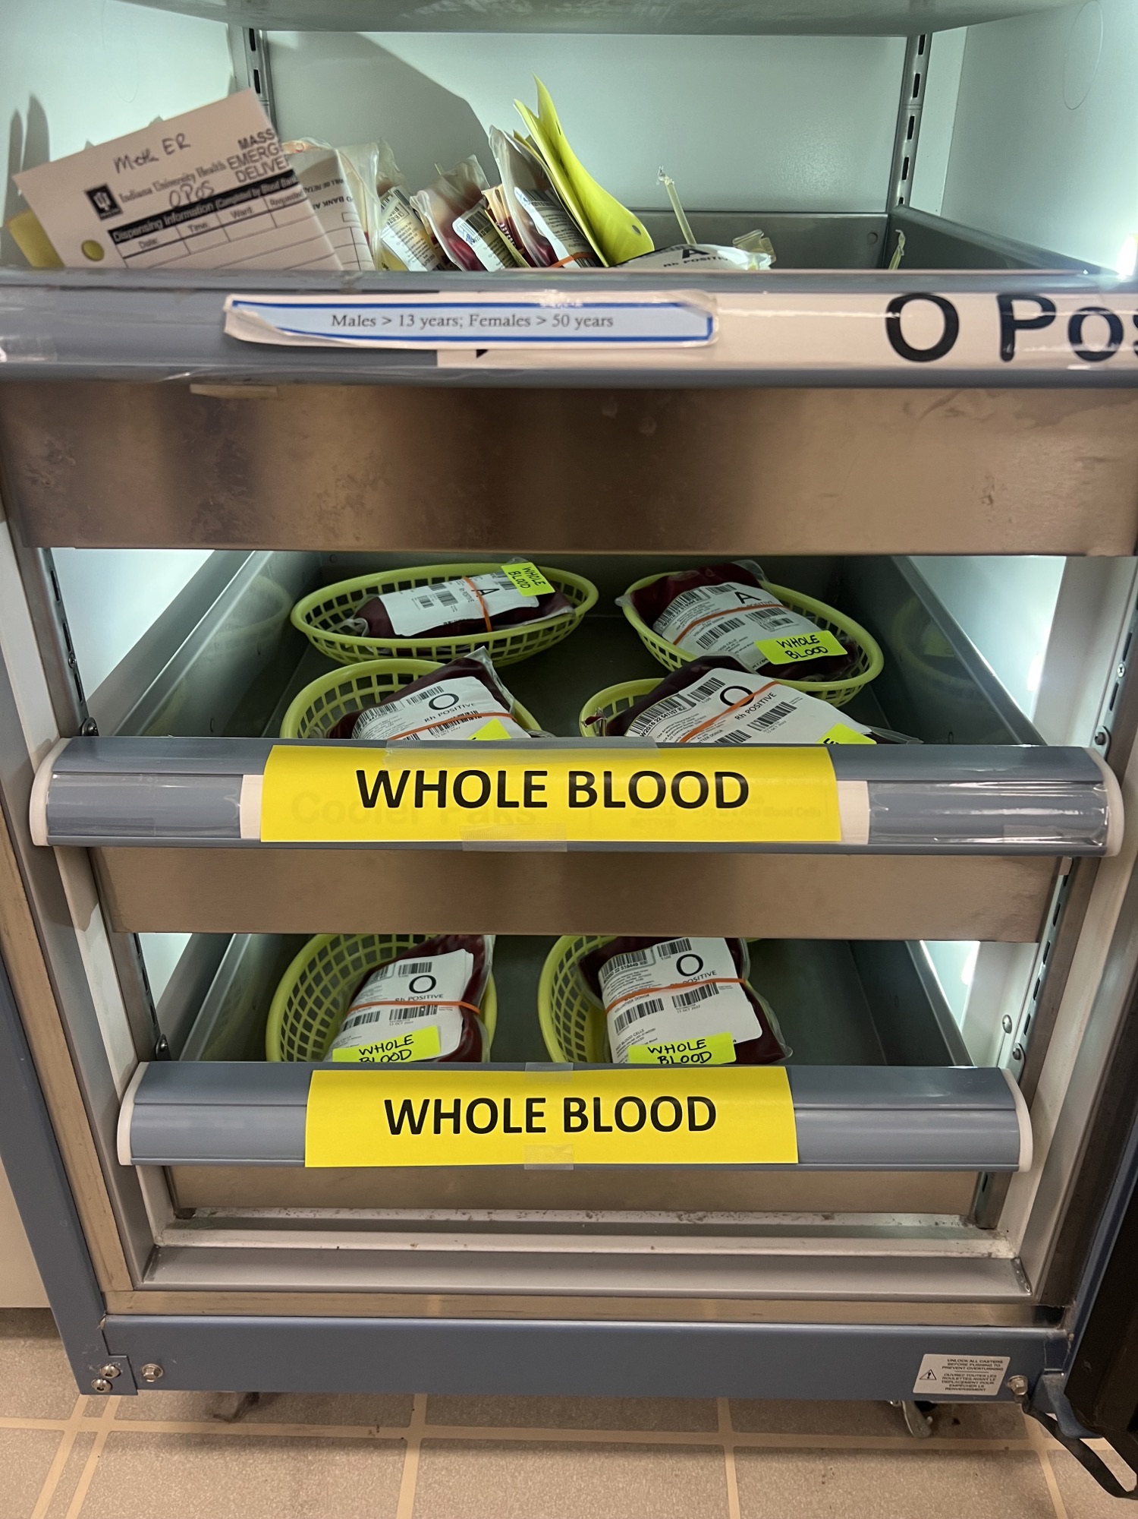

Slide 20
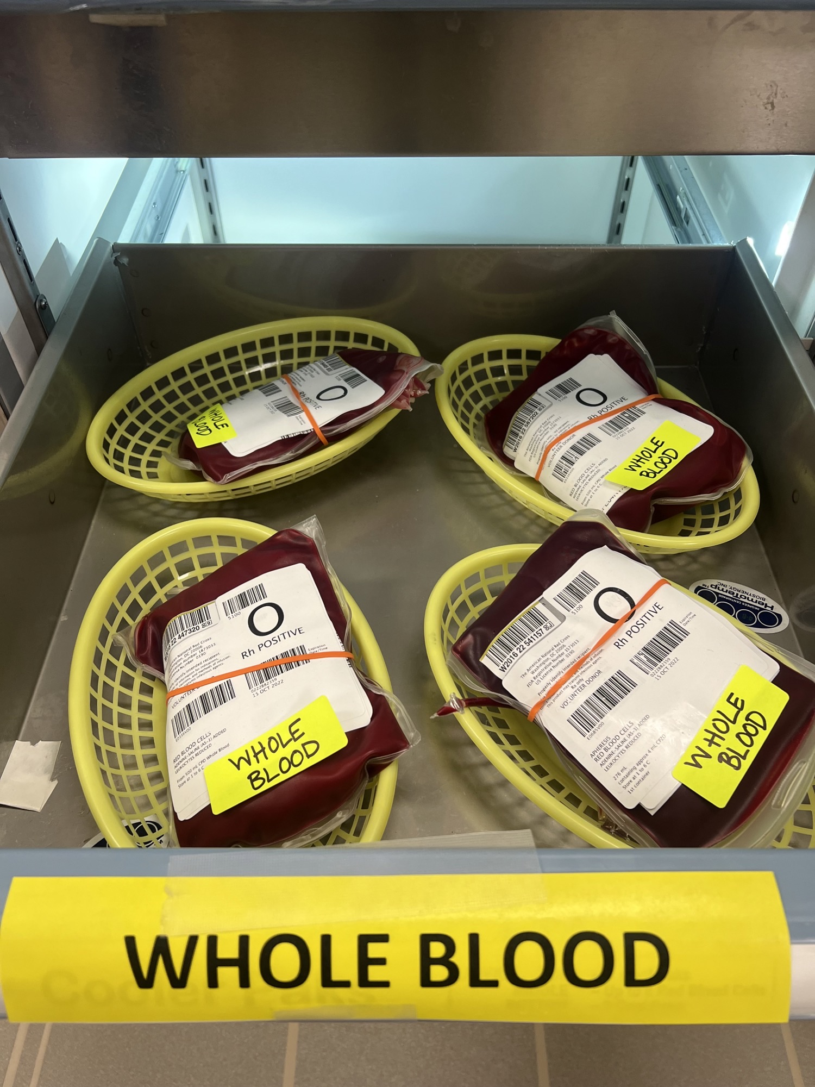

Slide 21
Quick Hits
Can I use the Belmont Infuser with WB? YES
Can I use a pressure bag with WB? YES
Do I still need to send a Type and Screen? YES
What is the pediatric (Pt weight <40kg) dose for WB? Typically 10-15 ml/kg
Is WB compatible with Lactated Ringers? NO

Slide 22
Tips
Send Type and Screen early – will be difficult to get correct T&S after multiple units of WB administration
Transition to component therapy when possible
Support other aspects of damage control resuscitation – hypothermia protection and avoidance of hypocalcemia

Slide 23
Questions/Concerns?
Please contact Dr. Amy Gabbard (agabbard1@iuhealth.org), Dr. Rachel Rodriguez (rrodriguez5@iuhealth.org), or Dr. Mark Liao (markliao@iu.edu).

