Slide 1
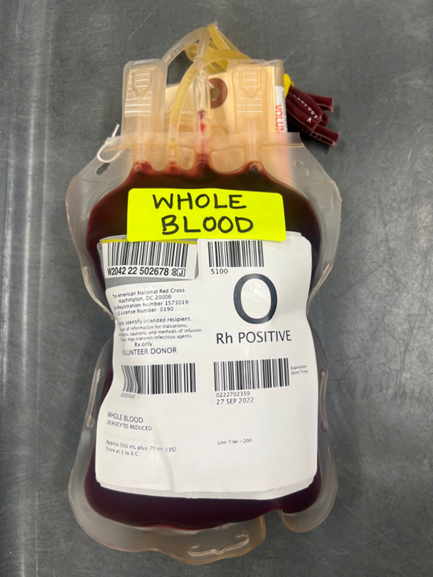

AHC Blood Bank Roll Out of Use of Whole Blood
10.18.22

Slide 2
Whole Blood Process Training
Training will be three-fold
  Education Training, routed to team 10/7/22.
  SOP Review in medtraining.org assigned 10/17/22
    All BB have a copy of the draft SOP in Standard Work Binder
    Job Aid for Update to Emergency Cells has been posted at RH and MH
    Video Training for Process routed and discussed at Huddles 10/18 and after.

Slide 3
Whole Blood Policy Decisions
Whole Blood will only be used in the ED at RH and MH
  Whole Blood may not be ordered
  Whole Blood may go with the patient to OR from the ED – we will monitor this action
Whole Blood will have different expirations
  RHBB – Use up to day 14 from collection, then replace
  MHBB – Use to expiration date, then replace
    We will be monitoring wastage closely

Slide 4
Whole Blood Policy Decisions
Whole Blood will be received at both MH and RH
Whole Blood will be one unit and one form in the yellow trays
We will continue to keep MTP trays of components available to each ED

Slide 5
What if We Run Out of Whole Blood for RH or MH ED?
Blood Bank can only receive this product on a standing order, which means if all units are transfused, Blood Bank cannot order more from the donor center for that week
**Please note for Riley: If Blood Bank has no O NEG Whole Blood, the units will be replaced with component packs. This means there will be times when there is no Whole Blood in the refrigerator. We will replenish the inventory as soon as we can.**
++ This should not be a problem for MH, as we can stock O Pos WB when O Neg WB not available.

Slide 6
Whole Blood Policy Decisions
RHBB ED Fridge
  Whole Blood
    Only O Negative, less than 14 days old
  Component MTP at RH ED
    Individual papers
      Liquid Plasma with their own Paper
      RBC (maintain with less than 14 days) on their own Paper

Slide 7
RH Changes
3 - Individual group O neg RBC, Individual group A Liquid Plasma
All Less than or equal to 14 days

Slide 8
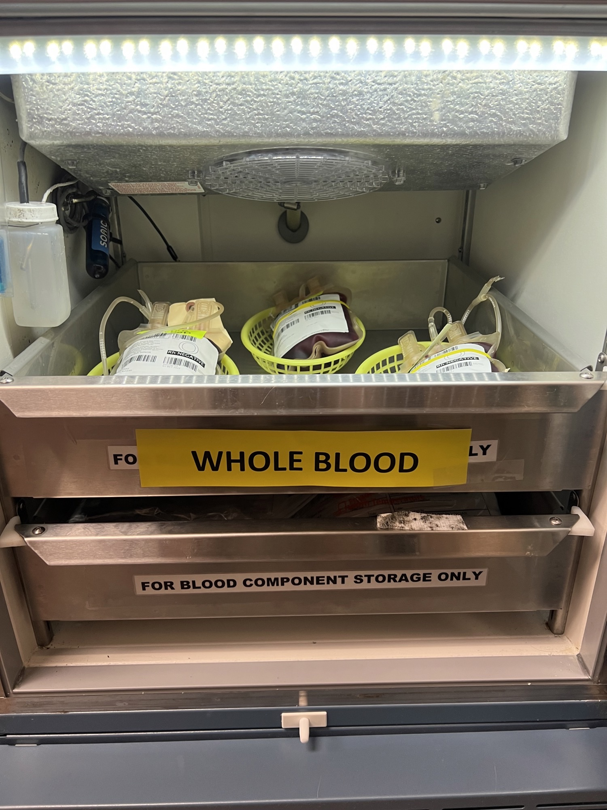
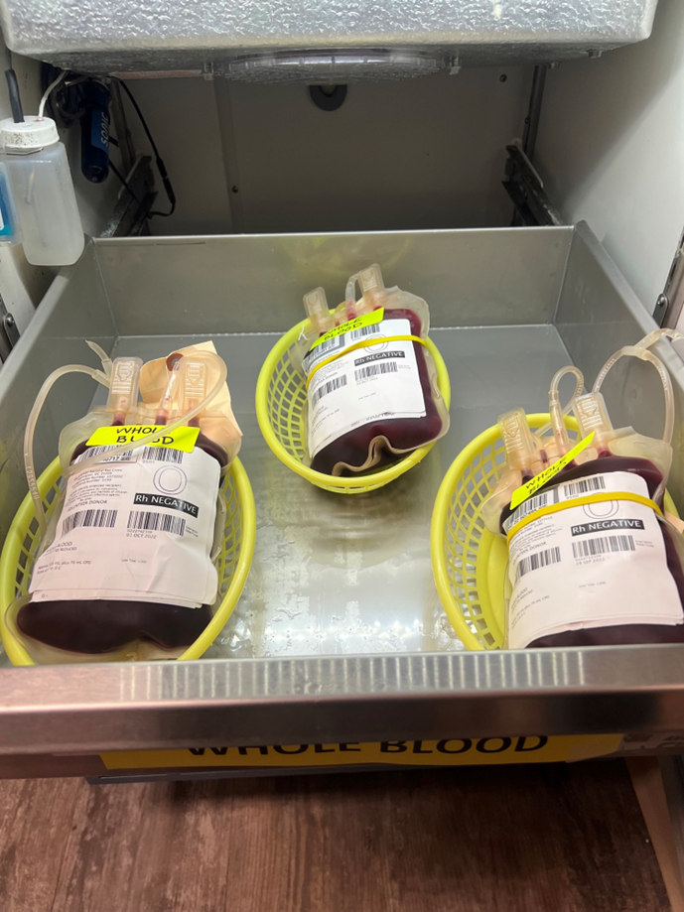
Riley ED Fridge

Slide 9
Whole Blood Policy Decisions
MH Fridge
  We will ideally have 8 trays, the mix of trays will be O Pos and O Neg (4 O Pos, and 4 O Neg/when available).
    If we don’t have O Neg for 4 trays, then set up a total of 8 trays with a mix of O Neg and O Pos.
  Continue to prepare MTP Component Trays

Slide 10
Fewer Trays of MTP in MH ED
1 Tray O Pos, 1 Tray O Neg and 2 Trays of A Plasma

Slide 11
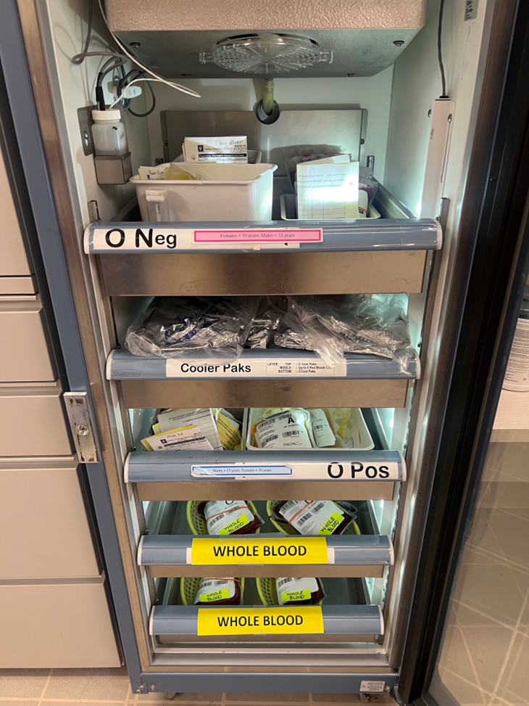
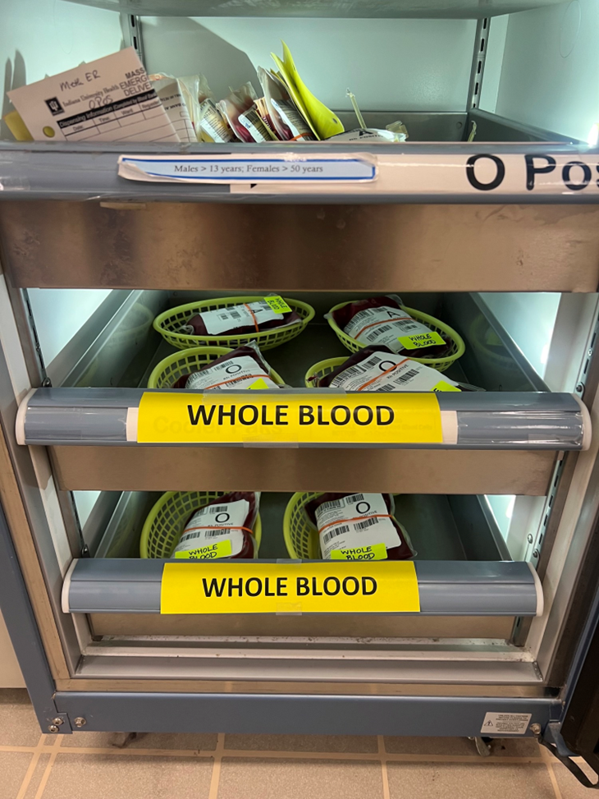
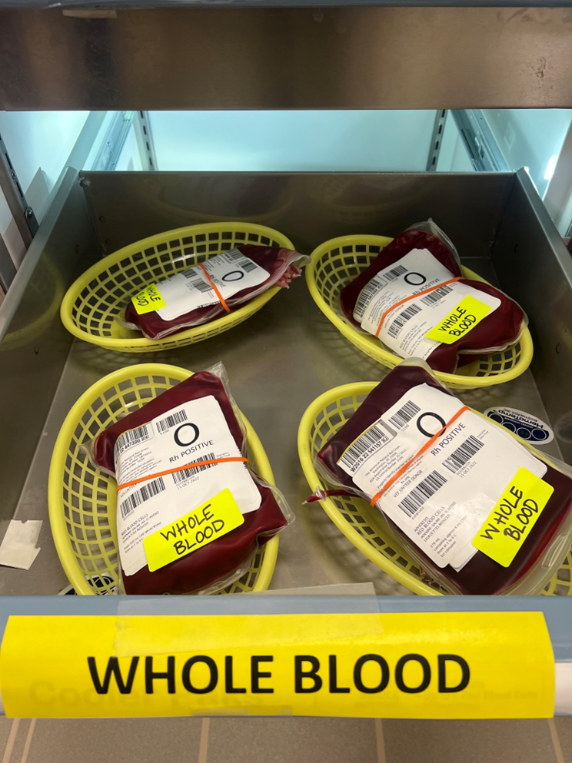
MH ED

Slide 12
Overall Process at MH vs. RH
MHBB
  Whole Blood from ARC
    Log in, Confirm blood type, Place on Designated Shelf
    Send segments to RH for storage
  Prepare 8 units for ED
    Mix of O Pos and O Neg (dependent on availability)
  Replace
    Replace if used or approaching expiration
  Complete the use of WB assigning to patient
    No crossmatch, only assigned
RHBB
  Whole Blood from ARC
    Log in, Confirm blood type, Place on Designated Shelf
  Prepare 3 units for ED
    Only O Neg with a replace date of 14 days from collection
  Replace
    Replace before Day 14
    Replace if used
  Complete the use of WB assigning to patient
    No crossmatch, only assigned

Slide 13
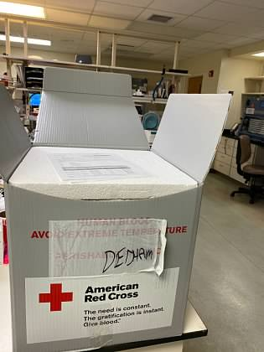
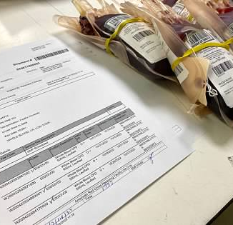
Whole Blood will arrive at MH and RH on an on-going basis
Check the units into inventory in Cerner

Slide 14
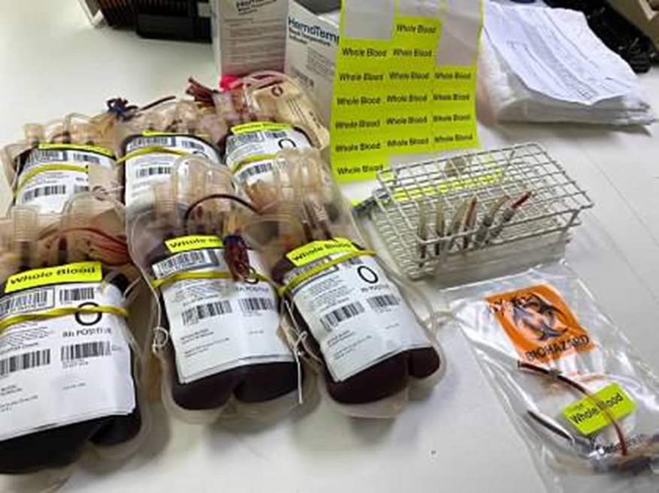
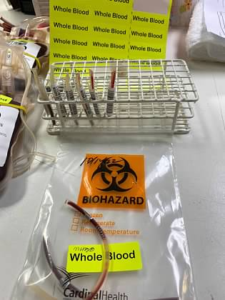
Pull Segments
  - At MHBB, create a segment bag and send to RH to have all retention segments at RHBB for any
  - At RHBB, place these segments in the designated bag with the bag of segments for the day
Add Yellow Whole Blood Sticker

Slide 15
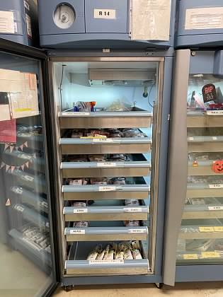
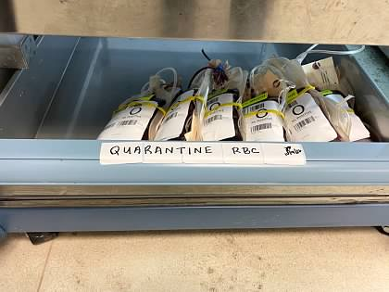
Place the units in QUAR location at each location while units are retyped.
  Units will have plasma bag and rubberband on them.
  Keep the rubberband, second bag and any tags on the unit at this time
  +++ Reason to keep the bag is to have physical reminder
  this is a Whole Blood

Slide 16
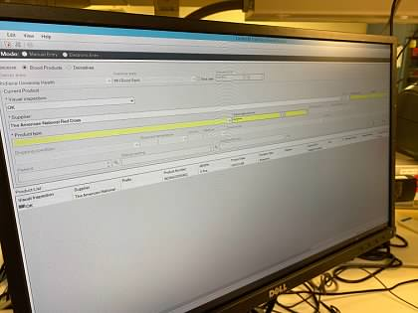
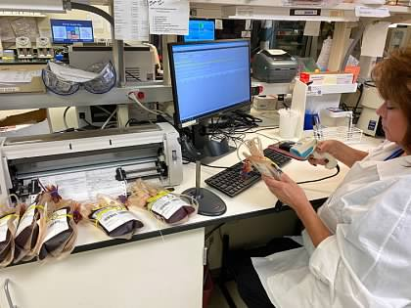
Complete retype either manually or on the Vision analyzer
After testing, then confirm the units in Cerner
Place the confirmed Whole Blood Units on the designated Whole Blood Shelf
  RHBB - front of lab in Immediate Release Fridge
  MHBB - in the TEG reagent fridge, designated from other products

Slide 17

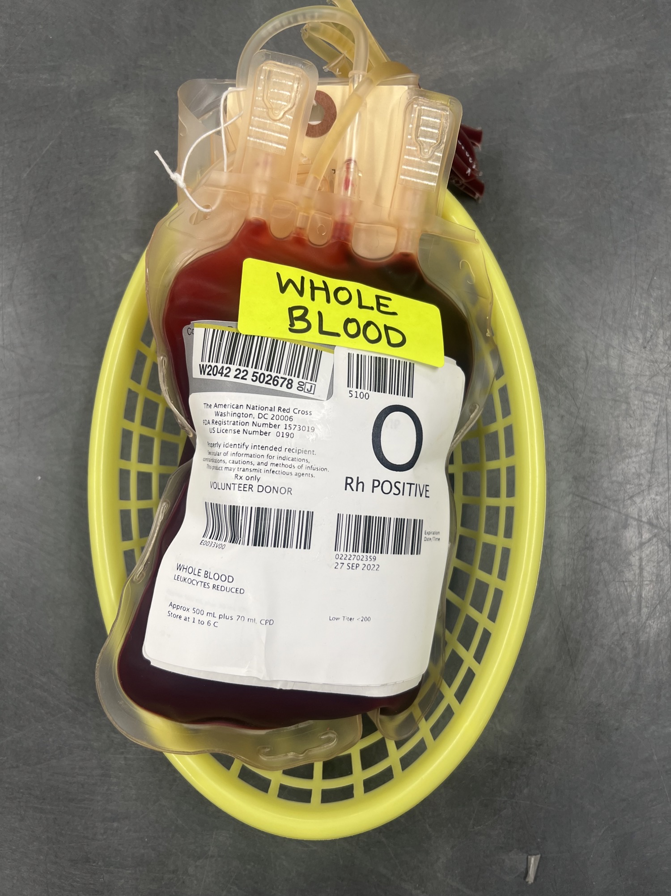
Prepare Whole Blood Baskets per facility
RHBB = 3 O Negative
MHBB = Total of 8 Units: 8 O Pos, or 4 O Pos and 4 O Neg (if available)

Slide 18
Whole Blood Paperwork Policy Change
Emergency Paperwork—removing the "initial and arrow down,” from SOP as an instruction.
New Instruction for Emergency Paperwork: Initial the Visual Inspection box for each product line on the form indicating that all components were inspected and found to be acceptable.

Slide 19
Whole Blood Process Change
Whole Blood Usage documentation
  No change in our practice with one exception: We assign the unit to the patient rather than XM
  We do not crossmatch Whole Blood
    This is a significant change
    Why do we not XM, we don’t XM because whole blood is RBC and Plasma.
      This product is not appropriate for e-XM.

Slide 20
Summary of WB Process at MH vs. RH
RHBB
  Whole Blood from ARC
    Log in, Confirm blood type, Place on Designated Shelf
  Prepare 3 units for ED
    Only O Neg with a replace date of 14 days from collection
  Replace
    Replace before Day 14
      After day 14, please transfer the unused O Negative WB to MH for use
    Replace if used
  Complete the use of WB assigning to patient
    No crossmatch, only assigned
MHBB
  Whole Blood from ARC
    Log in, Confirm blood type, Place on Designated Shelf
    Send segments to RH for storage
  Prepare 8 units for ED
    Mix of O Pos and O Neg (dependent on availability)
  Replace
    Replace if used or approaching expiration
  Complete the use of WB assigning to patient
    No crossmatch, only assigned
Fewer Component MTP Trays

Slide 21
Questions/Concerns?
Please contact
AHC Blood Bank Management group email
Keep your questions coming
This is a new process, and we encourage any feedback
or questions to help us improve this process

