Slide 1
Current Good Manufacturing Practices (cGMPs) with IUH BB Quality Plan
J.Slayten 2022

Slide 2

Course Objectives
Define terms related to the concept of GMPs
Review the historical background of GMPs
Discuss the basic elements of the GMP regulation, and the consequences of non-compliance
Introduction and review to the IUH Quality Plan

Slide 3

A Few Definitions
CFR – Code of Federal Regulations
FDA – Food and Drug Administration
Responsible Head – Medical Director
CBER – Center for Biologics Evaluation and Research.

Slide 4
GMP: A Not-so-Brief History
1988 Center for Biologics Evaluation and Research
1992 Clinical Laboratories Improvement Amendments of 1988
1993 Guidance for Quality Assurance in Blood Banks Establishments
Notes:
1988 – Center for Biologics Evaluation and Research (CBER)
New agency within the FDA is created to “protect and enhance public health” though the regulation of biological products.
1992 – Clinical Laboratories Improvement Amendments of 1988 (CLIA)
New regulation sets federal standards for clinical laboratories in areas such as personnel qualifications, competency, training, classification of testing by complexity, proficiency testing, etc.
1993 – Guidance for Quality Assurance in Blood Establishments
FDA begins to treat blood establishments more like manufacturers and requires strict compliance with cGMP regulation.

Slide 5
GMPs are …
Legal/Federal requirement representing the minimum practices (CFR)

Slide 6
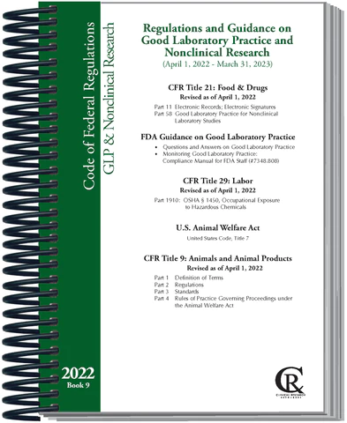
What is in the CFR?
Code of Federal Regulations
Title 21 – Food and Drugs
Chapter 1 – cGMPs
Subchapters:
“F” – Biologics (600 Series)
“C” – Drugs (200 Series)
“H” – Medical Devices (800 Series)

Slide 7
C
B
E
R
The Mission of the Center for Biologics Evaluation and Research is to protect and enhance the public health through the regulation of biological products including blood, vaccines, therapeutics,
and related drugs and devices, according to statutory authorities. The regulation of these products is founded on science and law to ensure their purity, potency, safety, efficacy and availability.

Slide 8
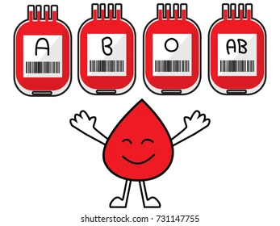
What is a Biological Product ?
21 CFR 600.3(b)
Any virus, therapeutic serum, toxin, antitoxin, vaccine, blood, blood component or derivative, allergenic product, or analogous product, or arsphenamine or derivative of arsphenamine (or any other trivalent organic arsenic compound), applicable to the prevention, treatment , or cure of a disease or condition of human beings.”

Slide 9

BIOLOGICAL PRODUCTS
REGULATED BY CBER
Vaccines
Allergenic Extracts
Blood Derivatives
Monoclonal Antibodies
Blood
Components
Biotech Derived
Therapeutics
Whole
Blood
Somatic
Cell & Gene
Therapy
Devices
Tissues
Xenotransplantation

Slide 10
Blood Products & the CFR
DRUG (211)
  Purity
  Safety
  Effectiveness
BIOLOGICS (600)
  Safety
  Purity
  Potency

Slide 11
Consequences of
Non-Compliance
MILD
Purity, Potency and Safety compromised
FDA Citation (483)
FDA Warning Letter
FDA Intent to Revoke Licensure
FDA Consent Decree
SEVERE

Slide 12
Benefits of GMPs
Improved products and customer satisfaction.
Consistent, reliable systems and processes for production.
Decreased product discards, rework, shortages.
Decreased regulatory problems.
Improved work environment.

Slide 13

Quality Assurance Program
A system of all activities necessary to assure and verify confidence in the quality of the process used to manufacture a finished blood component.
Blood manufactures must have a QC/QA unit that reports independently from production to the Responsible Head.

Slide 14

Responsibilities of the QA Unit
Assess impact of SOP changes
Review and Approval of all SOPs
Indexing of SOPs
Archiving of obsolete SOPs
Ensuring SOPs are accessible to staff
Ensuring validation protocols are written
Ensuring changes to the SOPs are documented

Slide 15

Responsibilities of the QA Unit
Approval of validation protocols
Approval of training program content
Approval of test procedures for QC
Error management
Record review
Internal audits
Job description approval

Slide 16
QA for BB = Quality Plan
Where is the BB Quality Plan?
  In PolicyTech
  What is the Quality Plan?
    The Quality System represents a formalized and structured plan designed to provide a process by which functions in the transfusion services are analyzed, formulated, implemented and continually monitored to achieve the desired goals.
    Requirements described in this document supplements requirements outlined in the Department of Pathology and Laboratory Medicine Quality Management Plan.
    Elements of the Quality System are derived from Quality System Essentials (QSE) as recommended by the AABB Standards forBlood Banks and Transfusion Services.
    These essentials address elements that include, but are not limited to, the receipt, collection, storage, processing, distribution, and transfusion of blood as required for current good manufacturing practice (cGMP)

Slide 17
Quality Plan
Organization
Resources
Equipment
Process Control
Documents and Records
Deviations, Nonconformances and Adverse Events
Assessments – Internal and External
Process Improvement Through Corrective Action and Preventative Actions
Facilities and Safety

Slide 18
What does GMP mean to me in the Blood Bank?

Slide 19

GMP Elements (21 CFR 606)
Record Keeping
Personnel
Calibration
Validation
Error Management
SOPs
Production Controls
Labeling/Lot Release
Facilities/Equip/Supplies
QA/Audits

Slide 20
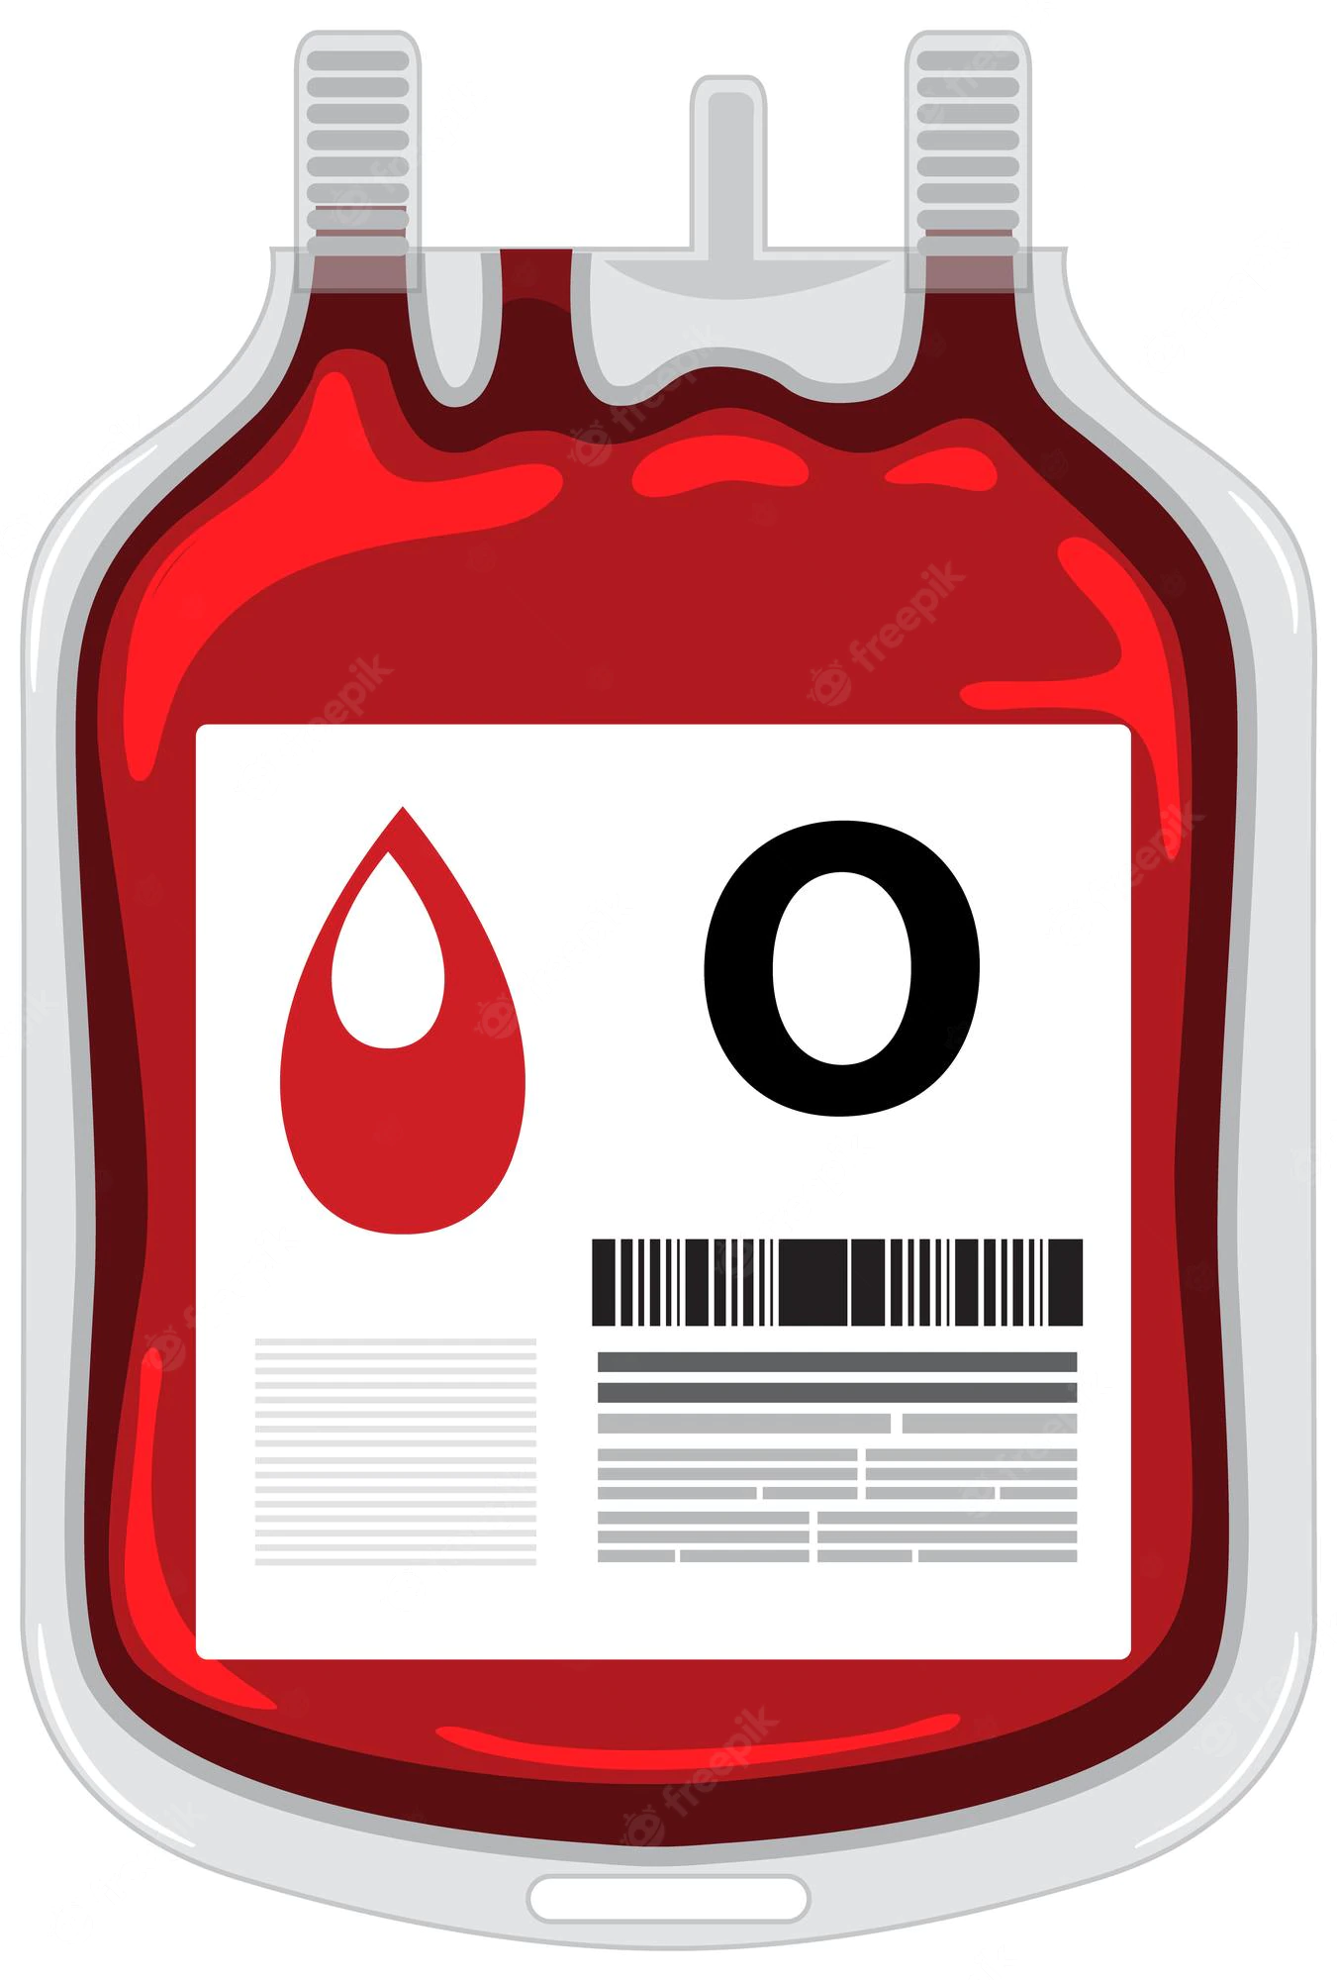


Record Keeping
Should provide a complete history of any component, including any process deviations or problems occurring during its life cycle.
Should provide trackability and traceability.
Manufacturing records must be reviewed prior to release of the product for distribution

Slide 21
Some Record Keeping Errors
Use of whiteout
Use of non-indelible ink
Use of pencil on an official record
Incomplete documentation
Documentation after the fact (non-concurrent)
Use of inappropriate forms
No review of records (QC/QA)
Inappropriate correction of a mistake

Slide 22
Personnel Training and Competency
Each person engaged in the manufacturing of a blood component shall have the education, training and experience to perform the assigned functions.
Training programs shall include GMP training.
Supervisors must have the necessary education, training and experience, and consultants must be documented.
Don’t perform any procedure you are not trained to perform
When training, do not sign off on tasks before you are confident and comfortable
IUH BB is changing practice to include this type of training. This will ensure all our team members are trained and prepared.

Slide 23
Calibration
Comparison between a measurement standard or instrument of known accuracy, an another standard or instrument of unknown accuracy in order to confirm, delete, correlate, report or eliminate by adjustment any variation in the accuracy of the item being compared.

Slide 24
Validation
Establishes documented evidence, which provides a high degree of assurance that a specific process will consistently produce a product (blood component) or result that meets its pre-established quality and performance specifications.

Slide 25
Validation Types
Retrospective (relies on historical data).
Prospective (before implementation) – IQ, OQ and PQ
  Installation Qualification
    Installation is generally performed by the vendor
  Operational Qualification
    Operational checks are performed by vendor and lab
  Performance Qualification
    Performed by lab
    Max and Min testing
    Normal profile testing and sample types.
Revalidation (must follow any significant change in the equipment, process or procedure).

Slide 26
Validation Protocol
  Should specify the following:
    Process description
    Responsibilities
    Tests to be completed
    Number of trials to be conducted
    Data collected
    Acceptable criteria
    Conclusions
    Approvals

Slide 27
Error Management
A system must be in place to prevent, detect, investigate and appropriately correct errors, in order to avoid adverse consequences.

Slide 28
Error Management
Includes deviations, accidents and incidents.
The FDA requires a thorough investigation and documentation of any deviation or variation from established SOPs, specifications or records.
Licensed establishments must report to the FDA all errors and accidents that may affect the safety, purity, or potency of the blood component.

Slide 29
Error Management
There shall be written records describing the handling of all written/oral complaints.
Blood component recalls must be documented.
Blood collection or transfusion-related fatalities must be reported to the FDA as soon as possible, and in writing with in 7 days.

Slide 30
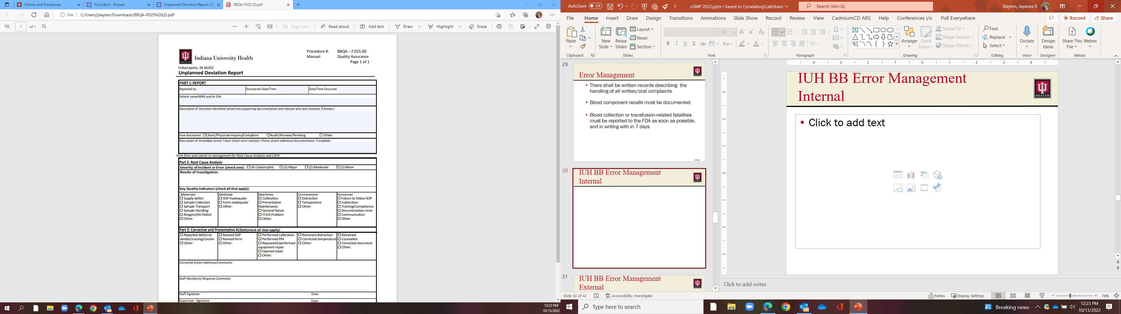

IUH BB Error Management
Internal
1
2
3
4
5
6
7
Send to Supervisory Review Box at RHBB – please use envelope

Slide 31
IUH BB Error Management
External – Ex. Nursing or Client Issue
1
2
3
4
5
6
7
Send to Supervisory Review Box at RHBB – please use envelope
Entered into Incident Reporting on Pulse Page

Slide 32

What do we track
Documentation Errors
Processes Deviations
Near Miss Events
Customer Complaints
Vendor issues
Trend Analysis

Slide 33
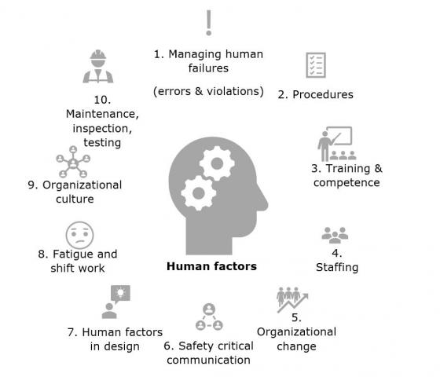
Error Management
The Responsible Head (Medical Director) must be informed of all complaints, errors, deviations, blood component investigations, recalls or regulatory actions.
Approach must be Non-Punitive, focusing on systems, processes and procedures, rather that individuals.

Slide 34
Some FDA Reportable Errors
Transfusion of a blood component:
  Repeatedly reactive to viral marker testing
  Intended for a specific donor, to another donor
  From a deferred donor
  Released prior to completion of all tests
  Incorrectly labeled (ABO type, expiration date,etc)
  Microbiologically contaminated

Slide 35
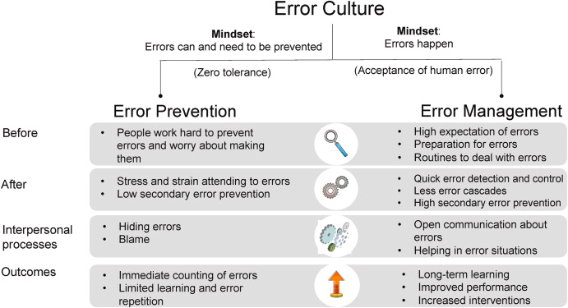
Response to errors
  SOP Change and Continual Process Improvement
  Culture has to change to meet this goal

Slide 36

Discussion –
Reported Events for IUH AHC BB
Testing error
Labeling Issue
Dispense Issue
  Example of corrective actions
  Continuing monitoring and continual improvement
Transfusion of incorrect blood to infant

Slide 37
Standard Operating Procedures
Written SOPs shall be maintained for all steps to be followed in the manufacturing of blood components.
SOPs shall be available for use in the areas where the procedures are performed.
SOPs must be reviewed, revised, approved and followed as written.

Slide 38
Labeling Controls
Labeling must be separate from other operations.
Labels for different product must be stored separately.
Obsolete labels must be destroyed.
Labels must be CLEAR and LEGIBLE.
Compared new labels to an approved copy.

Slide 39
Labeling Controls
Labels for blood components must not be altered or removed.
Instruction circular must be available when issuing the components.
Labeled blood components must be examined during finishing operations.
Components unsuitable for transfusion must be labeled “NOT FOR TRANSFUSION”

Slide 40
Facilities/Equipment/Supplies
Adequate space and design to ensure cleaning, maintenance, and proper flow of operations.
Equipment must be maintained in a clean and orderly manner.
All supplies and reagents must be stored in a safe, sanitary and orderly manner, and used according to manufacturer’s directions.

Slide 41
QA Auditing Functions
A mechanism for evaluating the effectiveness of the QA program.
Must be documented and include effectiveness checks of corrective actions and process improvement

Slide 42
Compliance with GMPs …
… is EVERYONE’S RESPONSIBILITY !!!

