Slide 1
IUH Blood Bank Quick Procedure Review: Vision Probe Maintenance for Max, Swift and Vinny
12.29.22

Slide 2
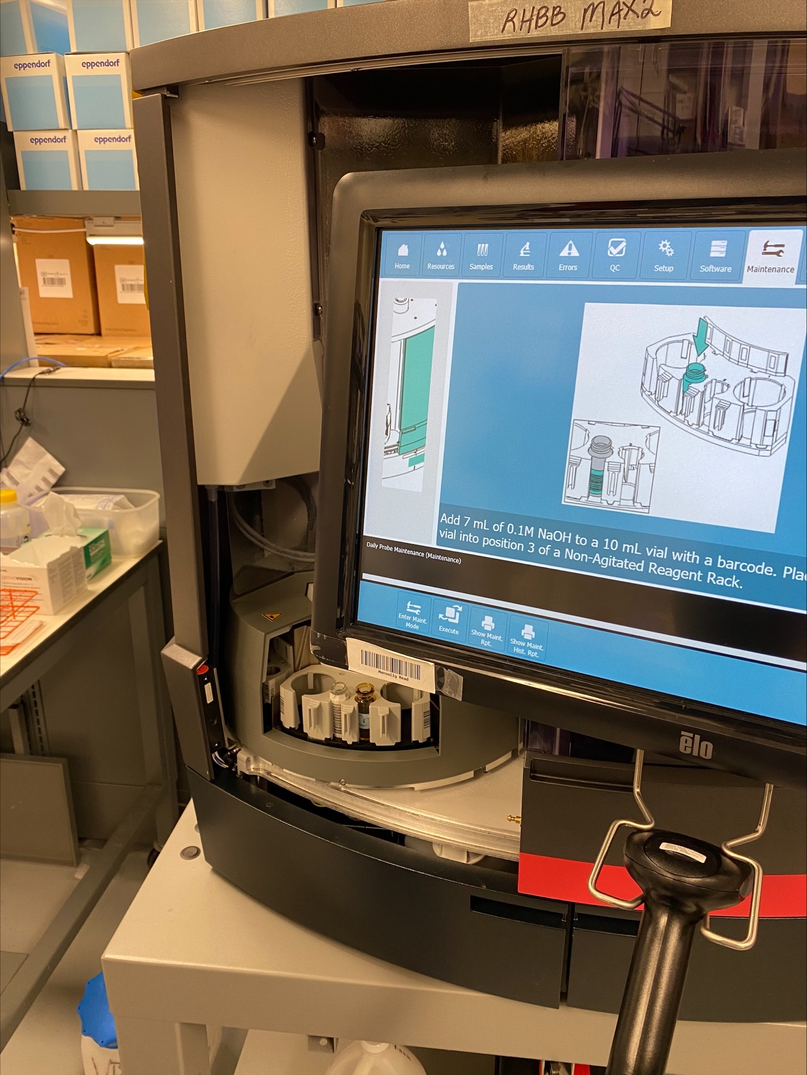
Probe Maintenance
A. Perform probe maintenance.
In the Home screen, select the Maintenance tab from the Menu bar.
2. Select Stop Processing and confirm by pressing the new Stop Processing prompt. The Vision may take a few seconds to finish processing.
3. Select Daily > Select Enter Maintenance Mode.
4. Select Daily Probe Maintenance > Press Execute button.
Notes:
VI. PROCEDURE
A. Perform probe maintenance.
1. In the Home screen, select the Maintenance tab from the Menu bar.
2. Select Stop Processing and confirm by pressing the new Stop Processing prompt. The Vision may take a few seconds to finish processing.
3. Select Daily > Select Enter Maintenance Mode.
4. Select Daily Probe Maintenance > Press Execute button.
5. When prompted, open the Load Station Door.
a. For Visions: With a transfer pipette, add 5 mL of 0.1 N NaOH to a 10 mL vial with a supported barcode.
b. For Vision Max: With a transfer pipette, add 7 mL of 0.1 N NaOH to a 10 mL vial with a supported barcode.
i. 0.1 N NaOH is obtained from the vendor. ii. Log the 0.1N NaOH into the blood bank reagent inventory SOP BBQC 052 Reagent/Supplies Inspection & Receiving .
c. Place the vial into position 3 of a Diluent Rack.
d. Place a new 5 ml or required 12 mL (dependent on the Vision) vial of ORTHO 7% BSA into position 2.
i. Load the Diluent Rack in the Sample Rotor position.
ii. Use a new vial of BSA each time.
iii. Do not combine open vials for 5 mL vials, but 5 mL vials may be combined for use when 12 mL vials are not available. Follow instructions on the analyzer for combination of vials for the larger volume of BSA.
e. Close the Load Station Door.
6. When prompted open the Maintenance Door.
a. Clean the Probe(s) with a lint free cloth moistened with 70% isopropyl alcohol.
i. WARNING: Be careful when cleaning to not cause harm to the probe. Be gentle and avoid bending probes.
b. Close the Maintenance Door. (Door is locked in place until the blue release button on lower left hand side of door is pressed.) The system will automatically complete the decontamination.
7. When prompted, open the Load Station Door.
a. Remove the Diluent Rack
b. Whenever possible, replace with alternate Diluent Rack.
i. The 2 Diluent Racks will be alternated every day.
ii. There should be one bottle of each, MTS Diluent 2 and MTS Diluent 2 Plus on the rack. Remove Diluent lids before loading on the Vision.
iii. If an alternate rack is not available, then one may be use the same rack and rotate the bottles of diluent.

Slide 3
Probe Maintenance
5. When prompted, open the Load Station Door.
a. For Visions: With a transfer pipette, add 5 mL of 0.1 N NaOH to a 10 mL vial with a supported barcode.
b. For Vision Max: With a transfer pipette, add 7 mL of 0.1 N NaOH to a 10 mL vial with a supported barcode.
0.1 N NaOH is obtained from the vendor.
ii. Log the 0.1N NaOH into the blood bank reagent inventory SOP BBQC 052 Reagent/Supplies Inspection & Receiving .
c. Place the vial into position 3 of a Diluent Rack.
d. Place a new 5 ml or required 12 mL (dependent on the Vision) vial of ORTHO 7% BSA into position 2.
i. Load the Diluent Rack in the Sample Rotor position.
ii. Use a new vial of BSA each time.
iii. Do not combine open vials for 5 mL vials, but 5 mL vials may be combined for use when 12 mL vials are not available.
Follow instructions on the analyzer for combination of vials for the larger volume of BSA.
e. Close the Load Station Door.

Slide 4
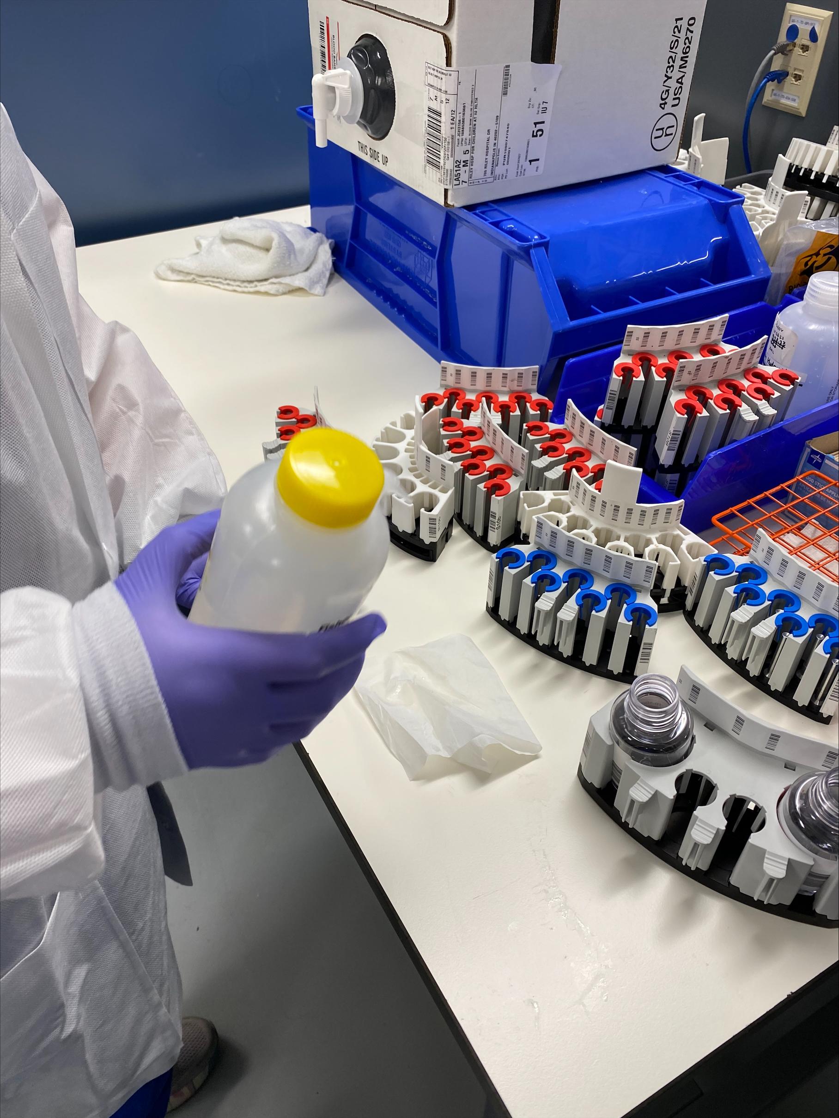
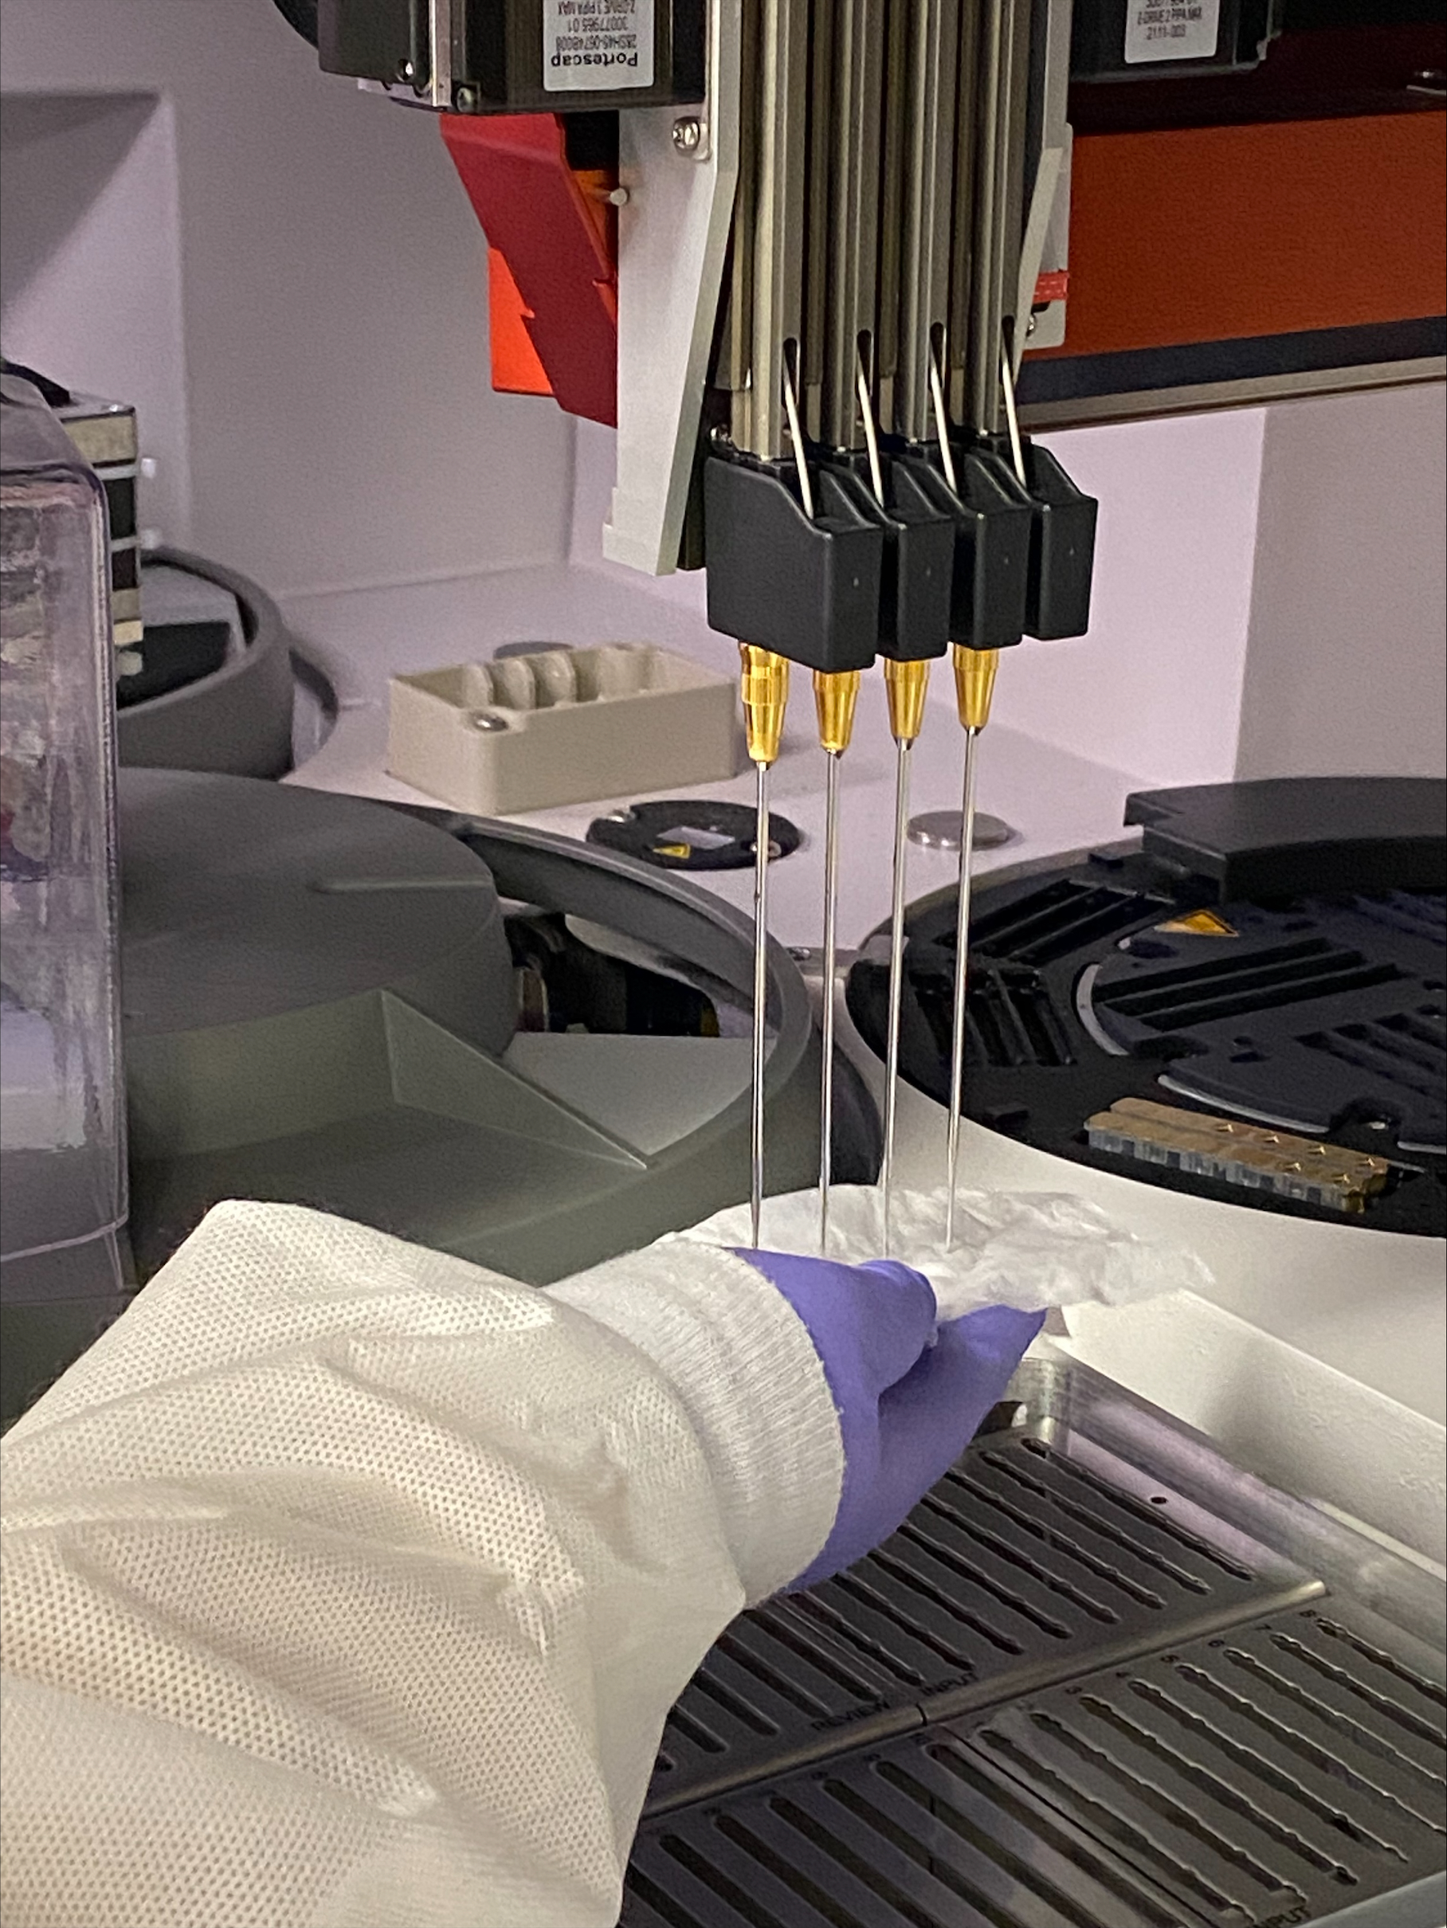
Probe Maintenance – Clean Probe by Blotting Probes rather than “Wipe Down” the probe
6. When prompted open the Maintenance Door.
a. Clean the Probe(s) with a lint free cloth moistened with 70% isopropyl alcohol.
i. WARNING: Be careful when cleaning to not cause harm to the probe. Be gentle and avoid bending probes.
b. Close the Maintenance Door. (Door is locked in place until the blue release button on lower left hand side of door is pressed.)
The system will automatically complete the decontamination.
Notes:
6. When prompted open the Maintenance Door.
a. Clean the Probe(s) with a lint free cloth moistened with 70% isopropyl alcohol.
i. WARNING: Be careful when cleaning to not cause harm to the probe. Be gentle and avoid bending probes.
b. Close the Maintenance Door. (Door is locked in place until the blue release button on lower left hand side of door is pressed.) The system will automatically complete the decontamination.
7. When prompted, open the Load Station Door.
a. Remove the Diluent Rack
b. Whenever possible, replace with alternate Diluent Rack.
i. The 2 Diluent Racks will be alternated every day.
ii. There should be one bottle of each, MTS Diluent 2 and MTS Diluent 2 Plus on the rack. Remove Diluent lids before loading on the Vision.
iii. If an alternate rack is not available, then one may be use the same rack and rotate the bottles of diluent.

Slide 5
Video of Probe Blotting vs. Probe Wipe Down This should prevent bent probe Click on Arrow at bottom of the picture to Watch

