Slide 1
BLOOD BANK TEAM MEETING
08.31.2022

Slide 2
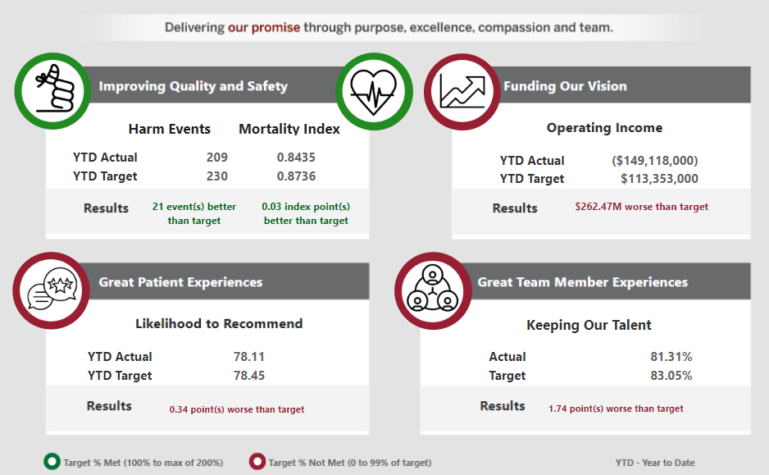
IU Health System Promise Dashboard – July 2022
Quality & Safety
Harm - All teams meeting except Riley
Mortality – all hospitals meeting Maximum (not just Target)
Great Patient Experience
Hourly rounding in waiting rooms
Region- and Service Line-specific tactics
Keeping Our Talent
Blitz interviews to improve time-to-fill
Funding Our Vision
90-day forecasts and improvement plans

Slide 3
Lab Promise Dashboard – July 2022
Goals Included in System Promise Dashboard
Improving Quality and Safety (Y/E Goal 25.30)
Blood Product Utilization (Red Blood Cell Units / 1,000 Patient Days)
Great Patient Experiences (Y/E Goal 78.59)
Likelihood to Recommend
Productivity Metrics (Y/E Goal $7.95 & 0.110)
Productivity Ratios
 | MTD Actual | YTD Actual | YTD Target
RBC / 1K Days | 26.90 | 23.67 | 25.30
 | MTD Actual | YTD Actual | YTD Target
NPS | 80.4 | 73.38 | 78.59
 | MTD Actual | YTD Actual | YTD Target
Tot. Cost / Test | 9.33 | 9.05 | 7.81
Hrs / Billed Test | .105 | .106 | .107
$8.80 YTD with Covid Buy-Ahead removed
$7.94 YTD with Core Budget Correction
Great Team Member Experiences (Y/E Goal 85.00%)
Overall Team Member Retention
Funding Our Vision (Y/E Goal $18K)
Operating Income ($100K)
 | YTD Actual | R12 Actual | R12 Target
% Retained | 88.10 | 83.41 | 85.00
 | MTD Actual | MTD Target | YTD Actual | YTD Target
OI | (698) | (178) | (6,115) | 117
(3,115) YTD with Covid Buy-Ahead removed
(1,388) YTD with Core Budget Correction

Slide 4
Blood Bank Metrics – Template
BLOOD BANK QUALITY MANAGEMENT PLAN ASSESSMENT (AUDIT) METRICS REPORT 2022
Policy Code # | Policy Description | Threshold | Jan | Feb | Mar | Apr | May | Jun | Jul | Aug | Sep | Oct | Nov | Dec
 | Specimen Identification Rejection Rate | ≤ 0.50%
 | Specimen Identification Rejection Rate -WBIT | 0.00%
 | Specimen Integrity Rejection Rate | ≤ 1.00%
 | TAT for Massive Transfusion Protocol (MTP) | ≥95.0%
 | TAT for Approved STATS | ≥ 92.0%
 | Corrected Reports Occurrence | ≤ 0.50%
 | Proficiency Testing Performance | 100%
 | Transfusion Blood Product Wastage | ≤ 5.0 %

Slide 5
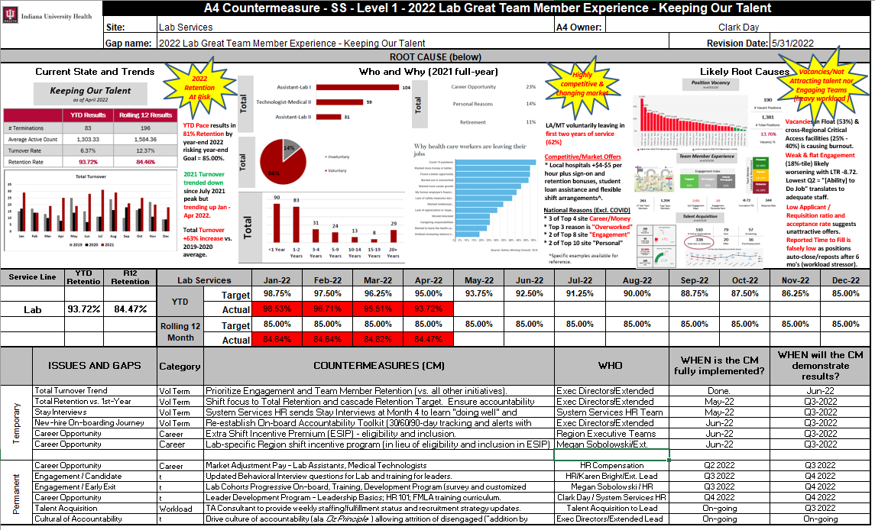
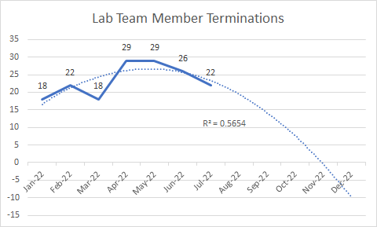
Lab Focus Priorities – Team Member Retention
Current State / Burning Platform
Retention is high at 88.10% YTD July
Rolling 12-month is 83.41%
2022 Retention Goal of 85% is At Risk
Losing mostly LA/MT in first 1-2 years
A4 Root Cause Analysis
Highly Competitive & Changing Market
Talent Acquisition challenges
Heavy Workloads
Countermeasures
Lab Cohort On-boarding & Training Program (Sep. 2022)
Market Adjustment Pay (Aug. 2022)
Talent Acquisition “Stay Interviews”
Leader Development
Drive Culture of Accountability

Slide 6
BLOOD BANK STAFFING
Open Positions*
Days
1 LA II
3 MT I/II
Evenings
1 LA II
2 MT I/II
Overnights
1 LA II
1 MT I/II
*several applicants in various stages of interview and review

Slide 7
BLOOD BANK WELCOMES NEW TEAM MEMBERS
Team Members joining the Blood Bank Team
Melani Vargas – 8/29/22 LA II Days
Aunyea Rippy – 09/06/22 MT1 (Contingent Worker)
Anna Johnston – 09/12/22 LA II Days
Rebecca Cer – 9/12/22 LA II Evenings
Angela Wanstrath – 09/19/22 MT2 Evenings

Slide 8
Dispense Errors
FDA Reportables are Increasing
Assign and Dispense Errors
5% of our Errors are FDA Reportable
Overall Error Rate = 1% of our workload volume
Immediate Actions
Keep blue form with product
Leave blue form BLANK (only to be filled in by TM performing Dispense)
Working with LIS to make modifications to product order requisition
Rearrange order details
Increase Font size
BOLD important information (i.e. requested attributes)
Other ideas?
Please submit suggestions via email to AHC Blood Bank Management

Slide 9
Projects Update
Cerner Electronic QC
build still in progress
IS XM Validation on Vision
in progress
Quotient Reagents
Implement mid-September
Whole Blood
To be Stored in ED (Riley and MH) for Trauma Patients only
Estimated start: Mid-October

Slide 10
ANNUAL COMPETENCIES
MEDIA LAB
Medtraining (MTS) modules assigned
Schedule and other Video training in TEAMS
AHC Blood Bank Competencies 2022 channel under AHC IUH BLOOD BANK Page
Quizzes and other observed Comps assigned in Media Lab
6 month; 12 month and Annual competencies
Team Leads and Supervisors will perform your observed competencies
All Competencies are due by 12/01/22

Slide 11
RECOGNITION
July Service Anniversaries
Abigail Hickson, Blood Bank (7/26) - 1 year
Alemzena Akelat, Blood Bank (7/26) - 1 year
August Service Anniversaries
Brenda Edwards, Blood Bank (8/2) – 40 years
Bukola Fatoye, Blood Bank (8/23) – 1 year
Alia Shobe, Blood Bank (8/23) – 1 year
Congratulations to Ruthie – Promoted to MTI
Congratulations to Cassie – Promoted to MTI
Congratulations to Abby – Promoted to MTI

