Slide 1
Irradiation:
Prevention of GVHD and Radiation Safety
IUH SBB Study Team / June 2020
JKS
Recorded in January 2023

Slide 2
Why do we irradiate blood?
To prevent transfusion-associated Graft-Versus-Host-Disease (GVHD)

Slide 3
What is GVHD?
GVHD is a transfusion-associated complication that occurs when:
  there is incomplete histocompatibility between the donor and recipient
  immunocompetent cells are present in the transfused component
  the recipient is unable to reject the grafted cells

Slide 4
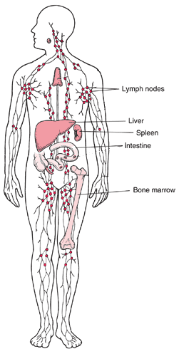
Organs and systems affected by
Graft Versus Host Disease
Spleen
Liver
Gastrointestinal tract
Bone marrow
Lymph nodes
Skin

Slide 5
Manifestations of GVHD
Fever
Skin rash
Loss of appetite
Nausea
Vomiting
Diarrhea
Hepatitis
Bone marrow suppression
Death

Slide 6
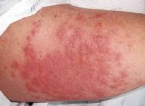
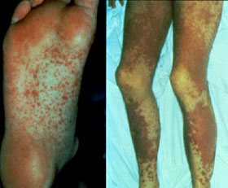
Manifestations of GVHD (continued)
Skin rashes caused by Graft-Versus-Host-Disease

Slide 7
Patients at risk for GVHD
Immunocompromised individuals:
  Bone marrow transplant patients
  Chemotherapy patients
  Radiation therapy patients
  Fetuses and newborns
  Heart, lung and liver transplant patients
Non-immunocompromised individuals:
  Recipients with same haplotype as the donor (genetically similar)
  Blood relatives of the donor

Slide 8
Treatment of GVHD
Treatment of acute onset GVHD is usually unsuccessful
Patients with chronic GVHD may respond to immunosuppressive regimens including steroids and alkylating agents
Because therapies have mostly been unsuccessful, prevention is paramount

Slide 9
What causes GVHD?
To better understand, let’s take a closer look at the immune system…

Slide 10
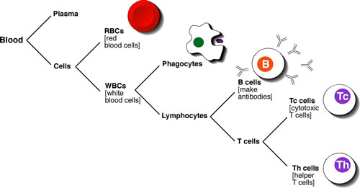
Immune System
Blood plays a central role in the immune system by carrying specialized cells called lymphocytes
Lymphocytes make up about 25% of white blood cells (leukocytes)
There are two types of lymphocytes, B cells and T cells

Slide 11
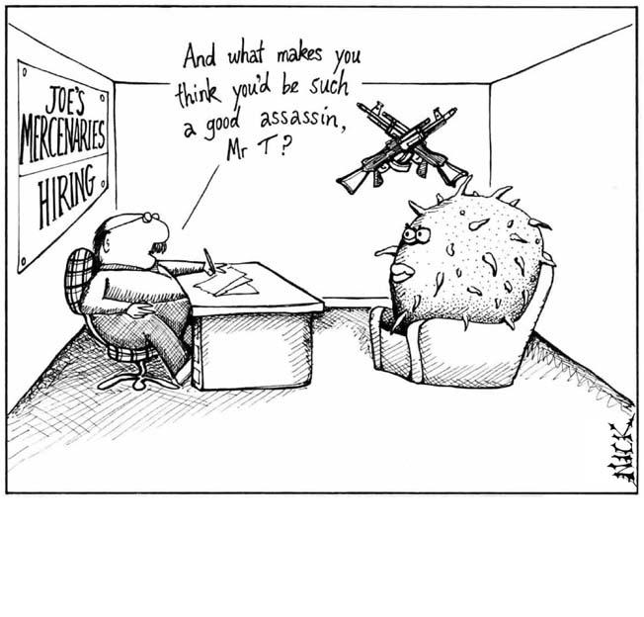
How lymphocytes work
Lymphocytes are transported to tissues throughout the body where they act as sentries on the lookout for foreign antigens
An antigen is a substance or marker that triggers an immune response
Once the immune system has been activated, the T cells orchestrate, regulate and coordinate the overall immune response
The invading microbe or other foreign invader is destroyed and eliminated

Slide 12
How lymphocytes work (continued)
In graft-versus-host-disease there are two basic scenarios
  One’s immune system is debilitated by disease (such as a cancer patient receiving chemotherapy) and the donor’s lymphocytes react against the already-weak recipient of a blood transfusion
  The recipient’s immune system fails to recognize the donor’s lymphocytes as foreign since recipient and donor are blood relatives with the same HLA haplotype

Slide 13

How lymphocytes work (continued)
In either case, the donor’s lymphocytes attack the recipient instead of being the other way around, where under normal circumstances the recipient’s immune system would recognize the foreign lymphocytes and eliminate them

Slide 14

How is GVHD prevented?
Graft-Versus-Host-Disease is prevented by irradiating blood and platelets for all recipients who either are immunocompromised or who are blood relatives of the donor.

Slide 15
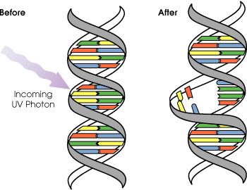
What happens when blood is irradiated?
When cellular blood components are irradiated, they are exposed to 25Gy of gamma radiation, a sufficient dose of radiation to damage the DNA of the donor lymphocytes, in effect rendering the lymphocytes incapable of replication, without affecting the function of red cells, platelets or granulocytes.

Slide 16
Transfusion Associated GVHD

Slide 17
73 y.o. male with a diagnosis of CLL, treated with fluradabine.
After developing thrombocytopenia, he received platelet transfusions (pooled platelet concentrates, 1 unit per 10 kg.) on three occasions

Slide 18
Three weeks later, the patient develops a skin rash in the trunk that later extends to the entire body.
He is admitted because of persistent diarrhea and fever of unknown origin.

Slide 19
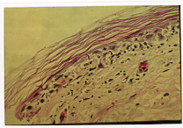
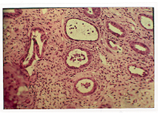
Treatment with corticosteroids and antibiotics is started, and biopsies of skin and colon are taken for diagnostic purposes

Slide 20
A diagnosis of transfusion-associated Graft vs. Host Disease (TA-GVHD) is made and an investigation is launched to determine the source of the lymphocytes that are infiltrating the patient’s tissues
Patient is put on immunosuppressive therapy.

Slide 21
Patient
A2 A9
B16 B40
Donor #14
A2 (blank)
B38 (16)
PCR from skin biopsy confirmed donor as a source

Slide 22
TA-GVHD Prophylaxis
Blood irradiation prevents donor lymphocyte replication by:
  Atomic ionization
  Free radical formation
  DNA damage that is severe enough to stop cellular division

Slide 23
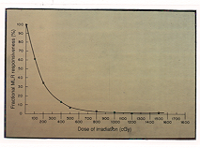
Radiation effects on lymphocytes

Slide 24
Effect on other blood cells
Red Blood Cells:
  Intracellular potassium loss
  Increased free Hgb levels in supernatant
  Cell viability shortened (28 days max)
Platelets:
  No qualitative or quantitative changes up for doses up to 50 Gy

Slide 25
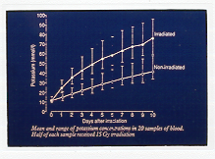
Effect of irradiation on rbcs

Slide 26
Requirements for the development of TA-GVHD
Transfusion of viable, immunocompetent cells that are able to replicate
Recipient must be unable to destroy the donor’s lymphocytes because:
  Cannot recognize the cells as non-self; or
  Cellular immune function is severely impaired

Slide 27
Factors that influence TA-GVHD development
Degree of histocompatibility between donor and recipient
Type of blood component transfused
Number of immunocompetent cells transfused
Medical condition of the patient:
  Age
  Ongoing infections
  Chemotherapy

Slide 28
Who is at risk for TA-GVHD?
Patients with severe cellular immunodeficiency:
  Congenital immunodeficiencies
  Bone marrow transplant recipients
  Leukemia or Hodgkin’s disease under treatment
  Intensive chemotherapy
  Fludarabine therapy

Slide 29
Who is at risk for TA-GVHD?
Recipients of cellular blood components collected from:
  HLA-compatible donors
  First degree blood relatives
Fetus receiving intrauterine transfusions

Slide 30
Who is at risk for TA-GVHD?
Some propose practicing irradiating cellular blood components transfused to:
  Infants supported by ECMO
  Neonates undergoing exchange transfusions
  Patients with AIDS on multi-drug therapy who have been tested and found non-viremic

Slide 31
Theoretical risks of blood irradiation
Latent-virus activation
Malignant transformation of viable nucleated cells in the component transfused
Address risk with Quality and Safely Irradiate Components

Slide 32
Radiation Safety

Slide 33
What is radiation?
Radiation is the process by which energy is emitted or propagated in the form of rays, waves or particles.

Slide 34
Forms of radiation
Sunrays (Ultraviolet)
Heat (Infrared)
Visible light
Microwaves (cooking; communication)
Radio waves (radio and television)
Background radiation (geologic or cosmic in origin)
Nuclear radiation (x-rays used in medicine)

Slide 35
In order to further understand the radiation process, it is necessary to briefly discuss atomic structure.

Slide 36
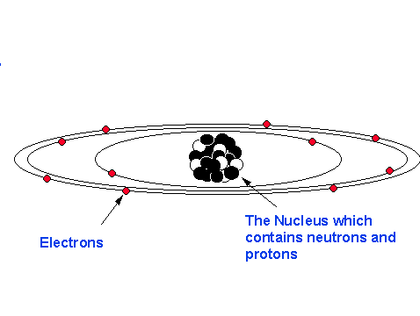
Atomic Structure
All matter is composed of minute particles called atoms.
The core of the atom is called the nucleus where two subatomic particles can be found: protons and neutrons.
Protons are positively charged particles, whereas neutrons carry no charge at all.
Orbiting about the nucleus of an atom are the negatively charged electrons.
Atomic Structure of Neon

Slide 37
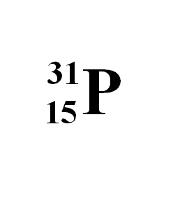
Elements
Every element is composed of atoms
An atom of phosphorous (chemical symbol P) contains 15 protons and 16 neutrons
The Atomic Number refers to the number of protons and is written to the lower left of the chemical symbol
The Atomic weight is the sum of the protons and neutrons and is written to the upper left of the chemical symbol

Slide 38
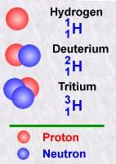
Isotopes
A nuclide is an atom described by its atomic number and its atomic weight.
Nuclides with the same number of protons but with different numbers of neutrons are called isotopes.
For example, deuterium and tritium are isotopes of hydrogen, with atomic weights two and three, respectively.
There are on the order of 200 stable nuclides and over 1100 unstable (radioactive) nuclides.
Radioactive nuclides can generally be described as those which have an excess or deficiency of neutrons in the nucleus.

Slide 39
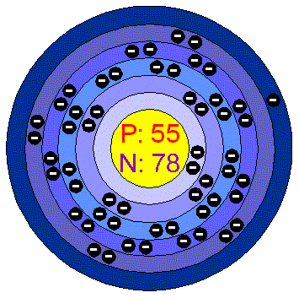
Isotopes (continued)
Cesium
Atomic symbol: Cs
Atomic number: 55
Atomic weight: 133
Isotope used
for irradiation
Cesium 137
Has 82 neutrons instead of 78
Half Life: 30.2 years
Cesium atom

Slide 40
Radioactivity
The spontaneous disintegration of radioactive substances (radioactive isotopes) in which the nuclei undergo breakdown (decay) and give off penetrating radiation (in the form of particles or rays)

Slide 41
Half Life
The time required for one-half of the original atoms in a sample to decay
The radioactive isotope used in the irradiator at Florida Blood Services is Cesium 137
The half life of Cesium 137 is 30.2 years

Slide 42
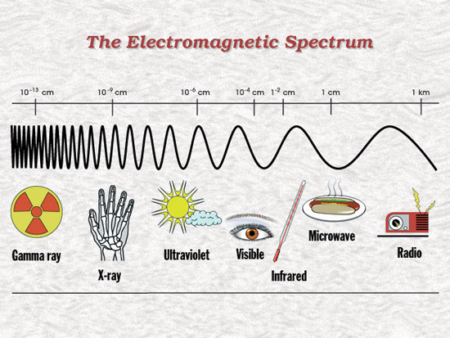
Radiation
Radiant energy is energy traveling in a wave motion
Electromagnetic radiation is measured in wavelengths
Radiation is the process of emitting radiant energy
There are two types of radiant energy:
  Ionizing
  Non-ionizing

Slide 43
Types of radiation
Non-ionizing radiation
  Type of energy that when striking an object it causes vibration leading to friction and therefore heat but not enough movement to remove tightly bound electrons from their orbit
  Example: ordinary white light
Ionizing radiation
  When an atom is exposed to ionizing radiation there is enough energy to remove electrons from their orbits causing the atom to become charged or ionized
  Examples: photons (x-rays, gamma rays), alpha and beta particles, neutrons

Slide 44
Ionizing radiation
Alpha Particles:
Particle ray consisting of two protons and two neutrons (a helium atom nucleus)
Product of spontaneous decay of radioactive atoms like uranium and plutonium
Travels short distance (1mm in water, 2-8cm in air)
Can be stopped by a single sheet of paper or the outer layer of dead human skin

Slide 45
Ionizing radiation (continued)
Beta particles
Particle ray consisting of a fast-moving electron
Produced following spontaneous decay of radioactive isotopes such as tritium and carbon-14
Can travel up to several meters in air
Plastic and wood are capable of stopping beta particles

Slide 46
Ionizing radiation (continued)
Gamma rays:
A photon, similar to ordinary visible light but shorter in wavelength than ultraviolet light, hence the higher energy level
Produced following spontaneous decay of cobalt-60 or cesium-137 (the CIS-US IBL 437 Irradiator utilizes cesium-137 as its radioactive material)
Can travel unimpeded for great distances
Can easily go right through people but can be blocked by lead

Slide 47
Ionizing radiation (continued)
X-rays:
Also a photon, has similar characteristics to gamma rays
When high speed electrons hit metals such as tungsten, electrons are deflected and release energy in the form of electromagnetic waves (x-rays)
As with gamma rays, x-rays have high penetration (depending on energy level) and can readily penetrate the body

Slide 48
Ionizing radiation (continued)
Neutrons:
Heavy, uncharged particles
Released as a result of nuclear fission (splitting of an atom) of uranium or plutonium
Cause ionization of atoms they strike

Slide 49
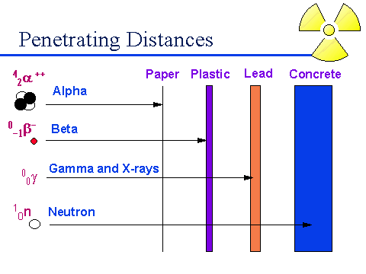
Radiation penetration

Slide 50
Biological effects of radiation
Alpha and Beta particles:
Health effects appear only when there is internal exposure through ingestion
Gamma rays and X-rays:
Capable of deep penetration into the body
Neutrons:
Don’t directly damage cells, however, they cause damage to the body by ionizing hydrogen (a constituent of water that accounts for 70% of the human body)

Slide 51
Biological effects of radiation (continued)
Radiation affects the cells of the body by ionization
Ionization of cells may have four consequences:
  Cells are undamaged
  Cells are damaged but repair and operate normally
  Cells are damaged, repair but operate abnormally
  Cells die as a result of damage

Slide 52
Calculating exposure
RAD:
Radiation absorbed dose
Quantity of ionizing radiation of any type that will deposit 100 ergs of energy in each gram of absorbing tissue
The rad has been replaced by the gray
GRAY
1 Gy = 100 rads
REM
Roentgen Equivalent Man
Accounts for difference in biological effectiveness
1 rem = rad x Q factor
Q factor: beta particles, gamma rays and x-rays = 1, alpha particles = 20
The rem has been replaced by the sievert
SIEVERT
1 Sv = 100 rem

Slide 53
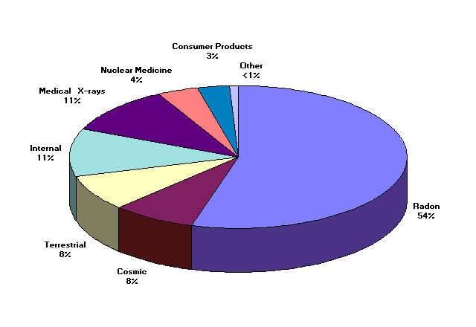
Sources of radiation exposure to the US Population

Slide 54
Exposure Sources and Limits
Limits for Exposures | Exposure
Occupational Dose limit (US - NRC) | 5,000 mrem/year
Public dose limits due to licensed activities (NRC) | 100 mrem/year
Source of Exposure
Average Dose to US public from All sources | 360 mrem/year
Average Dose to US Public From Natural Sources | 300 mrem/year
Average Dose to US Public From Medical Sources | 53 mrem/year
Average US Cosmic Radiation | 27 mrem/year
Average US Terrestrial Radiation | 28 mrem/year
Chest x-ray | 8 mrem
Dental x-ray | 10 mrem
Coast to coast Airplane roundtrip | 5 mrem
Three Mile Island (dose at plant duration of accident) | 80 mrem

Slide 55
Radiation Health Risks
Health Risk | Estimated Life Expectancy Lost
Smoking 20 cigs a day | 6 years
Overweight (15%) | 2 years
Alcohol (US Avg) | 1 year
All Accidents | 207 days
All Natural Hazards | 7 days
Occupational dose (300 mrem/yr) | 15 days
Occupational dose (1 rem/yr) | 51 days
Health Risk by Industry
All Industries | 60 days
Agriculture | 320 days
Construction | 227 days
Mining and quarrying | 167 days
Manufacturing | 40 days

Slide 56
Limiting Radiation Exposure
The three variables to keep in mind are:
Time
Distance
Shielding

Slide 57

Time
Decrease the Time, Decrease the Exposure
Increase the Time, Increase the Exposure

Slide 58
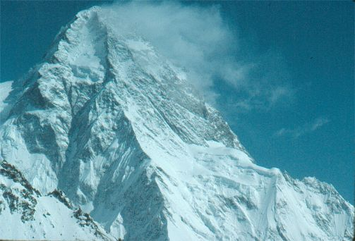
Distance
Increase the Distance, Decrease the Exposure
Decrease the Distance, Increase the Exposure

Slide 59
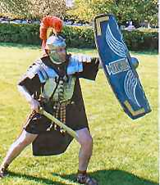
Shielding
Increase the Shielding, Decrease the Exposure
Decrease the Shielding, Increase the Exposure

Slide 60
Measuring Radiation
As part of quality control and safety procedures, it is necessary to monitor the function, efficacy and safety of the irradiator. Radiation measurement devices include:
Survey meters (Geiger counter)
Dosimeters (Film badges are not required at FBS)
Rad-sure labels (indicator changes when exposed to adequate dose of radiation)

Slide 61
ALARA
As
Low
As
Reasonably
Achievable
ALARA is the acronym for As Low As Reasonably Achievable, a radiation safety principle for minimizing radiation doses and releases of radioactive materials by employing all reasonable methods.
ALARA is practiced through safety training, continuing education, quality and safety controls.

Slide 62

Summary
GVHD
TA-GVHD
Radiation Safety

