Slide 1
APHERESIS TEAM MEETING
04.12.2023

Slide 2
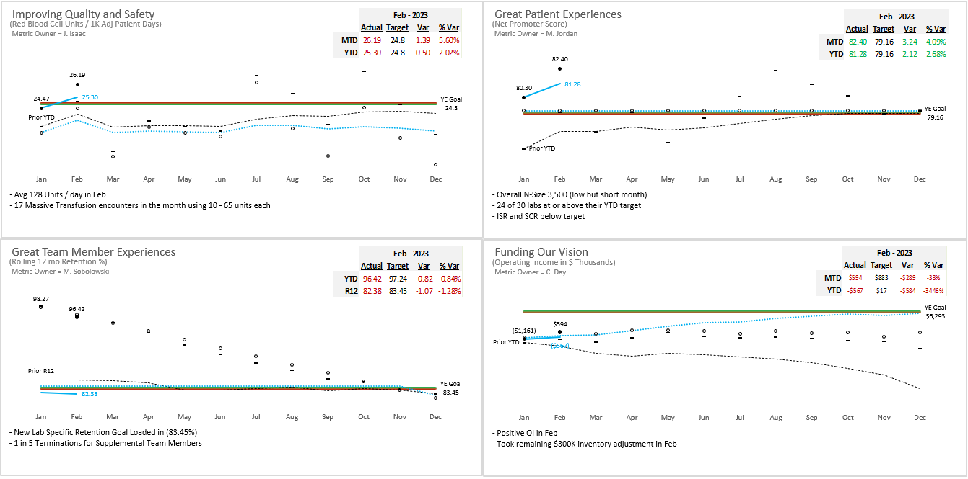
Pillar Metrics Overview

Slide 3
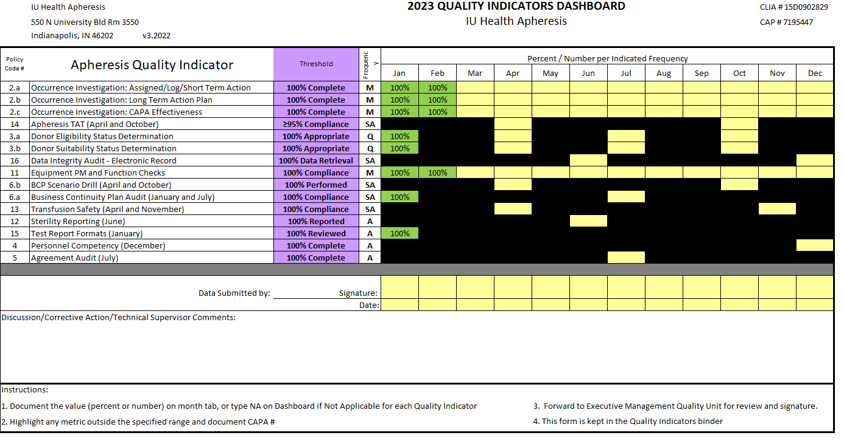
2023 Metrics

Slide 4
2023 Goals
Remember to set goals in Oracle—they’re due this month. Goal setting (part of performance development conversations) requires team members to set at least one performance goal specific to IU Health and one career goal for the coming year. Non-nurse leaders and teams have until Friday, April 14, to set goals in Oracle.
RNs have until Friday, April 28.

Slide 5
Apheresis Staffing Update
Sarah Baker- Past Apheresis RN will start 5/7
Madeline Sanders- Starts 5/7
CVICU RN at Riley
PCA Status Update
Scope of Practice in Apheresis
Assigned a PCA educator

Slide 6
Team Member Engagement
Engagement Update
Focus on improving engagement scores
Team to choose 1-2 main areas for improvement
Teamwork priority
Nursing Education
Led by Dr. LePage and Andrew Nord
1st meeting scheduled 5/3/2023
Any topics or ideas can be submitted to Dr. LePage
Recognition
Gallup research shows that recognition is impactful for individuals when it comes from both leaders and peers. Encourage team to share praise more often with each other in the moment, when they notice someone doing a great job.
Kudos for Colleagues (Email sent by Dr. LePage)
recognition is impactful for individuals when it comes from both leaders and peers. Empower and challenge your team to share praise more often with each other in the moment, when search shows that recognition is impactful for individuals when it comes from both leaders and peers. Empower and challenge your team to share praise more often with each other in the moment, when they notice someone doing a great job.

Slide 7
Blood Administration

Slide 8
Blood Administration
Follow all steps in Procedure: Blood/Blood Component Transfusion During Apheresis Procedures
Dispense Slip
Check and verify each unit listed on the dispense slip
Your signature indicates you have followed steps in the policy.
Second check when connecting to apheresis machine.
Your initials on the form indicate you performed this step.
Check one unit at a time. No where in the policy does it state you can check multiple units at a time. Do not take short cuts with blood administration.
Every patient MUST have an armband on. This will be audited. Breach of this policy will result in an immediate corrective action.

Slide 9
Apheresis Updates
Cell phone usage during Apheresis procedures
Complaints from patients regarding nurse on cell phone during procedure.
It is ok if you are reading/responding to work diagnotes.
Understand patient perspective of safety concerns.
Please make a copy of the procedure consult request. This is used to audit.
Riley Apheresis
Do not leave personal belongings at nurse’s station/med room.
Blood Bank break room with lockers is available.
Any empty locker with a key is available.
Refrigerator available to store food.
Cited by EOC inspection.
Lab Week of April 24th
Lunch and learn provided by Therakos on 4/26

Slide 10
QA Update - Dave
Inspection Update
AABB – Inspection
Great Inspection with no citations.
Inspector very complimentary of team.
Please continue to notify and involve QA as issues happen.

Slide 11
Values Acknowledgments: Purpose, Excellence, Compassion, Team
Excellence:
Joe, Charloom, and Anita were all observed performing a procedure during the AABB inspection.
The assessor was very complimentary of the nursing team and how relaxed patients were during procedures. She stated the patients had a lot of trust in our team.

Slide 12
Additional Topics Addressed/Updates
We have ordered wireless scanners to make armbands easier to scan while on patient wrists.
Badge numbers will be provided to security for access to the Riley blood bank break room
Doors will begin opening at 0715. We will have proper signage stating that patients will be required to wait in the waiting area and we have requested to have a badge scanner placed on the back door for added security (there is no current information on how long this will take).
Regarding procedure consult requests, we are working on a process so that we all have clear roles.

