Slide 1
CTL TEAM MEETING
04.28.2023

Slide 2
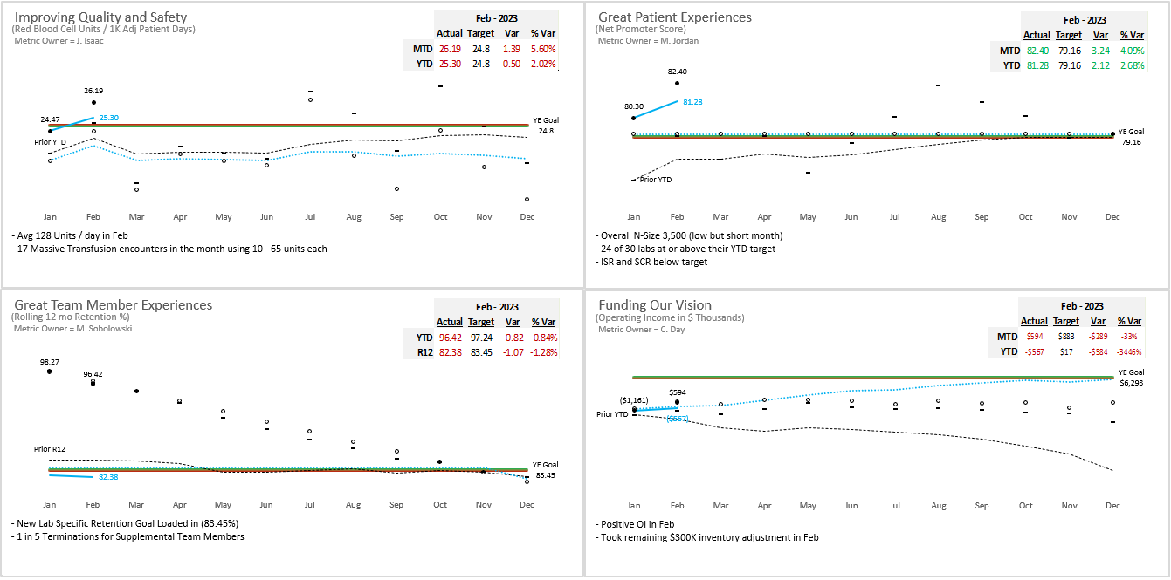
Pillar Metrics Overview

Slide 3
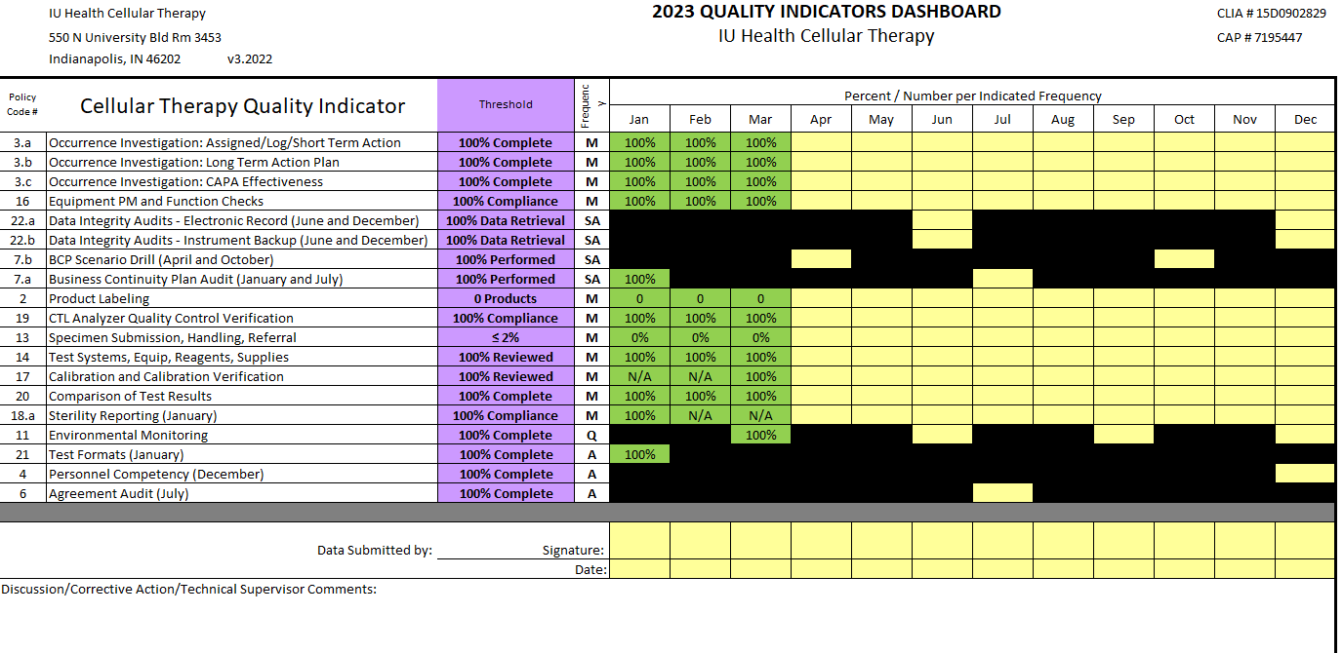
2023 Metrics

Slide 4
Team Member Engagement
Engagement Update
Focus on improving engagement scores
Team to choose 1-2 main areas for improvement
Teamwork priority
Recognition
Gallup research shows that recognition is impactful for individuals when it comes from both leaders and peers. Encourage team to share praise more often with each other in the moment, when they notice someone doing a great job.
Kudos for Colleagues (Email sent by Dr. LePage)
recognition is impactful for individuals when it comes from both leaders and peers. Empower and challenge your team to share praise more often with each other in the moment, when search shows that recognition is impactful for individuals when it comes from both leaders and peers. Empower and challenge your team to share praise more often with each other in the moment, when they notice someone doing a great job.

Slide 5
Team Member Engagement – Question 1
Q01: Questions to Ask Your Team
How do you know if you are doing a good job?
Are there times when you don’t know what your top priority should be?
How can we as a team help one another communicate needs and priorities?
How can we communicate better especially when work is hectic or quick action is needed?

Slide 6
Cellular Therapy Updates
Team Lead Position has been opened.
Will be only be filled by an internal candidate due to complexity of CTL and the specialized knowledge needed
Miltenyi Freeze Bag Validation
Preliminary qualification started
Validation finalization meeting set for the middle of next week
Need guidance from the doctors to set process and acceptable endpoints
FACSLyric Validation
I have set a 5/15/23 Go Live Date
SOPs and Forms in PolicyTech approval pathway
Please follow the email link and access BD training modules/videos

Slide 7
QA Update - Dave
Inspection Update
AABB – Inspection
Great Inspection with no citations.
Inspector very complimentary of team.
Please continue to notify and involve QA as issues happen.
- Temperature and Humidity alarms that are in the Action level require an Occurrence form to be submitted also.

Slide 8
Values Acknowledgments: Purpose, Excellence, Compassion, Team
Excellence:
Jennifer, Brody and Melissa were observed performing a procedure during the AABB inspection.
The assessor was very complimentary of the laboratory team. She stated that it was obvious that the lab team had a great deal of knowledge and were very well trained.

