Slide 1
APHERESIS TEAM MEETING
05.17.2023

Slide 2
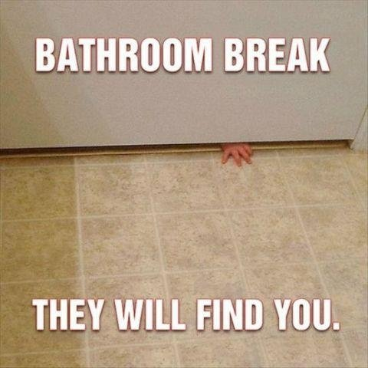
Shout outs
HAPPY BELATED MOTHER’S DAY!!
HAPPY BIRTHDAY
Jenn- 4/30
Anne- 5/9
Jeb- 5/16

Slide 3
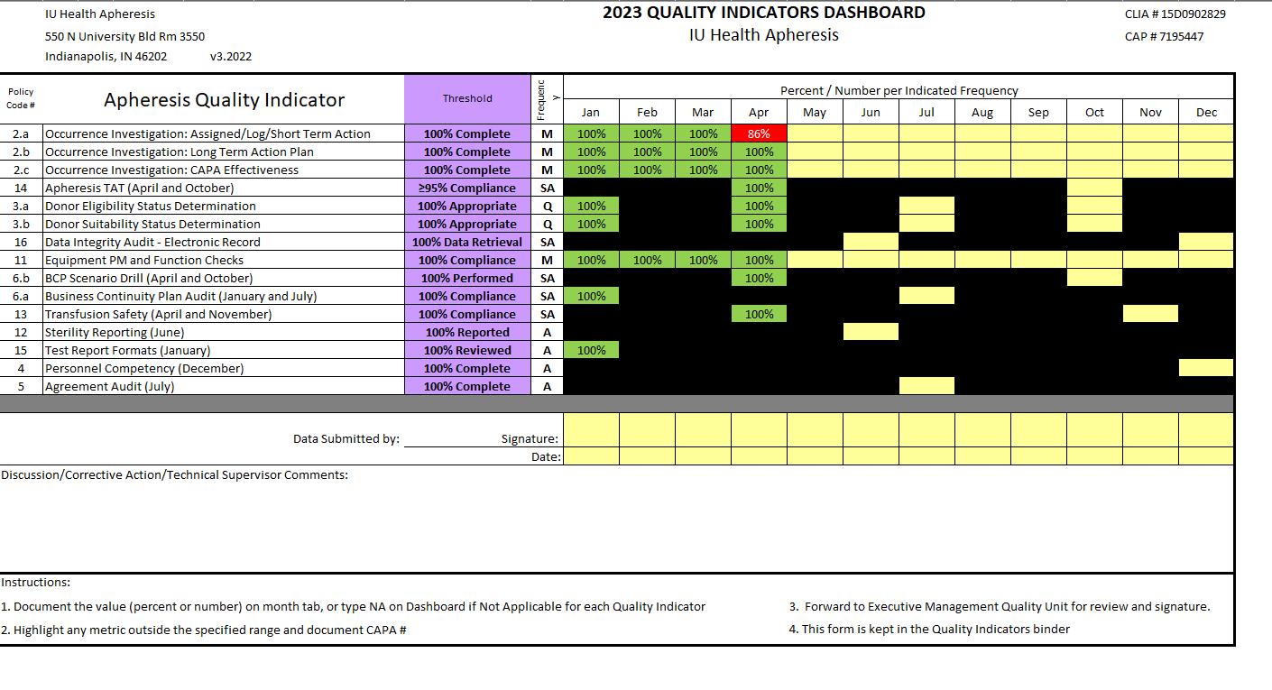
2023 Metrics
*
*Late entry of Occurrence into log due to incomplete or lost forms.
Please make sure all paperwork is complete and handed in on time. All pages need to be filled out – the nonconformity form is a constant issue (no name, date, missing information, etc)

Slide 4
Apheresis Training Update
Robin- Stem training
Sarah Baker- Photopheresis
Madeline Sanders- Photopheresis

Slide 5
Team Member Engagement
Engagement Update
Focus on “I have had opportunities at work to learn and grow”
Nursing Education
Starting 6/28/23 and will be monthly
45 minute sessions
Will be recorded for anyone unable to make it
First topic will discuss specific disease process requiring Apheresis
Email any ideas for education to Dr. Lepage
Kudos for Colleagues

Slide 6
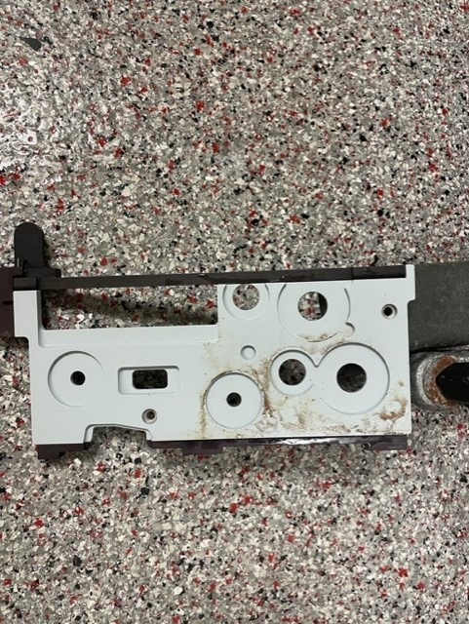

Slide 7
Machine Cleaning
If there is an extensive spill of blood products on the machine, contact Darren Douglass so that he can assist with accessing any unreachable parts.
Please break down machines prior to leaving patient rooms on inpatient units.
Bloody tubing should never be transported through the halls due to safety concerns.

Slide 8
Patient Safety Survey
10 question survey through Gallup 5/16/23-6/2/23
Action plan will be created for discussion based on results

Slide 9
QA Update - Dave
Inspection Updates
CAP 6/5/23-6/9/23
Mainly CTL
--NMDP 6/14/23
* Please log into Medialab and
finish the items you need to
review for Personal
Documentation – the ELMS
upload needs the employees
final review for some reason.
* Log into MTS and review training documents
on a regular basis – some employees are missing
quite a few acknowledgements.

Slide 10
UH BLOOD BANK
UH blood bank is now locked at all times due to a regulatory requirement.

Slide 11
Values Acknowledgments: Purpose, Excellence, Compassion, Team
Excellence:
Thank you to Joe, Robin, and Jay for assisting in getting me checked off on Photopheresis!!
Thank you Robin for our wonderfully decorated wall outside of Apheresis!

