Slide 1
CTL TEAM MEETING
05.31.2023

Slide 2
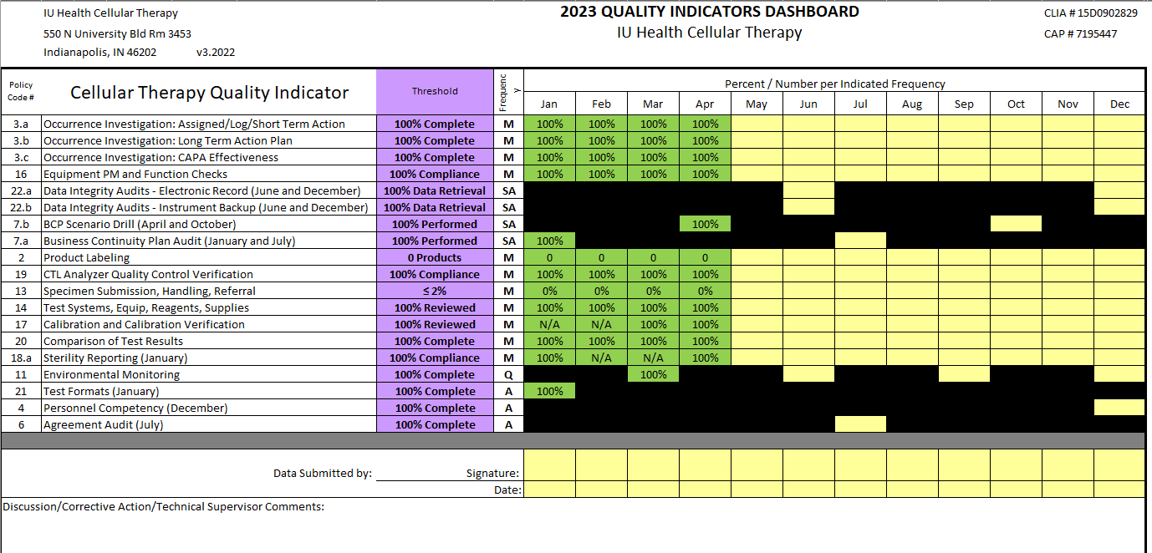
2023 Metrics
*

Slide 3
IU Health News
Financial issues remain at the forefront.
Driven mainly by scarcity of trained applicants, higher wages and increased costs of supplies.
IU Health is in a better position than other hospitals.
We plan to be back on track by the end of the year.
Ways to help
Avoid overtime – I understand that OT is necessary occasionally due to workload but please send me a note if that is the case.
Be good stewards of your work time -find extra projects or take low census when the workload is down.
Think about waste – wasted supplies, employee time, or other resources.
How can we do things more efficiently?
Perform a waste walkthrough of the lab.

Slide 4
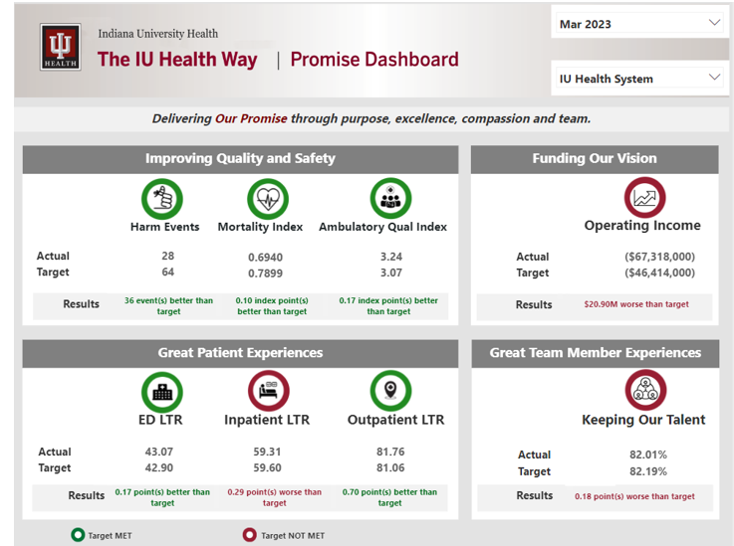
IU Health News

Slide 5
Team News
Steven has taken the CTL Team Lead Position.
We will need to pull him from bench work from time to time for other projects.
Melissa has taken on the CTL Research Coordinator Role.
She will be splitting her time between research activities and CTL routine work.
Please ask if you need her on a bench – research projects at times are her 1st job, time consuming and need to meet deadlines.
While she will be the expert on protocols, the entire team needs to be willing to participate.

Slide 6
Team Member Engagement
Engagement Update
Focus on “At work, my opinions seem to count”

Slide 7
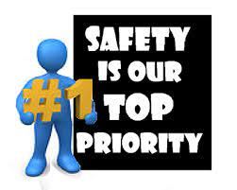
Patient Safety Survey
10 question survey through Gallup 5/16/23-6/2/23
Action plan will be created for discussion based on results

Slide 8
QA Update - Dave
Inspection Updates
CAP 6/5/23-6/9/23
Mainly CTL
--NMDP 6/14/23
* Please log into Medialab and
finish the items you need to
review for Personal
* Log into MTS and review training documents
on a regular basis
Please fill out an Occurrence F-228 along with
the F-126 when a temperature or humidity is in
an “Action” range.

Slide 9
UH BLOOD BANK
UH blood bank is now locked at all times due to a regulatory requirement.

Slide 10
Values Acknowledgments: Purpose, Excellence, Compassion, Team
Excellence:
Thank you to Hillary and Emma for getting the Miltenyi bag validation performed quickly and efficiently.
Thank you Brody for getting the dextran re-validated.

