Slide 1
APHERESIS TEAM MEETING
06.29.2023

Slide 2
Shout outs
HAPPY BIRTHDAY
Joe- 7/1
Sarah- 7/19

Slide 3
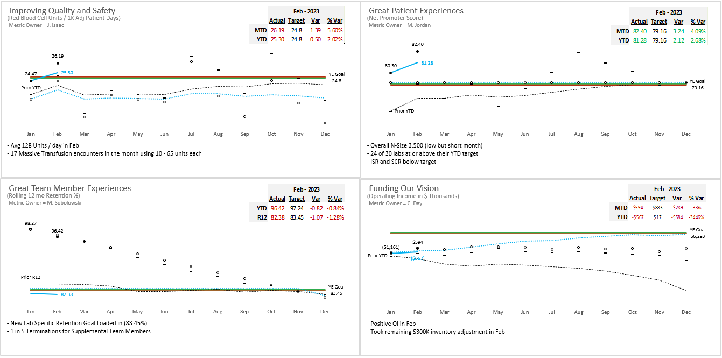
Pillar Metrics Overview

Slide 4
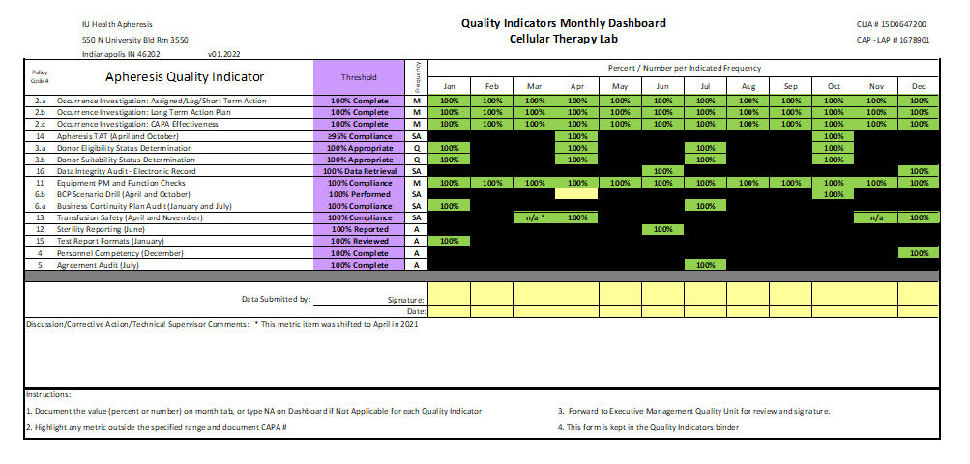
2022 Year End Metrics

Slide 5
Apheresis Training Update
Sarah Baker- RBCX and TPE
Madeline Sanders- STEMs

Slide 6
Team Member Engagement
Engagement Update
Focus on “I have had opportunities at work to learn and grow”
Nursing Education
Tentatively 7/6/23 and will be monthly
45 minute sessions
Will be recorded for anyone unable to make it
First topic will discuss specific disease process requiring Apheresis
Email any ideas for education to Dr. Lepage
Kudos for Colleagues

Slide 7
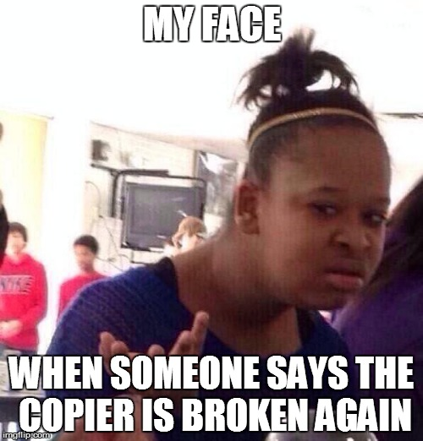
Team Member Engagement
I Have the Materials and Equipment I Need to Do My Work Right
-Any issues? Please send an email if issues are present.

Slide 8
QA Update - Dave
Inspection Updates
-CAP and NMDP inspections went well!!
Remember
-Document alcohol prep pad expiration dates
-Log and print certificates for ALL required supplies prior
to placing into stock.
-Please continue to place all donor registration form into Sakiah’s mailbox

Slide 9
Values Acknowledgments: Purpose, Excellence, Compassion, Team
Excellence:
Thank you to Madeline for constructing an Excel spreadsheet for supply ordering!
Congratulations to Agnes starting as NP on 7/1/23!

