Slide 1
APHERESIS TEAM MEETING
08.09.2023

Slide 2
Pillar Metrics

Slide 3
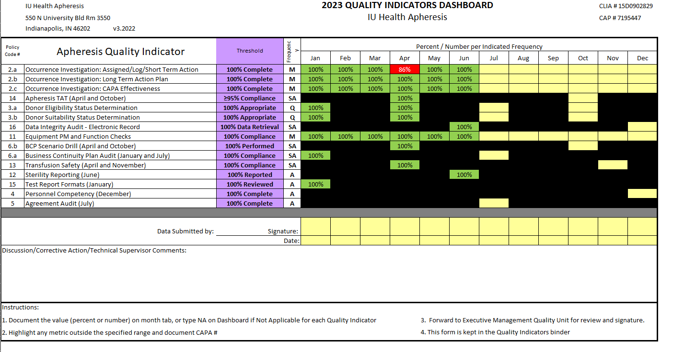
Apheresis Metrics

Slide 4
Housekeeping Items
Be sure that you are asking providers prior to placing ANY orders.
New template item for port access.
Please do time outs prior to starting procedure and glance at previous run records or notes.
- NEVER treat the patient without an order (example, we DO NOT manage some pediatric calciums).
Please send a Diagnotes to the group chat prior to starting ANY inpatient or Riley procedure.
- The providers would also like to know all ionized calcium results, etc. even if they are normal
Nursing notes- Please delete line access issues portion if there were no issues.
Please notify management if a patient passes away or any other adverse event.
New inpatient line documentation in the Cerner I/O Flowsheet

Slide 5
Apheresis Training Needs
Sarah Baker- RBCX and TPE
Madeline Sanders- STEMs
Jay Head- RBCX
CAR-T training- Sarah, Madeline, and Robin

Slide 6
Staffing updates
Jennifer Barnett is reducing her work hours
SBAR for a PCA and FT RN submitted, awaiting position control

Slide 7
Team Member Engagement
Engagement Update
Focus on “I have had opportunities at work to learn and grow”
Nursing Education- Next topic is Calcium- Date to come
Kudos for Colleagues- New goal for this month an award.
Please submit photos of yourselves with your pets to Robin this week.

Slide 8
QA Update - Dave
Inspection Updates
FACT preparedness
FACT Inspection January 2024
CAP, AABB, and NMDP Inspections
All went very well – Well done team!!
2 minor deficiencies from NMDP
No deficiencies from AABB or CAP
Please include machine number on red tag (i.e. Optia 10, Cellex 26 etc)

Slide 9
APHERESIS AWARENESS DAY-Celebrate Apheresis Together
The American Society for Apheresis (ASFA) is pleased to celebrate Tuesday, September 19th, 2023 as Apheresis Awareness Day!
The purpose of Apheresis Awareness Day is to raise awareness of apheresis medicine and honor the many donors, patients, and apheresis practitioners that have dedicated their lives to saving others by using evidence based practice to advance apheresis medicine. Apheresis Awareness Day is held annually on the third Tuesday in September.
Volunteers needed to help plan.

Slide 10
Apheresis pitch-in
Next pitch- 8/22/23 per Dr. LePage
- Baked Potato Bar- Sign-up sheet will be posted at the nurse’s station
Monthly pizza party starting 8/16/23 provided by Dr. LePage
-An opportunity for Apheresis staff to introduce themselves to the new residents

Slide 11
Values Acknowledgments: Purpose, Excellence, Compassion, Team
Great Catches:
Jeb- Recognizing that our towel packages were not
Sterilized
Tricia- Recognizing that a CAR-T’s line placement
was scheduled for the afternoon.

Slide 13
Questions???

