Slide 1
APHERESIS TEAM MEETING
11/2023

Slide 2
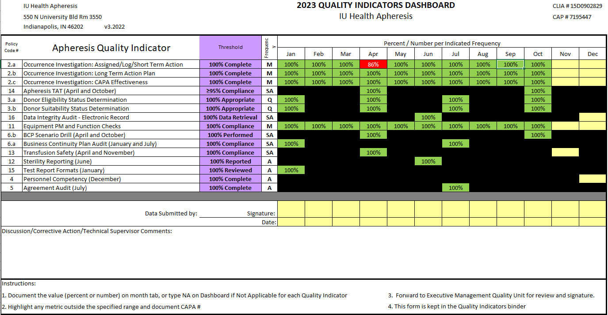
Apheresis Metrics

Slide 3
Housekeeping Items
FIT testing
ID badge distribution to University UH 6141 (there are also dates for RH and MH)
-12/5/23 from 0700-1500
-12/13/23 from 1100-1900
Riley construction almost complete
Oracle Goals due 11/30/23!!
Please start checking and filing 2023 charts!!

Slide 4
Staffing updates
Offer extended to RN Destiny Clark!! Update: She starts 11/20/23!!

Slide 5
Training
Blue Bird Bio
-Stem Cell collections for Beta Thalassemia patients
-Gene therapy manufacture
-Up to 3 days of collection
-Mainly pediatrics-mobilized

Slide 6
Education
PA-C Nord can do repeat Calcium education for staff that missed it.

Slide 7
Values Acknowledgments: Purpose, Excellence, Compassion, Team
Many thanks to Robin for being flexible and switching workdays and for organizing our work party!!

Slide 8
MNC Collections
AC ratio
-Ratio should NOT exceed 12:1 for non-mobilized patients due to clumping risk. This is recommended by Terumo and SOP will be updated to reflect.

Slide 9
FACT
FACT Inspection coming Jan 2024

Slide 10
Birthday Shout-outs
Shout out to our November Birthdays Andrew and Madeline!
11/16/23 pitch-in sign-up sheet is posted at the nurse’s station.

Slide 11
Questions???

