Slide 1
APHERESIS TEAM MEETING
12/2023

Slide 2
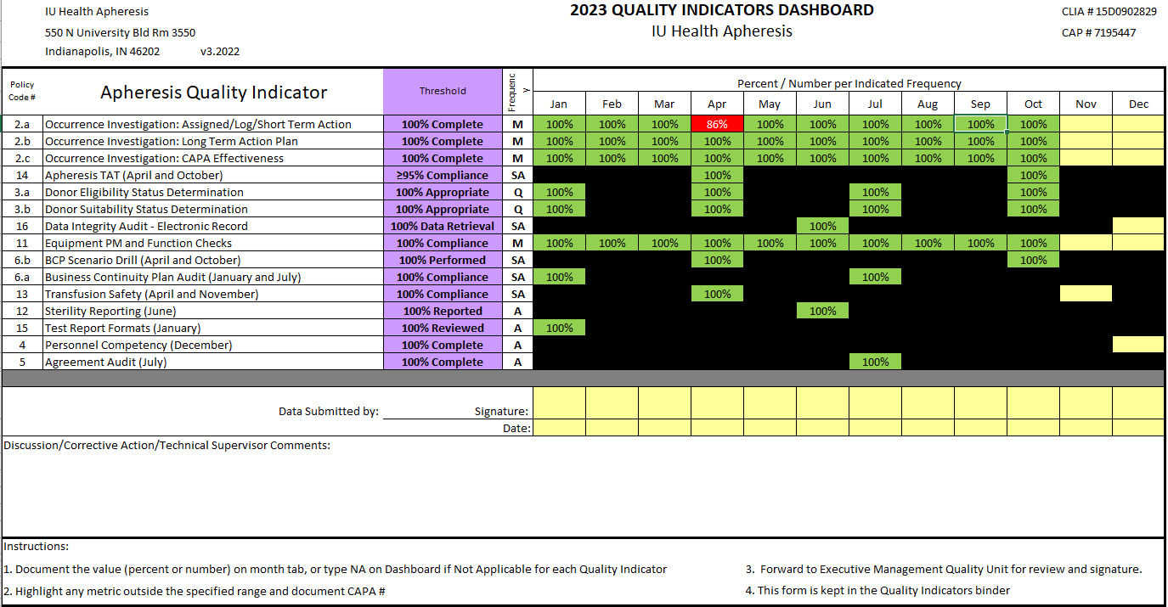
Apheresis Metrics

Slide 3
Pillar Metrics

Slide 4
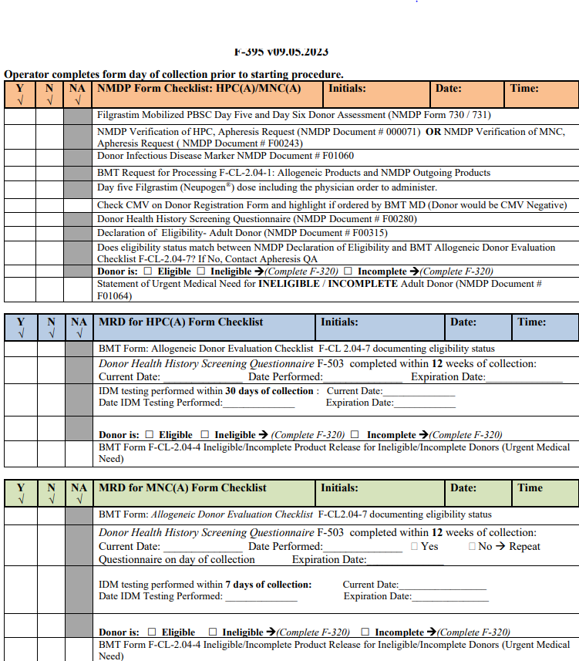
Housekeeping Items
Self-Evaluations Due 12/29/23
Riley construction is complete.
-Eyewash station
MediaLab quizzes and self-paced modules
UKG go-live 1/14/24
F-395 needs to be completed prior to start of Allo collections
Document Critical Labs
Encounters need to be opened before running ISTAT
Notify providers of ANY status changes with patients.

Slide 5
It’s Christmas Time!!!
12 days of Christmas
-Sign-up sheet is at the nurse’s station
-OK to double-up days
Meat tray and chips will be provided 12/14
Secret Santa 12/20
Howl at the Moon 12/15
-Ugly Sweaters

Slide 6
Staffing updates
Erik’s last day is 1/19/24
Still looking for a FT RN

Slide 7
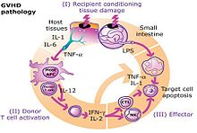
Education
GVHD Training is the next topic! Date TBD

Slide 8
SOGI
Starting in January team members will be prompted every 6 months to ask:
1. What is your legal sex?
2. What are your pronouns?
3. What is your current gender identity?
4. What sex were you assigned at birth?
5. Which sexual orientation do you identify most closely with?
This is to raise awareness, assist with providing the safest care, and ensure that we are personalizing patient care.

Slide 9
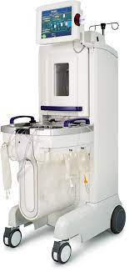
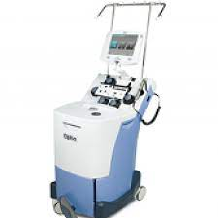
Machines
Please check machine numbers prior to documentation!
-Machines have been shuffled and are not at their usual locations.

Slide 10
Medications
Medications should ALWAYS be scanned before administration
-Recent med error
No Medications on the Cart

Slide 11
Values Acknowledgments: Purpose, Excellence, Compassion, Team
Thanks to Robin going above and beyond with our board outside of the unit.
Thanks to Anita for exceptional patient care and receiving the most WOW cards.

Slide 12
FACT
FACT Inspection coming Jan-March 2024

Slide 13
Telephone System Outage Quick Drill
Red or Black phones are at the Nurse’s Station
Scenario #1: Team members are unable to make or receive calls using the desktop Cisco IP telephones. The telephones have power, but no dial tone. What is your response?
Scenario #2: Neither desktop IP telephones or Emergency Phones (First Net/Red Phones) can make or receive calls. No dial tone on either system. What is your response?
Scenario #3: An overhead announcement message stating your facility is experiencing a complete loss of telephone service is heard- what would you take to ensure continuity of operation in the face of communication failure

Slide 14
Birthday Shout-outs
Shout out to our December Birthdays Dr. Gabbard and Elaine!

Slide 15
Questions???

