Slide 1
APHERESIS TEAM MEETING
1/2024

Slide 2
Housekeeping Items
New traveler Brenda starting on 1/29/24
Tricia FMLA until February
Badge Distribution
-2/19/24 from 6A-2P in the cancer pavilion
-2/20/24 from 8A-4P in the cancer pavilion
-2/21/24 from 11A-7P in the 6141 Board Room
EDI- working on how to incorporate a signature line
Call PM patients to ensure that they are coming

Slide 3
Second Label Checks
Date of testing = results in Cerner
Within 30 days on day one.

Slide 4
One on One
Goal is to start monthly one-on-one rounding with each RN.
A quick check-in with each other to see how we are doing.

Slide 5
Pitch-In 1/16/24
Salad/Wrap bar for Erik’s last week??

Slide 6
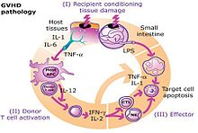
Education
GVHD Education 1/23/24 and 1/25/24.

Slide 7
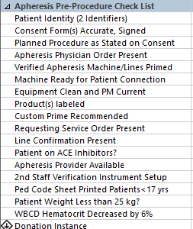
Time Out
Please make sure orders and consents are current
Request submitted to change the consent and Requesting Service Order components to include a portion to manually enter
the dates of completion
This needs to be completed PRIOR to run.

Slide 8
Values Acknowledgments: Purpose, Excellence, Compassion, Team
Thanks to Madeline for jumping in for our new TPE patient.

Slide 9
Patient Late/No Show Policy
Management and Providers are working on a solution.
Note from meeting: Hold off on the Apheresis made policy regarding attendance. When a patient is late or no-shows a Diagnotes should be sent to the group Diagnotes to inform the providers and management. This will be tracked by management, charge, or Dr. Lepage on the Teams apheresis scheduling spreadsheet. The RN should include how late the patient was, in the subject line of the Apheresis Cerner note so that this is tracked in Cerner. Patients can then be placed on a care-contract if necessary. Additionally, providers would like to know the reason for patients being late or cancelling if provided.

Slide 10
Questions???

