Slide 1
Irradiation and Radiation Safety
IUH AHC Blood Bank
JKS
Recorded in January 2023
Reviewed and Re-posted February 2024

Slide 2
Why do we irradiate blood?
To prevent transfusion-associated Graft-Versus-Host-Disease (GVHD)

Slide 3
What is GVHD?
GVHD is a transfusion-associated complication that occurs when:
Immunocompetent cells are present in the transfused component
There is incompatibility (via histocompatibility) between the donor and recipient

Slide 4
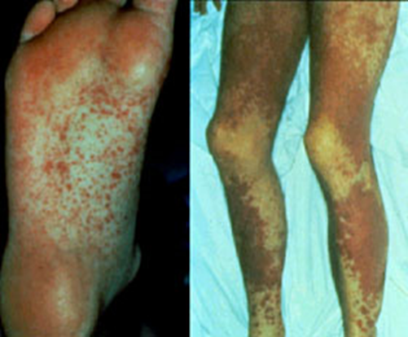
Manifestations of GVHD
Fever
Skin rash
Loss of appetite
Nausea
Vomiting
Diarrhea
Hepatitis
Bone marrow suppression
Death
Notes:
Spleen
Liver
Gastrointestinal tract
Bone marrow
Lymph nodes
Skin

Slide 5
Patients at risk for GVHD
Immunocompromised individuals:
Bone marrow transplant patients
Chemotherapy patients
Radiation therapy patients
Fetuses and newborns
Heart, lung and liver transplant patients
Non-immunocompromised individuals:
Recipients with same haplotype as the donor (genetically similar)
Blood relatives of the donor

Slide 6
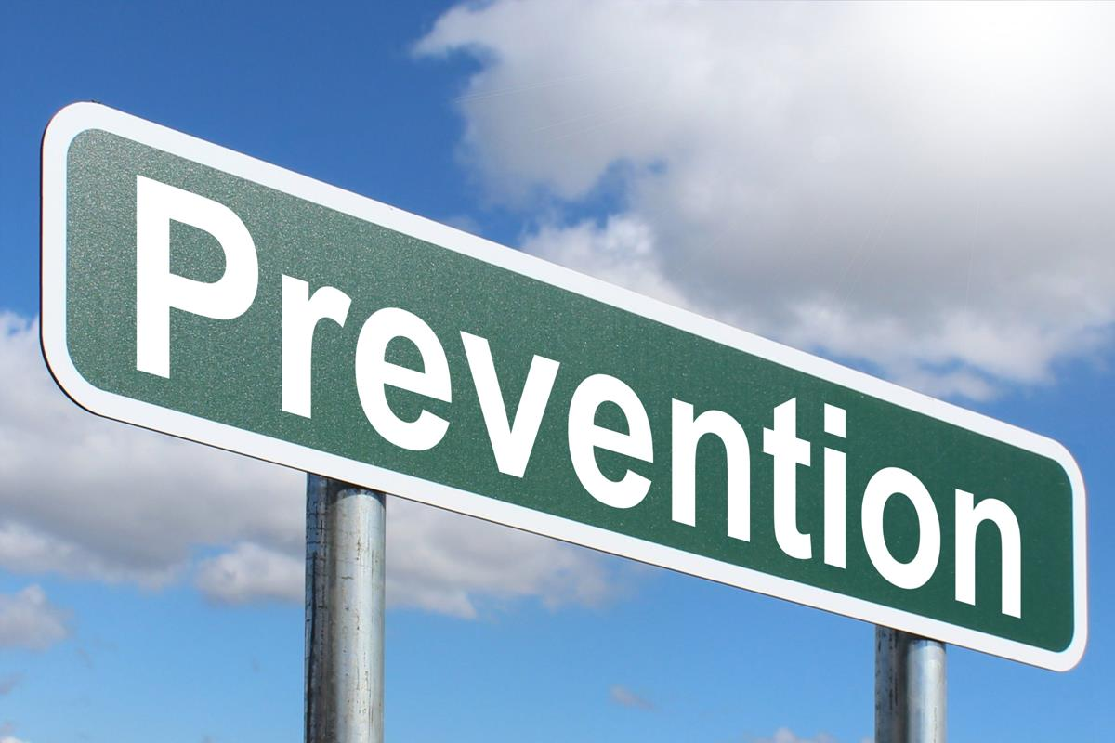
Treatment of GVHD
Treatment of acute onset GVHD is usually unsuccessful
Patients with chronic GVHD may respond to immunosuppressive regimens including steroids and alkylating agents
Because therapies have mostly been unsuccessful, prevention is paramount
This Photo by Unknown Author is licensed under CC BY-SA

Slide 7
How is GVHD prevented?
Graft-Versus-Host-Disease is prevented by irradiating blood and platelets for all recipients who either are immunocompromised or who are blood relatives of the donor.

Slide 8
What happens when blood is irradiated?
When cellular blood components are irradiated, they are exposed to 25Gy of radiation:
A sufficient dose of radiation to damage the DNA of the donor lymphocytes
Rendering the lymphocytes incapable of replication, without affecting the function of red cells, platelets or granulocytes.

Slide 9
Effect on other blood cells
Red Blood Cells:
Intracellular potassium loss
Increased free Hgb levels in supernatant
Cell viability shortened (28 days max)
Platelets:
No qualitative or quantitative changes up for doses up to 50 Gy

Slide 10
Radiation Safety

Slide 11
What is radiation?
Radiation is the process by which energy is emitted or propagated in the form of rays, waves or particles.

Slide 12
Forms of radiation
Sunrays (Ultraviolet)
Heat (Infrared)
Visible light
Microwaves (cooking; communication)
Radio waves (radio and television)
Background radiation (geologic or cosmic in origin)
Nuclear radiation (x-rays used in medicine)

Slide 13
Radiation
Radiant energy is energy traveling in a wave motion
Electromagnetic radiation is measured in wavelengths
Radiation is the process of emitting radiant energy
There are two types of radiant energy:
Ionizing
Non-ionizing

Slide 14
Types of radiation
Non-ionizing radiation
Type of energy that when striking an object, it causes vibration leading to friction and therefore heat but not enough movement to remove tightly bound electrons from their orbit
Example: ordinary white light
Ionizing radiation
When an atom is exposed to ionizing radiation there is enough energy to remove electrons from their orbits causing the atom to become charged or ionized
Examples: photons (x-rays, gamma rays), alpha and beta particles, neutrons

Slide 15
Radiation penetration

Slide 16
Ionizing radiation
Gamma Rays:
A photon, similar to ordinary visible light but shorter in wavelength than ultraviolet light, hence the higher energy level
Produced following spontaneous decay of cobalt-60 or cesium-137 (the CIS-US IBL 437 Irradiator utilizes cesium-137 as its radioactive material)
Can travel unimpeded for great distances
Can easily go right through people but can be blocked by lead

Slide 17
Ionizing radiation
X-rays:
X-rays are a photon, and has similar characteristics to gamma rays
When high speed electrons hit metals such as tungsten, electrons are deflected and release energy in the form of electromagnetic waves (x-rays)
As with gamma rays, X-rays
Have high penetration (depending on energy level)
Can easily go right through people but can be blocked by lead

Slide 18
Limiting Radiation Exposure
The three variables to keep in mind are:
Time
Distance
Shielding

Slide 19
Measuring Radiation
As part of quality control and safety procedures, it is necessary to monitor the function, efficacy and safety of the irradiator.
Radiation measurement devices include:
Rad-sure labels (indicator changes when exposed to adequate dose of radiation)
Survey meters (Geiger counter)
Dosimeters (Film badges are not required)

Slide 20
Summary
Irradiation for
Prevention of GVHD
Radiation Safety

