Slide 1
BLOOD BANK TEAM MEETING
03.27.2024

Slide 2
STAFFING Update –Blood Bank
Open Positions
Days
MLT/MLS
MLT/MLS
Evenings
MLT/MLS
MLT/MLS
MLT/MLS
Overnights
MLT/MLS
Open Team Lead Positions:
Two Days
One Nights
Candidates are being interviewed for Open Positions
Current MLS students, H1B sponsorship considerations, and other qualified applicants
CONGRATULATIONS – Lawrence Collins!
Promoted to Evening Supervisor

Slide 3
STAFF ACTION PLAN
Working towards staffing all locations and all shifts 24/7 with multiple team members (not working alone at UH)
New Scheduling (8hr and 10hr shifts only) – Began with this current pay-period (March 23rd)
Balance experienced team members and new hires as much as possible
Balance MLT/MLS and LAII ratios in the schedule
Allow more team members to be staffed across the week
There are still GAPS in the scheduling until new hires are trained and open positions are filled
Need your continued HELP in picking up Overtime spots
See DRAFT schedules on TEAMS channel for AHC IUH BLOOD BANK
Let Supervisor know if you are able to work and they will fill in the spot with your name ☺

Slide 4
STAFF ACTION PLAN (continued)
AYA Travel Team Members
Provide coverage while we finish training new team members and get them to shift
Extending Chiko and Chris’ contracts through end of June/mid-July.
Continue to Complete training for new team members
Being assigned in schedule by Supervisors
Team members assigned as Trainer’s should be :
Reviewing checklists daily with trainee
Completing sign offs when trainee has demonstrated acceptable knowledge and performance of task.
When tasks have a required # times for demonstration – the checklists will have it listed.
Sign off Read/Reviews with trainees
Trainee should read SOP and review SOP with Trainer for any questions. That’s all. No additional steps on these tasks.

Slide 5
BB Projects for 2024
STAT TAT --Continue to Monitor and Improve
Each location (MH, UH and Riley)
Goal: >= 92%
Everyone’s responsibility
REES
Daily review of temperatures and alarms
Retraining of all team members for proper documentation in software
Dedicated computers are already set up at each location (MH, UH and Riley)
Everyone’s responsibility
Will be made a bench assignment as primary task to sign in and monitor

Slide 6
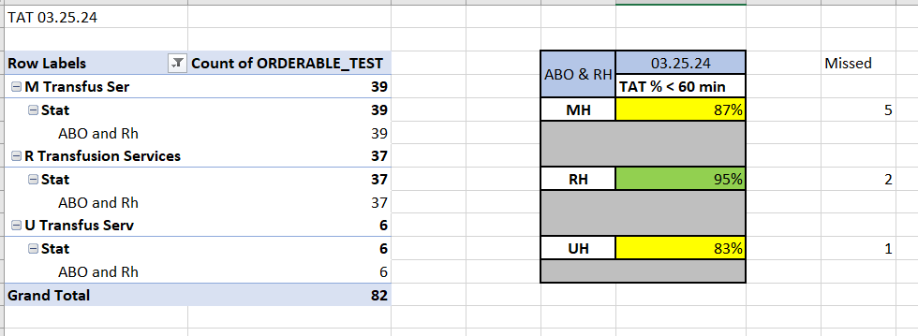
Blood Bank Metric Dashboard
STAT TAT
GOAL: >=92% (<60MIN)
ALL SHIFTS and ALL LOCATIONS
ABORH ONLY
Do NOT need to wait for the IAT to finish
Form coming soon to complete for samples that miss the TAT cutoff
KEEP the Prolonged Dashboard OPEN on the large monitors at each BB site at all times

Slide 7
BB Projects for 2024 (continued)
ReRouting UH orders
To eliminate complexity for the floor and us, all orders and samples for UH will be routed to UH BB
ETA still to be determined.
Education to the floors need to happen along with new tube station signage for them.
Internally we will develop process for when samples can be tubed to Riley for help in completion of work.
Pending Log Review –Continue to Monitor and Improve
Blood Product Orders were placed in the Component Prep Pending Log at each facility for easier review and monitoring
Everyone’s Responsibility
Future State: eventual paperless workflows in the lab (reduce paper dependency)

Slide 8
BB Projects for 2024 (continued)
Smart Refrigerators (Haemonetics)
Contracts with IUH have finally been approved
Working with Vendor on ETA for implementation at RILEY to start
CERNER Bridge Project
Estimated GO LIVE is August 2024
Post CPOE additional project for “scanning” of blood products and electronic documentation of vitals for transfusions
Surgery and Out of Hospital Locations will still require paper documentation

Slide 9
Capital Budget Approvals 2024
Project Name/Assets
DH8 QuickThaw® Plasma Thawing System
iBR 125-GX i.Series® Blood Bank Refrigerator
iBF125-GX i.Series® Blood Bank/Plasma Storage Freezer,
iBR 256-GX i.Series® Blood Bank Refrigerator
iBR 256-GX i.Series® Blood Bank Refrigerator
iBR 256-GX i.Series® Blood Bank Refrigerator
TEG 6S
TEG 6S
TEG 6S
Raycell MK1 X-ray Blood Irradiator
Lots of Validations required
If interested in helping let us know ☺

Slide 10
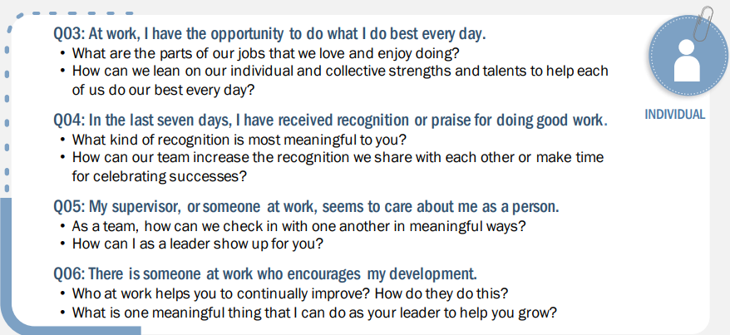
TEAM MEMBER Engagement Survey Questions

Slide 11
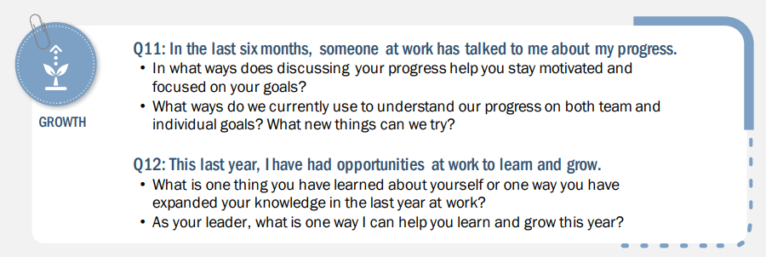
TEAM MEMBER Engagement Survey Questions

Slide 12
Engagement Survey Action Planning
Annual Gallup Survey 2023
Team, as a group, will choose three (3) Survey Questions to work on improving this year
Survey will be sent to each team member to make those selections
Each Supervisor will take one (1) question each from those selected
Present action plans for improvement with the team
Provide updates during Team Meetings on progress
For 2024 Gallup is sending PULSE CHECK Surveys each Quarter
These are ‘mini’ surveys to get Team Member perspective throughout the year
We encourage each of you to participate in these surveys and provide feedback

Slide 13
Gallup Pulse Surveys
Q1: Mar 12 -- Mar 24
Q2: Jun 11 – Jun 23
Q3: Aug 13– Aug 25 (full annual Survey)
Q4: Nov 11– Nov 24
“Gallup research indicates organizations who survey more often have higher employee engagement and retention.”

Slide 14
Workflow Changes – Bench Assignments
Job Task Prioritization List /Bench Assignments for Team Members
Guide team in ensuring all tasks are complete that are required for operation of lab
Riley Dayshift Bench Assignments – posted Feb 26th
Riley Evening & Night Bench Assignments –posting by April 4th
UH and MH Bench Assignments –posting by April 4th
Bench Assignments are Job Aids and can be easily updated/changed to reflect best work practice in the lab.
Provide Feedback to Supervisors/Management Team for updates

Slide 15
Workflow Changes–Bench QC
Starting April 1st – Dayshift team at all locations will be responsible for Bench QC
Help eliminate confusion by team
Multiple team members covering Overtime positions from different shift
Help eliminate Missing Bench QC
Dayshift primarily responsible (not rotating)
ALL Team Members are still responsible for knowing how to perform Bench QC
Training and Competency required

Slide 16
Updated QC and Maintenance Schedule
Update Schedule will be posted at all locations –effective April 1st
Dayshift will continue performing Bench QC going forward in 2024
NO CHANGES to instrument maintenance or weekly and monthly tasks

Slide 17
Quality Update –Dispense Retraining
Continue to have DISPENSE errors
Three (3) FDA reportables so far this year in 2024
Wrong patient’s blood dispensed with similar names
Fortunate that Error was caught at bedside and returned for correction
Fortunate that the blood type dispensed was a universal type
Possibility of a Serious Fatal Event
Dispense is the LAST check prior to leaving the Blood Bank
MUST be performed with accuracy and following SOP
DO NOT answer phone or multi-task when dispensing products
ALWAYS use MRN from the DELIVER PRODUCT REQUEST
Do not enter MRN into Cerner from the blood product label or the order

Slide 18
Quality Update –Dispense Retraining
By May 1st
All team members will have a Dispense retraining with Supervisor
Media Lab training and Quiz
Must demonstrate 3x correct Dispense Verification Process
During Retraining
Team Member reads SOP
Supervisor will discuss and demonstrate correct steps in dispense
Team Member will demonstrate one (1) correct Dispense Process
Team Member will then complete Annual Competency for Dispense Process
This includes two (2) more observed Dispenses
After Retraining: If more Dispense Errors occur – we will move to READ BACK by two team members to dispense products!

Slide 19
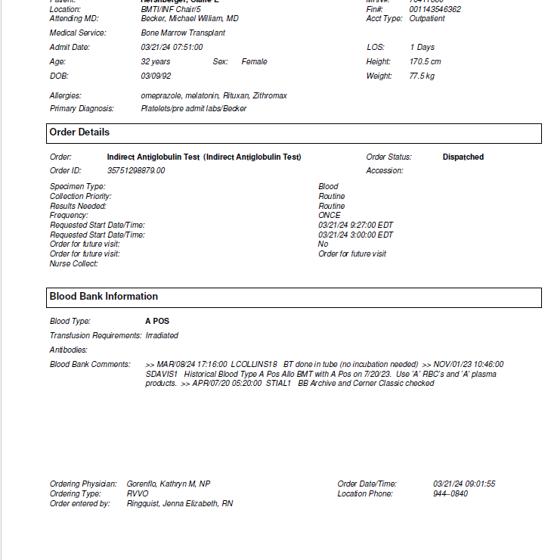
Quality Update ---Documentation of Events --REQUIRED
Documentation of ALL Communications
When calling or receiving any information to or from the RN or clinician, document on Requisition
Your initials
Name of who you talked to
Date and time
Calling CSR for Courier Pickup of Out of Hospital Cooler/Box
Document the same as above
Include the Confirmation# provided by CSR
Send email for DPLM BB Notification
Date/Time products needed for dispense
Include the Confirmation# provided by CSR
Delays in sample testing or provision of product
If there is a downtime (computer, tube station, instrument), then please be aware of delays
Communicate to the floor any issues
Document any complaints about delays or product errors on unplanned deviation report

Slide 20
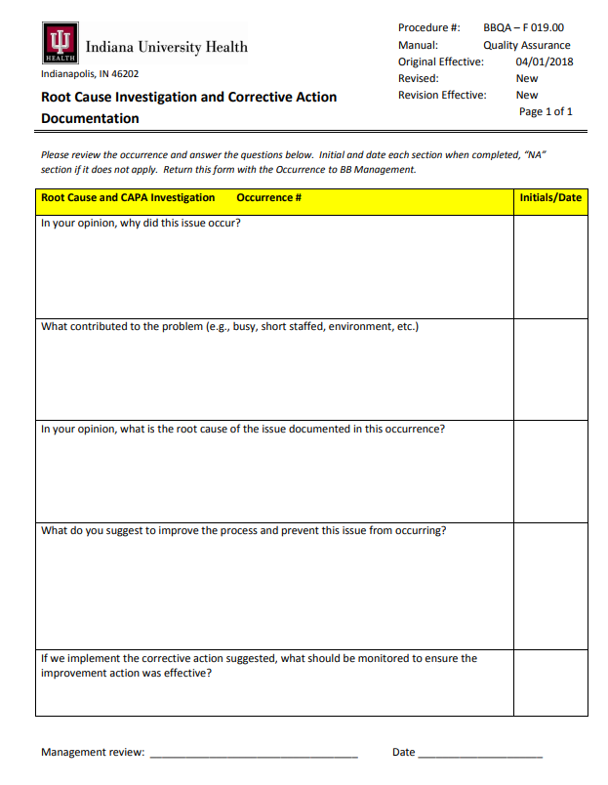
Unplanned Deviation Response and Corrective Actions
Thank you for all the submitted Unplanned Deviations!
Awesome reporting – keep up the reporting!
E-Unplanned Deviation is being validated – coming soon an easier way to submit issues and events!
Corrective Action Update Starting April 2024
When documented issues require a review only
MTS Review of SOP
Quiz to demonstrate understanding
Example: Documentation error
Repeat documentation errors will become a Performance Issue
When documented events require root cause analysis
Investigation by Phone call and Email request to provide written documentation of team member’s response
May use the Root Cause Investigation form to ensure all aspects of an event are considered.
Example: Step of SOP was omitted or SOP not followed.

Slide 21
BE PREPARED: SOLAR ECLIPSE 2024 – April 8th
See email from Clark Day, VP, System Lab Services
April 8th will be treated like a Major Weather Occurrence which could cause slight disruptions in service.
If scheduled to work Sunday Night 4/7, or any shift Monday 4/8
Need to prepare: to possibly work an extended shift
Need to prepare: to have long commute times to and from work
Health Care Team Members are Essential Workers and expected to be at work. IUH AHC clinics, outpatient and surgery areas will be open for business
Discuss any unique concerns with your Supervisor before next week (no later than Tuesday April 2nd).
There will be Solar Eclipse glasses provided to team members
For those working during the eclipse, team will develop a plan so that those that wish to view the event can take turns on a “viewing break” and still ensure the lab area is covered.

Slide 22
Reminders
New version of UKG/Kronos
On March 10th , IU Health transitioned to UKG Pro
Lots of kinks being worked out by Kronos Support Team.
Call the HELP DESK (317-962-2828) to report problems with your mobile device or software system in General regarding time-card review/corrections.
Give yourself time to arrive to work and clock in using the computer (on time) if mobile app is not working correctly.
WAMBI RECOGNITION
Welcome to the IU Health recognition platform.
Send in the moment meaningful appreciation
To and From leaders and peers
Easy Access from the Team Portal Page

Slide 23
2023 Performance Feed Back Discussions
Your Supervisor will be scheduling a specific time with each of you
Goal Setting will be finalized during this meeting
2 to 3 Goals per team member
Measurable and Meaningful
Conversations are TWO-WAY
Be prepared for your discussion with your leader. Summarize Key accomplishments/challenges in your role. Review these preparation questions:
“As you think back on 2023, what did you appreciate most about your accomplishments and what do you think you could have done differently to be even more effective?”
“Which value(s) do you think you most consistently demonstrated and how?”
“Which value(s) do you think are most important to continue to develop?”

Slide 24
Schedule for UPCOMING Discussions and Merit Awards
April 2 – 19: Performance Feedback and Merit Discussions
April 21: Effective Date of Merit Awards
May 10: Merit Award Reflected in Paycheck
May 15: Deadline for Team Member Acknowledgement in Oracle

Slide 25
LAB WEEK April 14th – 20th
More Details to come
There will be GiveAways, Games, Food and FUN ☺
IUH Lab Week Signs have been ordered to be delivered to each BB location
MH LABs has developed a LAB WEEK T-shirt.
Initially we submitted an order to M3Lab Manager last Friday via email.
NOW= there is a website link to order and pay directly for the T-shirt
LOOK FOR ANOTHER EMAIL> ALL ORDERS MUST BE PLACED BY APRIL 3
When ordering select “in-store pickup” to avoid shipping cost
M3lab Manager will pickup and distribute shirts for us
Cost $22

Slide 26
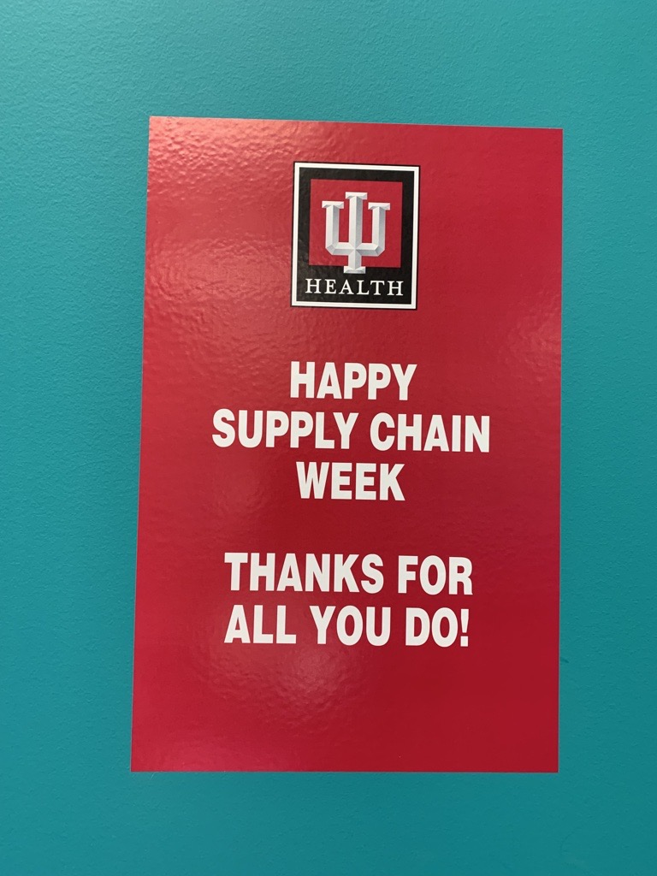
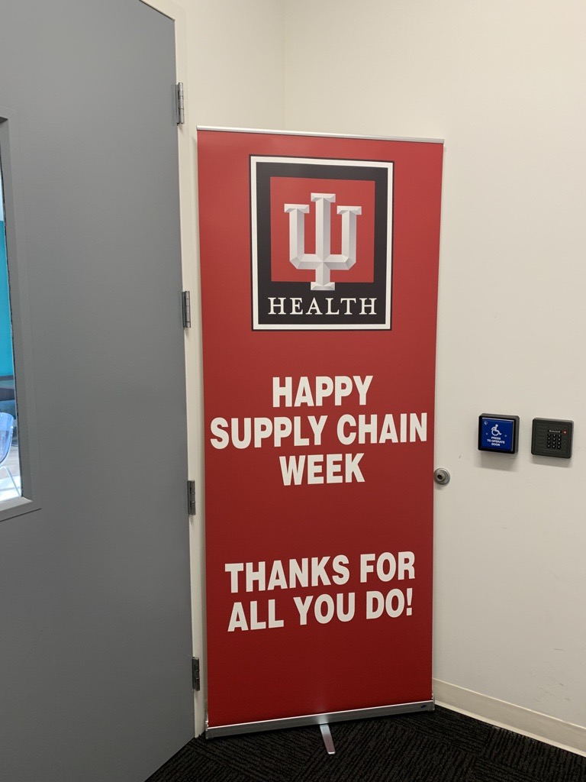
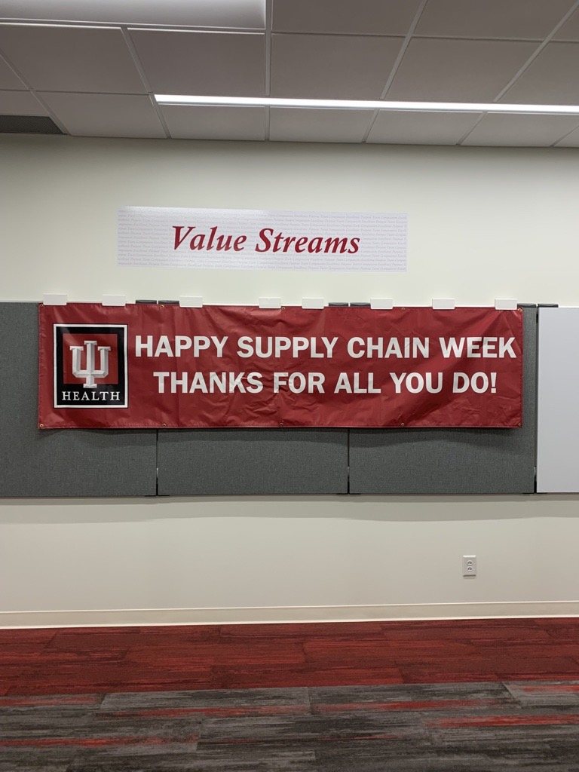
Lab Week Signs (showing examples from Supply Chain Week)

Slide 27
THANK YOU!
We could not provide quality patient care without each one of you!
Be mindful and support each other!
Keep Compassion, Team, Excellence and Purpose in all that you do.
"The strength of the team is each individual member. The strength of each member is the team." – Phil Jackson

