Slide 1
APHERESIS TEAM MEETING
4/2024

Slide 2
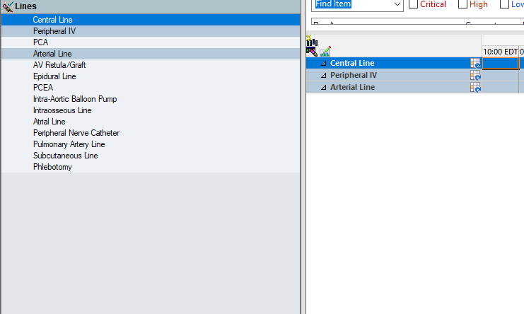
Housekeeping Items
If there are no templates, DO NOT schedule patients.
EPOC go live at RH 4/22
Check donor eval forms for IDM dates
Chart cap and dressing changes on inpatients in the
I/O flowsheet under the actual line

Slide 3
Staffing Updates
Briana Shields- Starts FT 4/14
Timesha Bailey- Starts FT on 4/29.
Nicolette Ryken (Nikki)- Aya Traveler for weekends, Tues/Wed, and call…starts 4/22
Interviewed a potential Unit Tech.
Tricia- Returning 5/1 (Mondays, Wednesdays, Thursdays)
Working on a possible 2nd shift RN and keeping one RN blocked every day.

Slide 4
Staffing Updates cont…
Welcome Rebecca Hopson and Peaches Williams!

Slide 5
Oracle Goals
Handwashing
- 90% for “meets” and 95% for “exceeds”
-Support team members when moments are missed
Scanning compliance
-98% for “meets” and 99% for exceeds
Send one WAMBI a month to a team member

Slide 6
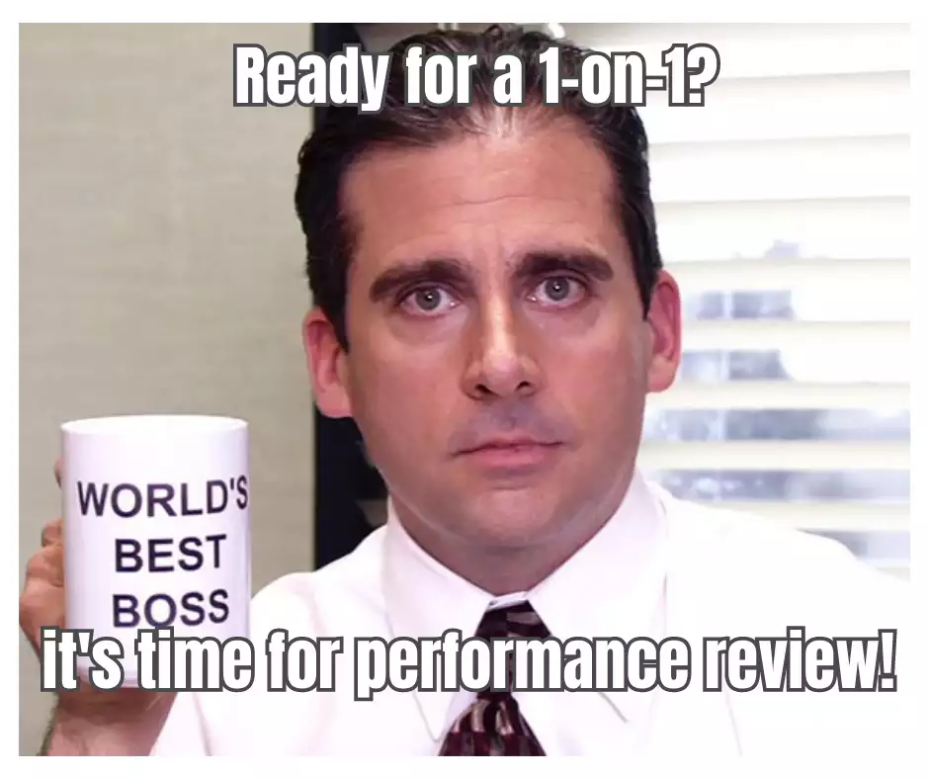
Performance Reviews
Due next week.

Slide 7
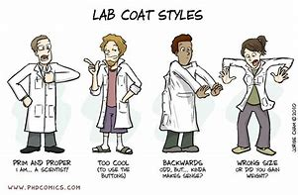
Lab Week 4/14/24
Monday and Tuesday- Ice Cream bar
Wednesday- Donuts and Coffee- Wear lab t-shirts
Thursday- Candy bags
Friday- Popcorn Day

Slide 8
ASFA 4/15-4/19
Dr. Lepage is covering

Slide 9
Values Acknowledgments: Purpose, Excellence, Compassion, Team
Charloom and Joe for staying late last week with 3 inpatients that ran late.

Slide 10
Questions???

