Slide 1
APHERESIS TEAM MEETING
9/2023

Slide 3
Apheresis Metrics

Slide 4
Housekeeping Items
Nursing License expire 10/31/23
-Goal is to renew by 10/2/23
Flu Shots Due 11/9/23
-Available in the AOC room #6136 9/17/23-9/23/23
New Stem Cell Form for Allogeneic and Autologous Quality Certificate.
Submit ID badge photos by 9/30/23
Add stopcock to all ports?
Employee Engagement survey

Slide 5
Staffing updates
Erik Lynn, Travel RN
-Starts 9/18/23
-Will do mainly Photopheresis
-2 years of Apheresis experience
-Will likely need Cerner assistance
Interview/Shadow for Jay’s position on 9/18/23
SBAR for a PCA and additional FT RN still awaiting position control
0630-1700 RN?

Slide 6
Training
Austin Davis is coming 12/12/23-12/13/23
-Main focus will be RBC Prime of the Cellex
On-site White Blood Cell Deplete training 11/8/23

Slide 7
Upcoming events
Culture Day 9/28/23
-Please bring a special dish that is special to your culture, something special that you grew up eating, or just something that simply brings you joy.
AAHC Fall Celebration 10/4/23
-11A-2P
-Food and music
-Will send more details as they become available

Slide 8
APHERESIS AWARENESS DAY-Celebrate Apheresis Together
The American Society for Apheresis (ASFA) is pleased to celebrate Tuesday, September 19th, 2023 as Apheresis Awareness Day!
The purpose of Apheresis Awareness Day is to raise awareness of apheresis medicine and honor the many donors, patients, and apheresis practitioners that have dedicated their lives to saving others by using evidence based practice to advance apheresis medicine. Apheresis Awareness Day is held annually on the third Tuesday in September.
Volunteers needed to help plan.

Slide 9
PROCEDURAL UPDATES/REMINDERS

Slide 10
RBC DEPLETE EXCHANGES
Post POC Hgb and Hct
Patient cannot leave the unit until results return and approved by provider.

Slide 11
STEM CELL COLLECTIONS
Pediatric
-Please remember to obtain pre and post weights
-Providers need to be notified of a 10% change in weight
-Please review SOP
Adult
-Nivestym will be the new GCSF preference

Slide 12
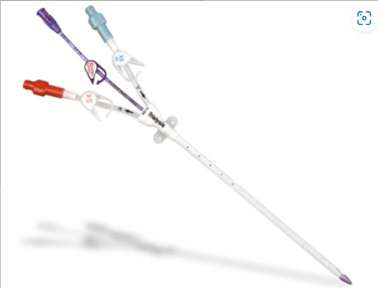
Transplant Patients
Triple Lumen Large Bore Line
-SALINE locked
-The consult request will contain a comment if the patient has this line
-Staff RN to call patient unit 30-60 minutes prior to run for line assessment/TPA need

Slide 13
Network Downtime/Cybersecurity Incident Quick Drill
Scenario #1: Team members are unable to send or receive email through outlook and are unable to access your department’s network drives. What is your response?
Scenario #2: An unplanned Cerner outage occurs. Team members are unable to access electronic medical records, submit orders, or electronically document patient care. What is your response?
Scenario #3: You receive an email stating that you are going to lose your IU Health Network access due to misuse. The message contains the IU Health logo and an “EXTERNAL Message” alert in red letters at the top of the email. The email address sender is not an IU Health email address. The message requests that you click on a link to submit information. What is your response?

Slide 14
Values Acknowledgments: Purpose, Excellence, Compassion, Team
Many thanks to Anita Liner for convincing the EVS manager to allow the current staff member to stay on our unit.

Slide 16
Questions???

