Slide 1
APHERESIS TEAM MEETING
2/2024

Slide 2
Housekeeping Items
Badge Distribution
-2/19/24 from 6A-2P in the cancer pavilion
-2/20/24 from 8A-4P in the cancer pavilion
-2/21/24 from 11A-7P in the 6141 Board Room
Electronic Discharge Instructions in progress
Type and screens for MRD
Machines need to be thoroughly wiped after each
procedure

Slide 3
Staffing Updates
Jennifer- Transplant 3/11. She will be out until mid June at least
Travelers
-Requesting a weekend traveler that can work 1-2 weekdays
-Traveler requested to work 10-hour shifts and take call
Interview 2/21 for RN
Unit Technician candidates have not responded to interview requests
Tricia has extended FMLA until 3/1/24

Slide 4
Extra Shift/Hours Bonuses
Staying past shift
-10 dollars per every extra hour worked
-OC/CB pay
Extra shift incentive
-$50 for every 4 hours worked. Then $10/hour per additional hours worked (ex. If you work for 6 hours you will get $70 total extra).

Slide 5
Hand Hygiene Audits
Goal is 90%. We were at 75% in January.

Slide 6
Port Infections
Several GVHD port infections have flagged infection prevention
Common denominator is APHERESIS
Hand washing BEFORE and AFTER gloves
Continue flush at the end and heparin lock through the stopcock.
Wear gloves when flushing.
At the end of the procedure, peel off the edges of the dressing with clean gloves. Then use sterile gloves to de-access ports.
Always scrub for the required time prior to flushing

Slide 7
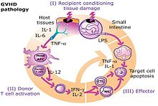
Education
GVHD Education coming soon by Dr. Lepage

Slide 8
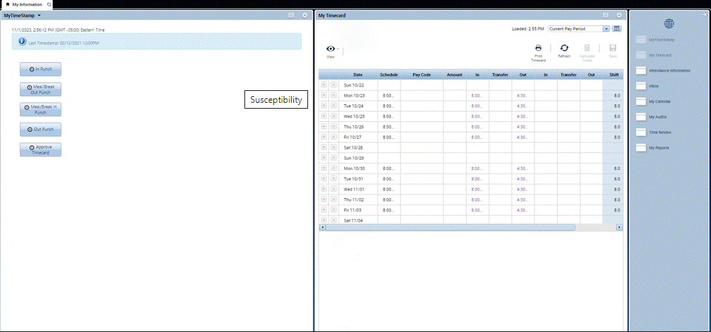
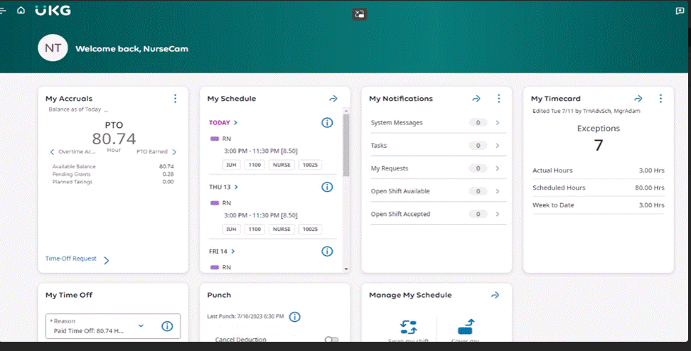
Kronos Upgrade
Go Live Date 2/25

Slide 9
Values Acknowledgments: Purpose, Excellence, Compassion, Team
ALL STAFF FOR TEAMWORK WITH OUR STAFFING CRISIS!!

Slide 10
Questions???

Slide 11
Power Outage Quick Drill

