Slide 1
APHERESIS TEAM MEETING
3/2024

Slide 2
Housekeeping Items
Inform providers about any issues/adverse events
PRIOR to disconnecting patients.
EPOC training dates are listed at the nurse’s station
Hand Hygiene Audits will continue through 2024!! Goal
is 90%.
Medication Scanning Compliance audits will
continue through 2024. Goal is 98%
Send Wambi!
I will be out 3/28-4/4 returning on 4/5.

Slide 3
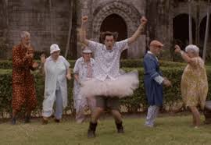
Staffing Updates
Rebecca Hopson- AYA traveler started 3/18.
-Will take call
-RBCX, TPE, WBCD
Timesha Bailey- Starts FT with Apheresis on 4/29.
Peaches Williams- Starts FT with Apheresis on 4/29. Dialysis background.
Briana Shields- Accepted an offer last night with Apheresis. Pending start date.
We still have a weekend traveler position open with AYA (Isaac is no longer coming). We also have a Monday through Friday traveler position open and Erik is interested.

Slide 4
Extra Shift/Hours Bonuses
Staying past shift
-10 dollars per every extra hour worked
-OC/CB pay
Extra shift incentive
-$50 for every 4 hours worked. Then $10/hour for additional hours worked up to 8 hours (ex. If you work for 6 hours you will get $70 total extra; if you work 8 hours then you will get $100).

Slide 5
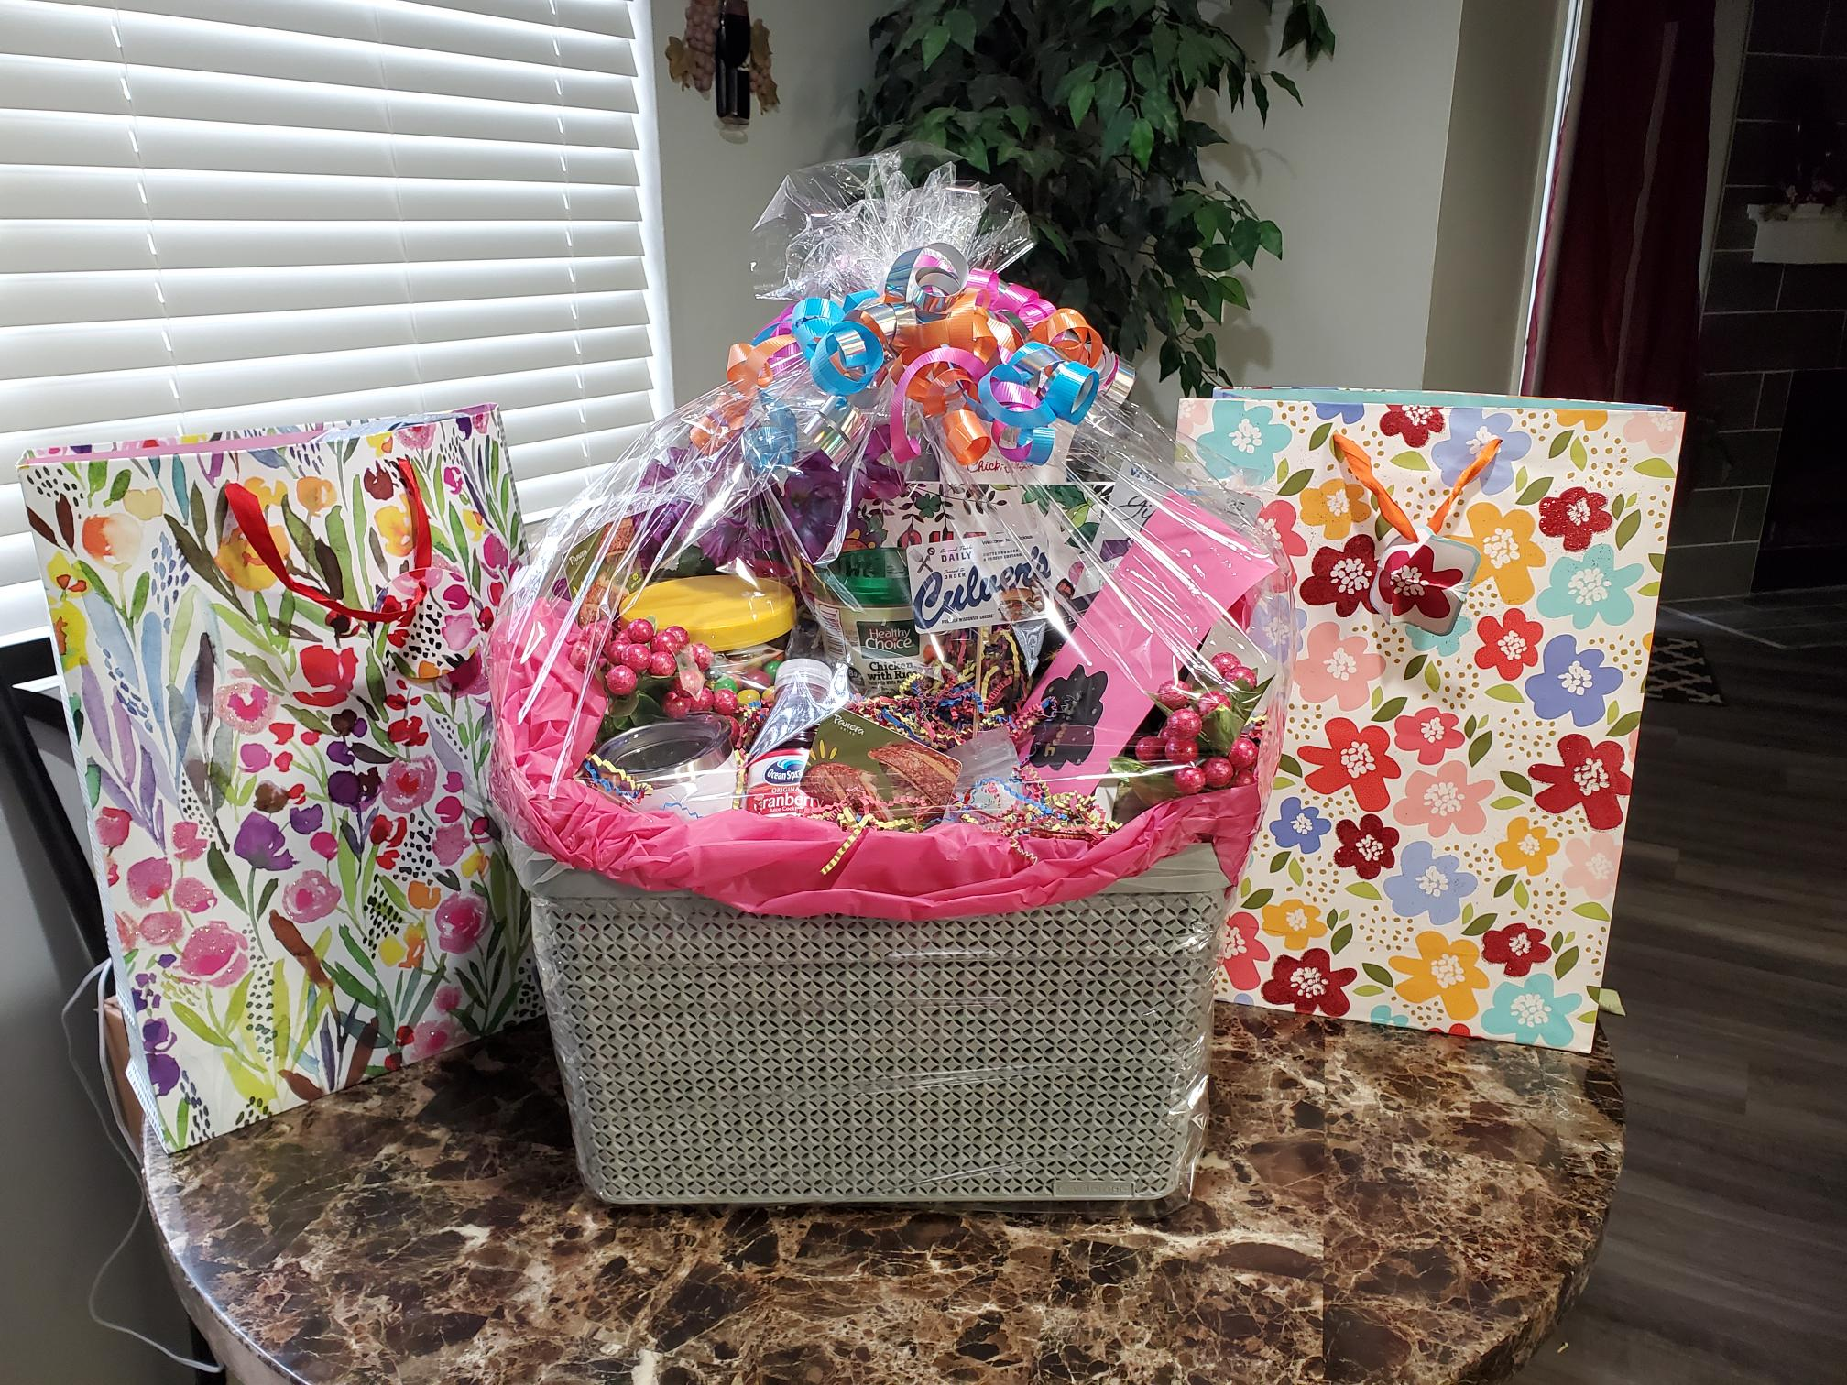
Jenn

Slide 6
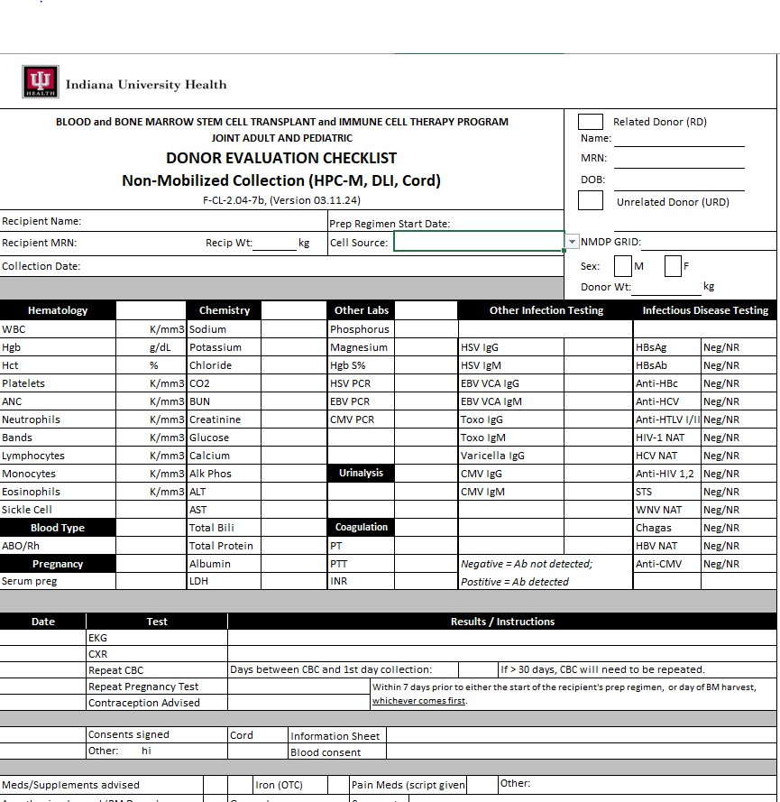
New BMT forms

Slide 7
Values Acknowledgments: Purpose, Excellence, Compassion, Team
Robin for going above and beyond for Jennifer!!

Slide 8
Questions???

