Slide 1
APHERESIS TEAM MEETING
5/2024

Slide 2
Nurse Week
Wednesday- Cookies
Thursday- Gift bags. Ice cream cart at RH
Friday- Breakfast Kolaches

Slide 3
Housekeeping Items
Send WAMBIs at least monthly!
Wash your hands! We are auditing.
Use the scanner at all times to scan meds. If it is broken,
tell the manager
EDI almost complete
QR code on the back of your badge links to Safety
and security page.

Slide 4
Staffing Updates
Briana Shields and Nikki Ryken!

Slide 5
Staffing/Training Updates
Briana Shields- Checked off on ECP, Now training on TPE
Peaches Williams- Checked off on ECP, Now training on TPE
Timesha Bailey?
Nicolette Ryken (Nikki)- Starting weekends 5/11, will also do Tuesdays and Wednesdays. Needs checked off on ECP.
No unit tech options.
Tricia- Mondays, Wednesdays, Thursdays 0800-1630. In at 0830 until the end of May.
No news on 2nd shift RN.
DO NOT schedule on or move blocks without checking with manager or shift coordinator.

Slide 6
Goals Updates
Handwashing
- 90% for “meets” and 95% for “exceeds”
-Don’t forget BUBBLES!
-80.24% this year
Scanning compliance
-98% for “meets” and 99% for exceeds
-97.38% for April
-94.37% for the year

Slide 7
Performance Reviews
Acknowledge by 5/15

Slide 8
MARTTI
RH now has a MARTTI for interpretation.

Slide 9
Cerner Apheresis Flowsheet Updates
Training Session with informatics on 5/15.

Slide 10
Apheresis Product Sample F-571
This form now requires a second verification for volumes.
Anyone from CTL or Apheresis can verify.

Slide 11
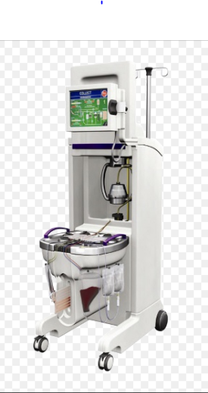
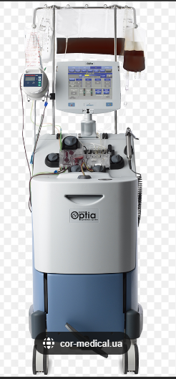
Machine Updates
New CellEx and Optia are at RH. NOT ready for use yet.
Machine 11 is down at MH. Machine 16 and warmer 2698 will be replacing.

Slide 12
Values Acknowledgments: Purpose, Excellence, Compassion, Team
Thank you, Joe, for managing our flowsheet updates!

Slide 13
Questions???

