Slide 1
APHERESIS TEAM MEETING
7/2024

Slide 2
Housekeeping Items
Cerner upgrade
Send WAMBIs at least monthly!
Wash your hands! We are auditing.
Always use the scanner to scan meds. If it is broken,
tell the manager
FACT is coming 8/30.

Slide 3
Staffing/Training Updates
Nikki’s last day is 7/31.
Peaches and Bri
-Training on TPE (no RBCX until TPE check-off)
RNs Christina, Harley, and Emily are coming to shadow next week (7/23 and 7/24)
Tech LaToiya is coming 7/19 for a shadow
Jenn is out until mid-September (weekends will need to be covered)

Slide 4
Scheduling
O700 RNs- 0730, 1000, 1300
0800 RNs- 0830, 1100, 1400
*please pay attention to times when shuffling patients
*Written schedule?
Dr. Soundar had the idea to change the slot color of the 0800 RNs
There was an idea presented by Robin to have RNs write down the patient preferred date/time.
Then a designated staff member to call and schedule patients for more balance.

Slide 5
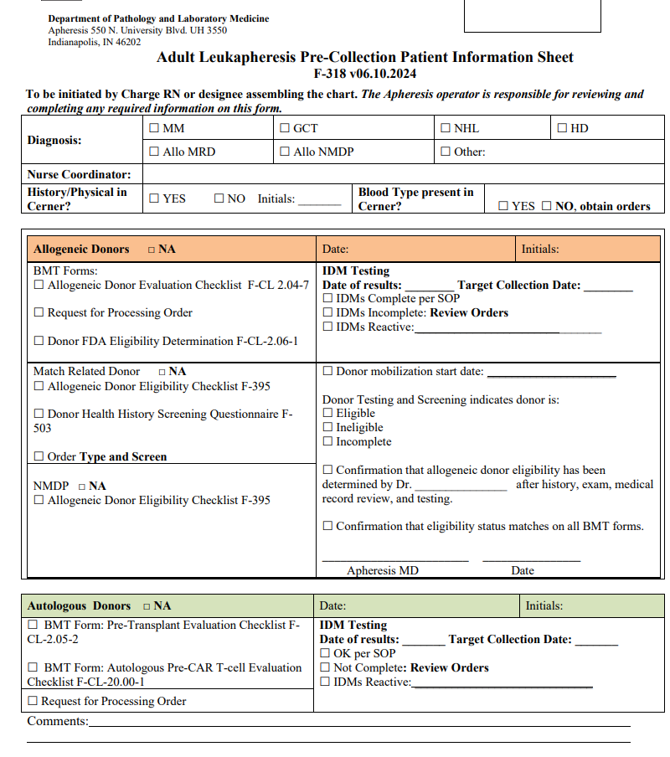
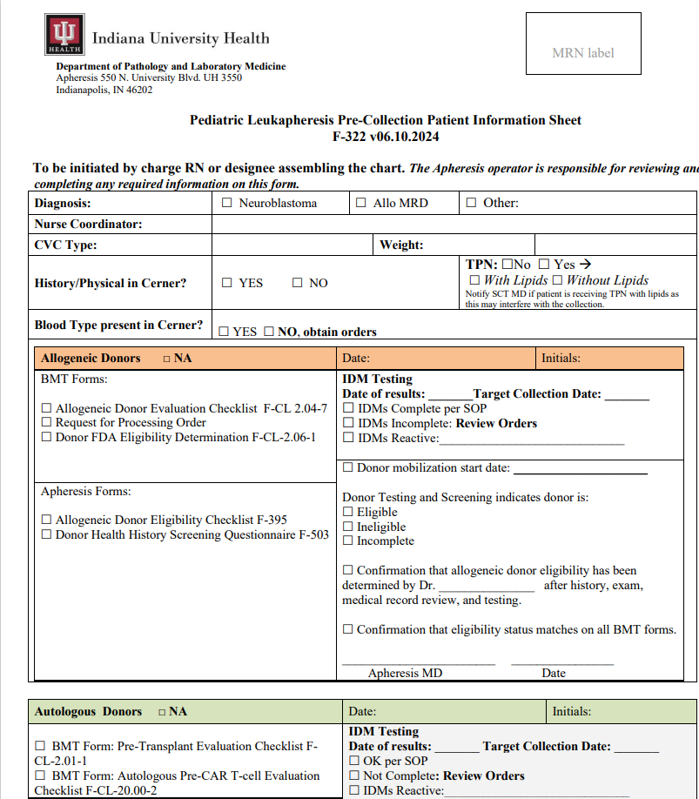
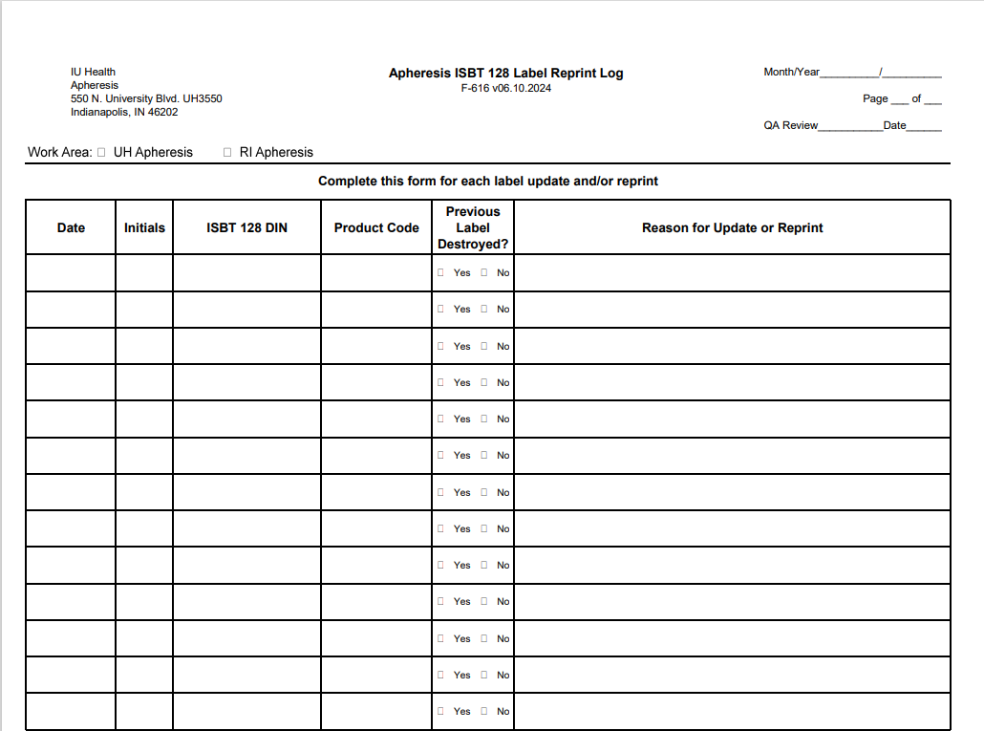
Updated Forms

Slide 6
Lunches
PLEASE BE PROACTIVE ABOUT TAKING LUNCHES

Slide 7
Vein checks and DHHQ
Current process
- If the vein check includes and DHHQ then the APP or MD will fax the paperwork to the coordinators.
- If there is ONLY a vein check, then the RN will fax
Process change- Coordinators have asked that the paperwork be scanned to email. Any objections?

Slide 8
Patient Policy
RNs to sit with patient and explain
Go-Live Date: 7/22
Any objections?

Slide 9
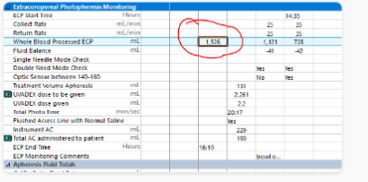
Documentation
Please be sure to double-check documentation on the Apheresis flowsheet
Cleaning and Outpatient information sections are frequently missed
WBP for ECP should be documented in the photopheresis monitoring section under the same line and the end time.

Slide 10
LCN vs TNP
TNP
-Uses PTO
-Will NOT accrue PTO
LCN
-Does NOT use PTO
-Will NOT accrue PTO
PLEASE CHECK TIMECARDS EVERY FRIDAY AND SUBMIT CORRECTIONS IN KRONOS AND ADVISE IF THERE ARE ANY DAYS THAT LCN IS WANTED

Slide 11
Quick Drill Building Lockdown
Scenario: Using the IU Health AHC Emergency Procedure Guide (EPG), discuss how department staff would respond if emergency access control alerts were received via overhead announcement and IU Health Emergency Alert

Slide 12
Apheresis Awareness
Frederick from Path Lab communication team is coming to record Apheresis RNs answering questions regarding why Apheresis is important to us. This is COMPLETELY optional.

Slide 13
Values Acknowledgments: Purpose, Excellence, Compassion, Team
HAPPY BIRTHDAY TO OUR JULY BIRTHDAYS: JOE, NIKKI, DR. SOUNDAR

Slide 14
Family Day
SEPTEMBER

Slide 15
Questions???

