Slide 1
APHERESIS TEAM MEETING
9/2024

Slide 2
Housekeeping Items
Flu Shot 9/15-9/21 in the AOC (Flyer is at the nurse’s station)
Send WAMBIs at least monthly!
Wash your hands! We are auditing. (84.1%)
Always use the scanner to scan meds. If it is broken,
tell the manager
FACT was a SUCCESS!
Extra shift/hours bonus still in effect
Patient policy

Slide 3
Staffing/Training Updates
Rebecca is returning
Peaches and Bri
-Checked off on TPE and will begin training on RBCX
Jenn is out at least through the end of the year-weekends will likely need coverage
Jeb is still out
Welcome LaToiya Diaz, Technician-US and Christina Lara, RN

Slide 4
Scheduling
O700 RNs- 0730, 1000, 1300
0800 RNs- 0830, 1100, 1400
* We will be trialing a new scheduling process. More details to come

Slide 5
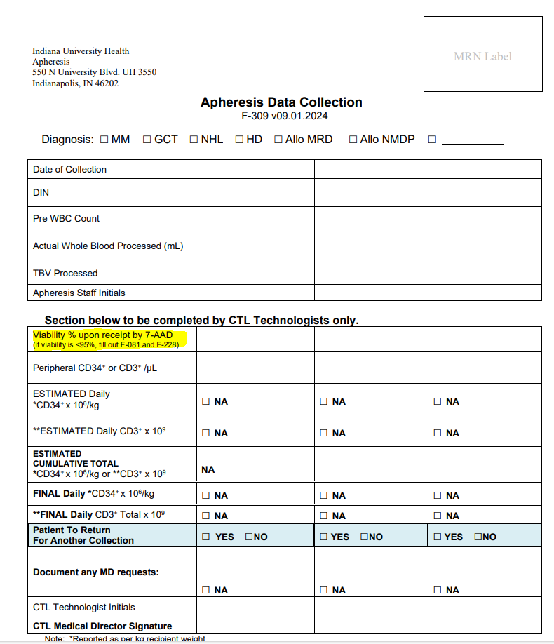
Updated Forms
If viability comes back less than 95% a non-conformity is
Required.

Slide 6
Apheresis Tasks
Putting charts together and checking orders
Setting up for the next day
Checking charts
Printing forms
Cleaning out the refrigerator
Blanket warmer restock

Slide 7
Charge
Will now be on a rotation between Robin, Tricia, and Joe
-One week Joe will take charge with Tricia or Robin being in charge on his day off
-The next week charge will be split between Tricia and Robin
-If you are interested in being in charge, let me know
Charge Duties
-Code cart, refrigerator temp, room temps
-Checking voicemails as needed
-Managing the charge phone
-Managing assignments-making sure staff is aware of next day travel if necessary
-Ensuring that orders are initiated for all patients
-Ensuring that all staff members have lunch breaks
-Ensuring that blood is ordered, and labs drawn for necessary patients
-Ensuring that tasks are complete

Slide 8
Shift Coordinator
Mondays
- Goal is to have a block on the schedule
Duties include:
-Call/Holiday schedule
-Ensure that machine QC is completed
-Add blocks to Cerner schedule for STEMS, etc
-Charge Audits
-Balance schedule
-Donor follow-up calls
-Entering Kronos call schedule
-Office supplies as needed
-Assisting with training/check-offs
If duties are completed early, then the shift coordinator will be helping on the unit

Slide 9
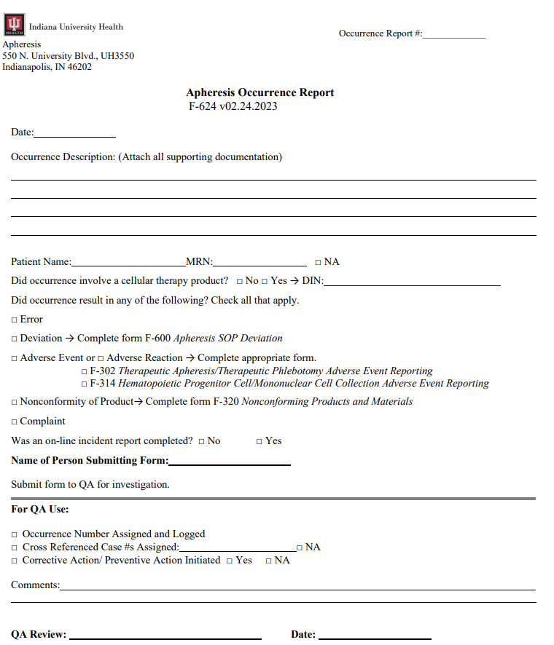
QA
ALL FORMS REQUIRE AN OCCURRENCE
EXCEPT CHANGE CONTROLS.

Slide 10
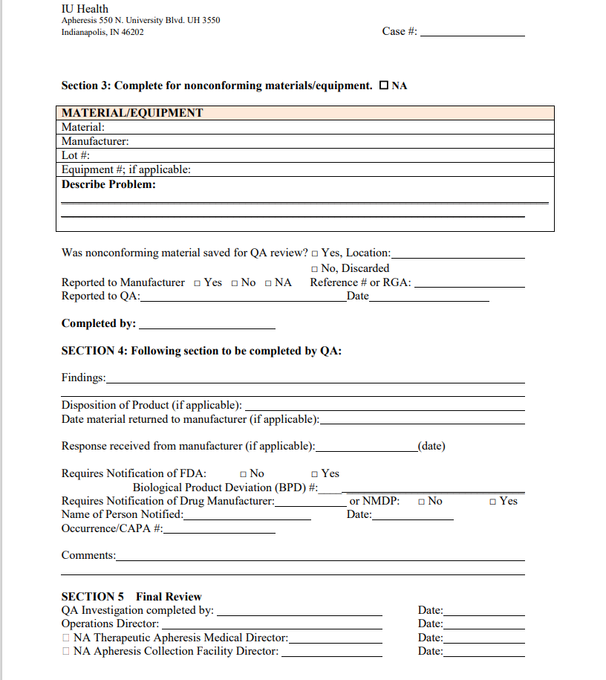
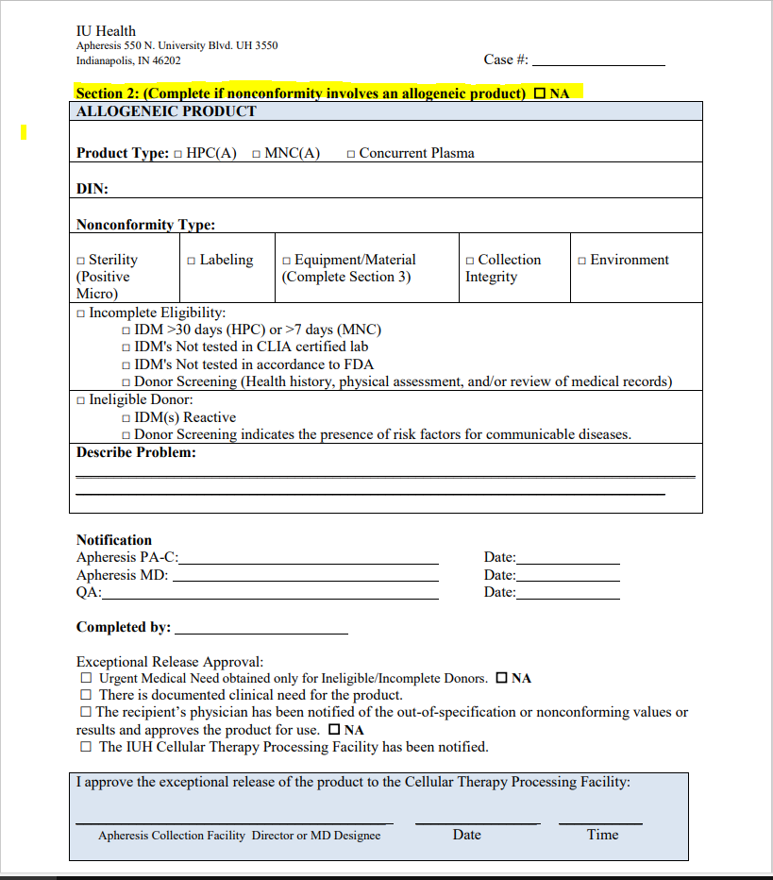
QA CONT

Slide 11
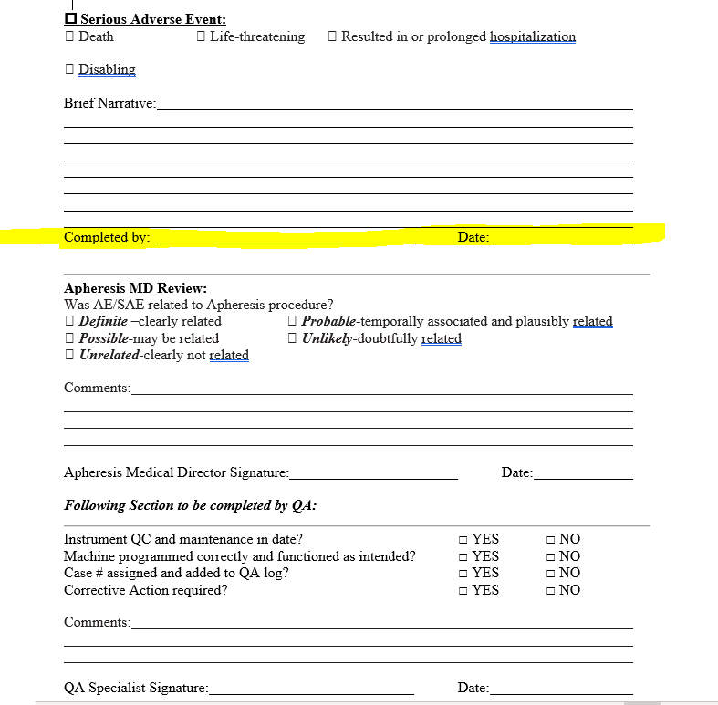
QA CONT

Slide 12
QA Cont
ONLINE INCIDENT REPORTS NEED TO BE FILLED OUT ANY TIME THERE IS AN OCCURRENCE WITH PATIENT INVOLVEMENT.

Slide 13
Apheresis Awareness 9/17
https://youtu.be/WomSYYREsjc

Slide 14
Values Acknowledgments: Purpose, Excellence, Compassion, Team
Thank you to everyone that helped prepare for FACT!!!

Slide 15
Family Day
On Hold until a location can be secured

Slide 16
Questions???

