Slide 1
APHERESIS TEAM MEETING
10/2024

Slide 2
Housekeeping Items
Flu Shots due 11/14.
Send WAMBIs at least monthly!
Hand Washing audits
Medication scanning compliance
FIT tests Due
Extra shift/hours bonus still in effect
Check-offs will be beginning
New scheduling process coming soon
Apheresis Task list
Charge/Shift Coordinator
DO NOT send QA forms with machines when taken out of service
IU Health moving to EPIC

Slide 3
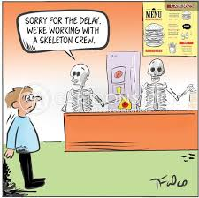
Staffing/Training Updates
Rebecca is here through 11/20 but NOT every weekend
Peaches and Bri
-Training on RBCX
LaToiya needs checked off on machine set-up
Christina is training on TPE and RBCX
Lee Cable is coming next week for ECP blood prime
Working on Terumo training dates

Slide 4
Cerner Combine
FAQ training 10/16
Go-Live 10/24 @5PM

Slide 5
Open positions
FT RN
-Req # 382661
-no applicants yet
PRN RN
-Req # 382597
-Currently 3 applicants
-Looking for experienced Apheresis RNs
*Considering another traveler

Slide 6
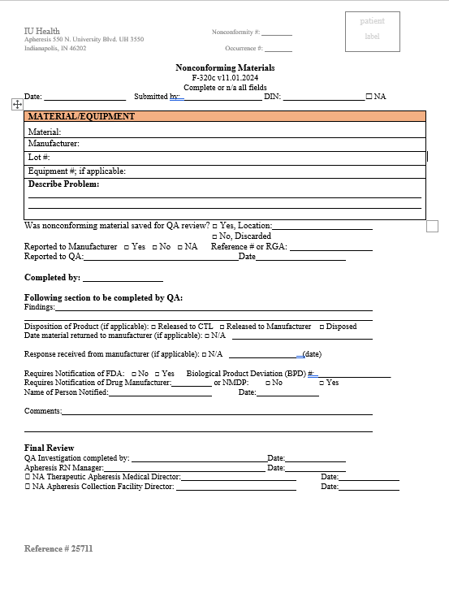
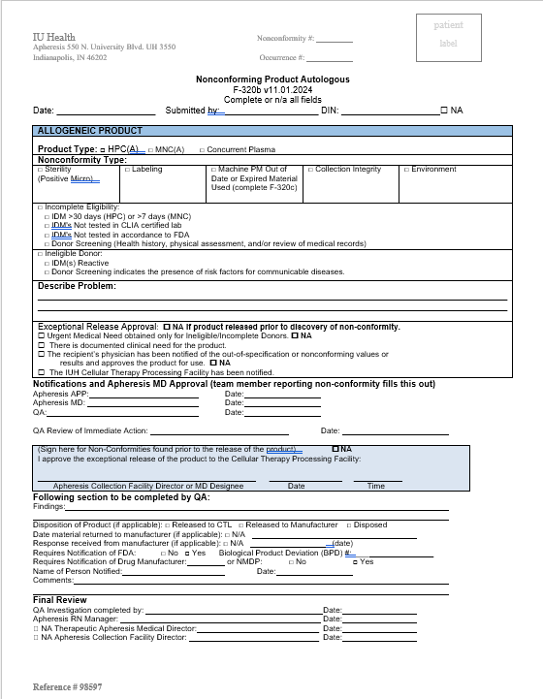
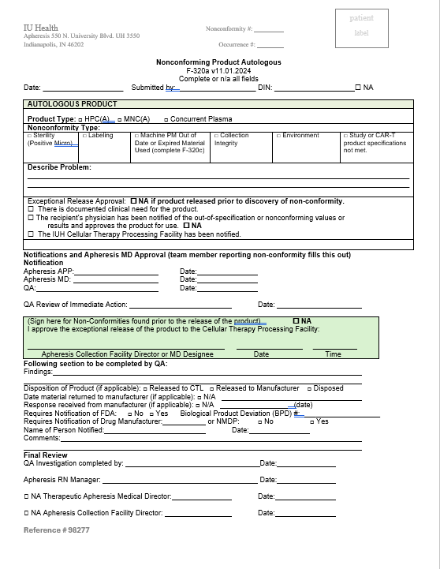
Updated Forms
Non-conformities separate

Slide 7
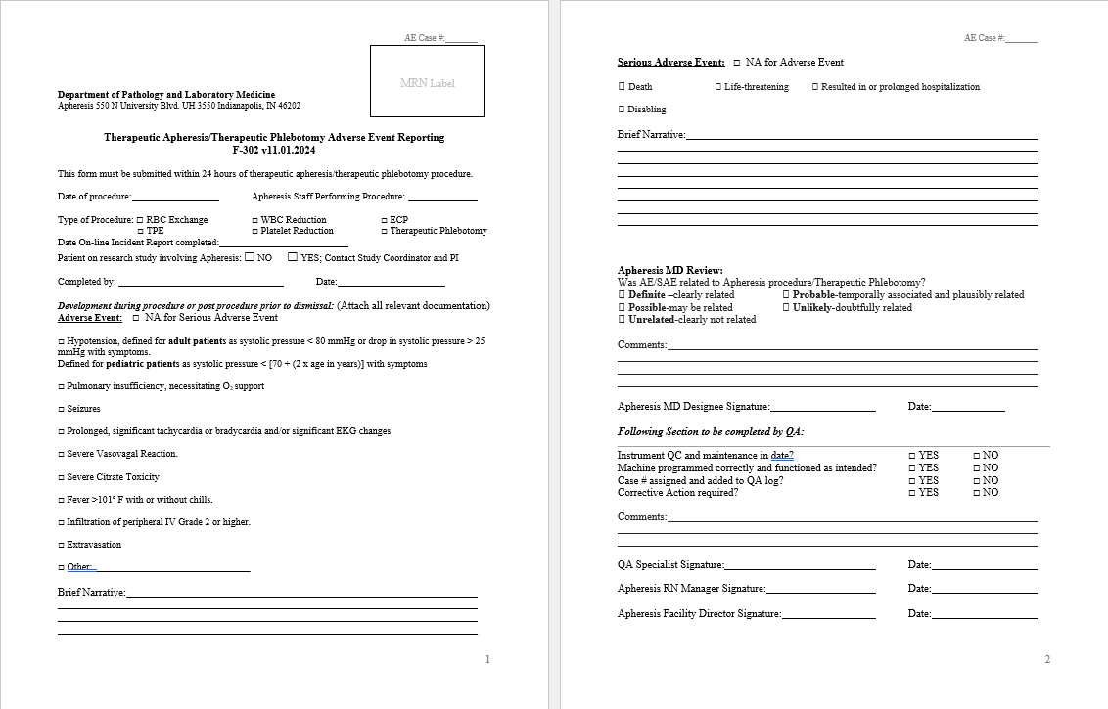
Updated Forms Cont.

Slide 8
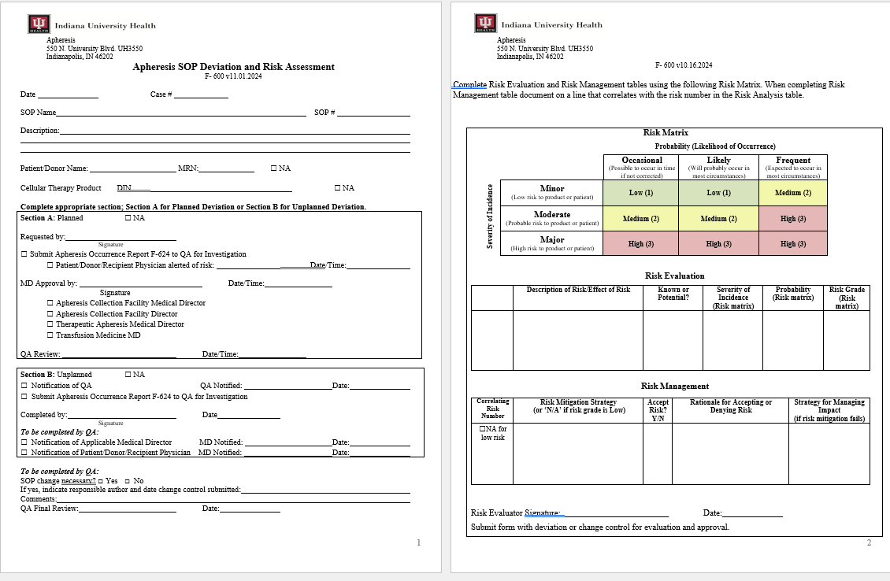
Updated Forms cont.

Slide 9
Holidays
Day after Thanksgiving
Day after Christmas
*The goal is to NOT schedule patients on those days, but we need someone here to answer the phone.
-Volunteers?
-If not volunteer then this will go to the person on-call.

Slide 10
Patient Increase
Per Dr. O’Brien, we should expect an increase in RBCX patients at some point.
A total of 5 peds collections coming within the next 2 weeks

Slide 11
Gel Pens
THROW THEM IN THE TRASH!!

Slide 12
Culture Day 10/16

Slide 13
Grand rounds

Slide 14
Values Acknowledgments: Purpose, Excellence, Compassion, Team
Thank you to Robin for speaking to the BO support group.
Everyone who has picked up shifts and call.
Bri for creating a training document.
Anita for all of her WOW cards.

Slide 15
Questions???

