Slide 1
Lisocabtagene maraleucel (liso-cel)
CAR T cell therapy
Information on leukapheresis, the liso-cel manufacturing process, dosing and administration, and adverse event monitoring following infusion. This guide is intended to prepare treatment sites for liso-cel prep and administration, and support patient safety considerations.
For purposes of assessing business relationship between BMS and treatment center for
CAR T cell therapy and subject to confidentiality agreement. Not for dissemination.
© 2024 Bristol-Myers Squibb 06/24 HE-US-2400457

Slide 2

Important context
This presentation is intended for use as part of BMS’s CAR T cell therapy onboarding, which assesses the business relationship between BMS and your treatment center for implementing lisocabtagene maraleucel (liso-cel)
This presentation does not discuss all of the important safety information associated with BMS’s CAR T cell therapies
The content of this presentation and related conversations are subject to a confidentiality agreement between the parties involved. This presentation is not to be disseminated to anyone not covered by the confidentiality agreement
BMS recognizes extensive planning and preparation is required to become a qualified CAR T cell treatment center. This includes having an understanding of the serious side effect profile of CAR T cell therapies, as well as logistics around product use
Please note that the intent of onboarding is to discuss operational considerations and safety considerations regarding CAR T cell therapies and not to promote any products
Additional important reference documents related to onboarding, nonconforming product, and long-term follow-up can be found on the BMS CAR T Treatment Site Repository at BMSCARTMedical.com
CAR, chimeric antigen receptor.

Slide 3
Today’s presentation
1. Liso-cel manufacturing and shipment
2. Product receipt and storage
2a) Product Receipt and Contents
2b) Product Storage
3. Preparing for administration
4. Thawing
5. Dose Preparation
6. Administration
7. Post-infusion

Slide 4

Index
Role | Sections to Review
If you are preparing the product | Please review Sections 1, 2a, 2b, 3, 4, and 5
If you are administering product | Please review Sections 1, 2a, 3, 6, and 7
If you are responsible for the creation of SOPs for product handling and administration | Please review All Sections
All contents from this slide deck will be sent to the site quality coordinator and housed on the BMS CAR T Treatment Site Repository
The USPI also includes full product preparation and administration information in section 2.0
CAR, chimeric antigen receptor; SOP, standard operating procedure; USPI, United States Prescribing Information.

Slide 5
About liso-cel
Indications
Lisocabtagene maraleucel (liso-cel) is a CD19-directed genetically modified autologous T cell immunotherapy indicated for the treatment of:
adult patients with large B-cell lymphoma (LBCL), including diffuse large B-cell lymphoma (DLBCL) not otherwise specified (including DLBCL arising from indolent lymphoma), high-grade B-cell lymphoma, primary mediastinal large B-cell lymphoma, and follicular lymphoma grade 3B who have:
  refractory disease to first-line chemoimmunotherapy or relapse within 12 months of first-line chemoimmunotherapy; or
  refractory disease to first-line chemoimmunotherapy or relapse after first-line chemoimmunotherapy and are not eligible for hematopoietic stem cell transplantation (HSCT) due to comorbidities or age; or
  relapsed or refractory disease after two or more lines of systemic therapy.
Limitations of Use: Liso-cel is not indicated for the treatment of patients with primary central nervous system lymphoma.
Note: Additional indications are included on the following slide
Reference: Breyanzi [prescribing information]. Bristol Myers Squibb Company. 2024.

Slide 6
About liso-cel (continued)
Indications
Lisocabtagene maraleucel (liso-cel) is a CD19-directed genetically modified autologous T cell immunotherapy indicated for the treatment of:
Adult patients with relapsed or refractory chronic lymphocytic leukemia (CLL) or small lymphocytic lymphoma (SLL) who have received at least 2 prior lines of therapy, including a Bruton tyrosine kinase (BTK) inhibitor and a B-cell lymphoma 2 (BCL-2) inhibitor. This indication is approved under accelerated approval based on response rate and duration of response. Continued approval for this indication may be contingent upon verification and description of clinical benefit in confirmatory trial(s)
Adult patients with relapsed or refractory follicular lymphoma (FL) who have received 2 or more prior lines of systemic therapy. This indication is approved under accelerated approval based on response rate and duration of response. Continued approval for this indication may be contingent upon verification and description of clinical benefit in confirmatory trial(s)
Adult patients with relapsed or refractory mantle cell lymphoma (MCL) who have received at least 2 prior lines of systemic therapy, including a Bruton tyrosine kinase (BTK) inhibitor
Reference: Breyanzi [prescribing information]. Bristol Myers Squibb Company. 2024.

Slide 7
Liso-cel Risk Evaluation and Mitigation Strategy (REMS)
Liso-cel is available only through a restricted program under a Risk Evaluation and Mitigation Strategy (REMS).
The required components of the liso-cel REMS are:
  Healthcare facilities that dispense and administer liso-cel must be enrolled and comply with the REMS requirements.
  Certified healthcare facilities must have on-site, immediate access to tocilizumab.
  Ensure that a minimum of 2 doses of tocilizumab are available for each patient for infusion within 2 hours after liso-cel infusion, if needed for treatment of CRS.
Further information is available at www.BreyanziREMS.com, or contact Bristol-Myers Squibb at 1-866-340-7332.
CAR, chimeric antigen receptor; CRS, cytokine release syndrome.
Reference: Breyanzi [prescribing information]. Bristol Myers Squibb Company. 2024.

Slide 8
Liso-cel components
The liso-cel formulation contains 75% (v/v) Cryostor® CS10 [containing 7.5% dimethylsulfoxide (v/v)], 24% (v/v) Multiple Electrolytes for Injection, Type 1, 1% (v/v) of 25% albumin (human)
Each CD8 or CD4 component is packed in a carton containing up to 4 vials, depending upon the concentration of the cryopreserved drug product CAR-positive viable T cells
The cartons for each CD8 component and CD4 component are in an outer carton
Liso-cel is administered as a defined composition of CAR-positive viable T cells (consisting of 1:1 CD8 and CD4 components).
CAR, chimeric antigen receptor.
Reference: Breyanzi [prescribing information]. Bristol Myers Squibb Company. 2024.

Slide 9
Chain of Identity verification
Chain of Identity (COI) describes the ability to link a patient to their cells from the time of leukapheresis collection through product administration.
COI is maintained using key verification steps throughout the treatment journey
The JOIN ID is the primary unique identification code that is assigned to a patient’s autologous blood product from the time of leukapheresis scheduling through product administration

Slide 10

Liso-cel Manufacturing and Shipment
SECTION 1

Slide 11
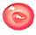
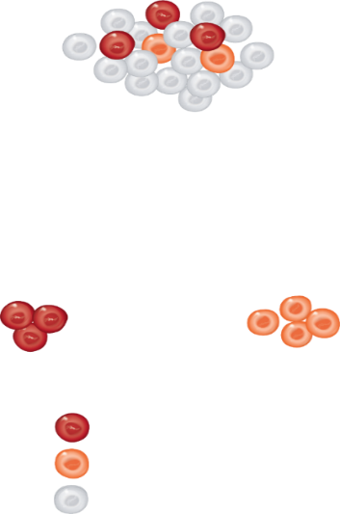
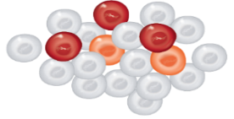



Liso-cel manufacturing process^{1,2}
Dose Range
Indication | Liso-cel dose range
LBCL after two or more lines of therapy | 50 to 110 × 10⁶ CAR-positive viable T cells
LBCL after one line of therapy | 90 to 110 × 10⁶ CAR-positive viable T cells
CLL or SLL | 90 to 110 × 10⁶ CAR-positive viable T cells
FL
MCL
Leukapheresis Material
Immunomagnetic selection for CD8+
and CD4+ T cells
CD8+ T cells
CD4+ T cells
Activation and lentiviral transduction
in vitro expansion
CD8+
CAR+ T cells
CD4+
CAR+ T cells
Formulation
CAR-positive viable T cells (consisting of 1:1 CAR-positive viable T cells of the CD8 and CD4 components), with each component supplied separately in one to four single-dose vials.
Liso-cel is a CD19-directed genetically modified autologous cell immunotherapy administered as a defined composition to reduce variability in CD8-positive and CD4-positive T cell dose.
Drug product
CD4+
component
Sequential infusion
CD8+
component
CAR, chimeric antigen receptor, CLL chronic lymphocytic leukemia; LBCL, large B-cell lymphoma; SLL, small lymphocytic leukemia.
References: 1. Abramson JS, et al. Abstract 241. Presentation of the American Society of Hematology. Orlando, FL. December 7, 2019. 2. Breyanzi [prescribing information]. Bristol Myers Squibb Company. 2024.

Slide 12
Screening for viral infectious agents
Hepatitis B virus (HBV) reactivation, in some cases resulting in fulminant hepatitis, hepatic failure, and death, can occur in patients treated with drugs directed against B cells
In clinical trials of liso-cel, 35 of 38 patients with a prior history of HBV were treated with concurrent antiviral suppressive therapy. Perform screening for HBV, HCV, and HIV in accordance with clinical guidelines before collection of cells for manufacturing. In patients with prior history of HBV, consider concurrent antiviral suppressive therapy to prevent HBV reactivation per standard guidelines.
Perform screening for HBV, HCV, and HIV in accordance with clinical guidelines before collection of cells for manufacturing
HBV, hepatitis B virus; HCV, hepatitis C virus; HIV, human immunodeficiency virus.
Reference: Breyanzi [prescribing information]. Bristol Myers Squibb Company. 2024.

Slide 13
Before liso-cel shipment and receipt
Leukapheresis
Collecting your patient’s T cells through leukapheresis at a Bristol Myers Squibb qualified facility is the first step in the treatment process^{1,2}
Before beginning leukapheresis, confirm that your patient is given adequate time after prior treatments
Washout Periods Prior to Leukapheresis
 | TRANSFORM³ | PILOT⁴ | TRANSCEND⁵ |  | TRANSCEND⁵ | TRANSCEND-CLL⁶ | TRANSCEND-MCL⁷ | TRANSCEND-FL⁸
Therapeutic doses of corticosteroidsª | ≥7 days
Cytotoxic chemotherapeutic agents^{b} | ≥7 days
Lymphotoxic chemotherapeutic agents (eg, cyclophosphamide, ifosfamide, bendamustine) | ≥2 weeks
Experimental agents^{c} | ≥4 weeks
Immunosuppressive therapies^{d} | ≥4 weeks | - |  |  | ≥4 weeks
Oral chemotherapeutic agents (Len, PI3Ki, BTKi, Ven) | - | Len or Ibr: At least 3 half-lives |  |  |  | Ven: ≥4 days Idel or Duvel: ≥2 days Len or Acala: ≥1 day | Len or Ibr: At least 3 half-lives | Len or Ibr or PI3Ki: At least 3 half-lives
Radiation: Multiple lesions Single lesion | ≥4 weeks ≥2 weeks | ≥6 weeks ≥2 weeks |  |  |  | ≥6 weeks | ≥6 weeks ≥2 weeks
Allogeneic hematopoietic stem cell transplantation | - | - |  | ≥90 days |  | ≥100 days | ≥90 days
ªDefined as >20 mg/day of prednisone or equivalent. ^{b}Not considered lymphotoxic. ^{c}Unless no response or disease progression was documented on the experimental therapy and ≥3 half-lives had relapsed prior to leukapheresis. ^{d}Examples include calcineurin inhibitors, methotrexate or other chemotherapeutics, mycophenolate, rapamycin, thalidomide, immunosuppressive antibodies.
Acala, acalabrutinib; allo-HSCT, allogeneic hematopoietic stem cell transplant; CAR, chimeric antigen receptor; CLL, chronic lymphocytic leukemia; Duvel, duvelisib; Ibr, ibrutinib;
Idel, idelalisib; LDC, lymphodepleting chemotherapy; Len, lenalidomide; MCL; mantle cell lymphoma; PD, progressive disease; PET, positron emission topography; Ven, venetoclax.
References: 1. Abramson JS, et al. Abstract 241. Presentation of the American Society of Hematology. Orlando, FL. December 7, 2019. 2. Data on file. Juno Therapeutics, A Bristol Myers
Squibb Company. 2019. 3. Kamdar M, et al. Lancet. 2022;399(10343):2294-2308. 4. Sehgal A, et al. Lancet Oncol. 2022;23(8):1066-1077. 5. Abramson JS, et al. Lancet. 2020;396(10254):
839-852. 6. Siddiqi T, et al. Lancet. 2023;402(10402):641-654. 7. Wang M, et al. J Clin Oncol. 2024;42(10):1146-1157. 8 Morschhauser F, et al. Nature Medicine. 2024; https://doi.org/10.1038/s41591-024-02986-9.

Slide 14
Manufacturing
>98% manufacturing success rate in the TRANSFORM pivotal trial¹
  Of 92 patients who underwent leukapheresis, there was 1 manufacturing failure
>98% manufacturing success rate in the PILOT pivotal trial¹
  Of 74 patients who underwent leukapheresis, there was 1 manufacturing failure
>98% manufacturing success rate in the TRANSCEND pivotal trial¹
  Of 299 patients who underwent leukapheresis, there were 2 manufacturing failures
>95% manufacturing success rate in the TRANSCEND-CLL pivotal trial¹
  Of 113 patients who underwent leukapheresis, there were 3 manufacturing failures
Following leukapheresis, your patient's T cells are sent to a manufacturing site
CD8 and CD4 T cells are selected, activated, and transduced with the replication-incompetent lentiviral vector containing the anti-CD19 CAR transgene
The transduced T cells are expanded in cell culture, washed, formulated into a suspension,
and cryopreserved as separate CD8 and CD4 components
The product is prepared from a patient's T cells and obtained from the product of a standard leukapheresis procedure at Bristol Myers Squibb qualified facilities, and then administered as a defined composition to reduce variability in CD8-positive and CD4-positive T cell dose
Each is packaged in a separate, patient-specific carton containing up to 4 vials and shipped as
a frozen suspension
Reference: Breyanzi [prescribing information]. Bristol Myers Squibb Company. 2024.

Slide 15

Product availability for shipment and administration
Sites will be provided with an estimated product availability date that may be updated throughout the manufacturing process. The product availability date is subject to change. Confirm the availability of liso-cel before starting lymphodepleting chemotherapy
For patient scheduling, delivery, and shipping information, visit the portal at CellTherapy360.com
Bristol Myers Squibb utilizes validated dry LN₂ shipping units to ship liso-cel
Additionally, to help ensure appropriate conditions are maintained during shipment, each shipping unit will have tamper-evident seals and contain a temperature-monitoring device
This is the end of Section 1.
Click HOME icon to return to Table of Contents or ARROW to proceed to next section.
For Cell Therapy 360 inquiries, please call 1-888-805-4555.
LN₂, liquid nitrogen.

Slide 16

Product Receipt and Storage
SECTION 2

Slide 17
Product Receipt & Contents
SECTION 2a

Slide 18



Receipt of LN₂ vapor shipper
COI
1
Chain of Identity (COI) verification check—receipt of LN₂ vapor product shipper
Two staff members are required to verify that the patient information listed on the RFI certificate matches that listed on the treatment center’s patient medical records. Please check the following:
JOIN ID*
Patient first and last name
Patient date of birth
Patient information listed on the syringe labels located on the liso-cel RFI Certificate will also need to be verified against the patient medical records
Note: If there are any issues with the RFI Certificate or labels, contact Bristol Myers Squibb: 1-888-805-4555
*JOIN is a unique 10 character identification code that is assigned to the patient’s specific cellular material and is the link between the patient and their cells throughout the manufacturing process.
LN₂, liquid nitrogen; RFI, Release for Infusion.

Slide 19
Receipt of liso-cel
Liso-cel is shipped directly to the cell associated lab or clinical pharmacy associated with
the infusion center in the vapor phase of a liquid nitrogen shipper
If the patient is not expected to be ready for administration before the shipper expires and
the infusion site is qualified for on-site storage, transfer liso-cel to on-site vapor phase of
liquid nitrogen storage prior to preparation
If the patient is not expected to be ready for administration before the shipper expires and the infusion site is not qualified for on-site storage, contact Bristol Myers Squibb at 1-888-805-4555
to arrange for return shipment
Reference: Breyanzi [prescribing information]. Bristol Myers Squibb Company. 2024.

Slide 20
Receipt of liso-cel (cont.)
For courier to release product to treatment center, staff receiving product must confirm JOIN* at the time of delivery as part of Chain of Custody handoff. Verify the tamper-evident seals of the dry LN₂ shipping unit are intact. If the tamper-evident seals are not intact, do not move forward with product thaw and administration, and immediately contact Bristol Myers Squibb to determine next steps
Bristol Myers Squibb will also monitor the temperature of CAR T products during shipment (from pack-out at our manufacturing facility to delivery at the treatment site), and will notify the site if there is any temperature event that occurred during shipment that may impact product quality
For designated sites that qualified for on-site storage during onboarding, have 2 staff confirm patient information listed on the RFI Certificate matches the information listed on the product carton labels when transferring to cryo storage (reference step 2 of COI leave behind)
For Cell Therapy 360 inquiries, please call 1-888-805-4555.
*JOIN is a unique identification code that is assigned to the patient’s specific cellular material and is the link between the patient and their cells throughout the manufacturing process.
CAR, chimeric antigen receptors; COI, Chain of Identity; LN₂, liquid nitrogen.

Slide 21
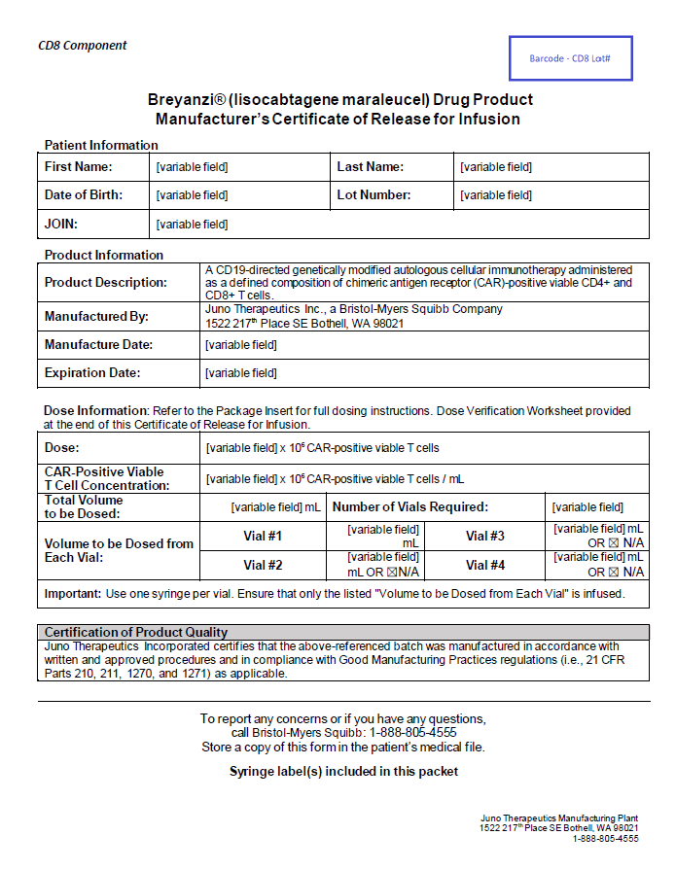

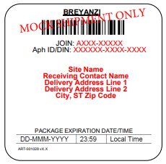
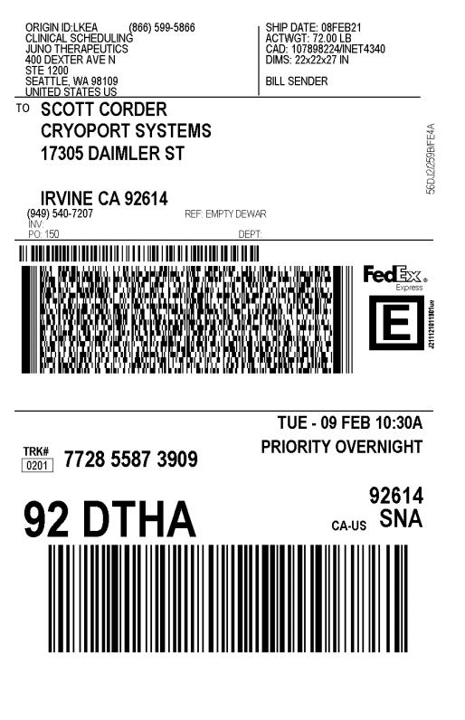

LN₂ shipper contents
The LN₂ shipper will contain the following:
Certificate of Release for Infusion (RFI Certificate) for CD8 and CD4 components
CD8 and CD4 syringe labels
(affixed to RFI Certificate)
Shipper expiry label
(affixed to outside of shipper)
FedEx® return label
DO NOT open the inner chamber of the shipper until you are ready to prepare the product for administration, or until you are ready to transfer to on-site cryo storage (for sites that have been qualified).
Once open, the thaw must be carried to completion and the cells administered within 2 hours.
LN₂, liquid nitrogen.

Slide 22
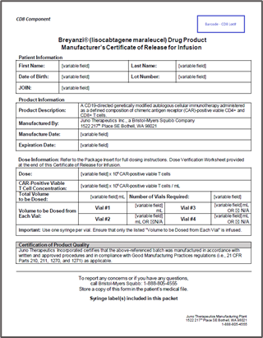
Certificate of Release for Infusion (RFI Certificate)
Each RFI Certificate is included within the shipper and product details are broken out for CD8+ and CD4+ component:
  Product lot
  Manufacturing date
  Expiration date
  Total dose
  Concentration
  Total volume to be infused
  Number of vials required
  Volume to be dosed from each vial
Certificate of Release for Infusion (RFI)
The following patient identifiers are also included:
  Patient first and last name
  Patient date of birth
  JOIN ID

Slide 23
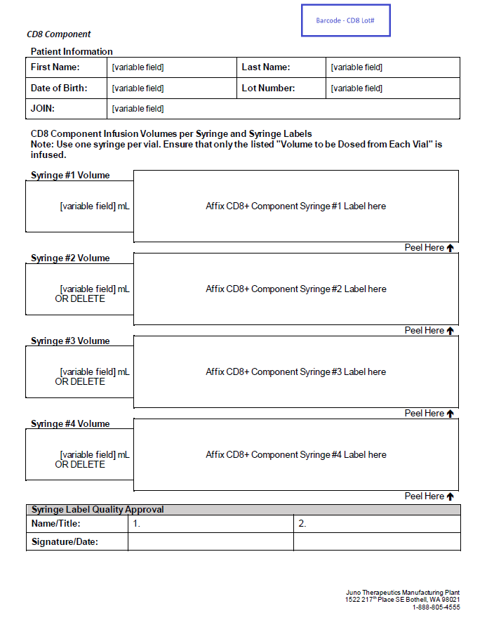
Release for Infusion Certificate – CD8 Component

Slide 24
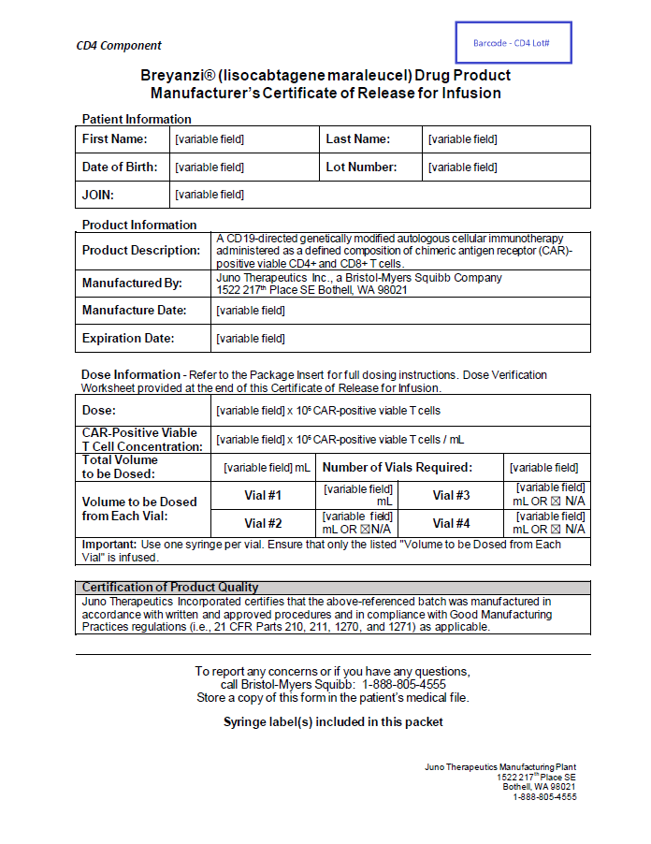
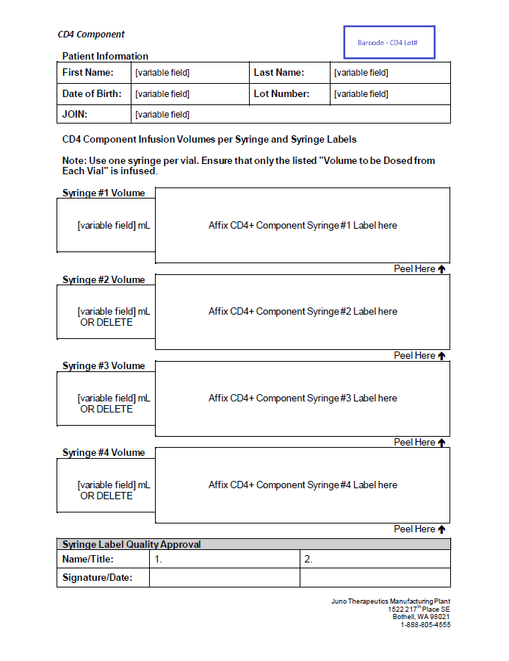
Release for Infusion Certificate – CD4 Component

Slide 25
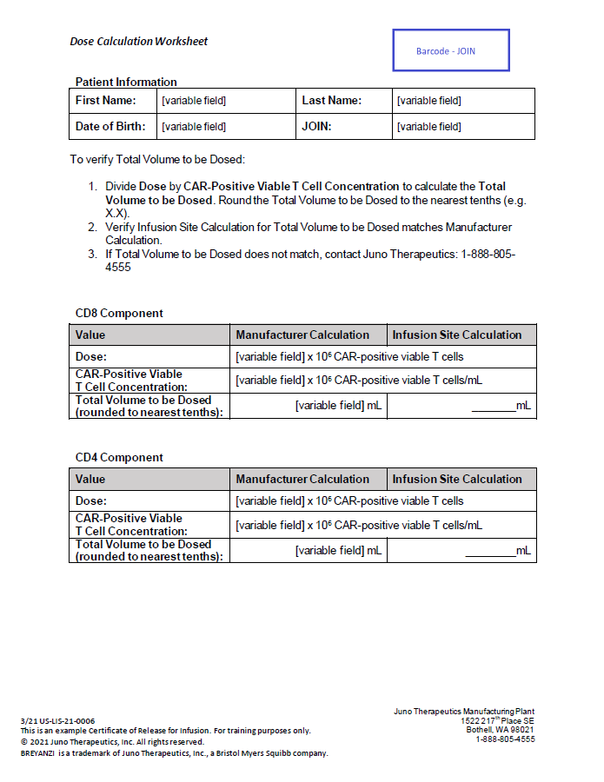
Release for Infusion Certificate – Dose Calculation Worksheet
Divide Dose by CAR-Positive Viable T-Cell Concentration to calculate the Total Volume to be Dosed. Round the Total Volume to be Dosed to the nearest tenths (e.g. X.X)
Verify Infusion Site Calculation for Total Volume to be Dosed matches Manufacturer Calculation
If Total Volume to be Dosed does not match, contact Bristol-Myers Squibb:
1-888-805-4555
Site should verify the total volume to be dosed.
(See dose calculation worksheet in RFI).
CAR, chimeric antigen receptor.

Slide 26
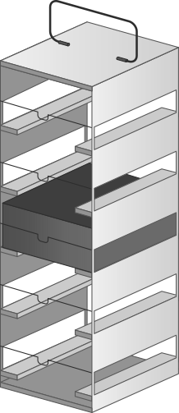
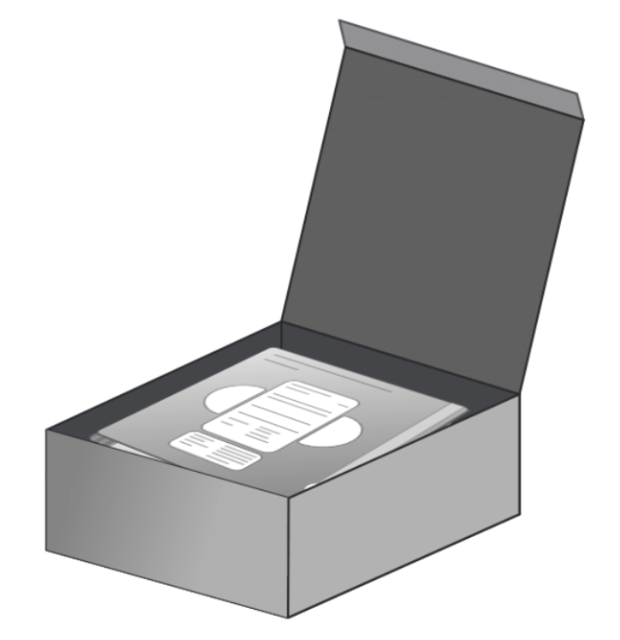


Contents inside the inner chamber
Rack
Box with vials
CAR-positive viable T cells
(consisting of CD8 and CD4 components)
10.96”
CD8
CD4
5.53”
5.63”
Outer carton that contains 2 inner cartons
One inner carton for each component
DO NOT open the inner chamber of the shipper until you are ready to prepare the product for administration, or until you are ready to transfer to on-site cryo storage (for sites that have been qualified).
Once open, the thaw must be carried to completion and the cells administered within 2 hours.

Slide 27

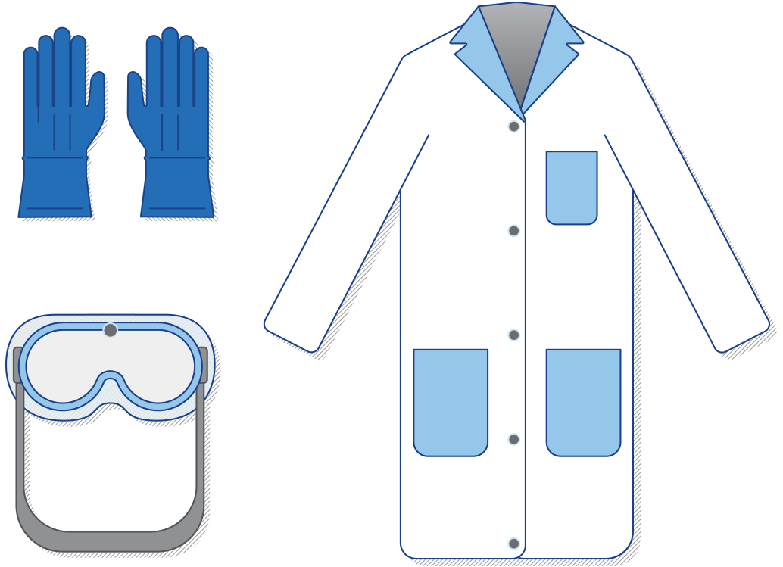
Safety guidelines
When removing liso-cel from vapor-phase LN₂ storage, ensure the appropriate safety measures are taken and that personnel have been trained on handling LN₂ according to institutional practices.
Wear the following personal protective
equipment:
Waterproof thermal protective gloves
Safety glasses with side shields
Lab coat
Note: Liso-cel MUST be administered within 2 hours from start of thaw.
This is the end of Section 2a.
Click HOME icon to return to Table of Contents or ARROW to proceed to next section.
For Product Prep or SOP
For Product Admin
LN₂, liquid nitrogen.

Slide 28
Product Storage
SECTION 2b

Slide 29
Product storage options
There are 2 delivery/storage options for liso-cel:
Just-in-time delivery
Liso-cel arrives prior to infusion and is stored in the LN₂ shipper, up to the expiry on the shipper. This option is available to every administration site
Onsite storage (requires Bristol Myers Squibb qualification)
Liso-cel may arrive earlier and is transferred to on-site vapor-phase LN₂ storage
The method of storage of liso-cel will depend on individual site qualifications.
Note: DO NOT open the dry vapor shipper until the day of dosing, unless transferring to an on-site storage tank.
LN₂, liquid nitrogen.

Slide 30

Just-in-time delivery*
Store the LN₂ shipper upright in a locked, well-ventilated room upon arrival at the site and until time of preparation for infusion.
DO NOT open the inner chamber of the shipper until you are ready to prepare the product for administration. The thaw must be carried to completion and the cells administrated within 2 hours.
STOP AND CHECK PRODUCT: Verify that the removal of liso-cel from the LN₂ dry shipper is prior to the expiration date and time on the shipping label, and the expiration date and time on the shipping label are after the planned date for removal of liso-cel from the shipper.
PRODUCT
This is the end of Section 2b.
Click HOME icon to return to Table of Contents or ARROW to proceed to next section.
*Sites may also have an option for on-site storage. BMS qualification is required.
LN₂, liquid nitrogen.
Reference: Data on file. Juno Therapeutics, A Bristol Myers Squibb Company. 2019.

Slide 31

Preparing for Administration
SECTION 3

Slide 32
Lymphodepleting chemotherapy
Confirm the availability of liso-cel before starting lymphodepleting chemotherapy
Administer the lymphodepleting chemotherapy regimen before infusion of liso-cel: fludarabine
30 mg/m²/day IV and cyclophosphamide 300 mg/m²/day IV for 3 days
See full prescribing information for fludarabine and cyclophosphamide, including for information on dose adjustment in renal impairment
Infuse liso-cel 2 to 7 days after completion of lymphodepleting chemotherapy
Delay the infusion of liso-cel if the patient has unresolved serious adverse events from preceding chemotherapies, active uncontrolled infection, or active graft-versus-host disease (GVHD)
Vaccination with live virus vaccines is not recommended for at least 6 weeks prior to the start of lymphodepleting chemotherapy, during liso-cel treatment, and until immune recovery following treatment with liso-cel
Reference: Breyanzi [prescribing information]. Bristol Myers Squibb Company. 2024.

Slide 33
Pre-treatment considerations
Before you begin treatment with liso-cel:
Ensure that a minimum of 2 doses of tocilizumab are available for each patient for infusion within 2 hours after liso-cel infusion, if needed for treatment of CRS
Monitor patients for signs and symptoms of infection before and after liso-cel administration and treat appropriately. Administer prophylactic antimicrobials according to standard institutional guidelines. Avoid administration of liso-cel in patients with clinically significant active systemic infections
Monitor complete blood counts prior to and after liso-cel administration
Note that liso-cel may cause a false-positive HIV test result by some commercial HIV nucleic acid tests
CRS, cytokine release syndrome; HIV, human immunodeficiency virus.
Reference: Breyanzi [prescribing information]. Bristol Myers Squibb Company. 2024.

Slide 34
Pre-medication on infusion day
Premedication
Premedicate your patient with acetaminophen (650 mg orally) and diphenhydramine (25-50 mg IV or orally), or another H1-antihistamine 30 to 60 minutes prior to treatment with liso-cel
Notification
Once the patient is prepared, the staff responsible for preparing liso-cel should be notified to start product thaw
Avoid prophylactic use of systemic corticosteroids as they may interfere with the activity of liso-cel
This is the end of Section 3.
Click HOME icon to return to Table of Contents or ARROW to proceed to next section.
For Thawing
For Product Admin
IV, intravenous.
Reference: Breyanzi [prescribing information]. Bristol Myers Squibb Company. 2024.

Slide 35
Thawing
SECTION 4

Slide 36
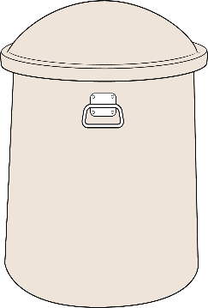

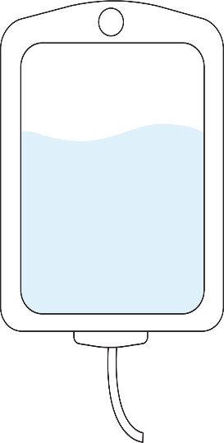
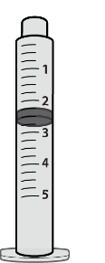

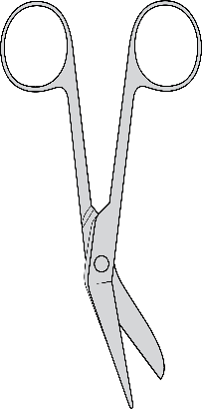
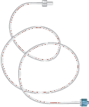



Preparation for thaw
Assemble the following supplies prior to retrieving liso-cel from vapor-phase LN₂ storage (materials not provided):
1, 3, and 5 mL
Luer-lock tip syringes;
20-gauge 1- to 1.5-inch needles for each vial
Alcohol swabs
Insulated
product carrier
Scissors
Intravenous (IV) tubing
Cryogloves
Protective
barrier pads
Normal saline
Note: Liso-cel MUST be administered within 2 hours from start of thaw.
LN₂, liquid nitrogen.
Reference: Data on file. Juno Therapeutics, A Bristol Myers Squibb Company. 2019.

Slide 37
Preparation for thaw (cont.)
Assemble the following supplies prior to retrieving liso-cel from vapor-phase LN₂
storage (continued):
Manufacturer-provided syringe labels (affixed to RFI Certificate)
Confirm the patient’s identity with the patient identifiers on the RFI Certificate
For information on the number of vials and required volumes, see the RFI Certificate on the inside lid of the shipper. The number of syringes required to complete the dose is indicated on the RFI Certificate and should be communicated to the site’s nursing staff in advance
Ensure that 2 doses of tocilizumab and emergency equipment are available prior to infusion and during the recovery period.
Note: Liso-cel MUST be administered within 2 hours from start of thaw.
LN₂, liquid nitrogen; RFI, Release for Infusion.

Slide 38
3 options for location of thawing
In Cell Therapy Lab/Pharmacy
During Transport to Bedside
At Bedside
Thaw the vial(s) and prepare the dose in the syringe(s), in the cell therapy lab
Transport the syringe(s) to bedside in an insulated room temperature carrier with a protective barrier pad inside
Thaw vial(s) during transport to bedside in an insulated room temperature product carrier with a protective barrier pad inside
Prepare the dose in the syringe(s) at bedside
Transport the LN₂ shipper directly to the infusion area
Thaw the vial(s) and prepare the dose in the syringe(s) at bedside
Note: Liso-cel MUST be administered within 2 hours from start of thaw
LN₂, liquid nitrogen.
Reference: Data on file. Juno Therapeutics, A Bristol Myers Squibb Company. 2019.

Slide 39
Thawing procedure
Confirm the infusion time in advance and adjust the start time of liso-cel thaw such that it will be available for infusion when the patient is ready
Confirm the patient’s identity with the patient identifiers on the outer carton and on the syringe labels
Remove the vial box from frozen storage
Initiate thaw of CD8 and CD4 vials after site staff confirms patient is ready for infusion
Immediately open the vial box and remove the CD8 component carton and CD4 component carton from the outer carton
Once the vials are removed from frozen storage, the thaw must be carried out to completion and administered within 2 hours
Reference: Breyanzi [prescribing information]. Bristol Myers Squibb Company. 2024.

Slide 40
Thawing procedure (cont.)
COI
2
COI verification check—product thawing preparation
Two site staff must verify that the following patient information listed on the product RFI Certificate* matches the information listed on the carton labels and vial labels
JOIN ID
Patient first and last name
Patient date of birth
*Patient information listed on the carton labels will need to be verified against the patient medical records.
Note: Liso-cel MUST be administered within 2 hours from start of thaw.
COI, Chain of Identity; RFI, Release for Infusion.

Slide 41
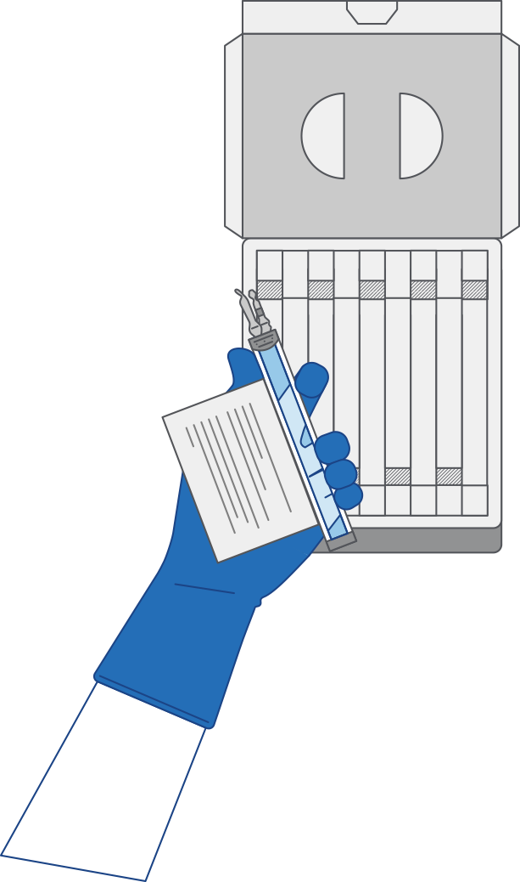
Thawing procedure (cont.)
Confirm the patient’s identity with the patient identifiers on the inner carton
Open each inner carton and visually inspect the vial(s) for damage.
If the vials are damaged, contact Bristol Myers Squibb at
1-888-805-4555
Confirm the patient’s identity with the patient identifiers on the vials
Carefully remove the vials from the cartons, place vials on a protective barrier pad, and thaw at room temperature until there is no visible ice in the vials. Thaw all of the vials at the same time. Keep the CD8 and CD4 components separate
Note: The total time from removal from frozen storage to patient administration should not exceed 2 hours as indicated by the time entered on the syringe label.
This is the end of Section 4.
Click HOME icon to return to Table of Contents or ARROW to proceed to next section.
Reference: Breyanzi [prescribing information]. Bristol Myers Squibb Company. 2024.

Slide 42
Dose Preparation
SECTION 5

Slide 43

Dose preparation: Introduction
Prepare liso-cel using sterile technique.
Based on the concentration of CAR-positive viable T cells for each component, more than one vial of each of the CD8 and CD4 components may be required to complete a dose. A separate syringe will be prepared for each CD8 or CD4 component vial received
  Note: The volume to be drawn up and infused may differ for each component as indicated on the RFI Certificate. Do NOT draw up excess volume into the syringe.
Note: Each vial is a single-use vial. Once a needle has been inserted into the port of the vial and then withdrawn, the vial is considered used. Multiple doses of cells should not be withdrawn from 1 vial.
RFI, Release for Infusion.
Reference: Breyanzi [prescribing information]. Bristol Myers Squibb Company. 2024.

Slide 44
Dose preparation: Introduction (cont.)
Each vial contains 5 mL with a total extractable volume of 4.6 mL of CD8 or CD4 cells. The RFI Certificate indicates the volume of cells to be drawn up into each syringe. Use the smallest Luer-lock tip syringe necessary (1, 3, or 5 mL) to draw up the specified volume from each vial. A 5 mL syringe should not be used for volumes less than 3 mL
Prepare the syringe(s) of the CD8 component first. Affix the CD8 syringe labels to the syringe(s) prior to pulling the required volume into the syringe(s). On the syringe label, fill in Expiration Day/Time with the day and time depicting 2 hours from start of thaw
Note: It is important to confirm that the volume drawn up for each component matches the volume specified in the respective RFI Certificate. Do NOT draw up excess volume into the syringe. The RFI Certificate will contain a worksheet for the site to independently calculate and verify the total volume to be dosed.
RFI, Release for Infusion.
Reference: Breyanzi [prescribing information]. Bristol Myers Squibb Company. 2024.

Slide 45
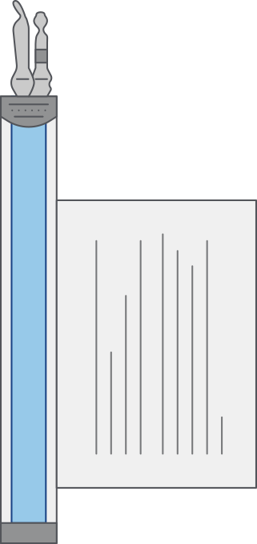
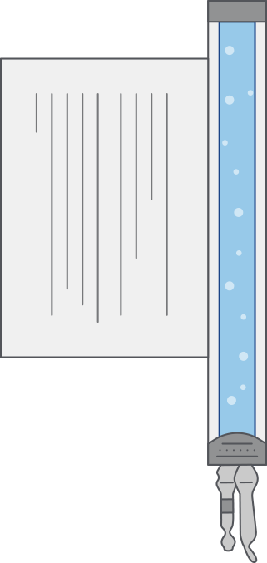

Dose preparation: Product resuspension
Invert and inspect: Hold the thawed vial(s) upright and gently invert the vial(s) 5 times to mix the cell product until cells appear to be evenly resuspended
If clumping is apparent, continue to invert the vial(s) until clumps have dispersed
Visually inspect for damage or leaks. The liquid in the vials should be slightly opaque to opaque, colorless to yellow, or brownish-yellow
Note: If there is any evidence of damage, leakage, or unresolved clumping, or any questions about the appearance of the product, stop and call Bristol Myers Squibb at 1-888-805-4555 immediately.
Reference: Breyanzi [prescribing information]. Bristol Myers Squibb Company. 2024.

Slide 46

Dose preparation: Vial preparation (cont.)
Remove the polyaluminum cover (if present) from the
bottom of the vial and swab the septum with an alcohol wipe
If there is no cover, you will still need to swab the septum
  The absence of the polyaluminum cover does not impact the sterility of the vial
  Allow to air dry before proceeding
Cut seal: There are 2 lines: 1 with a filter (A), and one
with no filter (B). Cut ONLY the tubing that has a filter.
DO NOT cut line B that has no filter.
It is important to keep the vial(s) upright and cut the
seal on the tubing line on the top of the vial immediately above the filter to open the air vent on the vial
Note: Be careful to select the correct tubing line, with the filter.
Cut ONLY the tubing with a filter.
Reference: Breyanzi [prescribing information]. Bristol Myers Squibb Company. 2024.

Slide 47

Dose preparation: Product withdrawal
Using a 20-gauge, 1- to 1.5-inch needle, hold the needle with the opening of the needle tip away from the retrieval port septum
Insert the needle into the septum at a 45- to 60-degree angle
As the needle enters the vial increase the angle of the needle to gradually align syringe and vial
Without drawing air into the syringe, slowly withdraw the target volume (as specified in the RFI Certificate)
Inspect the syringe for signs of debris before proceeding
If there are any signs of debris, please call
1-888-805-4555
RFI, Release for Infusion.
Reference: Breyanzi [prescribing information]. Bristol Myers Squibb Company. 2024.

Slide 48

Dose preparation: Product withdrawal (cont.)
After the CD8 or CD4 cell component volume in the syringe is verified, remove the needle and syringe from vial—while continuing to hold horizontal
Carefully remove the needle from the syringe and cap the syringe
Continue to keep the vial horizontal to avoid leaking from the septum, and return it to the carton
Dispose of any unused portion of liso-cel (according to local biosafety guidelines)
Repeat the process steps for the CD4 component
Reference: Breyanzi [prescribing information]. Bristol Myers Squibb Company. 2024.

Slide 49
Dose preparation: Volume verification and handover
If the dose was not prepared at the bedside, transport the labeled CD8 and CD4 syringes to the bedside by placing with protective barrier pad inside an insulated room-temperature container, and deliver along with the RFI Certificate
The RFI Certificate indicates the correct volume. Confirm syringe label matches the RFI Certificate prior to administration
Note: Liso-cel MUST be administered within 2 hours from start of thaw.
This is the end of Section 5.
Click HOME icon to return to Table of Contents or ARROW to proceed to next section.
RFI, Release for Infusion.
Reference: Breyanzi [prescribing information]. Bristol Myers Squibb Company. 2024.

Slide 50
Administration
SECTION 6

Slide 51
Prior to administration
COI
3
COI verification check—infusion
Two site staff must verify that the following patient information listed on the product RFI matches the information listed on the syringe labels
  JOIN ID
  Patient first and last name
  Patient date of birth
Site staff to verify patient information on product labels against patient medical record and verbally with the patient prior to infusion
COI, Chain of Identity; RFI, Release for Infusion.

Slide 52

Preparation for administration
Start an IV of 0.9% NaCl (normal saline) to flush all the infusion tubing prior to and after each CD8 and CD4 CAR T cell therapy infusion¹
Other IV fluids and medications should not be administered during liso-cel administration²
The IV can be either a peripheral line or central line²
Important: Do NOT use a leukodepleting filter¹
CAR, chimeric antigen receptor; IV, intravenous.
References: 1. Breyanzi [prescribing information]. Bristol Myers Squibb Company. 2024. 2. Data on file. Juno Therapeutics, A Bristol-Myers Squibb Company. 2019.

Slide 53
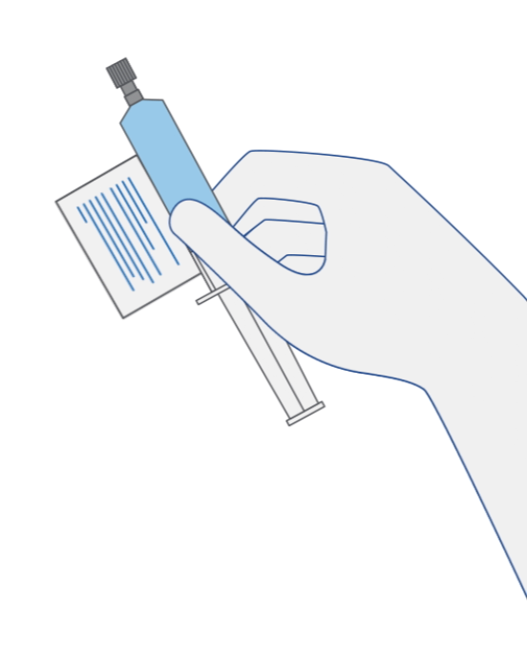

CD8 administration
Prior to administration of liso-cel, prepare the patient by starting an IV of normal saline to flush all infusion tubing
Administer the entire volume of the CD8 component intravenously at an infusion rate of approximately 0.5 mL/minute, using the closest port or Y-arm
  If more than one syringe is required for a full cell dose of the CD8 component, administer the volume in each syringe consecutively without any time between administering the contents of the syringes (unless there is a clinical reason [eg, infusion reaction] to hold the dose).
After administration, flush the tubing with normal saline, using enough volume to clear the tubing and the length of the IV catheter
Administration times vary but infusion usually takes less than 15 minutes for each component (CD8 and CD4)
Note: Liso-cel MUST be administered within 2 hours from start of thaw.
Do NOT use a leukocyte depleting filter for administration.
IV, intravenous.
Reference: Breyanzi [prescribing information]. Bristol Myers Squibb Company. 2024.

Slide 54
CD4 administration
Administer CD4 after CD8—use the same steps described for CD8
Flush tubing: Use normal saline to flush all the infusion tubing prior to and after each
CD8 and CD4 component administration
Dispose: Liso-cel contains human blood cells that are genetically modified with replication incompetent, self-inactivating lentiviral vector. Follow universal precautions and local biosafety guidelines applicable for handling and disposal of such products to avoid potential transmission of infectious diseases.
This is the end of Section 6.
Click HOME icon to return to Table of Contents or ARROW to proceed to next section.
Reference: Breyanzi [prescribing information]. Bristol Myers Squibb Company. 2024.

Slide 55
Post-infusion
SECTION 7

Slide 56
Monitoring post-infusion
Allergic reactions may occur with the infusion of liso-cel. Serious hypersensitivity reactions, including anaphylaxis, may be due to dimethyl sulfoxide (DMSO). Manage allergic reactions according to standard institutional guidelines
In the TRANSCEND-NHL-001 clinical trial, the following guidelines were used:
  Vital signs (temperature, respiratory rate, heart rate, blood pressure, and SaO2 by pulse oximetry) were measured within 15 minutes prior to, during, and within approximately 15 minutes after each IV administration, and then approximately every 15 minutes thereafter for the first hour, and hourly for the next 2 hours
  If the patient’s vital signs were not stable 4 hours following the final IV administration, vital signs were monitored as clinically indicated until stable
Continue to monitor CBC and watch for signs and symptoms of hypersensitivity reactions, serious infections, febrile neutropenia, cytopenias, B-cell aplasia and hypogammaglobulinemia
CBC, complete blood count; IV, intravenous.
References: 1. Breyanzi [prescribing information]. Bristol Myers Squibb Company. 2024. 2. Data on file. Juno Therapeutics, A Bristol-Myers Squibb Company. 2019.

Slide 57
Monitoring post-infusion (cont.)
Monitor patients daily at a certified healthcare facility during the first week, following infusion for signs and symptoms of CRS and neurologic toxicities
  Refer to the CRS and NT algorithms on the following slides for grading and management
  Accurate grading is imperative for appropriate management
  Fever may be associated with other adverse events and should be monitored and treated appropriately
Instruct patients to remain within proximity of the certified healthcare facility for at least 4 weeks following infusion
Advise patients to refrain from driving and engaging in hazardous occupations or activities, such as operating heavy or potentially dangerous machines for at least 8 weeks after liso-cel administration
Ensure that the patient has adequate caregiver support at home to help monitor for adverse reactions
CRS, cytokine release syndrome; NT, neurologic toxicity.
Reference: Breyanzi [prescribing information]. Bristol Myers Squibb Company. 2024.

Slide 58
Monitoring post-infusion (cont.)
Patients treated with liso-cel may develop secondary malignancies
  T cell malignancies have occurred following treatment of hematologic malignancies with BCMA- and CD19-directed genetically modified autologous T cell immunotherapies, including liso-cel
Mature T cell malignancies, including CAR-positive tumors, may present as soon as weeks following infusion, and may include fatal outcomes
Monitor lifelong for secondary malignancies. In the event that a secondary malignancy occurs, contact Bristol Myers Squibb at 1-888-805-4555 for reporting and to obtain instructions on collection of patient samples for testing
BCMA, B-cell maturation antigen; CAR, chimeric antigen receptor.
Reference: Breyanzi [prescribing information]. Bristol Myers Squibb Company. 2024.

Slide 59
Infusion reactions
The following guidelines were used to treat infusion reactions in the TRANSCEND clinical trial:
Grade | Guideline
Grade 1 | Administer symptomatic treatment; continue liso-cel administration of both CD8+ and CD4+ components at the same dose and rate
Grade 2 | Stop administration (if applicable) of liso-cel; administer symptomatic treatment; resume liso-cel administration of both CD8+ and CD4+ components at a reduced rate only after symptoms resolve
Grade 3 | Stop administration (if applicable) of liso-cel, administer symptomatic treatment, and resume liso-cel administration of both CD8+ and CD4+ components at a reduced rate of administration only after symptoms resolve. If Grade 3 reaction recurs, discontinue liso-cel; no further CD8+ or CD4+ components of liso-cel should be administered
Grade 4 | Discontinue administration (if applicable) of liso-cel and administer symptomatic treatment as necessary; no further CD8+ or CD4+ components of liso-cel should be administered
Reference: Data on file. Juno Therapeutics, A Bristol-Myers Squibb Company. 2019.

Slide 60
Monitoring cytokine release syndrome
Monitor for signs and symptoms of CRS. CRS may be life-threatening or fatal. Identify CRS based on clinical presentation
Evaluate for and treat other causes of fever, hypoxia, and hypotension
If CRS is suspected, manage according to the recommendations on the following slides
Patients who experience Grade 2 or higher CRS (e.g., hypotension not responsive to fluids, or hypoxia requiring supplemental oxygenation) should be monitored with continuous cardiac telemetry and pulse oximetry
For patients experiencing severe CRS, consider performing an echocardiogram to assess cardiac function.
For severe or life-threatening CRS, consider intensive-care supportive therapy
If concurrent NT is suspected during CRS, administer:
  Corticosteroids according to the more aggressive intervention based on the CRS and NT grades on slides 58-59 and 61-62
  Tocilizumab according to the CRS grade in slides 58-59
  Antiseizure medication according to the neurologic toxicity in slides 61-62
CRS, cytokine release syndrome; NT, neurologic toxicity.
Reference: Breyanzi [prescribing information]. Bristol Myers Squibb Company. 2024..

Slide 61
Cytokine Release Syndrome (CRS) grading and management
CRS Gradeª | Tocilizumab | Corticosteroids^{b}
Grade 1
Fever | If <72 hours after infusion, consider tocilizumab 8 mg/kg IV over 1 hour (not to exceed 800 mg). If ≥72 hours after infusion, treat symptomatically. | If <72 hours after infusion, consider dexamethasone 10 mg IV every 24 hours. If ≥72 hours after infusion, treat symptomatically.
Grade 2
Symptoms require and respond to moderate intervention. Oxygen requirement <40% FiO₂, or hypotension responsive to fluids or low dose of one vasopressor, or Grade 2 organ toxicity. | Administer tocilizumab 8 mg/kg IV over 1 hour (not to exceed 800 mg). Repeat tocilizumab every 8 hours as needed if not responsive to IV fluids or increasing supplemental oxygen. Limit to a maximum of 3 doses in a 24-hour period; maximum total of 4 doses. | If <72 hours after infusion, administer dexamethasone 10 mg IV every 12 to 24 hours. If ≥72 hours after infusion, consider dexamethasone 10 mg IV every 12 to 24 hours.
 | If no improvement within 24 hours or rapid progression, repeat tocilizumab and escalate dose and frequency of dexamethasone (10-20 mg IV every 6 to 12 hours). If no improvement or continued rapid progression, maximize dexamethasone, switch to high-dose methylprednisolone 2 mg/kg if needed. After 2 doses of tocilizumab, consider alternative immunosuppressants. Do not exceed 3 doses tocilizumab in 24 hours, or 4 doses in total.
ªLee criteria for grading CRS (Lee et al, 2014). ^{b} If corticosteroids are initiated, continue corticosteroids for at least 3 doses or until complete resolution of symptoms, and consider corticosteroid taper.
FiO₂, fraction of inspired oxygen; IV, intravenous.
Reference: Breyanzi [prescribing information]. Bristol Myers Squibb Company. 2024..

Slide 62
CRS grading and management (cont.)
CRS Gradeª | Tocilizumab | Corticosteroids^{b}
Grade 3
Symptoms require and respond to aggressive intervention. Oxygen requirement ≥40% FiO₂, or hypotension requiring high-dose or multiple vasopressors, or Grade 3 organ toxicity, or Grade 4 transaminitis. | Per Grade 2. | Administer dexamethasone 10 mg IV every 12 hours.
 | If no improvement within 24 hours or rapid progression of CRS, repeat tocilizumab and escalate dose and frequency of dexamethasone (10-20 mg IV every 6 to 12 hours). If no improvement or continued rapid progression, maximize dexamethasone, switch to high-dose methylprednisolone 2 mg/kg if needed. After 2 doses of tocilizumab, consider alternative immunosuppressants. Do not exceed 3 doses tocilizumab in 24 hours, or 4 doses in total.
Grade 4
Life-threatening symptoms. Requirements for ventilator support or continuous veno-venous hemodialysis (CVVHD) or Grade 4 organ toxicity (excluding transaminitis). | Per Grade 2. | Administer dexamethasone 20 mg IV every 6 hours.
 | If no improvement within 24 hours or rapid progression of CRS, escalate tocilizumab and corticosteroid use. If no improvement or continued rapid progression, maximize dexamethasone, switch to high-dose methylprednisolone 2 mg/kg if needed. After 2 doses of tocilizumab, consider alternative immunosuppressants. Do not exceed 3 doses tocilizumab in 24 hours, or 4 doses in total.
ªLee criteria for grading CRS (Lee et al, 2014). ^{b} If corticosteroids are initiated, continue corticosteroids for at least 3 doses or until complete resolution of symptoms, and consider corticosteroid taper.
CRS, cytokine release syndrome; FiO₂, fraction of inspired oxygen; IV, intravenous.
Reference: Breyanzi [prescribing information]. Bristol Myers Squibb Company. 2024..

Slide 63
Monitoring neurologic toxicities
Monitor patient for signs and symptoms of NTs. NTs may be life-threatening or fatal.
Rule out other causes of neurologic symptoms. Provide intensive care supportive therapy for severe or life-threatening NTs.
If NT is suspected, manage according to the recommendations on the following slides
If concurrent CRS is suspected during NT, administer:
  Corticosteroids according to the more aggressive intervention based on the CRS and NT grades on slides 62-63 and 65-66
  Tocilizumab according to the CRS grade in slides 62-63
  Antiseizure medication according to the neurologic toxicity in slides 65-66
CRS, cytokine release syndrome; NT, neurologic toxicity.
Reference: Breyanzi [prescribing information]. Bristol Myers Squibb Company. 2024.

Slide 64
Neurologic toxicities (NT) grading and management
NT Gradeª | Corticosteroids and Antiseizure Medication
Grade 1 | Start non-sedating, antiseizure medicines (eg, levetiracetam) for seizure prophylaxis. If ≥72 hours after infusion, observe. If <72 hours after infusion, consider dexamethasone 10 mg IV every 12 to 24 hours for 2-3 days.
Grade 2 | Start non-sedating, antiseizure medicines (eg, levetiracetam) for seizure prophylaxis. Dexamethasone 10 mg IV every 12 hours for 2-3 days, or longer for persistent symptoms. Consider taper for a total steroid exposure of >3 days. If no improvement after 24 hours or worsening of neurologic toxicity, increase the dose and/or frequency of dexamethasone up to a maximum of 20 mg IV every 6 hours. If no improvement after another 24 hours, rapidly progressing symptoms, or life-threatening complications arise, give methylprednisolone (2 mg/kg loading dose, followed by 2 mg/kg divided 4 times a day; taper within 7 days).
ªNCI CTCAE criteria for grading neurologic toxicities version. 4.03.
IV, intravenous; NT, neurologic toxicity.
Reference: Breyanzi [prescribing information]. Bristol Myers Squibb Company. 2024.
See next slide for Grades 3 or 4.

Slide 65
NT grading and management (cont.)
NT Gradeª | Corticosteroids and Antiseizure Medication
Grade 3 | Start non-sedating, antiseizure medicines (eg, levetiracetam) for seizure prophylaxis. Dexamethasone 10 to 20 mg IV every 8 to 12 hours. Steroids are not recommended for isolated Grade 3 headaches. If no improvement after 24 hours or worsening of neurologic toxicity, escalate to methylprednisolone (dose and frequency as per Grade 2). If cerebral edema is suspected, consider hyperventilation and hyperosmolar therapy. Give high-dose methylprednisolone (1-2 g, repeat every 24 hours if needed; taper as clinically indicated) and cyclophosphamide 1.5 g/m².
Grade 4 | Start non-sedating, antiseizure medicines (eg, levetiracetam) for seizure prophylaxis. Dexamethasone 20 mg IV every 6 hours. If no improvement after 24 hours or worsening of neurologic toxicity, escalate to methylprednisolone (dose and frequency as per Grade 2). If cerebral edema is suspected, consider hyperventilation and hyperosmolar therapy. Give high-dose methylprednisolone (1-2 g, repeat every 24 hours if needed; taper as clinically indicated), and cyclophosphamide 1.5 g/m².
ªNCI CTCAE criteria for grading neurologic toxicities version. 4.03.
IV, intravenous; NT, neurologic toxicity.
Reference: Breyanzi [prescribing information]. Bristol Myers Squibb Company. 2024.

Slide 66
Summary
Lisocabtagene maraleucel (liso-cel) is a CD19-directed genetically modified autologous T cell immunotherapy. It is administered as a defined composition of CAR-positive viable T cells (consisting of 1:1 CD8 and CD4 components)
Liso-cel is only available through a restricted program under a Risk Evaluation and Mitigation Strategy (REMS)
Liso-cel treatment sites must become REMS certified and ensure that healthcare providers who prescribe, dispense, or administer liso-cel are trained on the management of CRS and neurologic toxicities and have passed a REMS knowledge assessment
Important chain of identity checkpoints must be performed throughout the treatment journey
The RFI Certificate indicates the volume of cells to be drawn up into each syringe. Use the smallest Luer-lock tip syringe necessary (1, 3, or 5 mL) to draw up the specified volume from each vial. A 5 mL syringe should not be used for volumes less than 3 mL
Once liso-cel has been drawn into syringes, proceed with administration as soon as possible. The total time from removal from frozen storage to patient administration should not exceed 2 hours as indicated by the time entered on the syringe label
Prior to infusion, ensure that 2 doses of tocilizumab per patient and emergency equipment are available prior to infusion and during the recovery period
Monitor patients daily for at least 7 days following liso-cel infusion at a REMS-certified healthcare facility for signs and symptoms of CRS and neurologic toxicities. Instruct patients to remain within proximity of the certified healthcare facility for at least 4 weeks following infusion. Instruct patients to refrain from driving or hazardous activities for at least 8 weeks following infusion
CAR, chimeric antigen receptor; CRS, cytokine release syndrome.

Slide 67
Appendix
SECTION 8

Slide 68
Returning the LN₂ dry vapor shipper
Load the rack into the inner chamber of shipper and close the inner chamber lid
Remove shipping pouch from the pocket inside the outer shipping container and locate the “EMPTY” label, FedEx® return label, and plastic zip ties
Remove the “EMPTY” label from the shipping pouch and place the label on one of the metal plates on the outside of the shipper
Remove the plastic zip ties and set aside
Seal the shipping pouch containing the FedEx® return label, remove the sticker backing, and place FedEx® return label on the other metal plate on the outer container
Close the outer lid of the shipper and apply the zip ties to the black enclosure latches
Place LN2 dry vapor shipper in a courier pickup location or call the courier to schedule pickup
If assistance is needed, contact Bristol Myers Squibb at 1-888-805-4555
LN₂, liquid nitrogen.
Reference: Data on file. Juno Therapeutics, A Bristol-Myers Squibb Company. 2019.

