Slide 1
APHERESIS TEAM MEETING
2/2025

Slide 2
Housekeeping Items
Send WAMBIs at least one Wambi/month
Hand Washing audits
Use the scanner to scan meds
Apheresis Task list for downtime
Reminder: Please email vein checks and DHHQ to coordinators
Robin and Sakiah for scheduling needs
New consents and charts
Thoroughly clean machines- PLEASE CHECK FOR WEEKLY ON MONDAYS
Check for IDMs prior to drawing (easiest way is to check DEC)
Tricia is managing the call schedule
Sakiah/Peaches will be doing supply ordering
Ryan is no longer our IT contact
Darren is out through March
Sakiah is managing the weekly maintenance tracker
Timecards/PTO reminder
PDC due next month

Slide 3
Staffing/Training Updates
Rebecca will return on or after 2/18 for 14 weeks
Peaches -Training on RBCX (needs 10 more independent runs). Stems next. Needs peds.
Christina is checked off on ECP. Training on RBCX (has only done a few). Stems next. Needs more peds (checked off on gen peds but not custom prime.
Lara is training on RBCX, TPE, and access.
Joe is now officially PRN.
Final check-offs can be done by Sakiah, Tricia, and Sarah (Sakiah does not do WBCD or Platelet Dep).
Deb Ferrell and Cheryl Snodgrass officially PRN.
-Deb will be returning 2/14-2/18. Please put her with TPE and RBCX. Avail. 1 weekend day.
-Cheryl’s started 1/20. Working on training dates. She will be available some evenings and weekends.
Working to schedule an annual ECP refresher with Austin. This will be virtual (hoping for a May date).
Working on rescheduling Terumo training (webinar).
Jenn is likely NOT retuning
-Will start looking for a weekend option RN to do Sat, Sun, Tues, Wed.

Slide 4
Open positions
2 FT RN
1 TUS
Weekend option position coming soon

Slide 5
AABB/CAP
Supply Inserts
IDMs

Slide 6
Supply Inventory
DO NOT put away supplies without filling out the inventory sheet and ensuring that a certificate is in the binder.
Supply inserts
-ECP and CHG swabs DO NOT have inserts should be answered NA for reviewed.
-Everything else should be “yes changes” or “no changes.”
-If there is an insert with the delivery, check the binder to ensure that the date is the same.
-Different date=changes –notify Sakiah
-Same date=no changes
-no insert=no changes NOT “NA”
MH and RH should have their own binders with the same process
Sakiah will create a table of contents with current product insert dates

Slide 7
Supply Inventory Cont.

Slide 8
IDMs
AABB citation
-Apheresis asks if patients have been administered IV fluids within the last 48 hours but we do not know if asks the same questions.
-If patients have had a certain amount of IV fluids, then the IDMs could be diluted and incorrect.
-In this case we will NOT send IDMs and the donor will be incomplete.
-Question is added to DHHQ and Flow chart
-Donors should be sent to Apheresis prior to labs, if they are not and the answer is “yes,” contact the coordinator immediately.
-This ONLY applies to Allo donors. DO NOT ask this question unless you are drawing IDMs on an Allo donor or assisting with a DHHQ.

Slide 9
IDMs Cont.

Slide 10
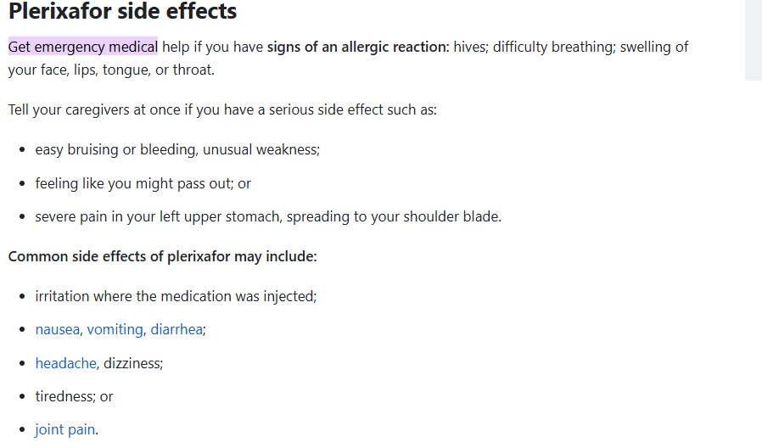
Mozobil
Confirmed with BMT that Mozobil was given in our clinic the past two times due to patient status.
-Pt had a high ending BP and had to stay in Apheresis for a while
-Pt was being admitted and BMT thought it could save a trip
I asked for Apheresis to be asked prior to an RN coming to give Mozobil
An APP or MD does not have to be present to monitor the patient for 20 minutes post.

Slide 11
On Call
Policy in the works for the following:
-Narrowing down the procedures that are urgent enough to run afterhours
-Rule for what time RNs would be required to return to work after working late
Extra incentive
-Do RNs prefer for be added to call or be paid $10 for any extra hour under or over 4 hours past shift when running patients late?

Slide 12
Cerner Bridge
Please make sure that you are ending all units that were started in Cerner Bridge
If you scanned in units and do not use them, please ensure the you return them to blood bank and in Cerner bridge
Please ensure that you are documenting temp, pulse, respirations, and BP for all units start/end.
This all applies to plasma as well
If you must use the slips for scanning issues, etc, please document all sections and give to Anita to check. Anita will send to blood bank.

Slide 13
Positivity

Slide 14
Clinical Engineering
Please red tag ALL machines that are down and fill out the Maintenance Checklist.
Per Darren, it is easier to call 317-962-8044 for service.
They will then email the summary to print.
If an occurrence was required, DO NOT send the occurrence with the machine. Put in Sakiah’s mailbox.
If there is a machine down at Methodist, let Sakiah know in case we need to arrange another to be sent.

Slide 15
Happy Birthday!!
Robin Landry- 2/1

Slide 16
Values Acknowledgments: Purpose, Excellence, Compassion, Team
Thank you everyone for your teamwork!!!

Slide 17
Questions???

