Slide 1
APHERESIS TEAM MEETING
3/2025

Slide 2
Housekeeping Items
Send WAMBIs at least one Wambi/month
Hand Washing audits
Use the scanner to scan meds
Apheresis Task list for downtime
Reminder: Please email vein checks and DHHQ to coordinators
Return to scheduling your patients during their appts.
Thoroughly clean machines- PLEASE CHECK FOR WEEKLY ON MONDAYS
Check for IDMs prior to drawing (easiest way is to check DEC)
Tricia is managing the call schedule
Sakiah/Peaches will be doing supply ordering-Please utilize the diagnotes group for ordering needs
Ryan is no longer our IT contact. We have a new Ryan
Darren is back
Sakiah is managing the weekly maintenance tracker
Timecards/PTO reminder
Pulse Survey due Tuesday 3/18.
CAP coming in April. Likely just a walkthrough for Apheresis.
Cerner Bridge- End all started units and return all unused units

Slide 3
Staffing/Training Updates
Rebecca is covering some weekends and weekdays through May (will get an exact date)
Peaches –Ready to check-off on RBCX. Stems next (maybe she can start next week). Needs peds. Needs custom prime. Would like to move to weekend option in May.
Christina- Needs RBCX training. Needs more peds. Not checked off on custom prime.
Lara is training on all things.
Joe is PRN.
Final check-offs can be done by Sakiah, Tricia, and Sarah (Sakiah does not do WBCD or Platelet Dep).
Deb Ferrell and Cheryl Snodgrass officially PRN.
-Cheryl’s started 3/10. Working on training dates. She will be available some evenings and weekends.
Working to schedule an annual ECP refresher 6/2/25 in the AM.
Working on rescheduling Terumo training (webinar). Emailed Barb but no response yet.
Jenn is NOT retuning
Miranda Green- Needs checked off on procedures. Four 10-hour shifts+rotating call. Here until 5/24.
EVERYONE needs trained on putting together STEM charts.

Slide 4
Open positions
2 FT RN
1 TUS
Weekend option position
-Peaches is interested so will need to replace
her current position

Slide 5
JACHO
Practice and enforce hand hygiene.​
Ensure your area is clean. Clean all equipment regularly.​
Educate staff on speaking with a surveyor. All staff need to be able to describe their role in an emergency, where to find MIFU, and processes they use in their roles. For example, medication preparation process, how patient safety is maintained during high-risk procedures, how equipment is cleaned, R.A.C.E and P.A.S.S, how to initiate a code (red, blue, rapid response etc.).​
Staff files need to be up to date with licenses, certifications, orientation/competencies and on-going education.​
Look at the posters in your areas such as the patient rights and responsibilities (2024 ed.) and the notice of privacy practices (2020 ed.). Also update all certificates/licenses in your areas that are displayed (CLIA and imaging for example). The newest posters are available in the brand center.​
Inspect all supplies in all areas to ensure that nothing is expired, and all items are stored appropriately. There should be no clean supplies next to a sink without a splash guard, under a sink, on the floor, or in a soiled utility room.​

Slide 6
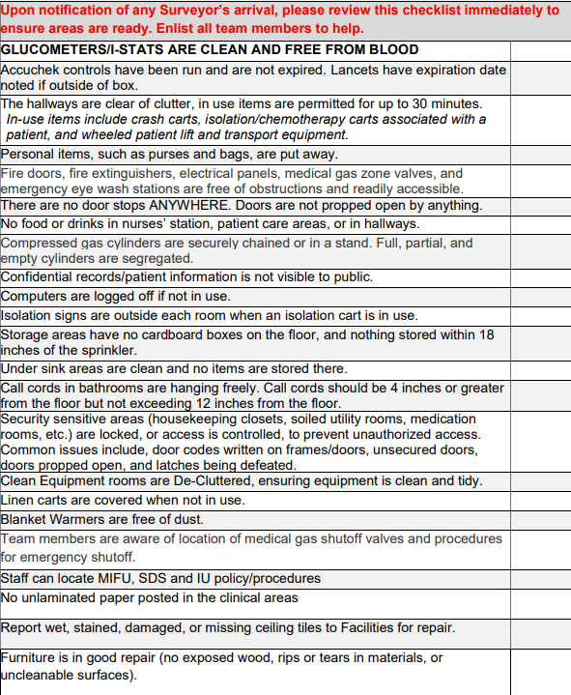
JACHO CONT.

Slide 7
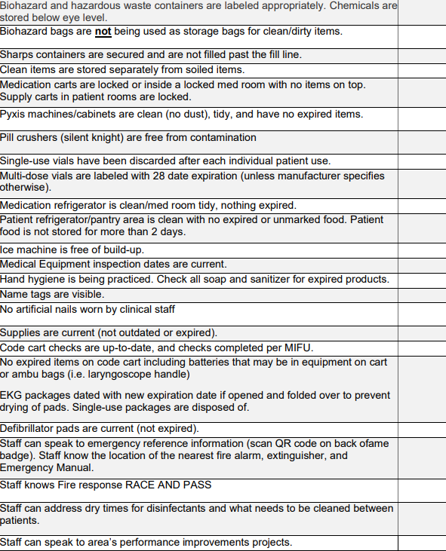
JACHO CONT.

Slide 8
Diagnotes
Please make sure you are checking Diagnotes often, especially after you ask for advice.
-Sometimes providers will answer with a question
-Please put a thumbs up reaction to acknowledge
Please keep informing us on any delays

Slide 9
Therapeutic Patient Charts
Consent (should be a copy; original goes in medical records bin)
Line Confirmation
Communication Sheet (please fill out entirely)
Requesting Service Order up-to-date and with frequency
-Please check this upon scheduling and when pulling charts
-If order is not current or lacking details (ex. Procedure frequency) please inform the providers via the provider Diagnotes chat

Slide 10
LogBook
HPCA and MNC
Adult or Pediatric Service
-This is a way to track collect and store patients
COI or Research study ID
-Some manufactures are asking us to track this
RBCX
Please go back and ensure that Hct, Hgb S, and D/E Replace NS volume is inputted

Slide 11
Efficiency
Heparin can always be tubed to the floor
ALWAYS call the floor, pharmacy, blood bank as soon as you are aware of your procedure timing
If you are awaiting meds/blood/etc.
-get vitals
-access the patient (if you access and are waiting for a while, consult with provider for possible heparin).
-Scan and hang meds
-The idea is to get the patient ready so that when you do have those items you can just press start.

Slide 12
TASKS
Stem charts
Supply Inventory
Next day Prep

Slide 13
Assignments
Assignments will be geared toward training

Slide 14
Performance Development Conversations and Merit
3/27-4/18
Merit on Paycheck 4/25

Slide 15
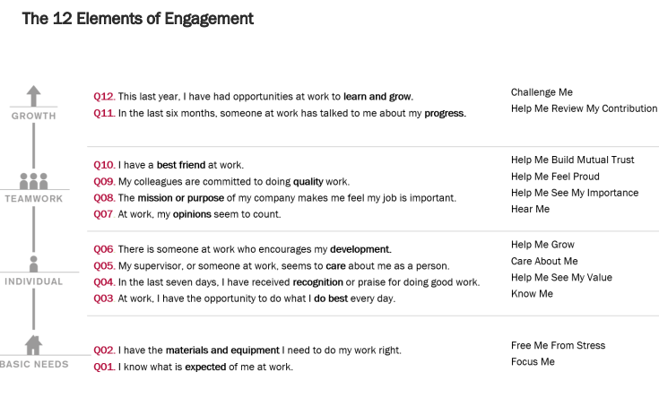
Performance Goals
Surrounded around Engagement
3/31

Slide 16
Performance Goal Cont.

Slide 17
Positivity

Slide 18
Happy Birthday!!
3/6: Anita
3/11: Tricia
3/18: Brody
3/31: Charloom

Slide 19
Values Acknowledgments: Purpose, Excellence, Compassion, Team
Thank you everyone for your teamwork!!!

Slide 20
Questions???

