Slide 1
CTL TEAM MEETING
3/2025

Slide 2
Housekeeping Items
Enter goals by 3/31
We will meet individually monthly to track progress
CAP inspection delayed.
Communication with CAP points to a possible date of 5/12/2025 but I am not 100% on that
New F-025a and F-025b approved. Continue to fill in the current forms until full and print new versions as needed.

Slide 3
Performance Goal Cont.

Slide 4
Staffing/Training Updates
CliniMACS training either 3/31/2025 or early April
Still trying to coordinate Optia BMP training.
Terumo would like to combine with Apheresis training

Slide 5
Methodologies
IU Health as a system has moved to go with Sysmex as the vendor for Hematology
We have a small backup analyzer we will get validated this year.
New FACSLyric to arrive 3/31/2025
CD34+ will need to be moved to the clinical software to comply with FDA LDT rules.
Unfortunately, CD3 will remain on the current research software.
We will need to work out the most efficient workflow possible, I know it is not ideal.
Optia Bone Marrow Processing
Riley doctor is very interested in moving forward.
Training being coordinated.

Slide 6
Exciting New Program for CTL
Parathyroid cryopreservation
Versiti stopped performing the cryopreservation of parathyroid tissue harvested during surgery.
The tissue is cryopreserved for possible reimplantation if the patient shows signs of hypoparathyroidism. This would affect the patient for the rest of their life.
“Your parathyroid glands are in charge of controlling the amount of calcium in your blood by producing parathyroid hormone (PTH). Too little PTH results in low amounts of calcium in your blood (hypocalcemia), and too much PTH causes high amounts of calcium in your blood (hypercalcemia). PTH also helps control the levels of phosphorus and vitamin D in your blood and bones… Calcium and phosphorus are both electrolytes. Hypoparathyroidism can lead to electrolyte imbalance since it causes low levels of calcium and high levels of phosphorous in your blood.” – Cleveland Clinic
Reimplantation of the preserved parathyroid tissue helps alleviate these symptoms by providing a natural source of PTH.
The time limit from surgical removal to cryopreservation is 18 hours so we have been asked to participate with this program.
There are still questions about logistics but the cryopreservation is fairly simple. A small amount of the tissue is mixed with a premade media and DMSO and stored in multiple cryovials.
20-40 cryopreservation's a year but the reimplantation does not happen often.
2-3 year expiration so we will try to work out a good disposal process.
There is a folder in L: Stem that has a few articles for your review.

Slide 7
JACHO
Practice and enforce hand hygiene.​
Ensure your area is clean. Clean all equipment regularly.​
Educate staff on speaking with a surveyor. All staff need to be able to describe their role in an emergency, where to find MIFU, and processes they use in their roles. For example, medication preparation process, how patient safety is maintained during high-risk procedures, how equipment is cleaned, R.A.C.E and P.A.S.S, how to initiate a code (red, blue, rapid response etc.).​
Staff files need to be up to date with licenses, certifications, orientation/competencies and on-going education.​
Look at the posters in your areas such as the patient rights and responsibilities (2024 ed.) and the notice of privacy practices (2020 ed.). Also update all certificates/licenses in your areas that are displayed (CLIA and imaging for example). The newest posters are available in the brand center.​
Inspect all supplies in all areas to ensure that nothing is expired, and all items are stored appropriately. There should be no clean supplies next to a sink without a splash guard, under a sink, on the floor, or in a soiled utility room.​

Slide 8
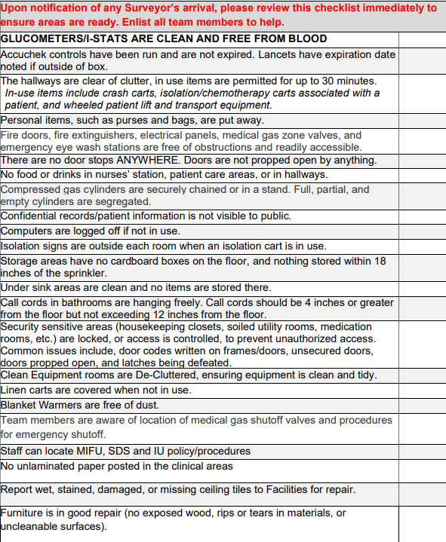
JACHO CONT.

Slide 9
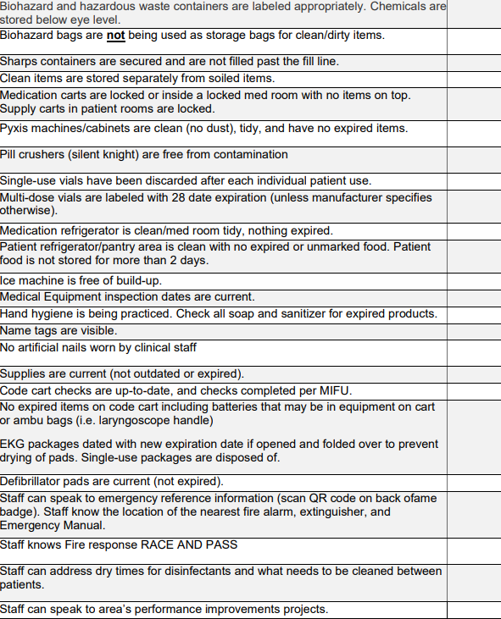
JACHO CONT.

Slide 10
Performance Development Conversations and Merit
3/27-4/18
Merit on Paycheck 4/25

Slide 11
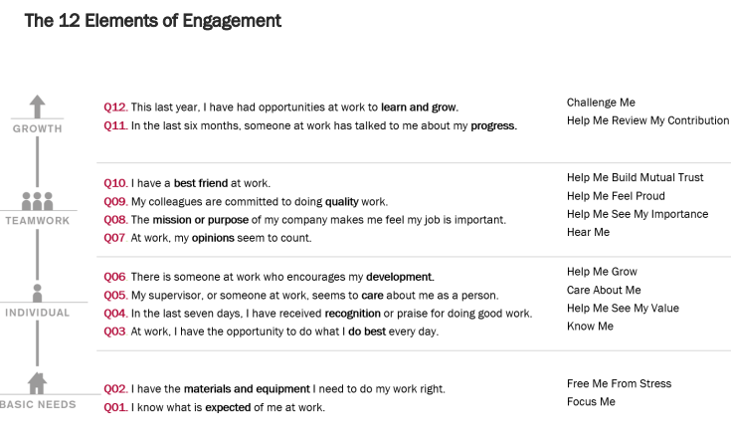
Engagement
We will have meetings monthly to go over the various elements.
Engagement improvement is a big goal for IU Health in 2025.
Understanding the elements will help drive this score.

Slide 12
Values Acknowledgments: Purpose, Excellence, Compassion, Team
Thank you everyone for your teamwork!!!

Slide 13
Questions???

