Slide 1
APHERESIS TEAM MEETING
5/2025

Slide 2
Housekeeping Items
Send WAMBIs at least one Wambi/month
Wash your hands
Use the scanner to scan meds
Apheresis Task list for downtime
Reminder: Please email vein checks and DHHQ to coordinators
Return to scheduling your patients during their appts.—Correct procedure :Correct RN
Thoroughly clean machines- PLEASE CHECK FOR WEEKLY ON MONDAYS
Check for IDMs prior to drawing (easiest way is to check DEC)
Tricia is managing the call schedule
Sakiah/Peaches will be doing supply ordering-Please utilize the Diagnotes group for ordering needs
Timecards/PTO reminder
CAP coming in May 16. Likely just a walkthrough for Apheresis.
Cerner Bridge- End all started units and return all unused units
Check Diagnotes frequently
Check MTS
JACHO rounding soon (do not tape papers to the wall)
Armband Audit Goal
Therakos email and phone number change

Slide 3
Random updates
SCT coordinator staffing shortage
Some WOWs are NOT configured for bridge- use the barcode that was sent out if units will not scan
Methodist is working on getting Heparin added to more Pyxis machines

Slide 4
Staffing/Training Updates
Rebecca’s last day is 5.20
Miranda’s last day is 5.22
Eri- here through July- Needs MH and RH orientation.
Peaches – Moving to weekend option 5.18 (will work some weekdays)
Christina- Needs RBCX, more peds and, custom prime.
Lara – Checked off on TPE and RBCX- Training on ECP
Joe is avail. for one 8 hour shift most weeks. Added slot “PRN RN” for when he is here.
Final check-offs can be done by Sakiah, Tricia, and Sarah (Sakiah does not do WBCD or Platelet Dep).
Deb Ferrell and Cheryl Snodgrass officially PRN.
-Cheryl’s started 3/10. Working on training dates. She will be available some evenings and weekends.
-Deb would like to return the week of 6.22
Annual ECP refresher 6/2/25 in the AM.
On-site Terumo training date 5.21 from 1230-1630. Will cover WBCD and Optia upgrade. Goal is to have
all Optias upgraded by the end of the year.
EVERYONE needs trained on putting together STEM charts.
Extended offer to Faith Tocco for FT RN
Considering replacing shift coordinator role (M-F without call)
Remember to cosign when RNs are not checked off.

Slide 5
Rebecca and Miranda Going Away
5.20 after work that the inferno room in fountain square.
RSVP to Robin

Slide 6
Scheduling
Starting in June, local patients will be required to fill the AM slots first.
Providers are working on a letter to be sent to patients.
This will allow the afternoons to be free for inpatients.
For example, we will NOT schedule any 1000, 1100, 1300, or 1400 until all 0730 and 0830 slots are filled.
Exceptions will be for patients that travel from out of town, IR, ect.

Slide 7
Refrigerator
Rec’d citation for refrigerator being dirty.
Will have to create a cleaning log.
More to come

Slide 8
Open positions
3 FT RN
-Awaiting reply from Faith
-Another applicant
1 TUS
-Person interested

Slide 9
Group Goals
Scanning compliance
- 98% for meets and 99% for exceeds
Armband audits
-Meets- > 95% Armband Compliance Rate (as a group). There will be five observations per week.
-Exceeds: > 95% Armband Compliance Rate + Complete Five Audit Sheets for the year (five sets of weekly audits/RN).
-Audit tool at the nurses’ station
-Be proactive and grab it for the week to complete
Goals begin this month
​

Slide 10
IDMs
Start date pushed back to 6.2.25 for in-house testing
Tube station will change
Turn-around time will be quicker
Forms and SOP to be updated

Slide 11
TPE-FFP
-Providers agree to pool a portion until the patient stabilizes
-If this is forgotten then just provide a gentle reminder

Slide 12
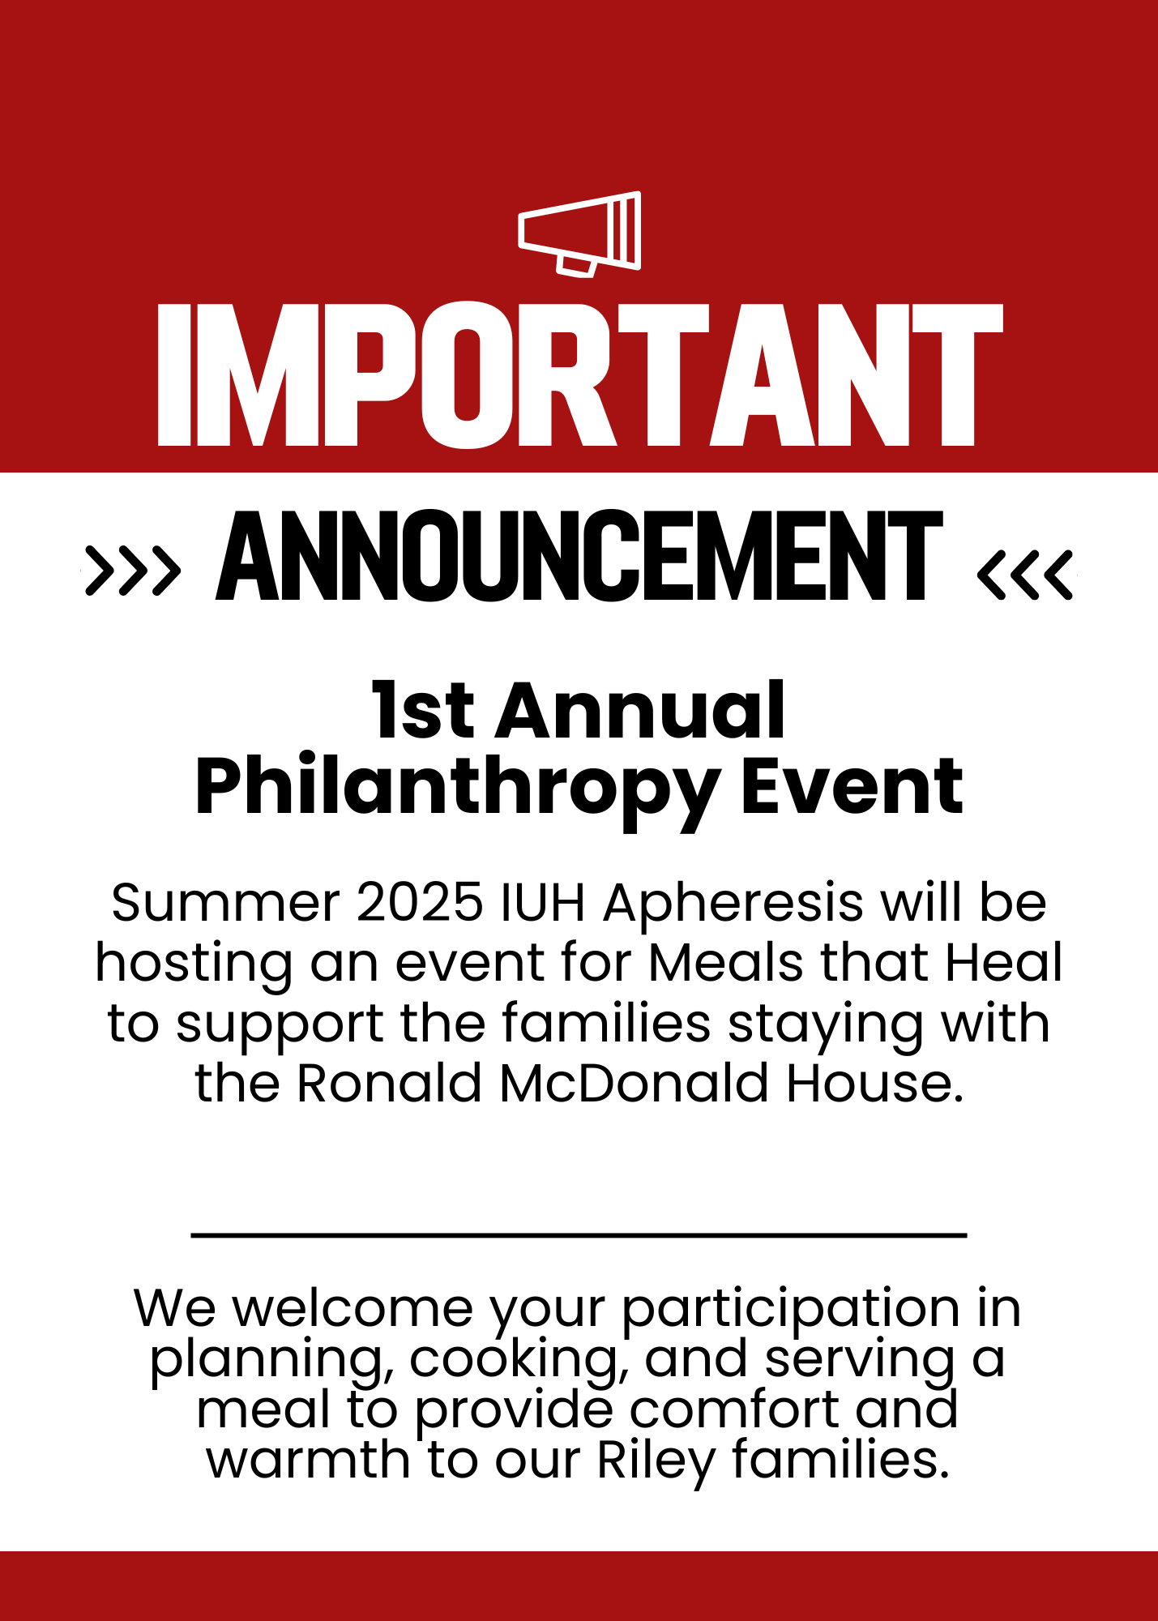
Happy Nurses Week 2025!
Thank you to everyone who contributed to making it a great week for our team!
Duck Hunt Results
1st Place: Anita (16)
2nd Place: Sarah (14)
Only one duck remained after a valiant hunt!

Slide 13
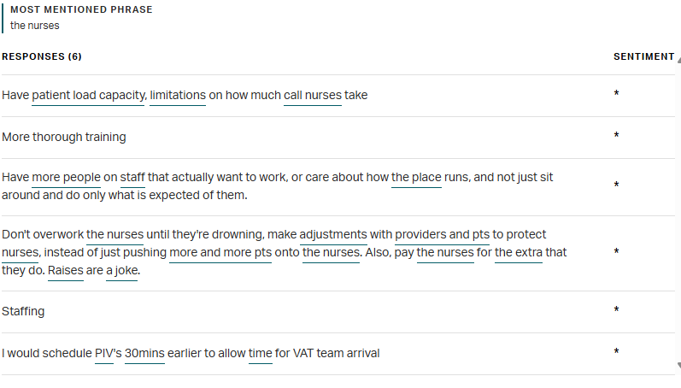
Gallup Survey

Slide 14
DMAIC
Define
Measure
Analyze
Improve
Control

Slide 15
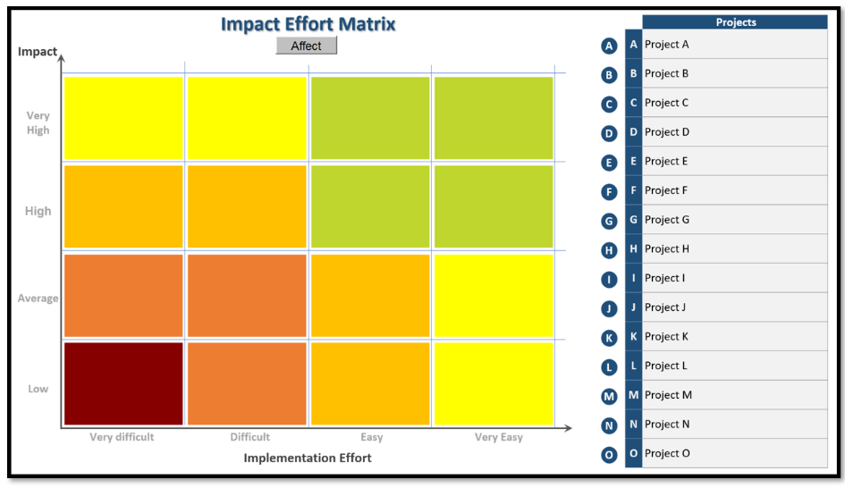
Effort Impact Matrix

Slide 16
Positivity

Slide 17
Happy Birthday!!
5.9- Anne T.

Slide 18
Values Acknowledgments: Purpose, Excellence, Compassion, Team
Thank you everyone that contributed to a successful Lab and Nurse Week

Slide 19
Questions???

