Slide 1
March 2026 Monthly Meeting
Arnett Lab
3/4/2026 @ 3 pm 3/5/2026 @ 7 am

Slide 2

Agenda
Promise Dashboard
Quality Dashboard
Quality and Safety
2026 Team Member Goals
Timecard Exceptions
Automation
Blood Bank
Chemistry
Heme/Coag/Urinalysis/Kits
Competencies
Engagement
Healthy Results
Continuing Education Opportunities
Emergency Management Quick Drill and Training
Around the Region
Reminders

Slide 3
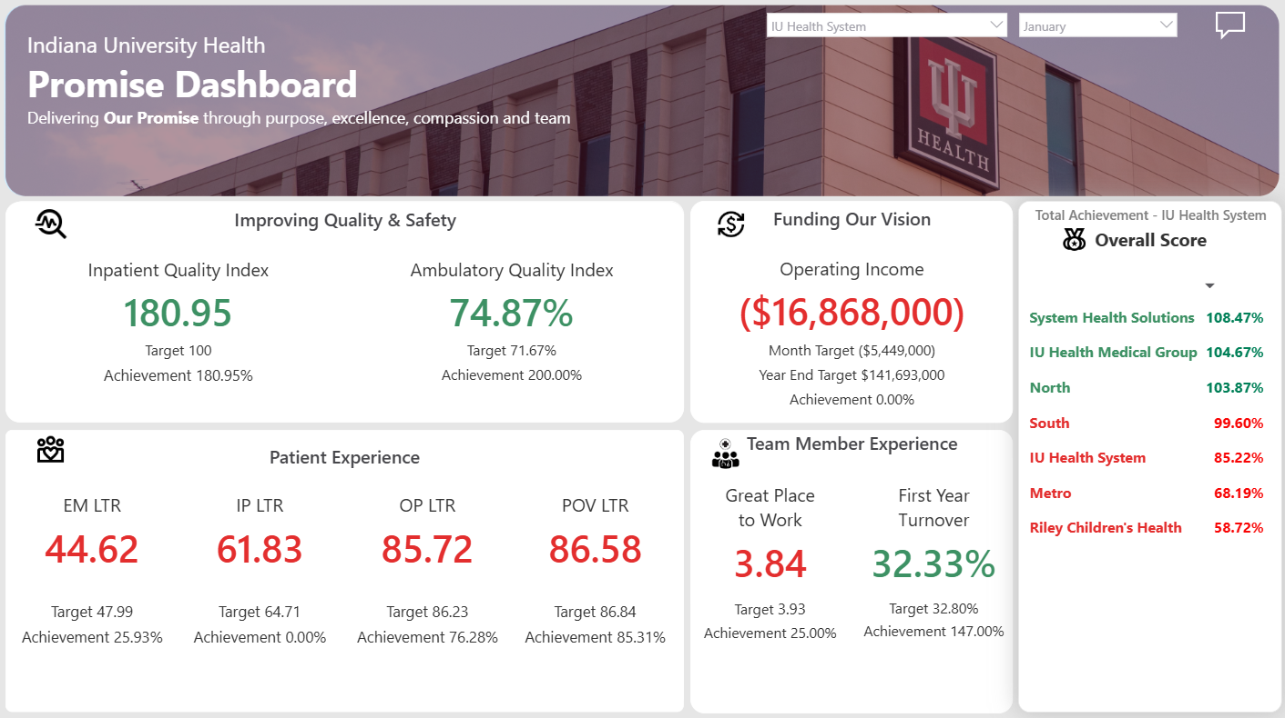
System Promise Dashboard January 2026

Slide 4
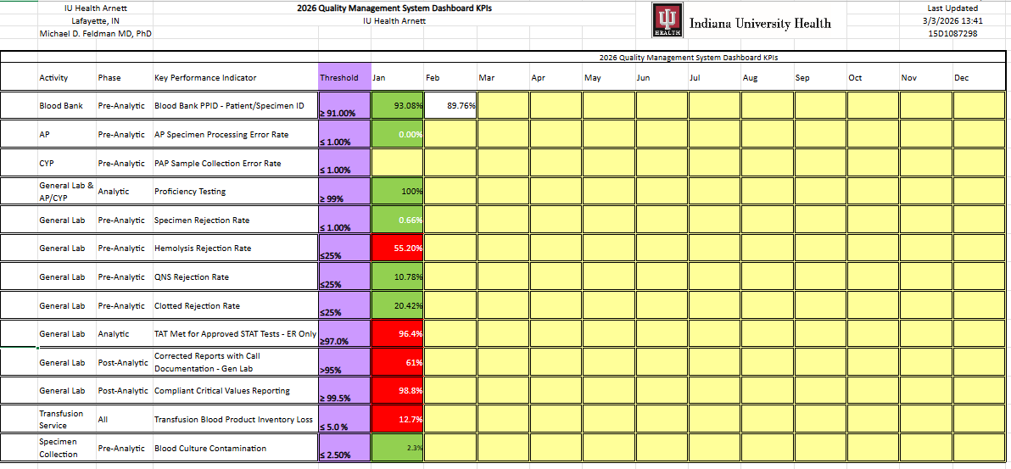
Laboratory Quality Dashboard
Notes:
A new Quality Management System Dashboard went into effect on 1 February 2026. This enhanced dashboard provides expanded visibility into compliance, quality, and key performance indicators. These improvements support earlier identification of gaps, corrective actions that are needed, more consistent monitoring, and a stronger culture of proactive quality.

Slide 5
Quality and Safety
Quality Culture Basics
What It Means
A quality culture exists when everyone in the organization consistently:
Prioritizes doing work right the first time
Follows standardized processes to reduce variation
Speaks up when something doesn’t look or feel right
Owns their role in delivering safe, accurate, and high-quality results
Continuously looks for ways to improve
Notes:
Quality isn’t just a department; it’s a behavior we practice.

Slide 6
Quality and Safety - continued
Quality Culture Basics
Why It Matters
A quality culture supports:
Patient Safety – Errors can lead to incorrect decisions, delayed care, or harm.
Compliance – Adhering to regulations and standards protects our accreditation and reputation.
Efficiency – Fewer reworks, fewer defects, and smoother workflows.
Trust – Providers and patients rely on our accuracy and consistency.

Slide 7
Quality and Safety - continued
Example of Why a Quality Culture Matters – Missed Instrument Flag Leads to Delayed Critical Result
Scenario: In one of our IU Health laboratories, a chemistry analyzer displayed an intermittent “reagent stability warning.” This flag didn’t stop the run, but it did require the technician to check calibration status, inspect reagent integrity, and document the action taken. Because the team was busy and the flag appeared briefly, the technician dismissed it, assuming it was a nuisance alert.
What Happened: A patient sample processed during that period produced a sodium result outside the expected clinical pattern. The provider questioned the value because it didn’t align with the patient’s condition, prompting a redraw. Upon investigation, the lab discovered that the reagent pack had expired earlier than projected due to a storage temperature deviation (exactly what the analyzer warning was trying to signal).
Impact: Critical result was delayed while the redraw was performed. Provider workflow was disrupted, creating uncertainty in patient management. Lab credibility was strained, requiring additional explanations and corrective actions. Workload increased due to rerun investigations, documentation, and quality reviews.
Quality Culture: A strong quality culture would have meant the technician stopped to investigate the abnormal flag, escalated the concern to a leader or supervisor, documented actions as required, and verified reagent performance before continuing patient testing.

Slide 8
Quality and Safety - continued
Quality Culture Basics
Core Behaviors
Standard Work
Follow defined procedures every time.
Avoid shortcuts unless formally approved.
Document accurately and completely.
Visual Management and Transparency
Use metrics and indicators to guide work.
Keep work areas organized and labeled.
Speak-Up Culture
Call out abnormalities without fear of blame.
Report near misses as learning opportunities.
Ask clarifying questions when something is clear.
Continous Improvement Mindset
Suggest small fixes (ex: workflow, labeling, layout).
Look for waste: motion, waiting, defects, rework, overprocessing.
Notes:
Quality Culture is created by consistent behaviors, not posters or policies. Each of us protects patient trust and organizational integrity through small, repeatable actions every day. A strong quality culture doesn’t happen by accident. It grows from consistent, intentional moments.
What is one small quality behavior that makes a big difference in our daily work?
What’s one quality habit we commit to reinforcing as a team this month?

Slide 9
2026 Team Member Goals – Processing and MLT/MLS Goal #1
Maintain Standards and Efficiency
Effective Date: March 15, 2026
Weight: 25%
Performing key and/or required tasks in support of quality and efficient patient care.
Examples (not all-inclusive):
Oracle Learn
FLU Shot Attestation
Competency Completion
MTS (MedTraining) requirements
CE Requirements and Form Completion
Being Present and Ready to Work
Participating in Projects/Initiatives to Drive Improvement/Performance
Policy Acknowledgements within 30 Days of Assignment
Goal Indicators
Exceeds Expectations
All key and/or required tasks are completed on time without leader follow up. Demonstrates proactive accountability and ownership.
Meets Expectations
All key and/or required tasks are completed on time, with leader follow-up.
Does Not Meet Expectations
Key and/or required tasks are not completed by established deadlines, or repeated reminders and follow-up indicate lack of ownership and accountability.

Slide 10
2026 Team Member Goals – Processing and MLT/MLS Goal #2
Decrease the Number of Harm Events
Effective Date: March 15, 2026
Weight: 25%
Demonstrating ability to accept constructive feedback and to pursue growth and development through learning to avoid negative quality or safety outcomes.
Goal Indicators
Exceeds Expectations
Proactively seeks support and resources to prevent negative quality and safety outcomes and/or contributes to the development of resources and embraces supporting others in their learning journey. Team member must be able to provide specific examples of this during their self-evaluation.
Meets Expectations
Consistently uses constructive feedback to make needed improvements.
Does Not Meet Expectations
Does not take ownership/accountability of errors, and/or there is limited to no improvement though coaching/training has been completed that may result in repeated errors, and/or does not contribute to a positive quality or safety culture.

Slide 11
2026 Team Member Goals – Processing and MLT/MLS Goal #3
Foster Great Team Member Experiences
Effective Date: March 15, 2026
Weight: 25%
Supporting team member engagement by contributing to a positive, respectful and collaborative work environment through consistent communication, teamwork and support of shared goals.
Support is measured by:
Regular participation of team activities, meetings, and huddles.
Participation in team-based improvement, engagement, or collaboration activity during the performance year.
Effectively communicating issues and concerns in a timely manner
Actively engaging in communications platforms (ex: reading Teams messages, emails, Technical Updates/Newsletters, Connect, etc.)
Positive and respectful communication and interactions
Goal Indicators
Exceeds Expectations
Actively contributes to shift and huddle communication that positively and respectfully contributes to the engagement of the team. Proactively communicates/escalates issues. Proactively responds to the needs of team members. Team member must be able to provide specific examples of this during their self-evaluation.
Meets Expectations
Attending huddles/meetings. Providing support to team members if they ask for support.
Does Not Meet Expectations
Does not attend huddles/meetings. Does not promote optimism. Not taking ownership/accountability for shared/posted communication and/or team contribution.

Slide 12
2026 Team Member Goals – Processing and MLT/MLS Goal #4
Maintain Standards and Efficiency
Effective Date: January 1, 2026
Weight: 25%
ED STAT TAT as measured by the STAT Bellwether
Goal Indicators
Exceeds Expectations
97% and demonstrates proactive accountability and ownership for the areas within the team members scope (i.e. monitoring pending, prioritizing STATs over Routines, proactively managing/communicating any barriers to optimal TAT).
Meets Expectations
Demonstrates proactive accountability and ownership for the areas within the team members scope (i.e. monitoring pending, prioritizing STATs over Routines, proactively managing/communicating any barriers to optimal TAT) and collaboratively works with team and leaders to assess and improve workflows to optimize TATs.
Does Not Meet Expectations
Does not demonstrate proactive accountability and ownership for the areas within the team members scope (i.e. monitoring pending, prioritizing STATs over Routines, proactively managing any barriers to optimal TAT) and/or does not collaboratively work with team and leaders to assess and improve workflows to optimize TATs

Slide 13
Timecard Exceptions
Leadership (from Finance to Executive Leadership all the way down to Frontline Leadership) will be keeping a closer eye on timecard exceptions this year. It’s important for us to get a handle on this to keep our labs running smoothly.
Examples of timecard exceptions that will be monitored include:
Early Ins
Early Outs
Missed Meals
Late Ins
Late Outs
It is very clear that the same team members are at the top of the exceptions report each pay period. Please make sure to be mindful of your timecard and avoid unnecessary exceptions.
To show our dedication to improving timecard exceptions, each pay period team members will need to submit the following Microsoft Form () for each exception to detail the reason for the exceptions on their timecards.
All schedules will be kept as up to date as possible by Megan in UKG as well as Shifts. Please bare with me if changes are made to Shifts but I forgot to make them in UKG. If you find this, just send me a quick Teams message or email as a reminder to update your UKG schedule.

Slide 14
Automation
A “Fix-It Guide” Binder has been created for the Automation line. When encountering an error, please take a moment to capture a picture of the error screen. You can send the picture and a detailed explanation of the resolution to Megan, or you can print the picture and add your notes to the image and place in the binder.
Please only load a maximum of 30 chemistry racks per lane on the Automation. Overfilling the trays will lead to errors.
How to handle certain tests on Automation:
Ammonia
Log into Cerner
Spin in cold centrifuge next to processing fridge
Load onto p612 in input sorter to send down the line
PTHInt
Put onto p471 to spin
Remove specimen from Kickout target on output sorter
Manually deliver to Chemistry for tech to load
IntraPTH
Log into Cerner
Spin at Inpatient tabletop centrifuge
Manually deliver to Chemistry and physically hand to tech to load informing them that it is an intraoperative PTH
How to handle certain tests on Automation:
Traumas/Strokes
Spin Chemistry samples at inpatient tabletop centrifuge
Place on –line testing in the input sorter trays of the p612
HbgA1C
Place onto input sorter tray of p612
Once target rack for A1C’s is full, remove rack and replace with empty one
Take full rack to Chemistry workstation behind inpatient bench.
Only Techs should load “COMPLETED” A1Cs back on the p612.
Hematology
Place testing in the input sorter trays of the p612 to send down the line.
Only Techs should load “COMPLETED” hematology tubes on the p612.

Slide 15
Blood Bank
Starting today 3-4-26 we are reducing the number of thawed plasma from 4 to 3 on hand in the refrigerator.
Make sure we are putting the green stickers on units transferred to us from White and Frankfort along with the initial from where it came from.
Please be sure to get all the information before deciding whether the CAH need to send us a sample for AB ID.
Be sure to use to correct reason when destroying a unit. ( ex: gen-return to sender when there is a tear in the bag, fibrin clots) so I will know to exclude them from wastage totals.
Read your policies. Remember policies are the 100% source of truth, use them.

Slide 16
Chemistry
UCSF Protein Samples will be coming from Indy while they work through a Beckman reagent shortage
Communication around masking a test, making it unavailable all together for testing in the Chemistry Department
Positive Urine Drug Screens- How we will handle saving samples
QC Warnings in Navify
Running Lyte and CO2 QC every 8 hours (6am, 2pm, and 10pm)
CAP survey reminder to complete by the due date
Continuing to work on Roche Studies- including LDH reference range, Hemolysate, Serum/Plasma, Pediatric reference range

Slide 17
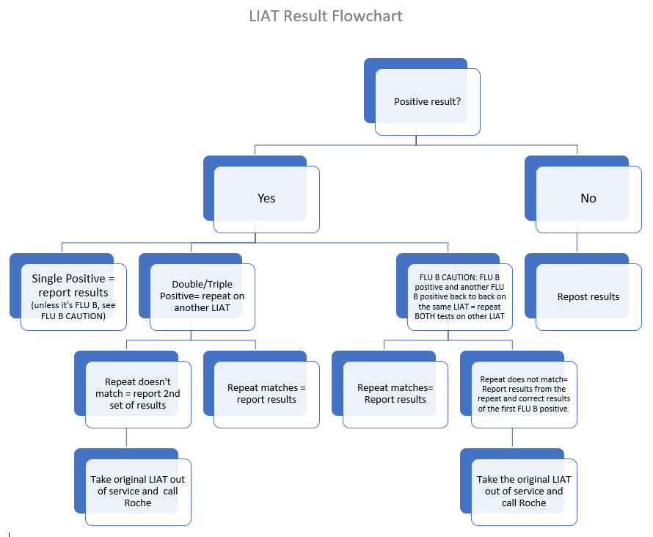
Heme/Coag/Urinalysis/Kits
Molecular
We have been seeing issues with our current lot of LIAT 4 plex.
Continue to monitor for multiple positives on an accession (rerun on another LIAT) as well as
2 consecutive Flu B results (rerun both on another LIAT). If results do not match, cease testing
and notify technical specialist.
Please prep all PCR testing in the hood (BSC). Clean surfaces after prepping samples.
Troubleshooting Guide is posted in Urines with a visual flowchart.
Heme
LIS is still working towards final approvals for Caresphere changes –
Remove the lookback component from Pathologist Review rules in Caresphere so that OP alerts trigger on every applicable result (we will re‑evaluate after six months).
Add a Caresphere rule for Hemograms with NRBCs >5 to trigger an OP alert instructing technologists to add a manual differential (add a new Rule).
Implement OP alerts for Path Review on reactive/abnormal lymphocytes (addition to Path Review criteria):
Reactive/Abnormal lymphocytes >10% (Age >50)
Reactive/Abnormal lymphocytes >15% (Age 3–50)
Bone Marrow Collection
Standard Work and other workaides - in Progress, to be followed by additional training.

Slide 18
Competencies – What, When, Why?
A competency assessment is the application of the skills, knowledge, and experience after initial training to assess if team members are performing testing or job tasks correctly.
Evaluating the competency of all testing personnel and assuring that the team members maintain their competency to perform test procedures and report results promptly, accurately, and proficiently is the law.
No employee will be assigned to work alone in any area/bench or on an instrument until he/she has completed the initial training for that area or instrument and all documentation has been completed and signed off on by appropriate responsible parties.
Tools available to you to help with tracking and communication include scheduling regular check ins with your supervisor, creating calendar events for competency assessment due dates, and setting calendar reminders to work on specific competency assessments.
For team members that do not complete competency tasks by the due date, leadership will follow the guidance of the progressive discipline policy. Failure to comply with the Competency Assessment procedure may result in disciplinary action, in accordance with the policy.
Team members are accountable for a competency failure that requires immediate removal from work area/bench or instrument, being retrained, and passing the competency assessment before returning to that assignment. Repeated competency failures will result in management addressing as a performance issue.

Slide 19
Competencies – Timeline
Initial Competency Assessment
Assigned when you begin training in a department
Signed training checklist will be uploaded to indicate completion of initial competency
First Year Semiannual Competency Assessment
Auto-assigned to team member based on completion date for initial competency assessment
Due within seven months from initial competency completion
First Year Annual Competency Assessment
Auto-assigned to team member based on completion date for initial competency assessment
Due no later than 12 months from initial competency completion
Annual Competency Assessment
Auto-assigned to team member after completion of first year annual competency assessment
Due no later than November 1st of the current calendar year

Slide 20
Competencies – Failures
Failure of Competency Assessment – 1st Attempt
Team member will not be allowed to perform patient testing for that skill/test/procedure.
Previous competencies are reevaluated, and training needs are determined.
Opportunity for retraining for team member occurs.
Team member completes competency assessment (2nd attempt) with passed evaluation.
Failure of Competency Assessment – 2nd Attempt
Gaps in team member’s knowledge are determined.
Supervisor/Technical Specialist reviews work and reassigned duties.
Supervisor follows up with progressive discipline policy.
For a more detailed explanation, see the “Competency Assessment and Annual Compulsory Requirements” policy in PolicyTech.

Slide 21
Engagement
Engagement Ambassador opportunity
Engagement Ambassadors help foster connection, encourage participation in engagement surveys and ensure team members feel heard.
Team member must embody positivity, purpose, and connection.
Expectations:
Join 1 committee recognized by the Legacy West Region Culture Council.
Regularly attend the monthly committee meeting and actively participate in meetings and initiatives.
Attend a quarterly Engagement Ambassador meeting.
Complete your Engagement survey each quarter.
Promote the Engagement survey to the team and/or shift each quarter aiming to hit regional participation goals.
Attend and actively participate in a monthly 1:1 meeting with Arnett Lab Leadership to discuss the department and/or shift’s current engagement needs.
In addition to monthly 1:1s, commit to up to 4 working hours per month for committee meetings, working groups, and engagement action planning.
Assist in creating a new action plan at least once per year and updating the action plan at least 3 times per year.

Slide 22
Healthy Results
Healthy Results offers a variety of ways for you to focus on your wellbeing throughout the program year.
Bronze: 800 – 1,199 points
Earn $20/pay period ($520/year) for 2027
Silver = 1200 – 1,599 points
Earn $30/pay period ($780/year) for 2027
Gold = 1600 or more points
Earn $40/pay period ($1,040/year) for 2027
Incentive Points Earning Deadline for 2027 Reward: November 30, 2026
Ways to Earn
Health Screening/Provider Option Form = 500 points
System Challenges, Elements Financial, and Empower Retirement = 200 points
Health Survey, Health Coaching, Condition Management, Health Screening Consultation, Wellness Consultation = 100 points
Preventive Care, Volunteerism, Weight Watchers = 50 points
Leveling Up, Healthy Results Webinars, Personal/Peer Challenges, Healthy Results Portal Courses = 25 points
5K a Day, 10K a Day = 1 point

Slide 23
Healthy Results – Wellness Champion
Wellness Champions help create a healthier, more supportive workplace by encouraging connection, participation, and well-being across their teams.
Expectations of a Wellness Champion
Be a friendly, go-to resource for wellness questions and support
Share Healthy Results programs and activities with your team
Encourage participation and model healthy habits
Help foster a positive, people-first work environment
Any IU Health team member eligible for Healthy Results who wants to support their coworkers and stay engaged through monthly meetings or recordings may become a Wellness Champion
Ready to become a Wellness Champion?
Contact our Healthy Results Consultant, Marti Blume (mblume@iuhealth.org)

Slide 24
Continuing Education Opportunity
CAP Inspector Team Member Training – 4.5 CE
You will learn inspection or auditing techniques, which will assist you in gathering the appropriate information to determine if your findings support compliance with the requirements.
The training will provide valuable insight and exposure to the guidelines that dictates the rules and regulations our laboratory must follow to remain CAP compliant.

Slide 25
Emergency Management Quick Drill and Training
Effective March 1st, the March 2026 Emergency Management Quick Drill and Training was launched. This month’s focus is the Statewide Tornado Drill.
The March Quick Drill focuses on ensuring every staff member across Legacy West is prepared for peak storm season. This drill serves as a practical exercise to refresh our knowledge of protective actions and communication workflows before severe weather impacts our facilities.
Things to Know:
In the event of warnings and weather emergencies, staff and visitors should be advised of weather conditions and urged to remain within the building until the warning/emergency is canceled or the “all clear” announced.
Communication about a watch/warning/emergency will come from lab leadership and/or via overhead announcement by Houston.
In the event of a “Tornado Emergency”, all individuals will immediately seek shelter in a heads down “fetal position”. Remain in this position until the “All-Clear” announcement.

Slide 26
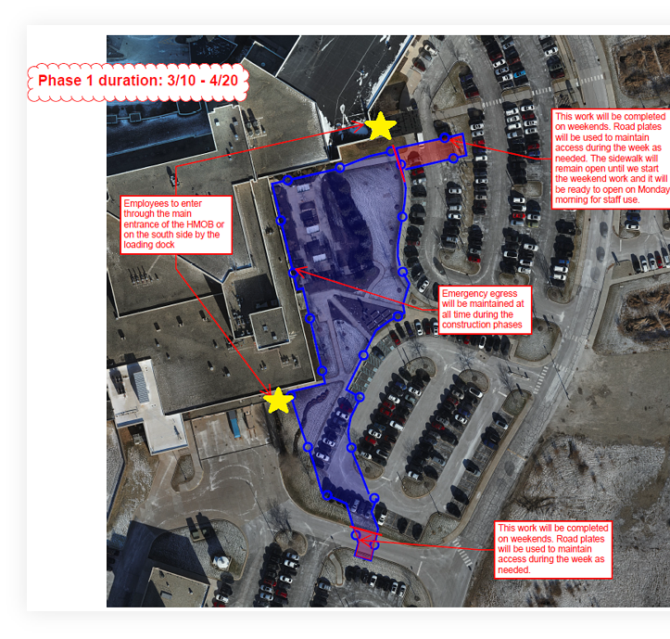
Around the Region
Arnett Hospital – Cancer Center construction impacts
Fencing will be installed on the east side of the Arnett Hospital campus beginning in March to support early utility work for the new cancer center.
Work will occur in phases. Phase 1 runs March 10 – April 20.
The garden-level team member entrance near the physician lounge will be emergency use only during construction.
Team members should use alternate entrances near the loading dock or Entrance 5 by the medical office building.
The Healing Garden will be closed for the duration of construction.
Community garden beds will be relocated to the north side of the medical office building.

Slide 27
Reminders
Spring Forward with the Start of Daylight-Saving Time
Sunday, March 8 – clocks should be moved ahead one hour at 2 am (clocks will jump from 1:59 am to 3 am)
UKG will automatically account for the missing hour by using available PTO if worked hours do not match FTE – if you do not want to use PTO, we can adjust your timecard.
Internal Self-Inspection will be this Friday 3/6/2026.
Tidy up your space and keep trash off the floors.
Dispose of overflowing bins.
Check appropriate supplies for open and expiration dates as well as initials.
Use appropriate PPE at all times.

