Slide 1
HemaPrompt Training

Slide 2
REGULATIONS
CMS and the state of California requires documentation for:
Initial training and competency
Annual competency thereafter

Slide 3
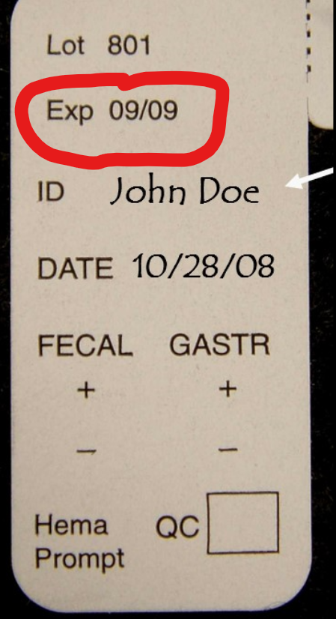
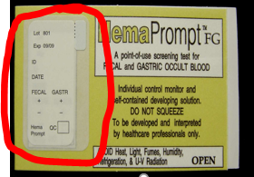

STORAGE and STABILITY
Room temperature (10-24°C or 50-75°F)
Avoid heat, light, fumes, humidity, refrigeration, and UV radiation
Stable until expiration date printed on test card and side of box

Slide 4
ACCEPTABLE SPECIMENS
Fecal specimens
Gastric specimens

Slide 5
PROCEDURE
Open test card
Apply very thin smear of specimen to each window and close card
  Do not cover entire window – leave outer periphery of white
Turn card over. Grip card with one hand and SLOWLY pull silver tab with other hand. Remove tab completely.
Interpret results after 1 minute but before 3 minutes.

Slide 6
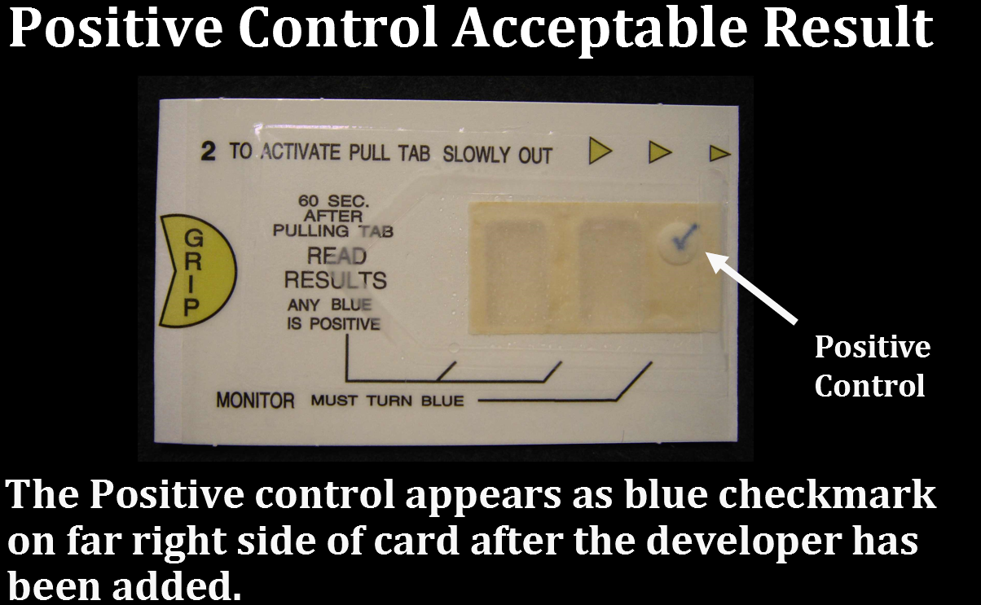
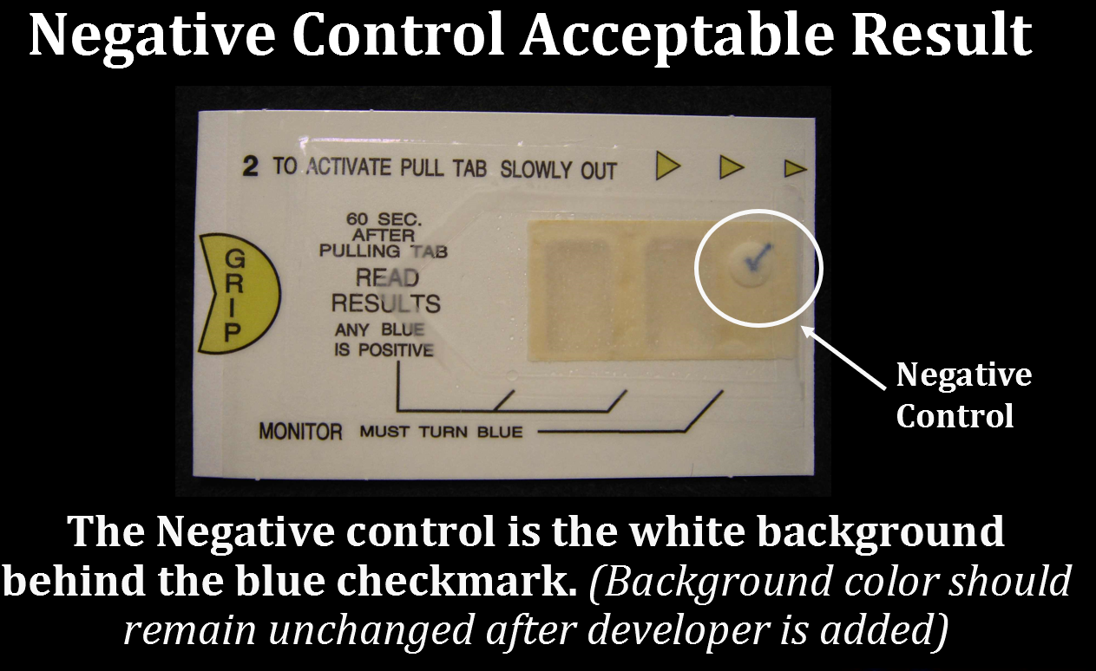
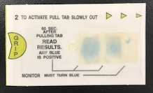
RESULT INTERPREATION
Internal positive and negative controls built into each test card
Any shade of blue is considered a positive result
Valid positive result
Valid negative result
Invalid test result: Absence of blue checkmark and/or background behind checkmark does not remain white

Slide 7
PROBLEM SOLVING SKILLS ASSESSMENT
HemaPrompt FG test cards are suitable for which of the following specimen types? Fecal and gastric specimens only
After the HemaPrompt test card has been developed, you will know the test has been performed correctly when: The blue checkmark and unchanged background color behind the checkmark are visible
After a HemaPrompt test card is developed, test results may be interpreted: After 60 seconds but before 3 minutes
A Hemaprompt test result is positive and acceptable when: Any shade of blue in either or both specimen windows, and the blue checkmark and unchanged background behind the checkmark are visible.
It is acceptable to put the HemaPrompt test cards in a lab coat, RN scrubs, or physician’s blazer pockets to avoid exposure to direct sunlight: False
State of CA requires completion of initial training and competency assessment for waived tests like HemaPrompt prior to patient testing: True

